Slide 1
Berkshire East’s Joint Strategic Needs Assessment (JSNA) How to navigate and use the JSNA website
Berkshire East JSNA Last updated: June 2022

Slide 2
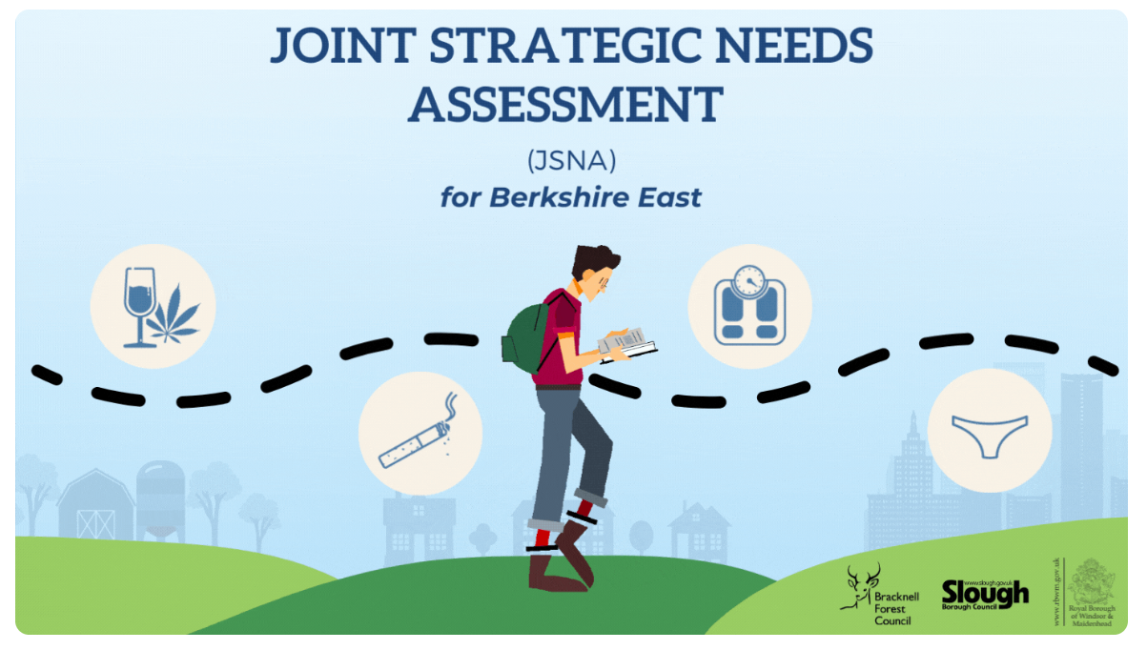
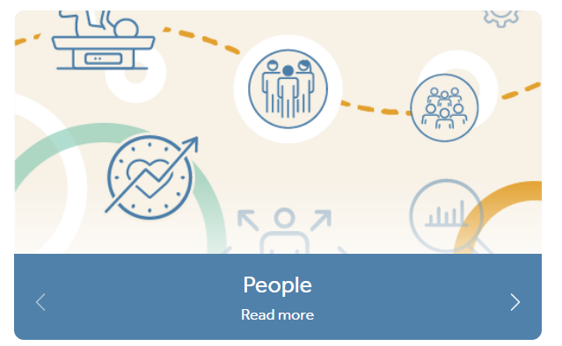
Contents
This short guide has been produced to support the use of Berkshire East’s Joint Strategic Needs Assessment (JSNA) website: https://www.berkshirepublichealth.co.uk/jsna.
This guide includes:
What is a Joint Strategic Needs Assessment?
What is Berkshire East’s approach to the JSNA?
How do I navigate the Berkshire East JSNA website?
Structure of the website
More detailed look at the Topics section (navigating the webpages and Topic Packs)
Help pages
How do I find out more?
Who do I contact for more information?
Berkshire East Public Health Hub

Slide 3
What is a Joint Strategic Needs Assessment?
The Joint Strategic Needs Assessment (JSNA) is a statutory process which local authorities and Clinical Commissioning Groups (CCGs) use to assess the current and future health, care and wellbeing needs of the local community to inform decision making.
Local authorities and CCGs have equal and joint duties to prepare JSNAs through their Health & Wellbeing Boards. Joint Health & Wellbeing Strategies should be based on the priorities identified through local JSNAs and should be clear and available to the public.
For more information on the statutory guidance, please see: JSNAs and JHWS statutory guidance - GOV.UK (www.gov.uk)
Berkshire East JSNA Last updated: June 2022

Slide 4
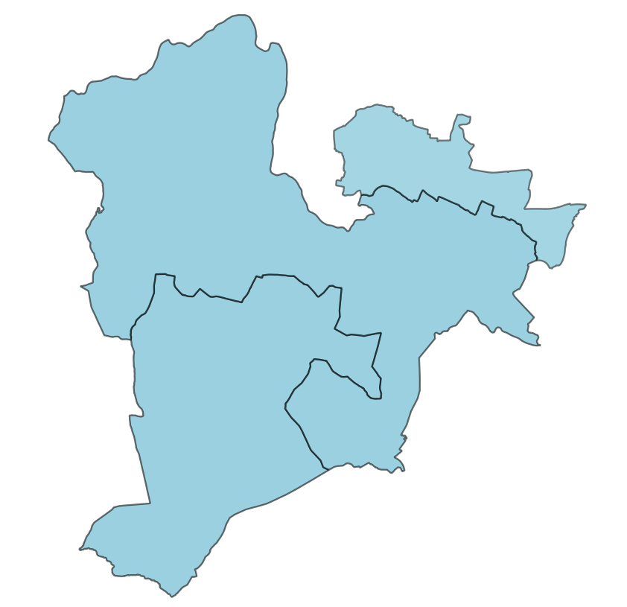
Berkshire East’s approach to the JSNA
The three local authorities in Berkshire East – Bracknell Forest Council, Slough Borough Council and the Royal Borough of Windsor and Maidenhead (RBWM) – work collectively to improve the health and wellbeing of residents across the area. The local authorities are all part of the Frimley Integrated Care System (ICS) and share a Joint Director of Public Health who leads across the whole of Berkshire East.
The Berkshire East local authorities are committed to developing their JSNAs together. By bringing information together for a wider geography, it is possible to assess health and inequalities across Berkshire East and share learning with each other.
Information on the Berkshire East JSNA website will continue to be shown separately for Bracknell Forest, Slough and RBWM to ensure that local data and inequalities are also easily available for each local authority. This approach supports the separate JSNA priority-setting processes that take place in each Health & Wellbeing Board.
Berkshire East Public Health Hub

Slide 5
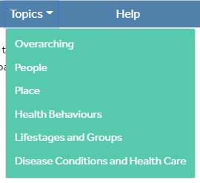
Structure of the website
The website is split into four different sections that can all be navigated to through the menu bar at the top of the page.
Topics
The main resources for the JSNA are included
under the Topics menu. To access the different
sections, hover over the menu bar and select your topic from the dropdown menu.
The Overarching section includes the JSNA
Summaries for each local authority and other
resources that cover population health generally.
Other sections focus on specific topic or subject
areas.
Help
Additional information to support the use of the website, including Frequently Asked Questions and a Glossary of key terms. How-to guides and resources will also be included on this page in the future.
Contact Us
Includes a contact form to provide feedback on the JSNA.
Useful Links
Links to the Berkshire East local authority and Frimley CCG websites.
Berkshire East JSNA Last updated: June 2022

Slide 6
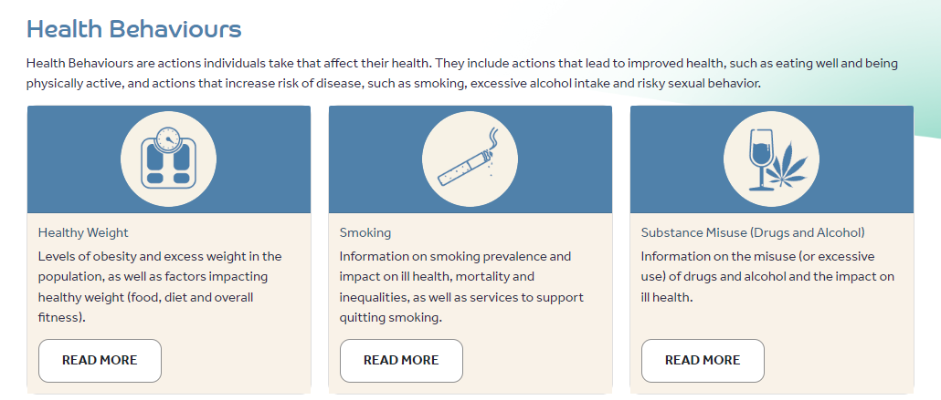
Topics sections
Each of the Topic sections are set-out in the same way. Once you have clicked on the main topic heading, the webpage will show the sections that are included within it. A screenshot from the Health Behaviours page is shown as an example.
To access resources within each topic area, click on the relevant ‘Read More’ button.
The topic webpage that appears will include:
Topic Packs – these provide a more detailed look at the subject from a local authority perspective. They include latest data, trends and a summary of the current services, gaps and next steps that will be taken locally. The packs are created in Microsoft PowerBI, but can be accessed without having a licence to this program. Topic Packs are not currently available for all subjects and will be developed over time. The order these are created are prioritised by the local authorities. An announcement will be added to the ‘Latest News’ section on the front page of the website when new packs are added.
Useful resources – this is a library of resources for the subject area, including national guidance, policies and analyses, as well as information that has been produced locally.
The following slide includes an example of the Healthy Weights page and how to navigate this.
Berkshire East JSNA Last updated: June 2022

Slide 7
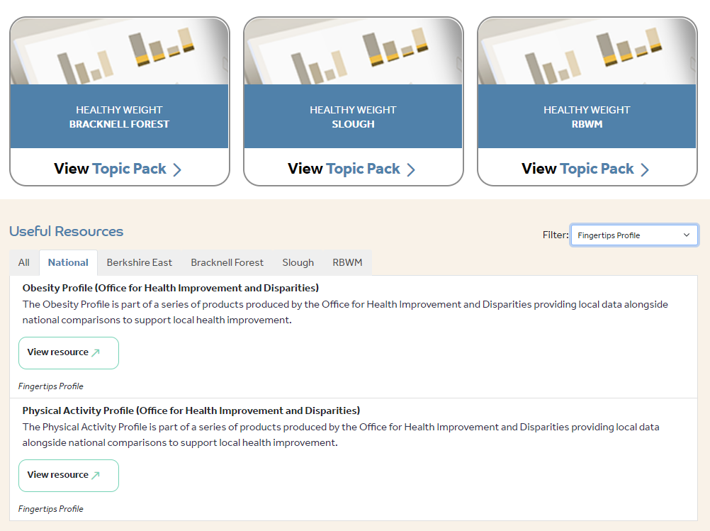
Navigating Topic Webpage
To access individual Topic Packs, click directly on them. They will open in the same window on your browser.
The types of Useful Resources shown in the list can be filtered by:
Selecting the type of resources you want from the Filter dropdown menu (data, research etc).
Selecting the geography that you’re interested in from the tabs
To open a resource click on ‘View Resource’. This may open in your current browser window, or a separate window, depending on the type of resource it is.
Berkshire East JSNA Last updated: June 2022

Slide 8
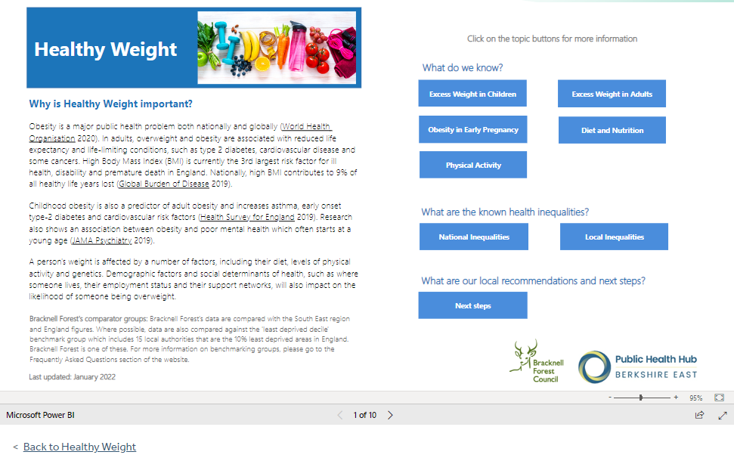
Navigating the Topic Packs
Topic Packs are created in Microsoft PowerBI. You do not need a licence to access these packs, as they automatically open in your browser window.
The Topic Pack can look small when it opens, depending on what device you’re using to access it. To make it full screen click on this button.
Each of the Topic Packs include answers to the same 3 key questions:
what do we know? what are the known health inequalities? what are our local next steps?
To go to the individual pages of the Pack, click on the relevant blue button or use the page number navigation menu.
Click on the ‘Back’ hyperlink to return to the main topic page
Berkshire East JSNA Last updated: June 2022

Slide 9
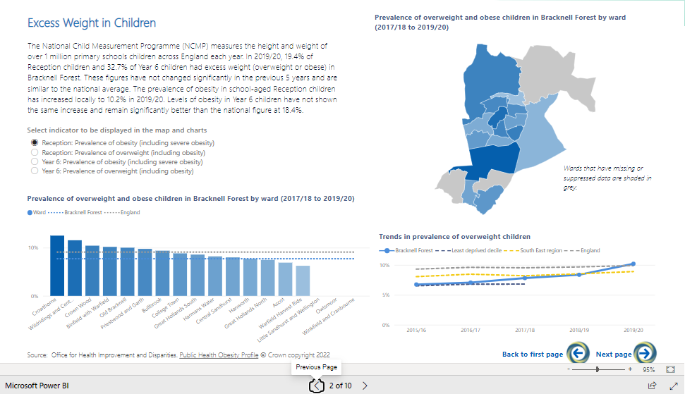
Navigating the Topic Packs
The Topic Pack pages all include different data and charts. However, they can all be used in the same way. To select the indicator that you want to see data for, click on the relevant radio button. The data and charts on that page will automatically update.
The Back and Next buttons are another option for navigating to different pages in the Pack.
Berkshire East JSNA Last updated: June 2022

Slide 10
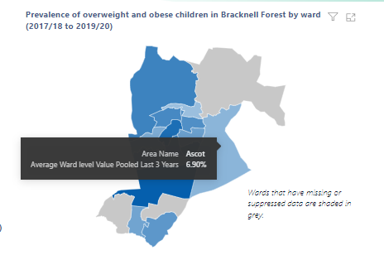
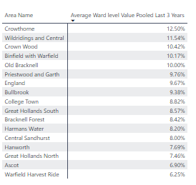
Other Topic Pack tips
Data Values: Data values used in a chart or map can be seen by hovering over individual aspects of the visual (for example: Ascot in the map shown here). To see all of the values used in a chart or map, right click on the visual and select ‘Show as table’. The full dataset will then appear (as shown in the example below).
Copying information included: The Topic Packs have been created to share publicly available data analysis to a wider audience. You are allowed to copy the text, data and visuals included in these packs and put them into your own reports. Please ensure that you reference the original source, which is always included on the Topic Pack page.
The best way to copy visuals is to ‘snip’ them. To do this press Shift+Windows key+S on your keyboard. This will allow you to select what you want to copy. To paste this into your report then press Ctrl+V on your keyboard and resize as required.
Berkshire East JSNA Last updated: June 2022

Slide 11
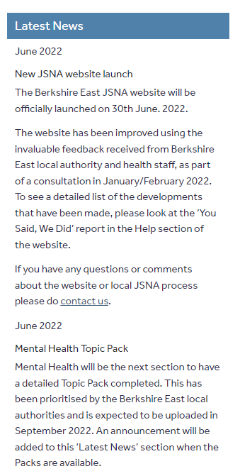
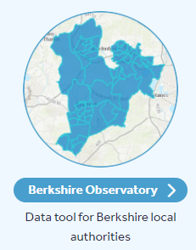
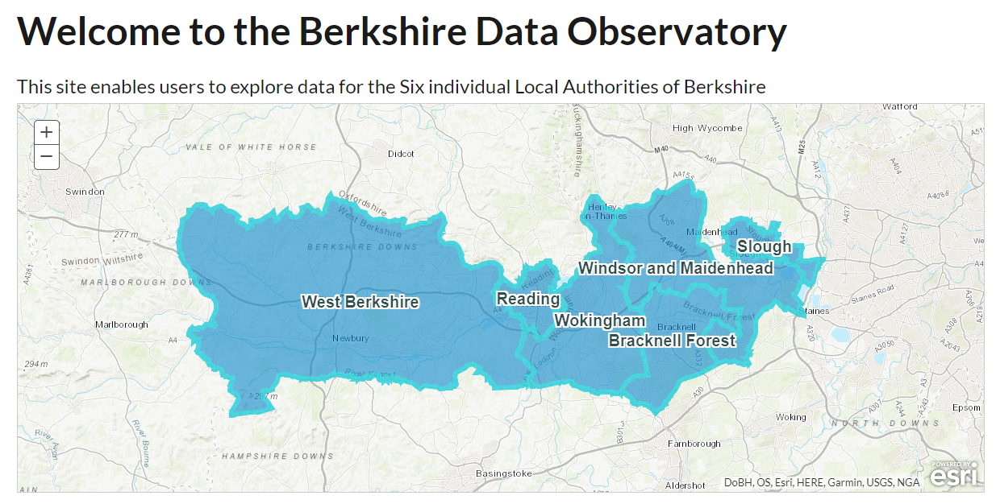
How do I find out more?
The front page of the website includes a Latest News section, which will be updated whenever new resources are added to the website. This will also highlight which sections have been prioritised to be worked on next.
The website also includes a link to the Berkshire Observatory at the foot of the webpage. The Berkshire Observatory covers the whole of Berkshire and includes 1,000s of real-time indicators in one place. This site compliments the Berkshire East JSNA and is one of the library of resources being used to ensure that the latest data is available to a wider audience. The Observatory can be found at: https://berkshireobservatory.co.uk/
Berkshire East JSNA Last updated: June 2022

Slide 12
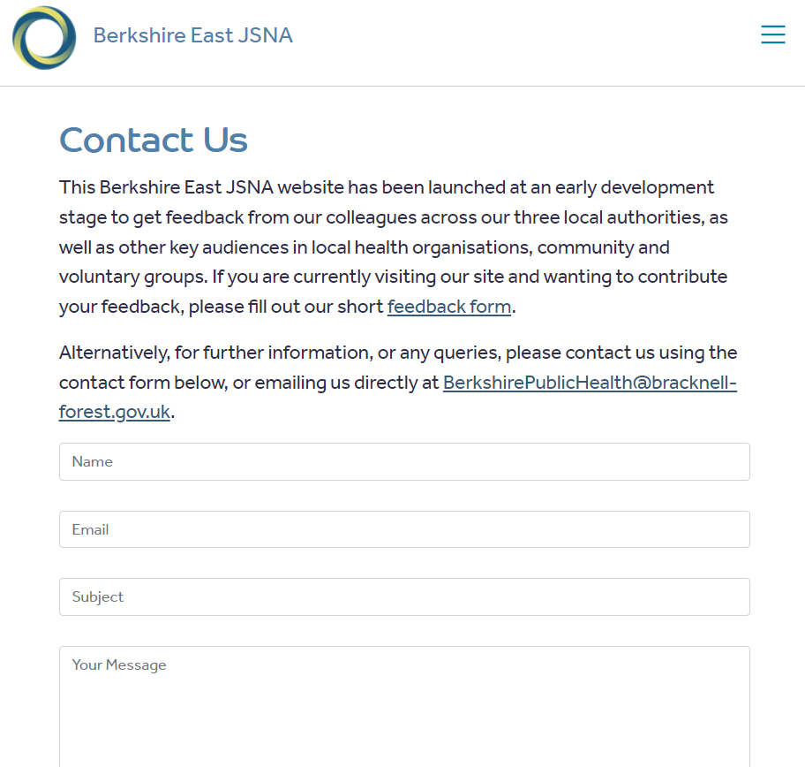
Who do I contact for more information?
If you have any questions, queries or feedback about the JSNA, please do fill in the contact form on the website or email: berkshirepublichealth@bracknell-forest.gov.uk.
Your feedback will support the development of the website’s Help page and will shape future improvements to the site.
The JSNA will be continually updated and developed, based on the priorities agreed by the local authorities. If you are aware of any information or resources that you think should be included on the website, please also contact us.
Berkshire East JSNA Last updated: June 2022

