Slide 1
Berkshire East Healthy Behaviours Health Needs Assessment Executive Summary September 2022

Slide 2
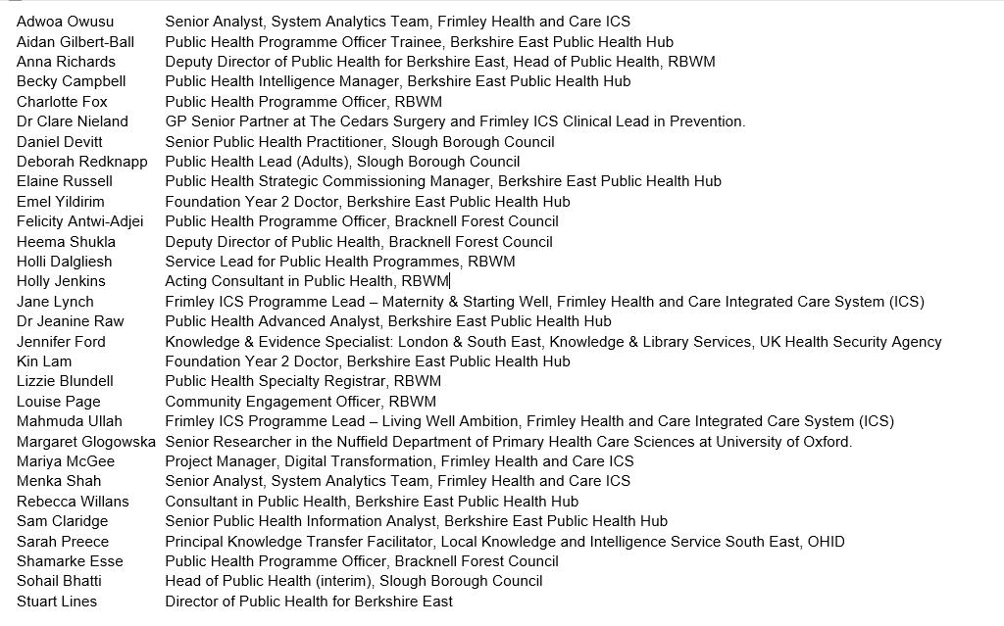
Acknowledgements
Berkshire East Healthy Behaviours Health Needs Assessment Summary September 2022

Slide 3
Introduction
What are healthy behaviours?
Healthy behaviours are those that are positive for an individual’s health and mortality, such as stopping smoking, drinking less alcohol, moving more and eating more healthily.
Why are health behaviour services important?
Public Health England (PHE) (2018) stated that in order to prevent diseases and reduce inequalities, people needed to be supported to make manageable and sustained behaviour changes.
Unhealthy behaviours often cluster together in the population (The King’s Fund 2018), which means that individuals may benefit from support to change multiple behaviours.
Many of the behaviour change services across Berkshire East are currently addressing these behaviours separately.
Berkshire East Healthy Behaviours Health Needs Assessment Summary September 2022

Slide 4
Berkshire East Healthy Behaviours HNA
A Healthy Behaviours Health Needs Assessment (HNA) has been jointly developed by the Public Health Teams in Berkshire East – Bracknell Forest, Slough and the Royal Borough of Windsor and Maidenhead – and the Berkshire East Public Health Hub, with support from colleagues across Frimley Integrated Care System (ICS).
The HNA has been developed in line with Berkshire East Public Health Network’s agreed approach to HNAs.
This incorporates epidemiological, comparative and corporate approaches to ensure that a systematic review of the health needs of the local population are undertaken. The structure of the HNA is shown here.
4
2
5
6
7
1
3
Executive summary
Current service provision for health behaviours in Berkshire East
Research on integrated health behaviour service models
What do we know about healthy behaviours in Berkshire East?
Evidence review on effective interventions for healthy behaviours
Feedback from professionals and the public
Recommendations and next steps
Appendices
Aim, purpose and scope of HNA
Berkshire East Healthy Behaviours Health Needs Assessment Summary September 2022

Slide 5
Aims and purpose of the Healthy Behaviours HNA
The aims of the HNA are:
to understand healthy behaviours of adults across Berkshire East in relation to excess weight, diet, physical activity, smoking and alcohol use
to identify health inequalities within the 3 local authorities and how these affect healthy behaviours
to evidence what good health behaviours services should look like and establish the benefits of integrated and individual service models
The purpose of the HNA is to inform the commissioning of adult-focussed health behaviour services in Berkshire East, so that the most effective support for those in greatest need can be planned and delivered. We recognise that behaviour change is complex, and that services are only one part of the jigsaw.
Healthy/unhealthy behaviours included in the HNA
Healthy Weight
Obesity and overweight (Body Mass Index of 25kg/m² or over) Diet Physical activity and inactivity Sedentary behaviour
Smoking
Current smokers
Alcohol
Regularly drinking 15 to 50 units of alcohol per week
Berkshire East Healthy Behaviours Health Needs Assessment Summary September 2022

Slide 6
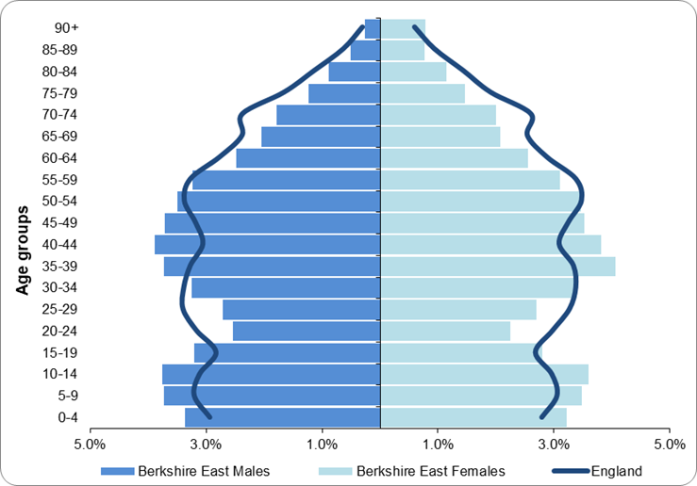
Key demographics for Berkshire East
Population
Berkshire East’s population is estimated at over 425,000 with 75% of the population aged 18 and over. Berkshire East’s population profile differs to England’s, with significantly higher proportions of people aged under 19 and 35 to 49. In contrast, there are significantly lower proportions of people aged 20 to 29 and 60 and over compared to England.
The population profiles of the Berkshire East local authorities also differ. Slough’s population is much younger than Bracknell Forest and RBWM, while RBWM has significantly higher proportions of people aged 65 and over.
Ethnicity
27% of people in Berkshire East come from a black, Asian or other minority ethnic group, compared to 15% in England. A further 9% of the population come from a white non-British background, compared to 6% nationally.
Slough has one of the most diverse populations in England (54% from black, Asian or other minority ethnic groups), while RBWM (14%) and Bracknell Forest’s (9%) populations are more comparable to the national profile.
People from Asian/Asian British backgrounds make up the largest minority group in Berkshire East and this is the case across all three local authorities.
Population Pyramid for Berkshire East (mid-2020 estimates)
Deprivation
Levels of deprivation vary significantly across Berkshire East.
Slough is more deprived than the rest of Berkshire East with approximately 8% of the Slough population living in the 20% most deprived neighbourhoods in England. In contrast, Bracknell Forest and RBWM are both in the 10% least deprived local authorities nationally. However, both have pockets of deprivation and neighbourhoods that are noticeably more deprived than the local authority areas as a whole.
Berkshire East Healthy Behaviours Health Needs Assessment Summary September 2022

Slide 7
What do we know about healthy behaviours in Berkshire East?
Proportion of adult population estimated to have unhealthy behaviours in Berkshire East
l England prevalence
Unhealthy behaviours
(as recorded in national surveys)
Modifiable conditions
(as recorded in local health care systems. This does not take undiagnosed population into account)
Estimated number of adults affected in Berkshire East:
Excess weight | Unhealthy diet | Physically inactive | Current smoker | Alcohol consumption |  | Type 2 diabetes (diagnosed) | Hypertension (diagnosed)
257,700 | 187,600 | 116,300 | 49,500 | 80,800 |  | 29,900 | 68,700
Berkshire East Healthy Behaviours Health Needs Assessment Summary September 2022

Slide 8
What do we know about healthy behaviours in Berkshire East?
Proportion of adult population estimated to have unhealthy behaviours in Bracknell Forest
l England prevalence Berkshire East prevalence
Unhealthy behaviours
(as recorded in national surveys)
Modifiable conditions
(as recorded in local health care systems. This does not take undiagnosed population into account)
Unhealthy behaviours
(as recorded in national surveys)
Estimated number of adults affected in Bracknell Forest:
Excess weight | Unhealthy diet | Physically inactive | Current smoker | Alcohol consumption |  | Type 2 diabetes (diagnosed) | Hypertension (diagnosed)
78,800 | 52,800 | 28,300 | 13,200 | 23,600 |  | 7,000 | 20,200
Berkshire East Healthy Behaviours Health Needs Assessment Summary September 2022

Slide 9
What do we know about healthy behaviours in Berkshire East?
Proportion of adult population estimated to have unhealthy behaviours in Slough
l England prevalence Berkshire East prevalence
Unhealthy behaviours
(as recorded in national surveys)
Modifiable conditions
(as recorded in local health care systems. This does not take undiagnosed population into account)
Unhealthy behaviours
(as recorded in national surveys)
Estimated number of adults affected in Slough:
Excess weight | Unhealthy diet | Physically inactive | Current smoker | Alcohol consumption |  | Type 2 diabetes (diagnosed) | Hypertension (diagnosed)
92,600 | 75,200 | 57,000 | 20,800 | 28,400 |  | 14,900 | 23,600
Berkshire East Healthy Behaviours Health Needs Assessment Summary September 2022

Slide 10
What do we know about healthy behaviours in Berkshire East?
Proportion of adult population estimated to have unhealthy behaviours in RBWM
l England prevalence Berkshire East prevalence
Unhealthy behaviours
(as recorded in national surveys)
Modifiable conditions
(as recorded in local health care systems. This does not take undiagnosed population into account)
Unhealthy behaviours
(as recorded in national surveys)
Estimated number of adults affected in RBWM:
Excess weight | Unhealthy diet | Physically inactive | Current smoker | Alcohol consumption |  | Type 2 diabetes (diagnosed) | Hypertension (diagnosed)
86,200 | 59,600 | 31,000 | 15,600 | 28,700 |  | 8,200 | 24,800
Berkshire East Healthy Behaviours Health Needs Assessment Summary September 2022

Slide 11
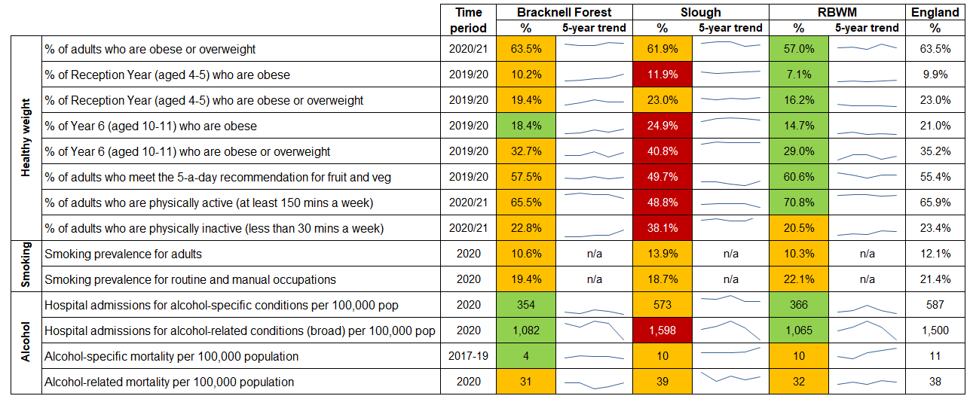
What do we know about healthy behaviours in Berkshire East?
Health behaviour indicators for Berkshire East local authorities
Source: Office for Health Improvement and Disparities (2022), Fingertips Profiles
Berkshire East Healthy Behaviours Health Needs Assessment Summary September 2022

Slide 12
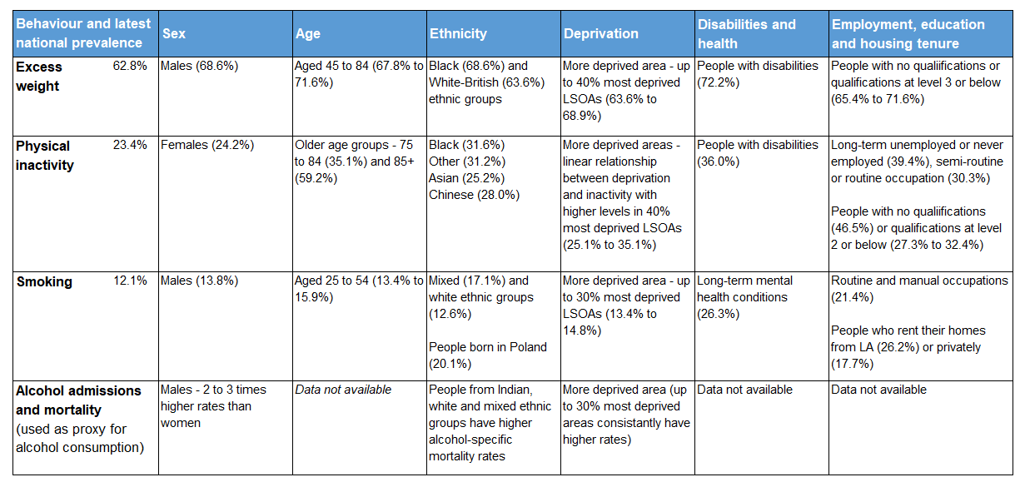
What do we know about inequalities in healthy behaviours?
Population groups with significantly higher prevalence of unhealthy behaviours compared to general adult population (national information)
Berkshire East Healthy Behaviours Health Needs Assessment Summary September 2022

Slide 13
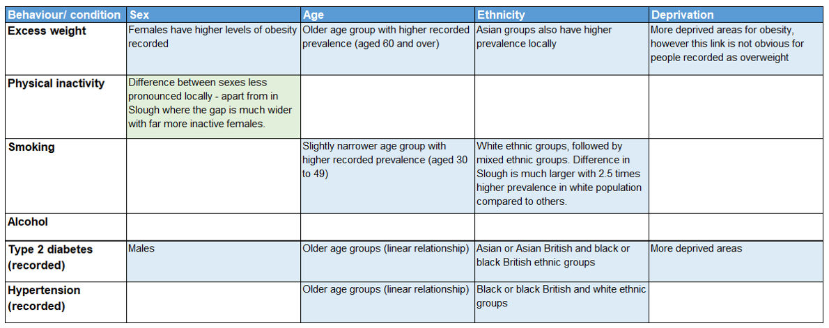
What do we know about inequalities in healthy behaviours?
Population groups with significantly higher prevalence of unhealthy behaviours in Frimley ICS and Berkshire East analyses, which are different to those identified nationally*
Unless stated, the inequalities identified are true in Bracknell Forest, Slough and RBWM
Identified through Connected Care (GP Record) analysis
Identified through analysis of national survey
* The information gathered from Connected Care focuses on what is recorded on patient GP records and will not be a representative sample of the population in the same way as a national survey. Instead, this will be skewed towards groups that are more likely to contact their GP (older populations and those with long-term conditions)
Berkshire East Healthy Behaviours Health Needs Assessment Summary September 2022

Slide 14
Current service provision for Healthy Behaviours
Health behaviour services are commissioned nationally and locally. In Berkshire East, local authority public health teams and NHS providers (previously Frimley Clinical Commissioning Group and now Frimley Integrated Care Board) commission health behaviour services for the local population.
Bracknell Forest and RBWM commission separate services for individual health behaviours, while Slough have an Integrated Wellbeing Service that includes:
The following slide summarises the services currently commissioned across Berkshire East at February 2022.
A review of the outcomes achieved by the current services identified several key points to be incorporated into future commissioning:
Improvement in the recording of data and outcomes for services, including standardising demographic information for those that accept and decline services and measuring longer-term outcomes through follow-ups
Consider the development of generic set of performance indicators for health behaviours that can be used and compared across local services
Ensure smoking quit rates are biochemically validated
weight management programmes (WMP)
smoking cessation services
alcohol identification and brief advice
NHS Health Checks
falls prevention
sedentary behaviour change
advice on oral health
Berkshire East Healthy Behaviours Health Needs Assessment Summary September 2022

Slide 15
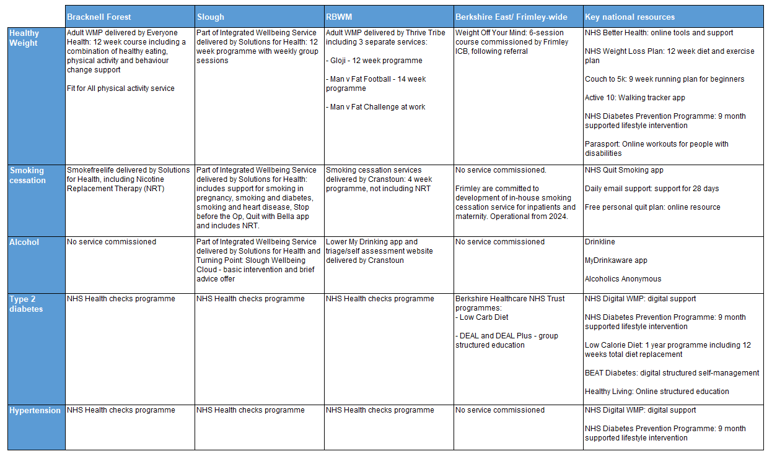
Current service provision for Healthy Behaviours
Health behaviour services currently commissioned for Berkshire East residents (at February 2022)
Berkshire East Healthy Behaviours Health Needs Assessment Summary September 2022

Slide 16
Evidence review: effective interventions for healthy behaviours
The HNA included an evidence review of effective interventions for healthy behaviours and recommended that future commissioning should:
Follow the national recommendations outlined in OHID and NICE guidance
consider including digital and mobile interventions within services as an option for people who would benefit from improving their diet, increasing their physical activity levels or reducing their alcohol consumption.
Ensure services are tailored to better suit the needs of underserved populations
Ensure that a family-based, multi-component weight management service for children and young people is available that makes sure the whole family is on-board with the programme
All healthy weight pathways should be made clear to professionals and the public, in line with NICE guidance
Offer vaping as a substitute for smoking. Provide free Swap to Stop packs in deprived communities.
Consider providing behavioural support beyond 4 weeks post quit-date alongside smoking therapies to certain populations
Deliver alcohol identification and brief advice in all adult health, social care and criminal justice settings, as recommended by NICE
Berkshire East Healthy Behaviours Health Needs Assessment Summary September 2022

Slide 17
Evidence review: effectiveness of integrated health behaviour services
Unhealthy behaviours are often clustered in the same population groups and this had led to policy calls to establish integrated services that support individuals more holistically (The King’s Fund 2018). The HNA included an evidence review of the benefits of integrated and independent service models, including feedback from discussions with local authorities that already commission integrated services.
The evidence review and discussions with local service evaluations found that it is effective to combine physical activity and healthy diet interventions to support overall achievement of healthy weight. However, smoking cessation services are more effective (and more cost-effective) when provided as a single service.
The HNA recommends that further local work should explore whether the required expertise and intensity of smoking cessation interventions could be achieved within an integrated model in Berkshire East.
Berkshire East Healthy Behaviours Health Needs Assessment Summary September 2022

Slide 18
Evidence review: effectiveness of integrated health behaviour services
From discussions with LA leads with established integrated services, it was clear that there is no “one-size fits all” model. Common themes for delivering a good service that were identified included:
A single point of access – all referrals go to one place requiring only one administration team
Streamlined process for cross-referrals, making it easier, quicker, and more effective to support people with multiple unhealthy behaviours compared to referring into different services
A consistent approach to measuring health inequalities to demonstrate impact on underserved communities
A blended approach, offering both face to face and digital/online support. This improved accessibility.
Signposting further support beyond the remit of the integrated service can support people to take further action to continue improving their health (if appropriate)
Staff who are trained to support health improvement across multiple risk behaviours. This leads to efficiencies in service delivery and also means that service users can receive support with applying behaviour change strategies to multiple risk behaviours
Consulting with residents to understand the needs of the community and to design services appropriately
Marketing and advertising the service so the community knows about available support and how to access it. As part of this, utilise community groups and residents’ associations to raise awareness.
Berkshire East Healthy Behaviours Health Needs Assessment Summary September 2022

Slide 19
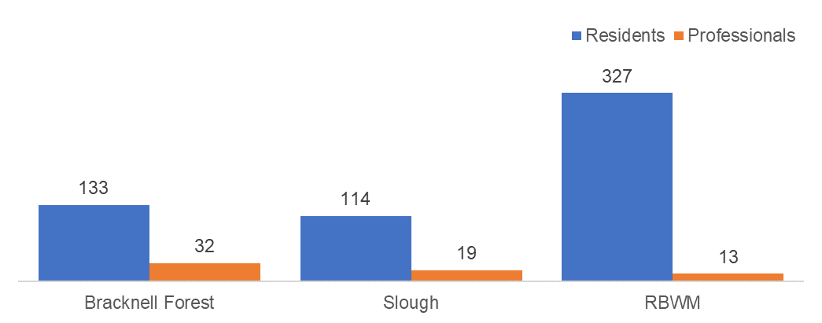
Consultation feedback
Each of Berkshire East’s three local authorities carried out surveys to gather feedback for the HNA between April and July 2022. The aim of these surveys were to ascertain the type of support required to enable people to improve their health.
Number of responses to healthy behaviours survey in Berkshire East
The surveys focussed on two different groups:
Professionals working in health and frontline services – 64 responses
Residents – 574 responses
The majority of the respondents to the resident survey were:
Female
Aged 65 and over
From a white ethnic group
Able to afford their basic needs (selected ‘all of the time’ to the statement ‘I am able to afford everything to meet my basic needs and those of my family’)
Retired (differed in Slough where the highest proportion were from people in employment)
Without dependents
Without disability or impairment
Berkshire East Healthy Behaviours Health Needs Assessment Summary September 2022

Slide 20
Consultation feedback summary
Summary of key themes and findings from the Berkshire East healthy behaviour surveys
Desired health improvements that residents identified | A substantial number of resident respondents were looking to make healthy changes, 7 out of 10 wanted to lose weight, and 6 out of 10 wanted to get active. Many respondents selected that they wanted to make changes in both of these areas.
Uptake of services | Despite resident respondents wanting to make healthy changes 68% had not used existing local authority support services. Support through GP practice was most frequently used (with exception of tier 2 weight management service in Bracknell Forest). Professionals that responded to the survey most frequently referred to primary care services to support healthy behaviour changes.
Preference for separate or integrated services | Half of resident respondents did not have a preference as to how access services. Of those that did, three-quarters (76%) preferred separate services for smoking, alcohol, diet and exercise. Amongst professional respondents, 20% had no preference, of those that did, 41% preferred separate models and 59% an integrated service model. However, in Bracknell Forest there was a greater preference for separate services (14 out of 26).
Mode of delivery | When asked how support should be delivered, resident respondents most frequently selected in-person and digitally via apps or online, and professional respondents in-person and by telephone.
Barriers to access and benefiting from services | Several communities were identified as underserved by current services, including those in low-income groups, people with chronic health conditions and people with mental illnesses. Cost of leisure service – residents who wished to become more active reported that not being able to afford the cost of leisure services as a barrier to access. Mental health – identified as a barrier by both residents and professionals. Mental health support was seen as a key component to support healthy behaviour change. Lack of readiness for change and inability to maintain change – professionals cited these as key reasons for people not engaging and benefitting from services
Berkshire East Healthy Behaviours Health Needs Assessment Summary September 2022

Slide 21
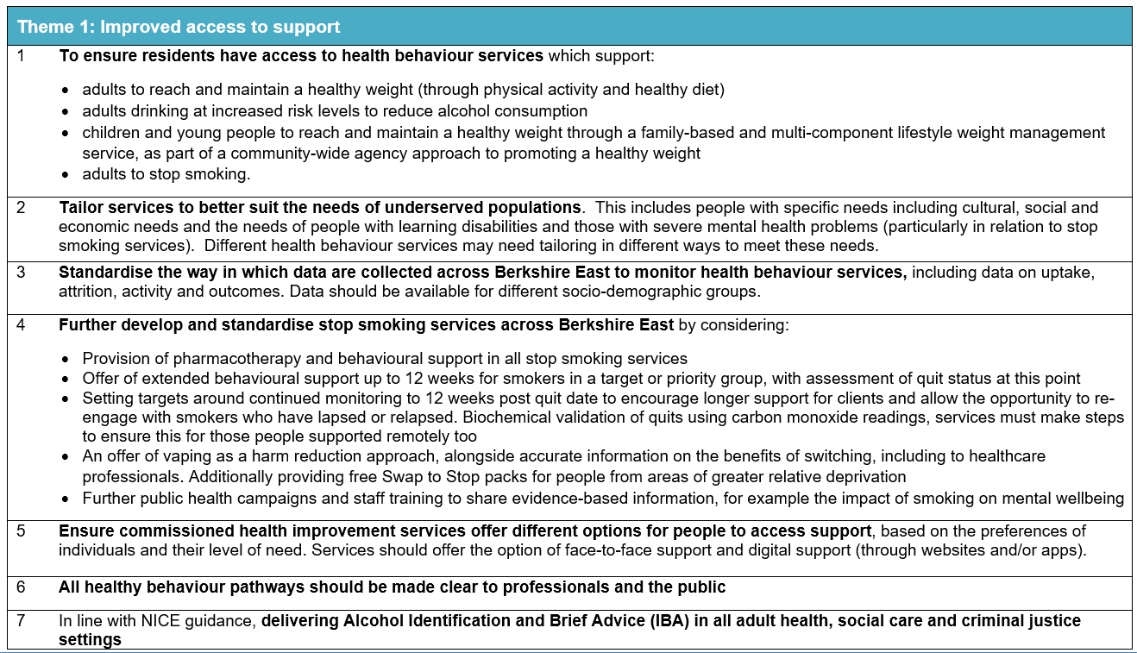
Recommendations for Berkshire East
The HNA’s key recommendations have been informed by the intelligence collated throughout the process and have been split into three themes.
Berkshire East Healthy Behaviours Health Needs Assessment Summary September 2022

Slide 22
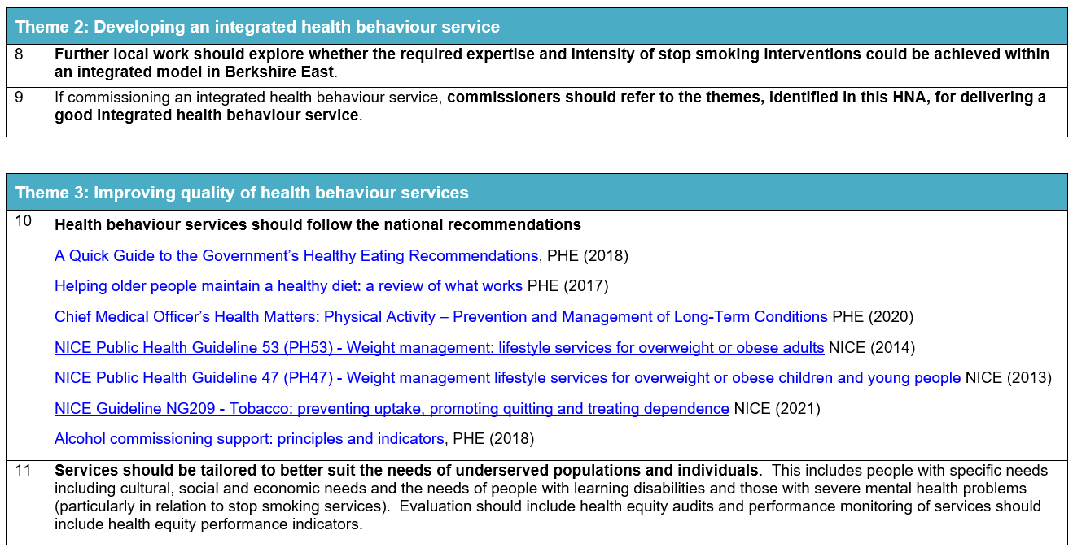
Recommendations for Berkshire East
Berkshire East Healthy Behaviours Health Needs Assessment Summary September 2022

Slide 23
Next steps
The findings from this HNA will be published on the Berkshire East Joint Strategic Needs Assessment (JSNA) website and will be actively shared with a wide range of stakeholders, including partners from across the Frimley ICS and Berkshire East residents. These findings will inform the design and delivery of health behaviour services across Berkshire East.
The impact of this HNA will be measured through feedback from commissioners across Berkshire East. This will look at how well the HNA has informed the conversations and future actions of the Berkshire East commissioners around an integrated health behaviours service.
Berkshire East Healthy Behaviours Health Needs Assessment Summary September 2022

