Slide 1

Bracknell Forest 0 to 19 Health Needs Assessment: Deep Dive
Summary Slides

Slide 2








Purpose of the 0-19 HNA Deep Dive Document
The 0-19 Health Needs Assessment (HNA) was jointly developed by the Public Health Teams in Berkshire East: Bracknell Forest Council, Slough Borough Council, the Royal Borough of Windsor and Maidenhead and the overarching Berkshire East Public Health Hub
Children and Young People (CYP) aged 0 to 19 were identified as the first priority area following the creation of the new Berkshire East Public Health System in April 2021
The high-level summary produced by the 0-19 HNA provides a more general overview of these topic areas, presenting data at a Berkshire East, local authority or national level
In order to better understand the health needs of the local 0-19 population and identify areas of inequalities, there is a need for a more detailed, Bracknell Forest specific, analysis of granular, ward level data.

Slide 3
Population Profile
Children and Young People (0-19) in Bracknell Forest
There were a total of 31,231 children and young people living in Bracknell Forest in mid-2020, which comprised as 25.2% of the population
The CYP population is expected to decrease by 7.1% between 2023 and 2043. The CYP population is projected to comprise of 22.1% of the total population in 2043 (Office for National Statistics, 2020)
The distribution of the children and young people population varied greatly by ward. Hanworth has the greatest number of CYP residents (2,705) with Wildridings and Central ward having the smallest number of CYP residents (937)
Great Hollands South had the highest proportion of CYP with more than 1 in 2 (52.9%) residents aged 0-19. Conversely, Warfield Harvest Ride has the lowest proportion of CYP residents (16.0%).
Location of children and young people population (0-19) in Bracknell Forest (mid-2020)
Source: Office for National Statistics (2021) Ward-level population estimates mid-2020

Slide 4
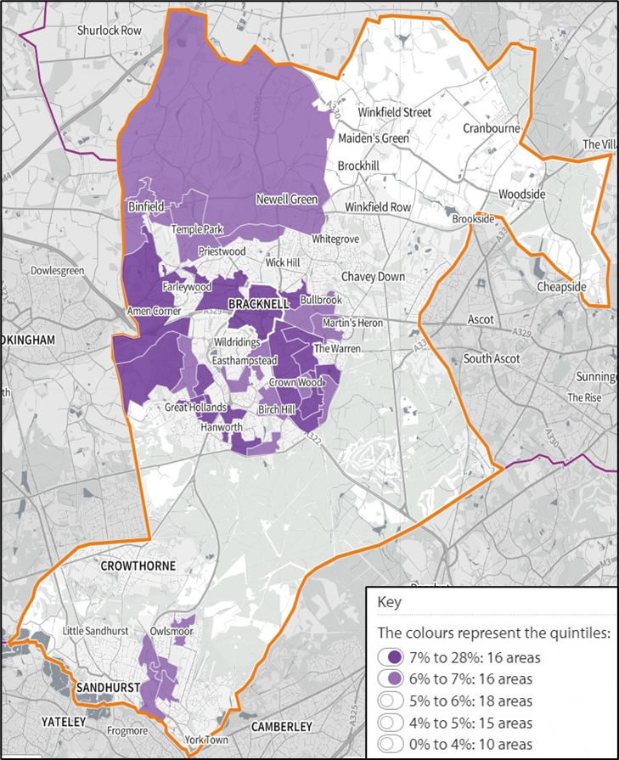
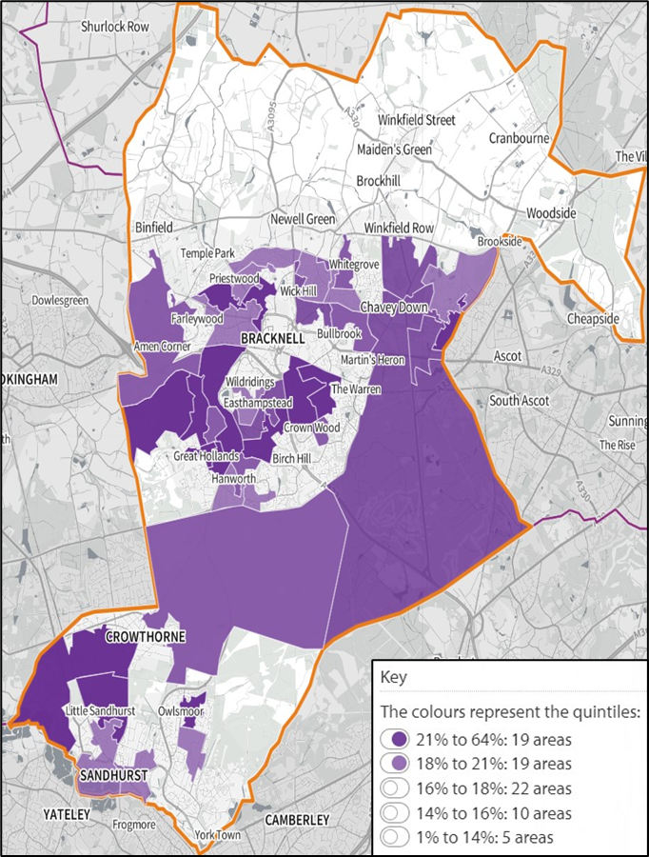
Population Profile: Location of 0-19 Population
LSOAs with the highest proportion of children aged 0-4 in Bracknell Forest (mid-2020)
LSOAs with the highest proportion of children and young people aged 5-19 in Bracknell Forest (mid-2020)
Source: Office for National Statistics (2021); Lower layer Super Output Area population estimates mid-2020.
https://shapeatlas.net/place/ 19 September 2022

Slide 5
Population Profile: Ethnicity and Language
Ethnicity and Language
Ethnicity data from the 2011 census estimated that 17.3% of residents aged 0-19 were from an ethnic minority group. The largest minority ethnic group were Asian or Asian-British (5.9%)
College town had the highest proportion of ethnic minority CYP (26.9%) with Crowthorne having the lowest proportion (12.0%)
There are indications that since the 2011 census the proportion of CYP from minority ethnic groups in Bracknell Forest has increased exponentially
In 2019, 24.8% of births were to mothers not born in the UK. This is up 17.0% since 2009
Ethnicity date from the annual school census reported that 26.0% of pupils were from an ethnic minority group in January 2022. This is up from 16.8% in January 2012
Similarly, 13.3% of pupils spoke English as an additional language (EAL) in January 2022, up from 9% in January 2012.
School Census - Minority Ethnic & English as an Additional Language
Pupils from a Minority Ethnic Group in Bracknell Forest Schools (2022)
*Other: All through schools; Pupil Referral Unit; Special schools
Source: Department for Education (2022): School, Pupils and their Characteristics

Slide 6
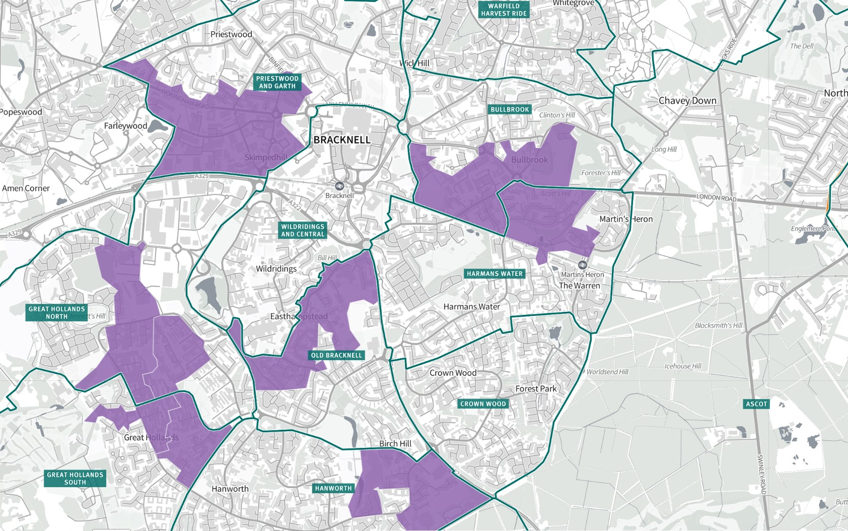
Deprivation
Income deprivation affecting Children
8.9% of children, aged 0-15, living in Bracknell Forest are affected by income deprivation compared to 17.1% in England in 2019
At ward level, the proportion of children living in an income deprived household ranged between 2.6% in Little Sandhurst and Wellington and 14.8% in Priestwood and Garth
The most deprived neighbourhood in Bracknell Forest was in Great Hollands North (LSOA 009B) where 21.0% of children were living in an income deprived household
Another key indicator of child deprivation is Free School Meal (FSM) eligibility. In January 2022, 11.8% of all school pupils were FSM eligible, up from 8.1% in 2012.
Income Deprivation Affecting Children Index (IDACI) for Bracknell Forest by Lower Super Output Area (2019)
Ward | LSOA | % children affected by income deprivation
Great Hollands North | 009B | 21%
Old Bracknell | 007B | 20%
Priestwood and Garth | 004D | 19%
Great Hollands North | 009H | 18%
Great Hollands South | 009F | 18%
Harmans Water | 006E | 17%
Bullbrook | 006G | 17%
Hanworth | 010B | 17%
Source: English Indices of Deprivation 2019 © Crown copyright 2019. https://shapeatlas.net/place/ 12 September 2022

Slide 7
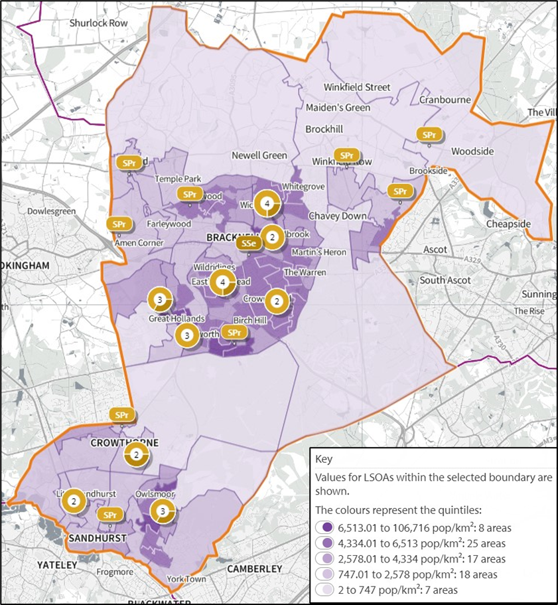
Educational Attainment
Schools and Pupils
There are 29 state-funded primary schools and 7 state-funded secondary schools in Bracknell Forest
There were a total of 18,175 students attending state-funded schools of which 10,336 attended the primary school with a further 7,339 attending secondary schools
13.0% of primary school students and 14.9% of secondary school student were identified as having Special Educational Needs (SEN) or an Education, Health and Care (EHC) plan in January 2022
13.3% of pupils spoke English as an additional language (EAL) in January 2022, up from 9.0% in 2012
11.8% of all school pupils were FSM eligible in January 2022, up from 8.1% in 2012
26.0% of pupils were from an ethnic minority group. This is up from 16.8% in 2012.
State-funded Primary and Secondary Schools in Bracknell Forest 2022
Source: Office for National Statistics (2021); Lower layer Super Output Area population estimates mid-2020.
https://shapeatlas.net/place/ 12 September 2022

Slide 8
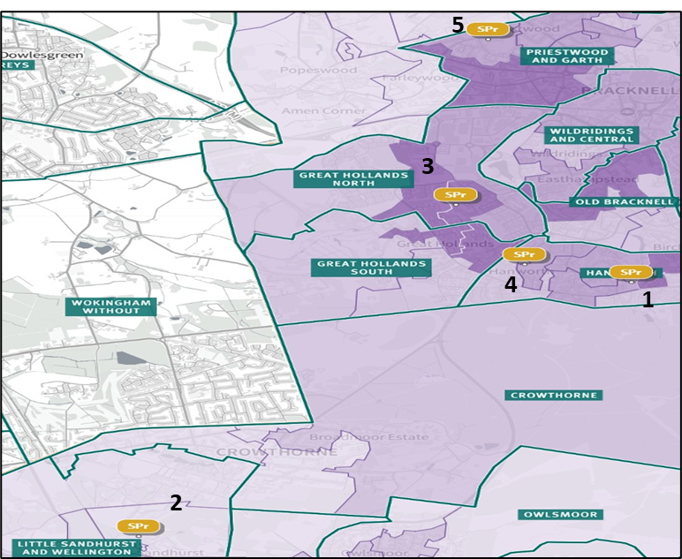
Educational Attainment: Reception
Pupils achieving a Good Level of Development (GLD)
This is a key measure of early year development across a wide range of developmental areas including communication and language, mathematics and literacy
The percentage of children achieving a good level of development has steadily risen since 2012/13, from 57.8% to 76.4%
Bracknell Forest performed significantly better than local authorities regionally (74.6%) and nationally (71.8%), including the 15 most similar local authorities in England (73.4%).
Primary schools with lowest proportion of pupils achieving GLD and proportion of pupils in cohorts (2018/19)
ID | Primary School | GLD | EAL | FSM | SEN
1 | The Pines | 62.0% | 14.1% | 18.6% | 16.8%
2 | New Scotland Hill Primary | 63.3% | 4.3% | 5.7% | 10%
3 | Great Hollands Primary | 64.4% | 16.8% | 30.5% | 19.5%
4 | Birch Hill Primary | 70.0% | 15.2% | 11.8% | 8.9%
5 | Meadow Vale Primary | 70.2% | 12.4% | 16.6% | 6.5%
 | Bracknell Forest | 76.4% | 14.9% | 11.5% | 10.5%
Pupils achieving Good Level of Development at the End of Reception by Cohort (2018/19)
Source: Department for Education: Early years foundation stage profile results 2018 to 2019. https://shapeatlas.net/place/ 19 September 2022

Slide 9
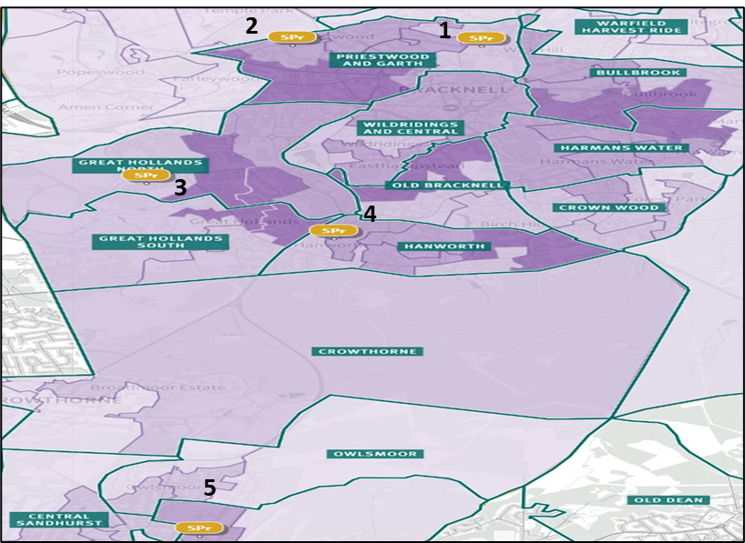
Educational Attainment: Year 1 Phonics
Pupils achieving the expected level in the phonics screening check in year 1
The Year 1 phonics screening check is an assessment used by teachers to determine how well each child can use the newly acquired phonic skills to read words (decoding)
The proportion of children achieving the expected level in Bracknell Forest has steadily increased since 2011/12, from 53.6% to 84.7%. This is in line with regional (South-East) and national trends
Bracknell Forest schools performed significantly better than the regional (82.8%) and national (81.8%) averages in 2018/19.
Primary schools with lowest proportion of pupils achieving the expected level in phonics and proportion of pupils in cohorts
ID | Primary School | Phonics | FSM | SEN | EHC Plan
1 | Sandy Lane Primary | 71.6% | 15.4% | 12.6% | 2.2%
2 | Meadow Vale Primary | 76.7% | 16.6% | 6.5% | 3.0%
3 | Jennetts Park CE Primary | 77.6% | 10.1% | 11.3% | 3.3%
4 | College Town Primary School | 78.9% | 7.3% | 12.2% | 1.0%
5 | The Pines | 78.9% | 18.6% | 16.8% | 3.6%
 | Bracknell Forest | 84.7% | 11.5% | 10.5% | 2.5%
Pupils achieving the expected level in Phonics in Year 1 by Cohort (2018/19)
Source: Department for Education: Phonics screening check and key stage 1 assessments 2019. https://shapeatlas.net/place/ 19 September 2022

Slide 10
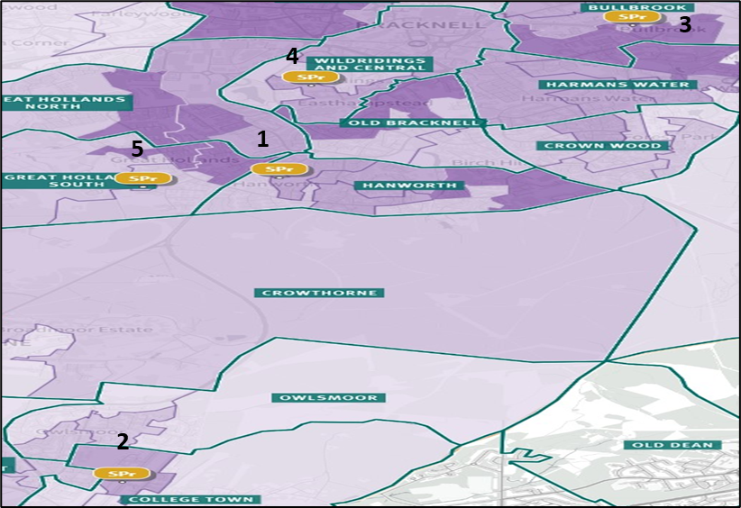
Educational Attainment: Year 1 RWM
Pupils meeting or exceeding the expected level in reading, writing and maths (RWM) in year 1
Primary schools with lowest proportion of pupils meeting/exceeding the expected level in RWM and proportion of pupils in cohorts
ID | Primary School | RWM | FSM | SEN | EHC Plan
1 | The Pines | 52.2% | 18.6% | 16.8% | 3.6%
2 | College Town Primary School | 55.9% | 7.3% | 12.2% | 1.0%
3 | Holly Spring Primary | 59.0% | 20.2 % | 13.4% | 1.9%
4 | Wildridings Primary | 60.0% | 17.9% | 14.0% | 1.9%
5 | Wooden Hill Primary | 60.9% | 12.1% | 9.4% | 2.4%
 | Bracknell Forest | 67.1% | 11.5% | 10.5% | 2.5%
Pupils achieving the expected level for each subject in Year 1 by Cohort (2019/20)
Children achieving the expected level in RWM in Year 1 by Cohort (2019/20)
Source: Department for Education: Phonics screening check and key stage 1 assessments 2019. https://shapeatlas.net/place/ 12 September 2022

Slide 11
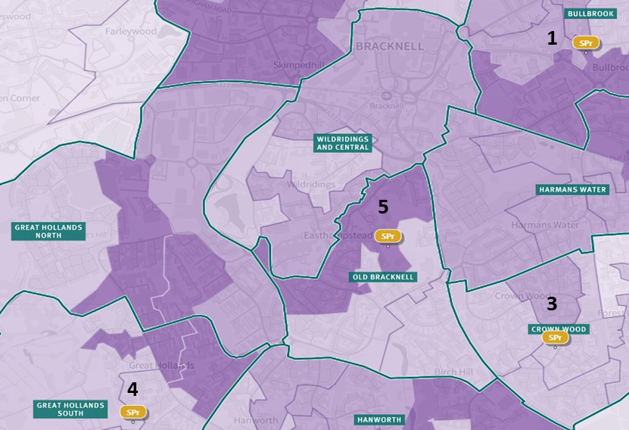
Educational Attainment: KS2 RWM
Pupils meeting or exceeding the expected level in reading, writing and maths in KS2
64.7% of KS2 pupils in Bracknell Forest met or exceeded the expected level in RWM in 2019/20, up from 52.0% in 2016/17
Bracknell Forest KS2 pupils performed at a similar level to other pupils regionally (66.3%) and nationally (65.3%) in 2019/20.
Primary schools with lowest proportion of pupils meeting/exceeding the expected level in RWM and proportion of pupils in cohorts
ID | Primary School | RWM | FSM | SEN | EHC Plan
1 | Holly Spring Primary | 39.3% | 20.2% | 13.4% | 1.9%
2 | New Scotland Hill Primary | 40.0% | 5.7% | 10.0% | 2.4%
3 | Crown Wood Primary | 50.0% | 15.4% | 10.8% | 3.4%
4 | Wooden Hill Primary | 58.0% | 12.1% | 9.4% | 2.4%
5 | Fox Hill Primary | 58.6% | 16.3% | 14.5% | 3.1%
 | Bracknell Forest | 64.7% | 11.5% | 10.5% | 2.5%
Pupils achieving the expected level in RWM in KS2 by Cohort (2019/20)
Source: Department for Education: Key stage 2 attainment 2019/20 . https://shapeatlas.net/place/ 12 September 2022

Slide 12
Educational Attainment: KS4 Attainment 8
Attainment 8 score for pupils in Key Stage 4
The attainment 8 score measures the achievement of pupils across 8 subjects including English and Maths (both weighted double)
The average attainment 8 score for state-funded secondary school pupils in Bracknell Forest for the academic year 2018/19 was 4.69. This was lower than the South-East regional (4.80) but higher than the national (4.48) average scores
In the same, pre-pandemic, academic year 44.1% of students achieved between grades 9-5 for English and Maths compared to 44.1% of students regionally and nationally
For both measures, pupils who were FSM eligible, had SEN or had an EHC plan significantly underperformed relative to other pupil cohorts
Students who were FSM eligible in particular underperformed compared to other cohorts.
Attainment 8 score in Bracknell Forest by Cohort (2018/19)
English and Maths grade 9-5 in Bracknell Forest by Cohort (2018/19)
Source: Department for Education, Key stage 4 performance 2019

Slide 13
Child Health: Life Expectancy
Live births and live expectancy at birth
The crude rate of live births in Bracknell Forest for the period 2016-2020 was 57.6 per 1,000 population (women aged 15-44).
The latest ward level data indicates that during the period 2019/20 the live birth rate varied in the borough between 71.7 per 1,000 in Hanworth and 34.2 per 1.000 in Crowthorne.
Life expectancy at birth for male infants was 81.8 years for the period 2016-2020. This was higher than the national average life expectancy (79.5 years).
Within the Borough, there was a 10 year gap between the highest life expectancy for male infants (88.5 years, Warfield Harvest Ride and 78.2 years, Wildridings and Central).
Life expectancy at birth for female infants born during this same period was 85.0 years, also higher than the national average (83.2 years).
The gap in life expectancy at ward level was around 5.4 years (88.0 years in Harmans Water and 82.6 years in Wildridings and Central).
Life expectancy at birth in Bracknell Forest by ward
(2016-2020)
Ward | Male - Age | Female - Age
Ascot | 82.6 | 84.0
Binfield with Warfield | 82.7 | 86.3
Bullbrook | 78.5 | 85.7
Central Sandhurst | 81.3 | 85.0
College Town | 82.6 | 87.9
Crown Wood | 84.2 | 86.6
Crowthorne | 82.0 | 84.5
Great Hollands North | 78.8 | 83.3
Great Hollands South | 82.4 | 83.4
Hanworth | 78.9 | 85.9
Harmans Water | 82.7 | 88.0
Little Sandhurst and Wellington | 83.4 | 84.6
Old Bracknell | 80.7 | 82.6
Owlsmoor | 83.6 | 85.7
Priestwood and Garth | 82.4 | 84.1
Warfield Harvest Ride | 88.5 | 87.0
Wildridings and Central | 78.2 | 82.0
Winkfield and Cranbourne | 83.1 | 86.6
Bracknell Forest | 81.8 | 85.0
England | 79.5 | 83.2
Source: Office for Health Improvement and Disparities (2022). Local Health Fingertips Profile

Slide 14
Child Health: A&E Attendance and Admissions
A&E Attendance and Emergency Admissions (0-4)
A&E attendance rates per 1,000 were higher for children in Bracknell Forest than Frimley CCG (550) and nationally (673). Rates varying considerably between the three Primary Care Networks (PCN) servicing the Borough
Rates for children attending A&E were highest for those registered to Braccan Health Network practices, where there were 907 per 1,000 aged 0 to 4 years, followed by Bracknell and District (734 per 1,000) and the Health Triangle (713 per 1,000)
Among the GP practices, Forest Health Group (Braccan Health Network PCN) had the highest rate of A&E attendances (993.8 per 1,000 people aged 0 to 4)
Conversely, emergency admissions rates for children, aged 0-4, per 1,000 population, for the period 2017/18 to 2019/20 were lower in Bracknell Forest than the CGG (143.1) and national (165.2) rates
Emergency admission rates were similar between the three PCN’s, ranging between 93.1 and 99.9 per 1,000 population aged 0 to 4 years
Ringmead medical practice (Bracknell and District PCN) had the highest emergency admission rate (115.29 per 1,000 aged 0-4) during this period.
PCN A&E attendance rate (0-4) per 1,000 population (2018/19)
PCN Emergency admission rate (0-4) per 1,000 population (2017/18 to 2019/20)
Source: Office for Health Improvement and Disparities (2022), National General Practice Profile

Slide 15
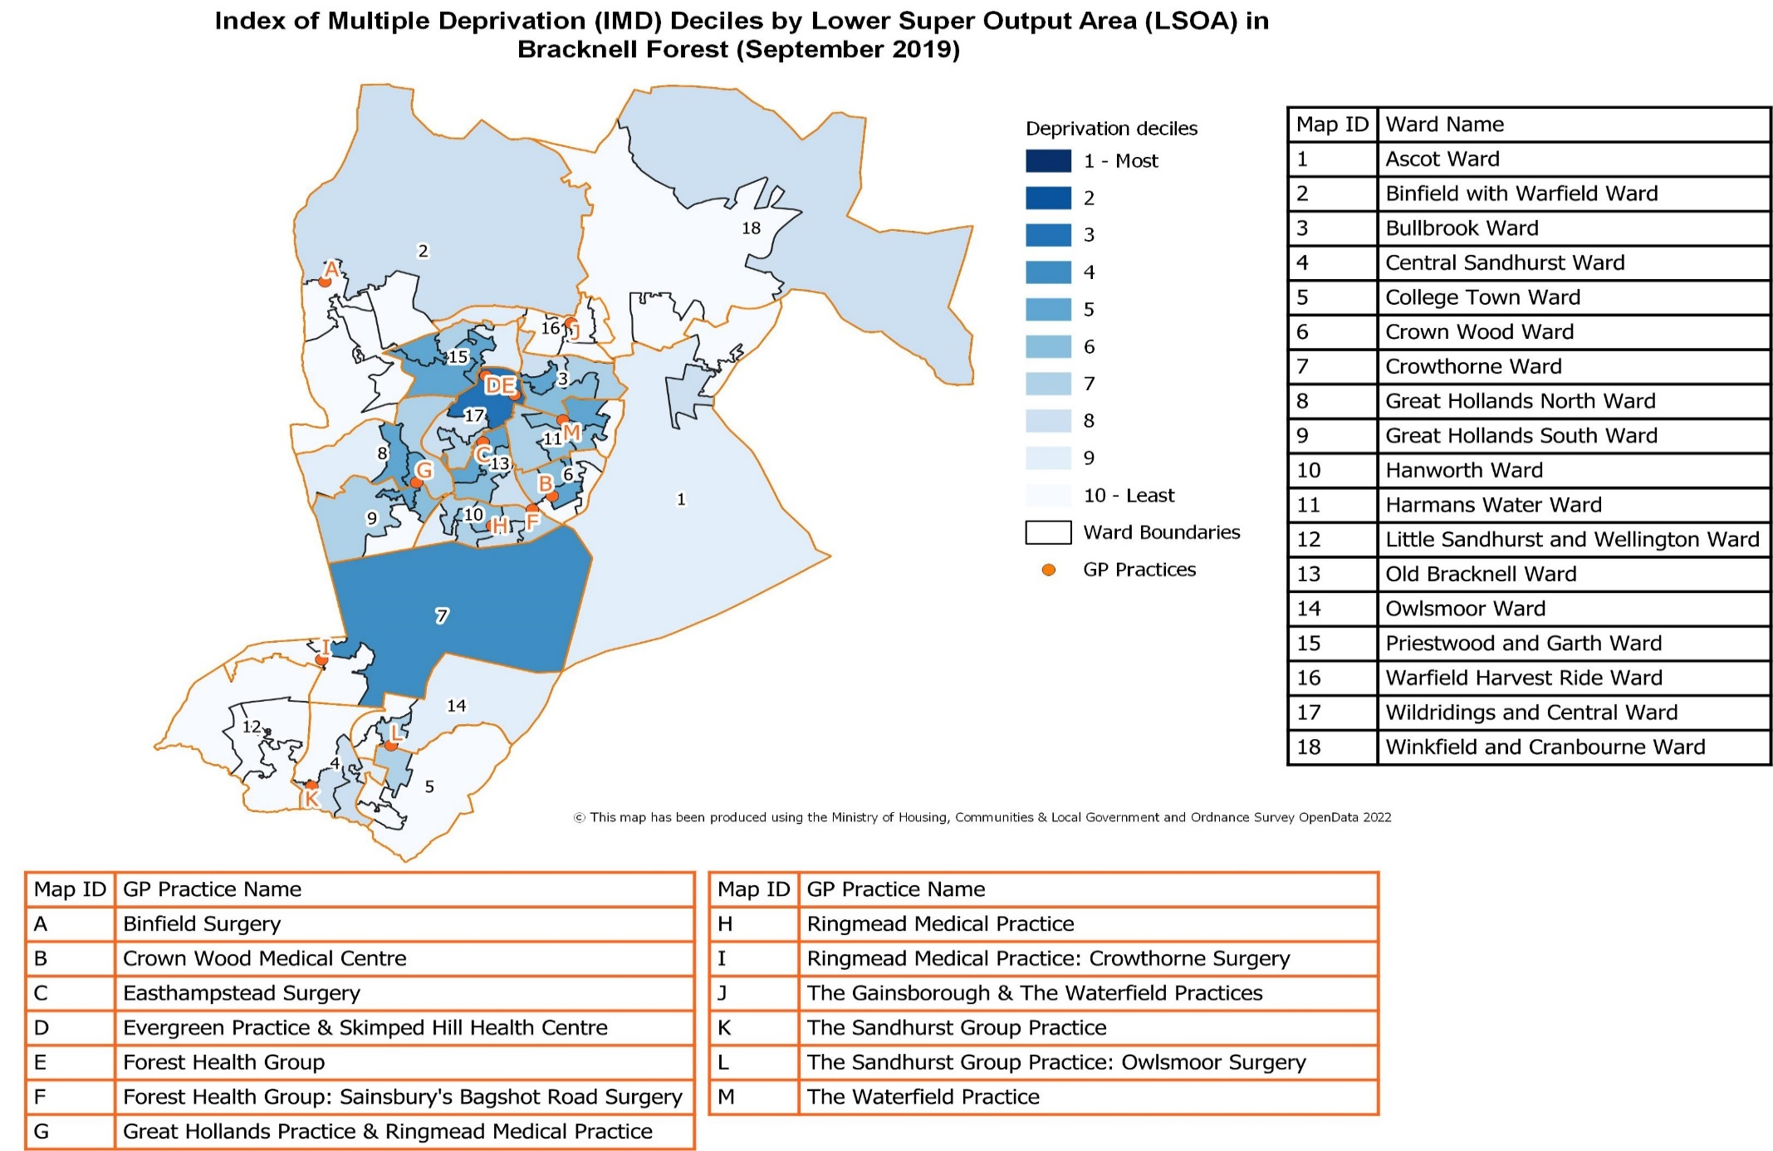
Child Health
Index of Multiple Deprivation (IMD) deciles by Lower Super Output Area (LSOA) in Bracknell Forest (September 2019)

Slide 16
Healthy Weight: Reception
Excess weight in children in reception (2017/18 - 19/20)
20.2% of children in reception (aged 4-5) were classed as having excess weight (including obesity) in Bracknell Forest. This was similar to the South-East (21.2%) and national (22.6%) figures
At ward level, prevalence was highest in children in reception living in Priestwood and Garth (24.4%) and lowest in Little Sandhurst and Wellington (15.0%) wards
8.4% of children in reception were classes as being obese (including severe obesity) in Bracknell Forest, similar to the South-East (8.5%) and lower than the national (9.7%) figures
Obesity in children aged 4-5 was most prevalent in those living in Crowthorne (12.5%) and least prevalent in Warfield Harvest Ride (6.3%) wards.
Prevalence of excess weight and obesity in reception by ward (2017/18 to 2019/20)
Ward | Prevalence of children classed as overweight (including obese) | Prevalence of children classed as obese (including severe obesity)
Ascot | 17.2% | 6.9%
Binfield with Warfield | 22.0% | 10.2%
Bullbrook | 21.9% | 9.4%
Central Sandhurst | 20.0% | 8.0%
College Town | 23.5% | 8.8%
Crown Wood | 22.9% | 10.4%
Crowthorne | 20.8% | 12.5%
Great Hollands North | 19.4% | 7.5%
Great Hollands South | 22.9% | 8.6%
Hanworth | 23.1% | 7.7%
Harmans Water | 19.7% | 8.2%
Little Sandhurst and Wellington | 15.0% | -
Old Bracknell | 20.0% | 10.0%
Owlsmoor | 16.7% | -
Priestwood and Garth | 24.4% | 9.8%
Warfield Harvest Ride | 16.7% | 6.3%
Wildridings and Central | 19.2% | 11.5%
Winkfield and Cranbourne | - | -
Bracknell Forest | 20.2% | 8.4%
England | 22.6% | 9.7%
Source: Office for Health Improvement and Disparities (2022). Local Health Fingertips Profile

Slide 17
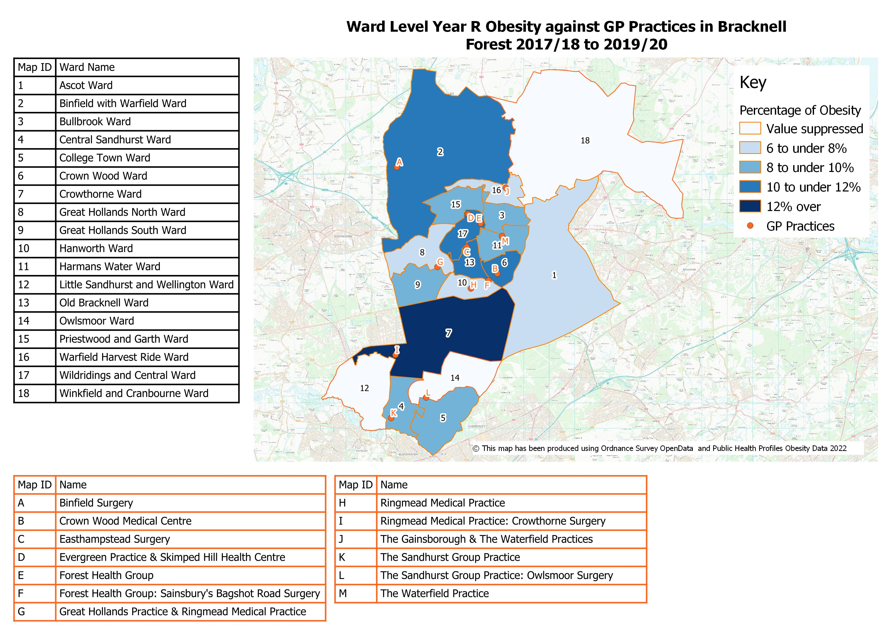
Healthy Weight: Reception
Prevalence of Obesity in Reception at Ward Level in Bracknell Forest against GP practices
(2017/18 -2019/20)

Slide 18
Healthy Weight: Year 6
Excess weight in children in year 6
(2017/18 - 19/20)
31.4% of children in year 6 (aged 10-11) were classed as having excess weight (including obesity) in Bracknell Forest. This was higher than the South-East region rate (30.9%), but lower than the national (34.6%) rate
At ward level, prevalence was highest in children in year 6 living in Wildridings and Central (41.9%) and lowest in Ascot (21.2%) wards
17.6% of children in year 6 were classed as being obese (including severe obesity) in Bracknell Forest, similar to the South-East rate (17.3%) and significantly lower than the national rate (20.4%)
Obesity in children in year 6 was highest in those residing in Wildridings and Central (25.8%) and lowest in Ascot (9.1%) wards.
Prevalence of excess weight and obesity in year 6 by ward (2017/18 to 2019/20)
Ward | Prevalence of children classed as overweight (including obese) | Prevalence of children classed as obese (including severe obesity)
Ascot | 21.2% | 9.1%
Binfield with Warfield | 27.3% | 16.4%
Bullbrook | 29.8% | 17.0%
Central Sandhurst | 37.5% | 15.6%
College Town | 37.9% | 17.2%
Crown Wood | 29.5% | 15.9%
Crowthorne | 28.1% | 15.6%
Great Hollands North | 32.0% | 20.0%
Great Hollands South | 28.9% | 15.8%
Hanworth | 38.2% | 23.6%
Harmans Water | 34.7% | 21.3%
Little Sandhurst and Wellington | 24.2% | 12.1%
Old Bracknell | 31.8% | 22.7%
Owlsmoor | 31.6% | 18.4%
Priestwood and Garth | 31.8% | 16.7%
Warfield Harvest Ride | 27.1% | 13.6%
Wildridings and Central | 41.9% | 25.8%
Winkfield and Cranbourne | 31.8% | 13.6%
Bracknell Forest | 31.4% | 17.6%
England | 34.6% | 20.4%
Source: Office for Health Improvement and Disparities (2022). Local Health Fingertips Profile

Slide 19
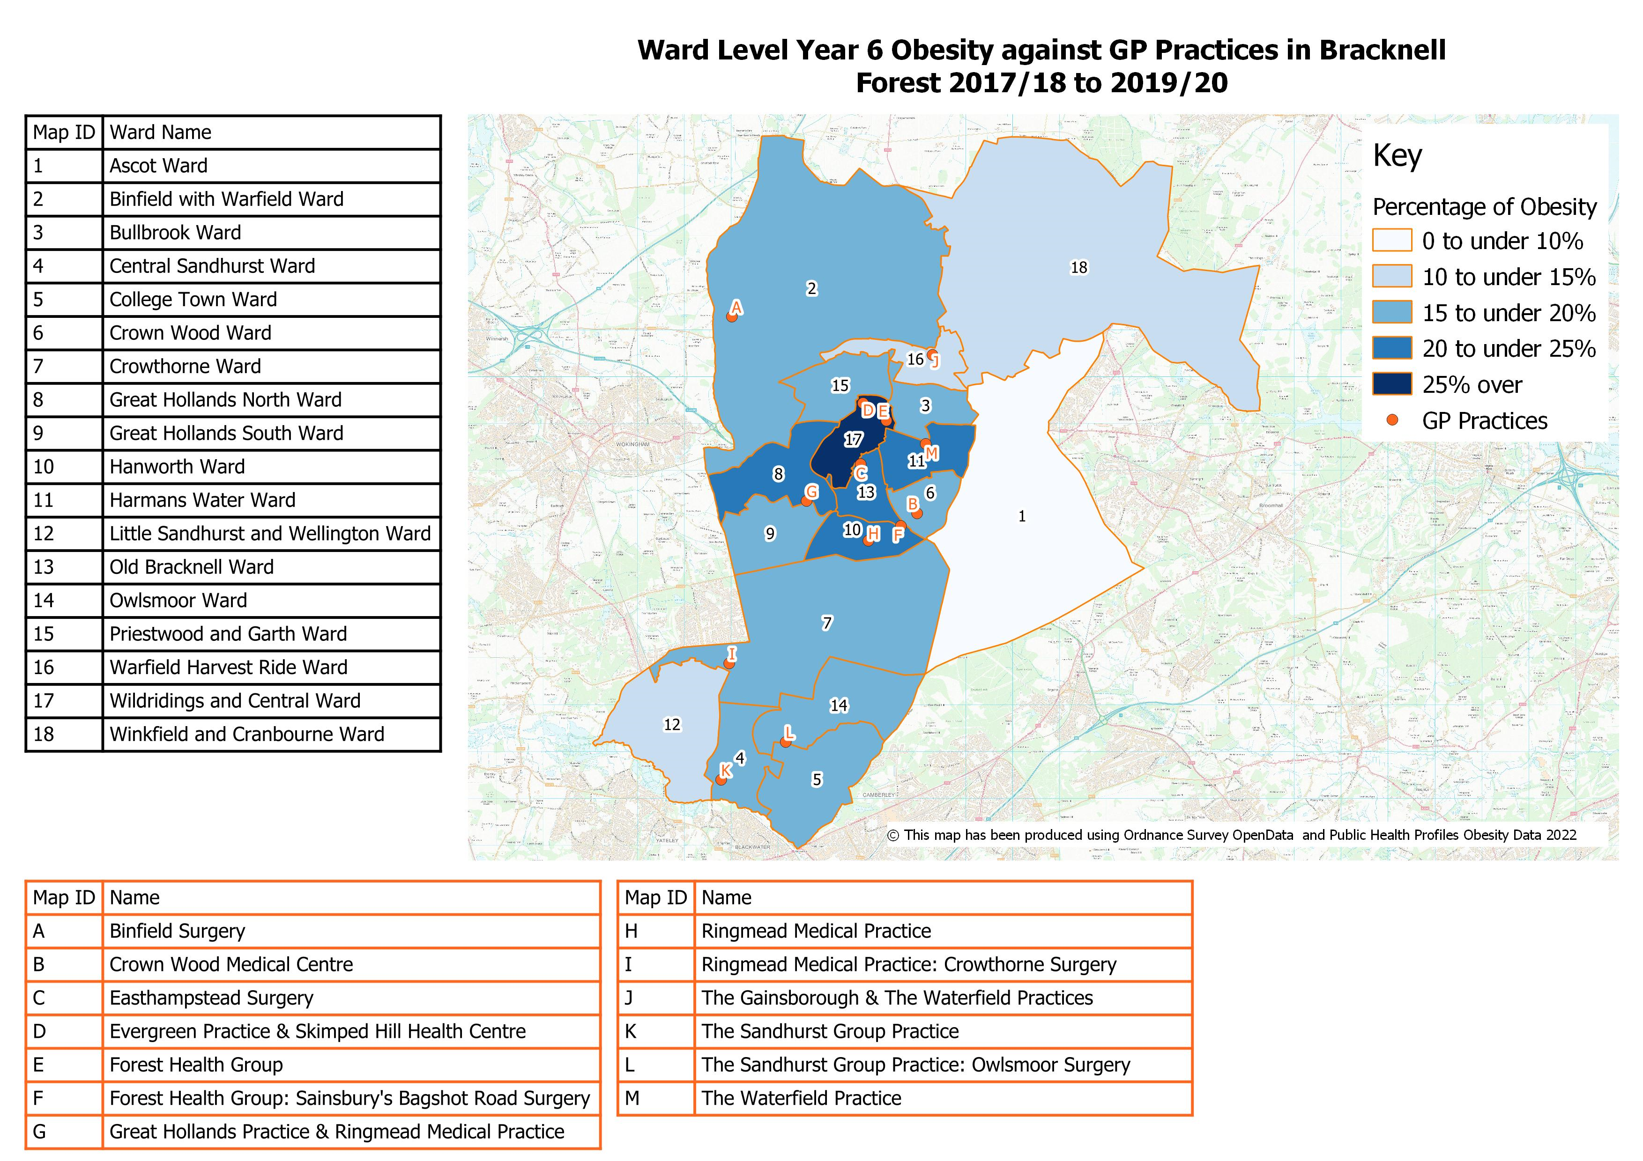
Healthy Weight: Year 6
Prevalence of Obesity in Year 6 at Ward Level in Bracknell Forest against GP practices
(2017/18 -2019/20)

Slide 20
Children in Need
Children in Need
Children are considered to be in need if they are unlikely to reach or maintain a satisfactory level of health or development, their health or development is significantly impaired without the provision of services, or if they are disabled (Children Act 1989; Department of Education 2020)
The rate of children in need in Bracknell Forest has increased from 280.9 to 330.9 per 10,000 population between the years 2013 and 2021. The children in need rate now exceeds the South-East region and national rates
The main primary need group for children in need in Bracknell Forest in 2021 was Abuse or Neglect, in line with regional and national picture
In 2013, Family dysfunction was the main primary need. Since then, a steady decrease for this need group was observed. This is mirrored by a steady increase in the proportion of children for whom abuse or neglect was the primary need.
Source: Department for Education, Characteristics for Children in Need 2021

Slide 21
Children in Need: Child Protection Plan
Child Protection Plan
The rate of children with a child protection plan (CPP) in Bracknell Forest was 64.2 per 10,000 population in 2022. This exceeded the rate for the South-East (40.2) and England (41.4) in 2021
Between 2013 and 2022, CPP rates regionally (South-East) and nationally hovered around 41 per 10,000 population. In contrast, the CPP rate in Bracknell Forest has recently been increasing
At ward level, the rate of children with CPP per 10,000 population varied greatly year to year. Data suppression (<6 CPPs) meant that ward level rates were not available every year
In 2022, CPP ward rates ranged between 25.8 per 10,000 in Great Hollands North and 226.2 per 10,000 in Great Holland South.
Child protection plan at 31st March: Rate per 10,000 population (0-17)
Source: Department for Education, Characteristics for Children in Need 2021

Slide 22
Children in Need: Children Looked After
Children Looked After
The rate of Children Looked After (CLA) in Bracknell Forest was 45.3 per 10,000 population in 2022
The regional (South-East) and national trends between 2013 and 2021 indicate plateauing CLA rates. However, CLA rates in Bracknell Forest have been decreasing since 2019
At Ward level, CLA rates varied due to the small number of children in the borough and data suppression (<6 children) rules mean that rates were not available for every ward
In 2022, Bullbrook (124.1), Old Bracknell (99.9) and Hanworth (73.5) stood out having the highest rates of CLA per 10,000 population
Over the period 2018-2022, these three wards consistently had the highest CLA rates in the borough
There seems to be a relationship between ward deprivation, represented by the IMD score, and CLA rates. The more deprived ward have greater number of children with CLA.
Source: Department for Education, Characteristics for Children in Need 2021

Slide 23
Early Help
Early Help Services
Between 2014 and 2020, the number of families referred to the early help services increased from 30 to 210
The rate of families accessing the service also increased from 0.6 to 4.1 per 1,000 household during the same period
However, the number and rate of families referred and accessing the service decreased by 50% between 2020 and 2021, likely due to pandemic-related restrictions
The most common areas of need for families accessing the service were health (mental and physical) was the primary reason for referral (28%) closely followed by children needing help (from abuse and exploitation) at 26% between 2014 and 2021
The number of families accessing the service for the categories crime, education and children needing help have gradually decreased between 2014 and 2020.
Source: Early Help and Communities, Bracknell Forest Council (2022)

Slide 24
Early Help
Early Help Services
Families accessing the early help services between 2017 and 2021 came from every ward. The greatest proportion resided in the most deprived wards in Bracknell Forest
36.8% of families accessing the service resided in four wards: Wildridings and Central, Priestwood and Garth, Old Bracknell and Bullbrook
The primary areas of need for families referred to the service, at ward level, were health (physical and mental) and children needing help (abuse and exploitation) in almost all of the wards.
Domestic violence was the primary area of need for families living in Binfield and Warfield (23%) with education the primary need for families in College Town (24%)
The proportion of families requiring intensive support ranged between 65% (College Town) and 84% (Crowthorne). Families residing in the most deprived wards were also more likely to require intensive support.
Number and rate of families accessing the early help service (2021)
Source: Early Help and Communities, Bracknell Forest Council (2022)

Slide 25
Mental Health
Prevalence of Mental Health Conditions
The 2017 Mental Health of Children and Young People Survey estimated that nationally 1 in 8 children had at least one mental health disorder when assessed. Specific mental health disorders were grouped into four categories: emotional, behavioural, hyperactive and other less common disorders. Emotional disorders were the most prevalent type (8.1%)
The number of children and young people in Bracknell Forest with mental health disorders, based on modelled estimates using the national figures, was around 3,040 in 2020
At ward level, this ranged between 254 in Little Sandhurst and Wellington and 94 in Winkfield and Cranbourne
The prevalence of mental health conditions in Bracknell Forest has likely risen since the 2017 survey. Hospital admissions for mental health conditions (<18 yrs.) rose from 88.7 to 138.7 per 100,000 population between 2016/17 and 2020/21
This was significantly higher than the South-East (99.4 per 100K) and national (87.5 per 100K) admission rates for 2020/21.
Modelled prevalence of mental health disorders in children and young people (5-19) in Bracknell Forest (mid-2020)
Ward | Number of children and young people
Little Sandhurst and Wellington | 254
Harmans Water | 242
Great Hollands North | 237
Binfield with Warfield | 233
Priestwood and Garth | 211
Warfield Harvest Ride | 210
Hanworth | 186
Ascot | 169
Old Bracknell | 161
Bullbrook | 153
Crown Wood | 150
Crowthorne | 138
Great Hollands South | 128
Wildridings and Central | 124
Owlsmoor | 123
College Town | 118
Central Sandhurst | 110
Winkfield and Cranbourne | 94
Bracknell Forest | 3,040
Source: Office for Health Improvement and Disparities (2022). Child and Maternal Health Profile

Slide 26
Mental Health
CAMHS and Neurodiversity (ND) referrals
The Child and Adolescent Mental Health Services (CAMHS) is an NHS service that assesses and treats young people with emotional, behavioural or mental health difficulties.
In the period covering June 2021 and May 2022 there were a total of 1,375 children and young people in Bracknell Forest referred to the CAMHS (878) and ND (497) and service.
There were overall more referrals for female (54%) than male clients for both services. Almost 1 in every 2 referrals (46.3%) for the services were for children aged 11 to 15 with a third of referrals (34.2%)for children aged 6-10.
66% of referrals with ethnicity data were for white clients. BAME referrals represented on 6.5%. Of note is that 27% of referrals did not include ethnicity.
The primary source of referral were GP practices (34.8%) and Education Services (29.7%). The primary reasons for referral were Anxiety (33.6%), Self-harm behaviours (23.8%) and Depression.
Source: Berkshire Healthcare Foundation Trust (2022)

Slide 27
Mental Health
CAMHS and Neurodiversity (ND) referrals
At ward level, for the period July 2021 to August 2022, the greatest number of children referred to the CAMHS and ND services lived in Harmans Water (10.3%), Hanworth (9.7%) and Priestwood and Garth (9.3%)
The rate of referral to these was highest for residents in Hanworth at 72.5 per 1,000 population and lowest in Little Sandhurst and Wellington at 15.8 per 1,000 population
The data indicates that the referral rate is highest for children and young people living in wards with greater childhood deprivation, associated with poor mental health
The proportion of patients referred to the services was similar between the three PCNs in Bracknell Forest, the rate of referral per 1,000 patients ranged between 47.2 (The Health Triangle) and 60.6 (Braccan Health Network)
At GP practice level, the rate of referrals ranged between 31.7 per 1,000 patients (Binfield Surgery) and 68.9 per 1,000 patients (The Waterfield Practice).
Estimated rate of referrals to CAMHS and ND for Bracknell Forest residents aged under 18, by Ward (2021-22)
Ward | IDACI | Rate per 1,000 population (0-17)
Hanworth | 12.1 | 72.5
Great Hollands South | 13.1 | 66.2
Priestwood and Garth | 14.8 | 65.0
Owlsmoor | 5.9 | 59.6
Harmans Water | 12.7 | 58.5
Great Hollands North | 14.0 | 53.4
Old Bracknell | 13.5 | 53.3
Wildridings and Central | 12.7 | 51.3
Bullbrook | 11.8 | 46.9
Ascot | 3.3 | 45.5
Central Sandhurst | 6.6 | 43.4
College Town | 5.8 | 39.2
Crowthorne | 5.5 | 39.1
Crown Wood | 8.7 | 37.9
Warfield Harvest Ride | 3.8 | 35.8
Binfield with Warfield | 3.7 | 34.7
Winkfield and Cranbourne | 3.4 | 34.3
Little Sandhurst and Wellington | 2.6 | 15.8
Bracknell Forest | 8.9 | 47.5
Source: Berkshire Healthcare Foundation Trust (2022)

Slide 28
Mental Health
Children Looked After
The Strengths and Difficulties Questionnaire (SDQ) is a short behavioural screening questionnaire for children aged 5 to 16
The questionnaire is widely used to assess children’s mental health, and in various settings including clinical assessments
The proportion of children looked after with SDQ scores that are of concern was 58% in 2021, significantly higher than the regional (South-East) and national figures
Between 2018 and 2021, SDQ scores indicating cause for concerns increased from 48% to 58%. Conversely, both regional and national averages indicate a decreasing trend
Possible reason: Bracknell Forest has a higher completion rate for SDQ (92%) compared with South-East (74%) and England (80%).
Source: Department for Education, Characteristics for Children in Need 2021

Slide 29
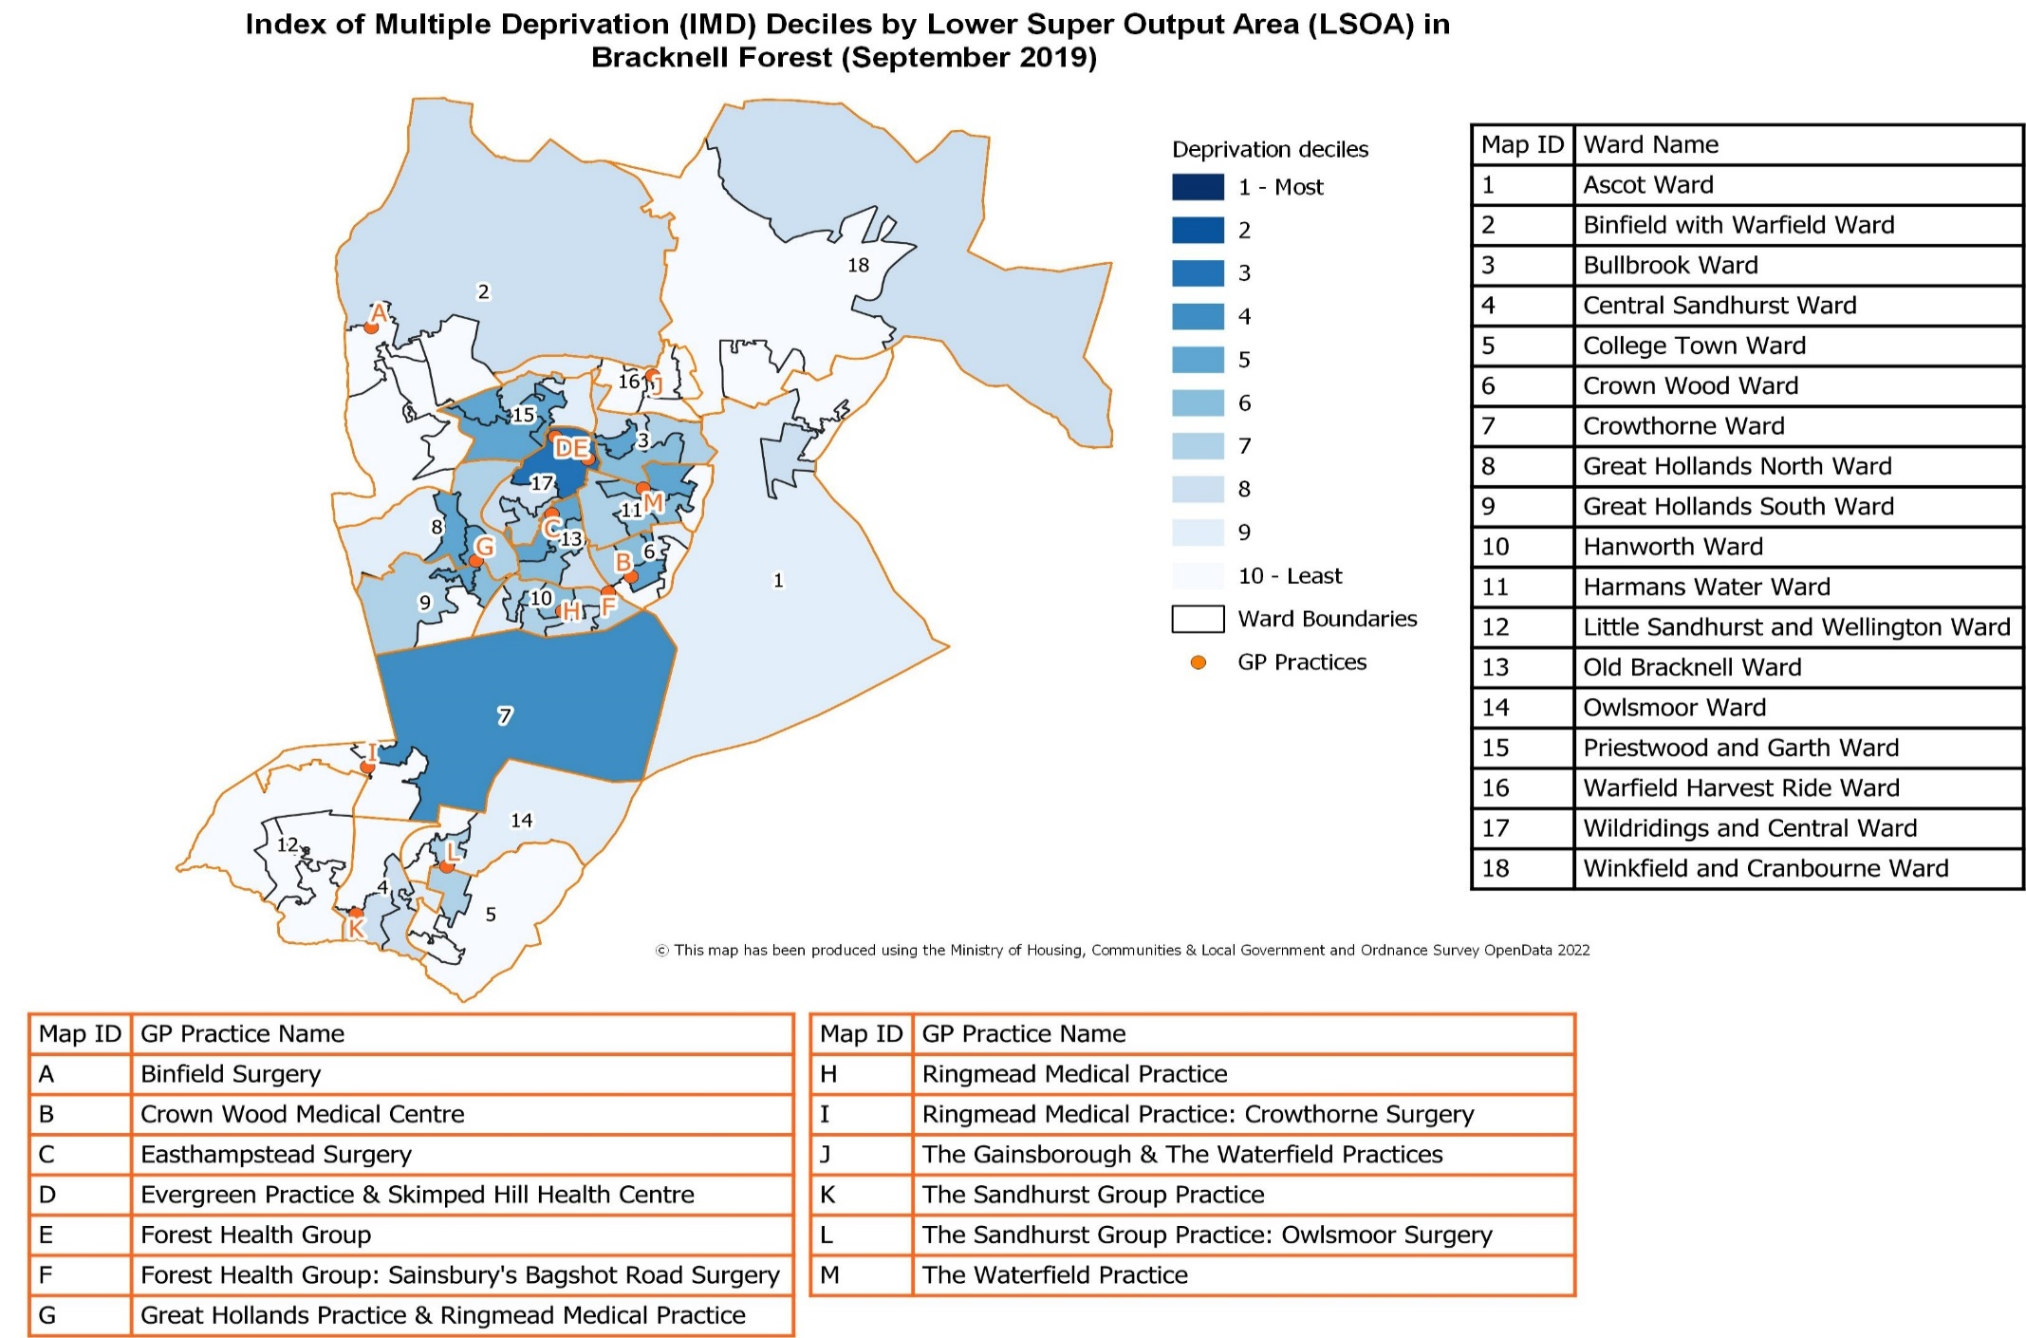
Mental Health
Index of Multiple Deprivation (IMD) Deciles by Lower Super Output Area (LSOA) in Bracknell Forest (September 2019)

Slide 30
Health Visiting
Health Visiting
Antenatal health promoting visits are carried out by the health visiting service between 28 and 32 weeks into pregnancy. In 2021/22, 87.3% of eligible women were invited for a visit, with another 11.4 % receiving an Antenatal health review
All infants and their families are eligible to receive a visit lead by a health visits with the first 14 days from birth – known as a New Birth visit (NBV). In 2021/22, 99.2% of infants received a NBV. This was up from 93.4% in 2020/21
The 6 to 8 week health review is an opportunity to support mother with breastfeeding, assess her mental health and to ensure the mother has had a six-week postnatal check. 97.9% of mothers living in the borough had a 6 to 8 week review, up from 91.0% in 2020/21
Around 90% of infants received a health review at 12 months (90.9%) and 15 months (89.9%) in 2021/2022
All children and families are expected to receive a review when the child reaches 2 to 2^{1/2} years allowing for an integrated review of the health and development. In 2021/22, 82.3% of children received a 2 to 2^{1/2} year review, up considerably from 2020/21 (57.1%).
Source: Berkshire Healthcare Foundation Trust, Health Visiting data for Bracknell Forest (2021/22)

Slide 31
Health Visiting
Health visiting and reviews conducted in Bracknell Forest, by ward (2021/22)
Source: Berkshire Healthcare Foundation Trust (2021/22); Health Visiting data for Bracknell Forest

Slide 32
Health Visiting
Breastfeeding prevalence in Bracknell Forest
Breastfeeding of infants (at 6-8 weeks) is an important indicator for future health outcomes. Health benefits associated with breastfeeding include reduced hospitalisation for diarrhoea and respiratory infections and lower levels of childhood obesity (Quigley 2007; Ma 2020)
Current national guidance recommend exclusive breastfeeding for the first six months of infancy (NICE)
The prevalence of breastfeeding (partial or total) of infants in Bracknell is trending upwards from 52.4% (2015/16) to 58.6% (2020/21). This was consistently better than the national average during the same period of time
The prevalence of breastfeeding in 2021/22 was 57.5%. There was no significant difference in the prevalence of breastfeeding between infants registered at the children’s centres in Bracknell Forest.
Source: Berkshire Healthcare Foundation Trust, Health Visiting data for Bracknell Forest (2021/22)

Slide 33
Health Visiting
Prevalence of breastfeeding in Bracknell Forest, by Ward (2021/22)
Source: Berkshire Healthcare Foundation Trust, Health Visiting data for Bracknell Forest (2021/22)

Slide 34
Health Visiting
Ages and Stages Questionnaire 3
Since 2015, all children in England became eligible for a Healthy Child Programme development review around the time of their 2nd birthday, which is delivered as part of the universal health visitor service
Health visiting teams use the Ages and Stages Questionnaire (ASQ-3) as part of the 2 to 2 ½ year review. ASQ-3 provides an objective measure of development and allows comparisons to be made helping to identify children who are not developing as expected and supporting decisions on closer monitoring of progress or early intervention services
Domains of development which are tested include communication, gross motor, fine motor, problem solving and personal-social skills
The proportion of children at, or above the expected level in all five domains gives an indicator of the proportion of children who are developing as expected at age 2 to 2 ½.
Source: Berkshire Healthcare Foundation Trust, Health Visiting data for Bracknell Forest (2021/22)

Slide 35
Health Visiting: Ages and Stages Questionnaire 3
ASQ-3: Proportion of children exceeding the threshold for each developmental area by children’s centre in Bracknell Forest (2021/22)
Children's centre | Communication above the threshold | Gross Motor above the threshold | Fine Motor above the threshold | Problem Solving above the threshold | Personal/Social above the threshold
Alders and Chestnuts | 93% | 98% | 98% | 97% | 96%
Oaks and Hollies | 93% | 100% | 98% | 97% | 97%
Rowans and Sycamores | 94% | 99% | 99% | 99% | 98%
Willows and Maples | 92% | 97% | 97% | 96% | 95%
Bracknell Forest | 93% | 98% | 98% | 98% | 96%
Source: Berkshire Healthcare Foundation Trust, Health Visiting data for Bracknell Forest (2021/22)

Slide 36
Health Visiting: Ages and Stages Questionnaire 3
ASQ-3: Proportion of children with developmental areas below the threshold by developmental area and children’s centre in Bracknell Forest (2021/22)
ASQ-3: Proportion of children monitored or referred after assessment by developmental area and children’s centre in Bracknell Forest (2021/22)
Source: Berkshire Healthcare Foundation Trust, Health Visiting data for Bracknell Forest (2021/22)

Slide 37
Health Visiting: Ages and Stages Questionnaire 3
ASQ-3: Proportion of children with developmental areas above the threshold, by ward (2021/22)
Source: Berkshire Healthcare Foundation Trust, Health Visiting data for Bracknell Forest (2021/22)

