Slide 1
Bracknell Forest Census 2021 Analysis
Demographics, Household Characteristics and Socioeconomics

Slide 2
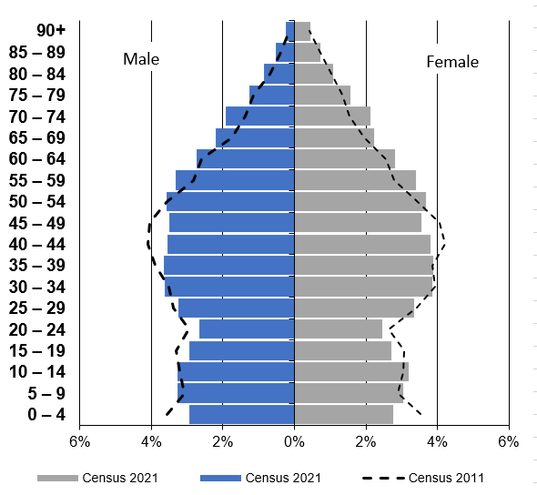
Population
Bracknell Forest had a total population of 124,608 recorded in 2021 census, an increase of 10.1% from 113,205 in 2011 - This was higher than the percentage increase of 7.5% in the South East and 6.6% in England during the same period (Table 1).
The CYP population during the same period increased by 3.6% (29,085 to 30,134). However, there was a decrease in the proportionate age distribution for the CYP population, from 25.7% in 2011 to 24.2% in 2021, due to a much higher increase in the older age groups (Table 2).
Population pyramid: Bracknell Forest 2021 vs Census 2011
Table 1: Local, regional and national CYP population in 2021
Table 2: CYP population in 2011 and 2021
Quinary Age Bands | Bracknell Forest | South East | England
0 ‒ 4 | 5.7% | 5.3% | 5.4%
5 ‒ 9 | 6.3% | 6.0% | 5.9%
10 ‒ 14 | 6.5% | 6.1% | 6.0%
15 ‒ 19 | 5.7% | 5.6% | 5.7%
Total | 24.2% | 23.1% | 23.1%
Quinary Age Bands | Census 2021 | Census 2011 | % Change in Population
0 ‒ 4 | 7,120 | 8,027 | -11.3%
5 ‒ 9 | 7,862 | 6,745 | 16.6%
10 ‒ 14 | 8,080 | 7,082 | 14.1%
15 ‒ 19 | 7,072 | 7,231 | -2.2%
Total | 30,134 | 29,085 | 3.6%
Source: ONS Census 2021, Age at single year

Slide 3
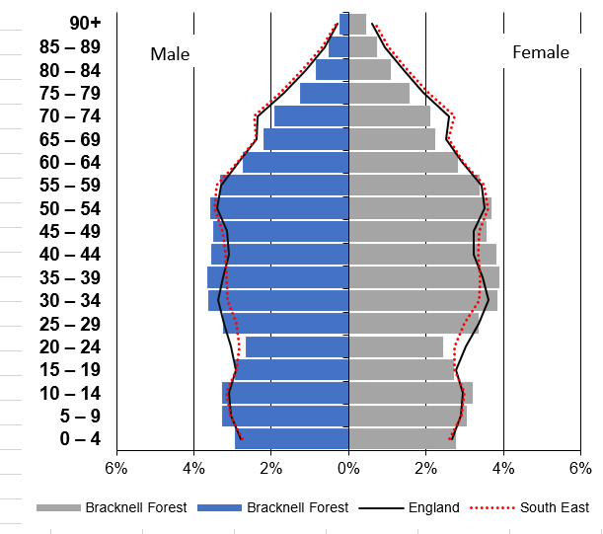
Age structure of Bracknell Forest, the South-East and England (2021)
Population pyramid for Bracknell Forest, the South-East and England, 2021
Bracknell Forest had a higher proportion of children in the 0-14 year age groups (18.5%) and the 30-59 year age groups (43.4%), for both females and males.
Bracknell Forest has a younger population profile than the South East and England.
Source: ONS Census 2021, Age at single year

Slide 4
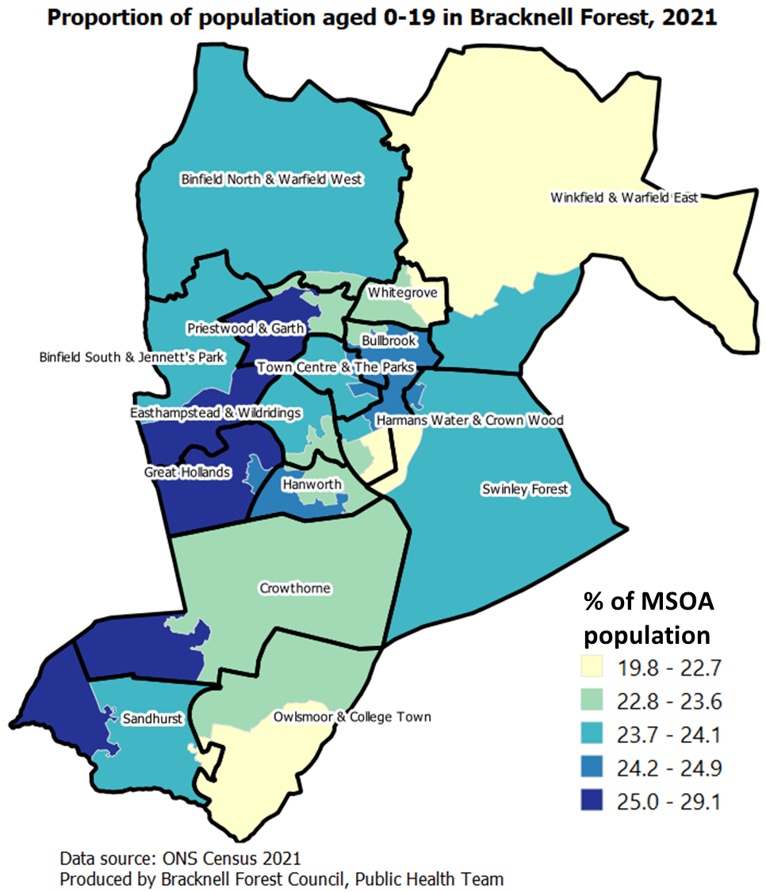
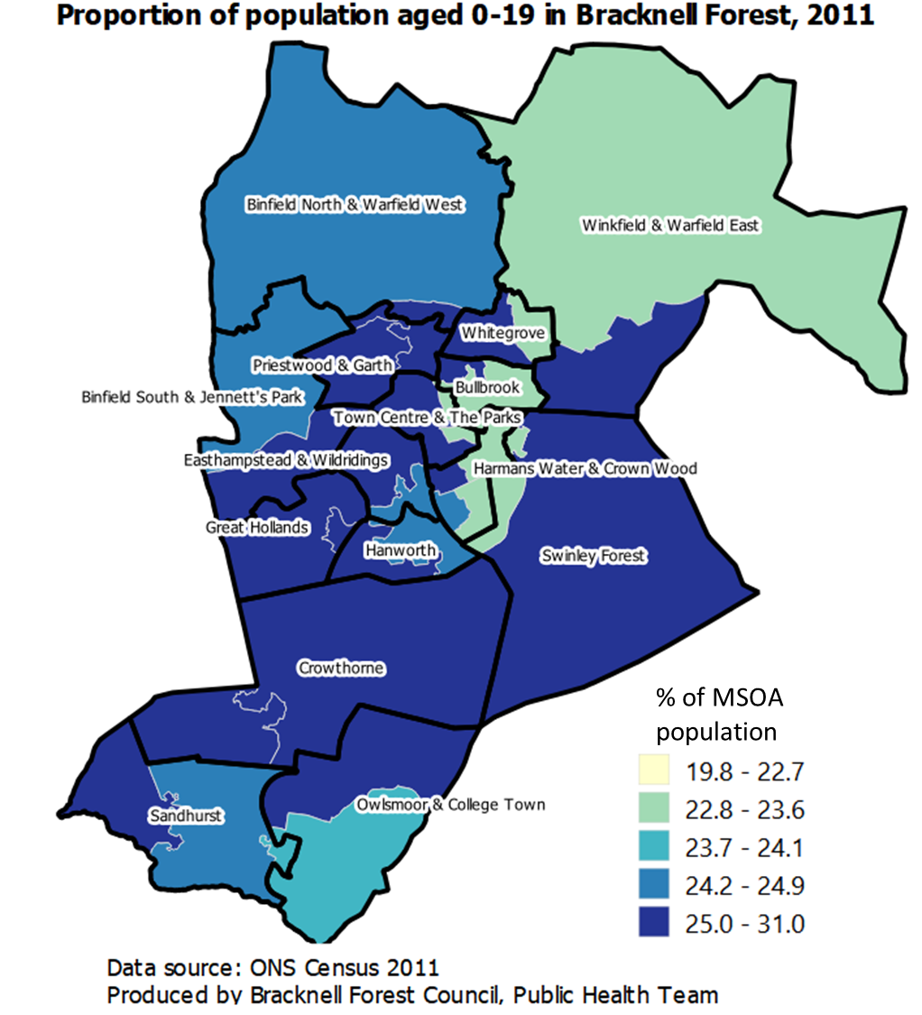
Distribution of population aged 0-19 in Bracknell Forest, 2021 and 2011
Middle Super Output Areas (MSOAs) with highest proportion of young population aged 0-19 are located in the western parts of Bracknell Forest.
Compared with 2011, there are fewer MSOA where 0-19 age group makes 25% (and over) of the population.
Source: ONS Census 2021, Age at single year

Slide 5
Population aged 50 and over
Bracknell Forest population is ageing. Residents aged 50 and over were 43,225 and represented 34.7% of the population in 2021 representing a 4.4% increase in population share from 30.2% (34,238) in 2011.
The most significant increases were in the 55-59 age group, up from 5.6% to 6.7%, and the 70-74 age group, up from 2.9% to 4.0%.
Compared with the regional and national comparators, the 50 and over population still comprised a smaller share of the total population than the South-East (39.3%) and England (37.8%).
Notably, the population aged 50 and over grew at a faster rate between the two census dates in Bracknell Forest than the South-East and England.
Proportion of population aged 50 and over in Bracknell Forest, 2021 and 2011
Proportion of population aged 50 and over in Bracknell Forest, South-East region and England, 2021 and 2011
Source: ONS Census 2021, Age at single year

Slide 6
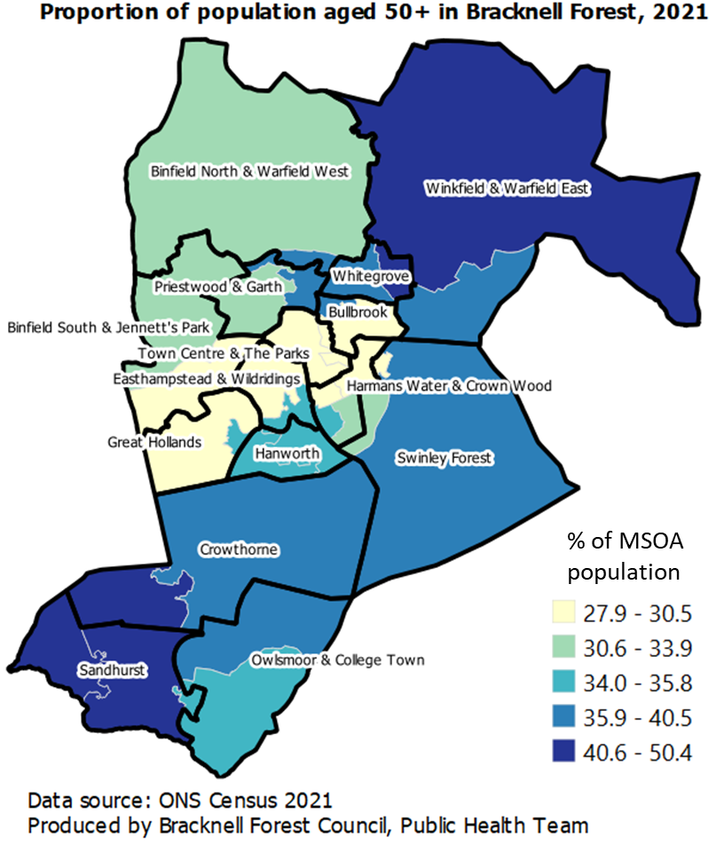
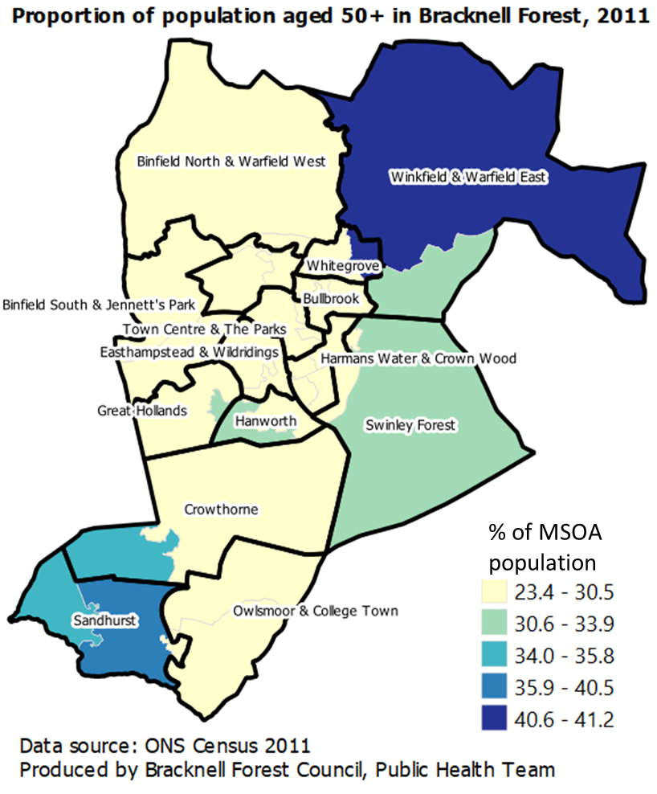
Distribution of population aged 50 and over in Bracknell Forest, 2021 and 2011
Most MSOAs had an increase in population aged 50 and over in 2021 census, compared to 2011 census, especially MSOAs which had proportion of 50+ population under 30.6% in 2011.
Source: ONS Census 2021, Age at single year

Slide 7
Ethnicity
Residents identifying themselves as White-British (96,950) remain the largest ethnic group in Bracknell Forest, up 1% from 2011.
Although the number of White-British residents has increased since 2011, the proportion of residents belonging to this ethnic group is down from 84.9% in 2011 to 77.8% in 2021.
The largest ethnic minority group was White-Non-British (10,319), up 37% from 2011. The proportion of Bracknell Forest residents belonging to this group was 8.3%, which is up from 5.7% in 2011. This was primarily driven by an increase in the White-other ethnic group, up 40% since 2011.
The number of Black, Asian, and Minority Ethnic (BAME) residents is up 38.6% from 2011. BAME residents comprised 13.9% of the total population in 2021, up from 9.4% in 2011.
The proportion of White-other and mixed-multiple ethnic groups in Bracknell Forest were slightly greater than the regional and national averages.
Table 3: Changes in the ethnic make-up of Bracknell Forest: Census 2021 vs 2011
Ethnic Categories | Census 2021 | Census 2011 | % Increase in population
Asian or Asian-British | 8,879 | 5,664 | 56.8%
Black or Black-British | 2,993 | 2,189 | 36.7%
Mixed or Multiple Ethnic | 3,843 | 2,303 | 66.9%
White-British | 96,950 | 96,080 | 0.9%
White-non-British | 10,319 | 6,474 | 59.4%
Other Ethnic group | 1,621 | 495 | 227.5%
Table 4: Ethnic make-up of Bracknell Forest, as share of the population, in 2021 compared with South-East and England
Ethnic Categories | Bracknell Forest | South East Region | England
Asian or Asian-British | 7.1% | 7.0% | 9.6%
Black or Black-British | 2.4% | 2.4% | 4.2%
Mixed or Multiple Ethnic | 3.1% | 2.8% | 3.0%
White-British | 77.8% | 78.8% | 73.5%
White-non-British | 8.3% | 7.5% | 7.5%
Other Ethnic group | 1.3% | 1.5% | 2.2%
Source: ONS Census 2021, Ethnic Group

Slide 8
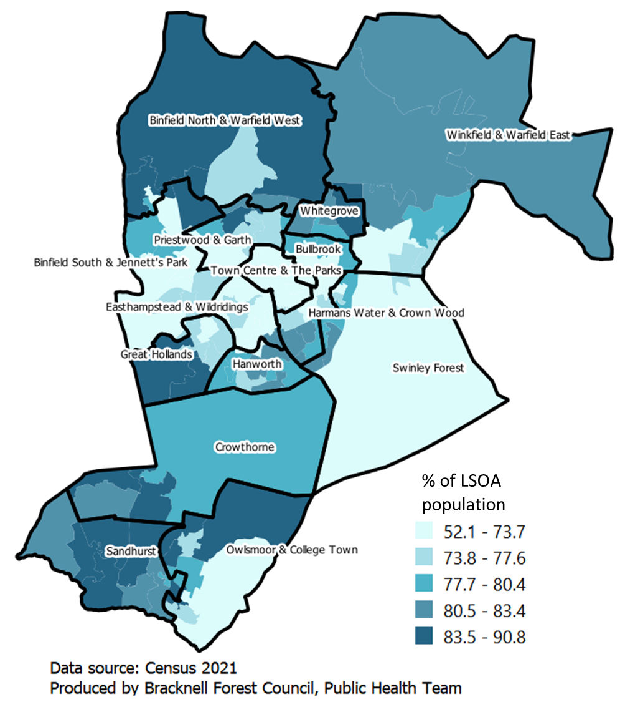
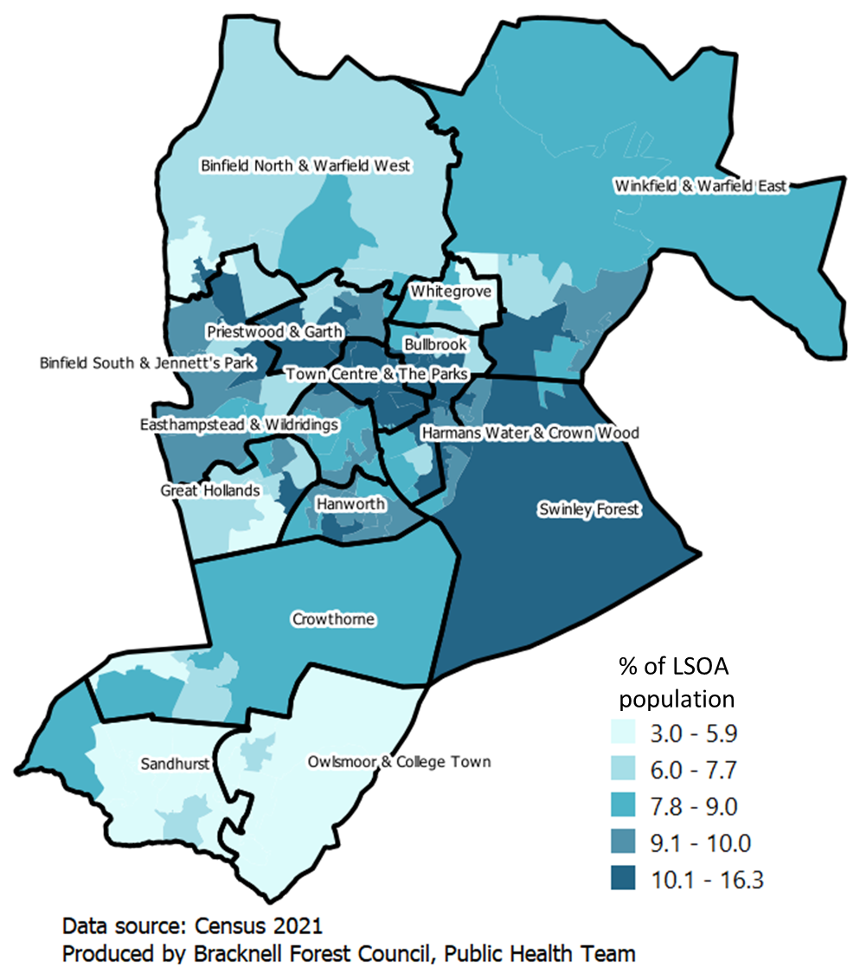
Distribution of White (UK) and White-other ethnic groups
In 2021, Lower Super Output Areas (LSOAs) with highest proportion of
White population (from UK) were located in the southern and the northern parts of Bracknell Forest.
Other White ethnic groups were located in Swinley Forest ward and in the central parts of Bracknell Forest
White ethnic group (English, Welsh, Scottish, Northern Irish or British)
White-Other ethnic group
Source: ONS Census 2021, Ethnic Group

Slide 9
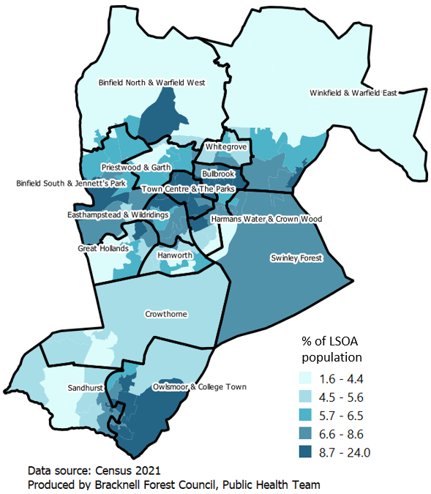
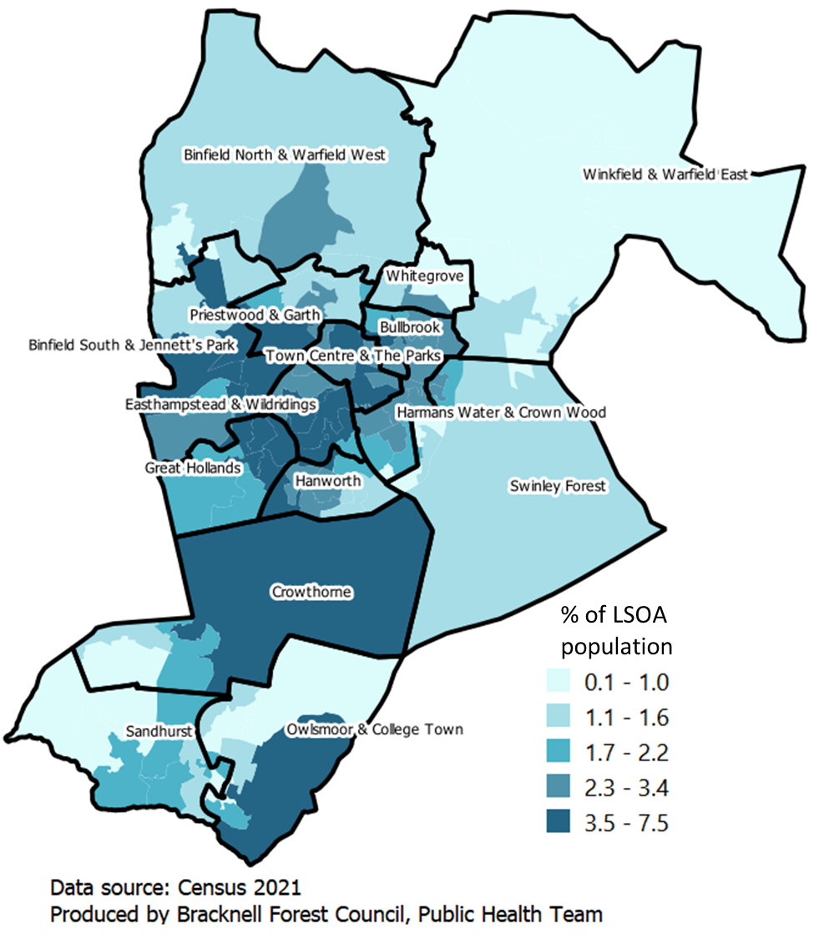
Distribution of Asian and Black ethnic groups
LSOAs with highest proportion of
Asian ethnic population were located in the central part of Bracknell Forest
Black ethnic population were located in central and southern parts of Bracknell Forest
Asian ethnic group
Black ethnic group
Source: ONS Census 2021, Ethnic Group

Slide 10
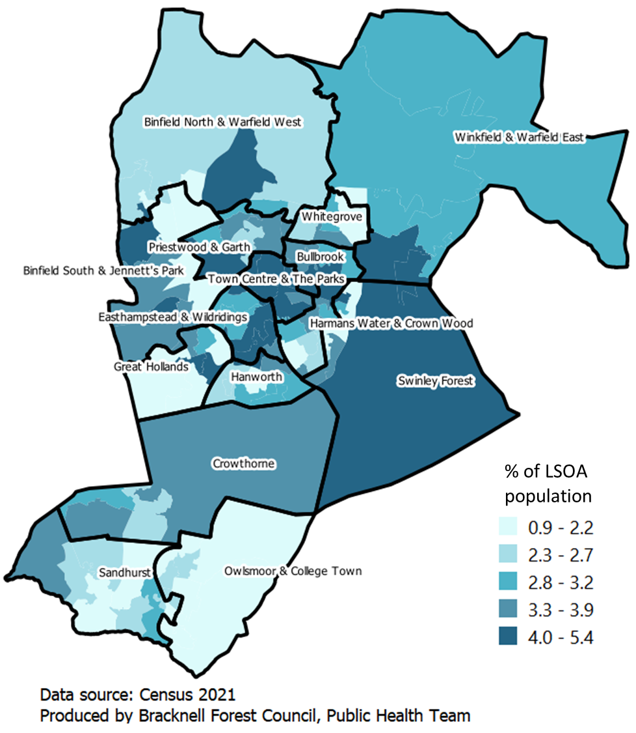
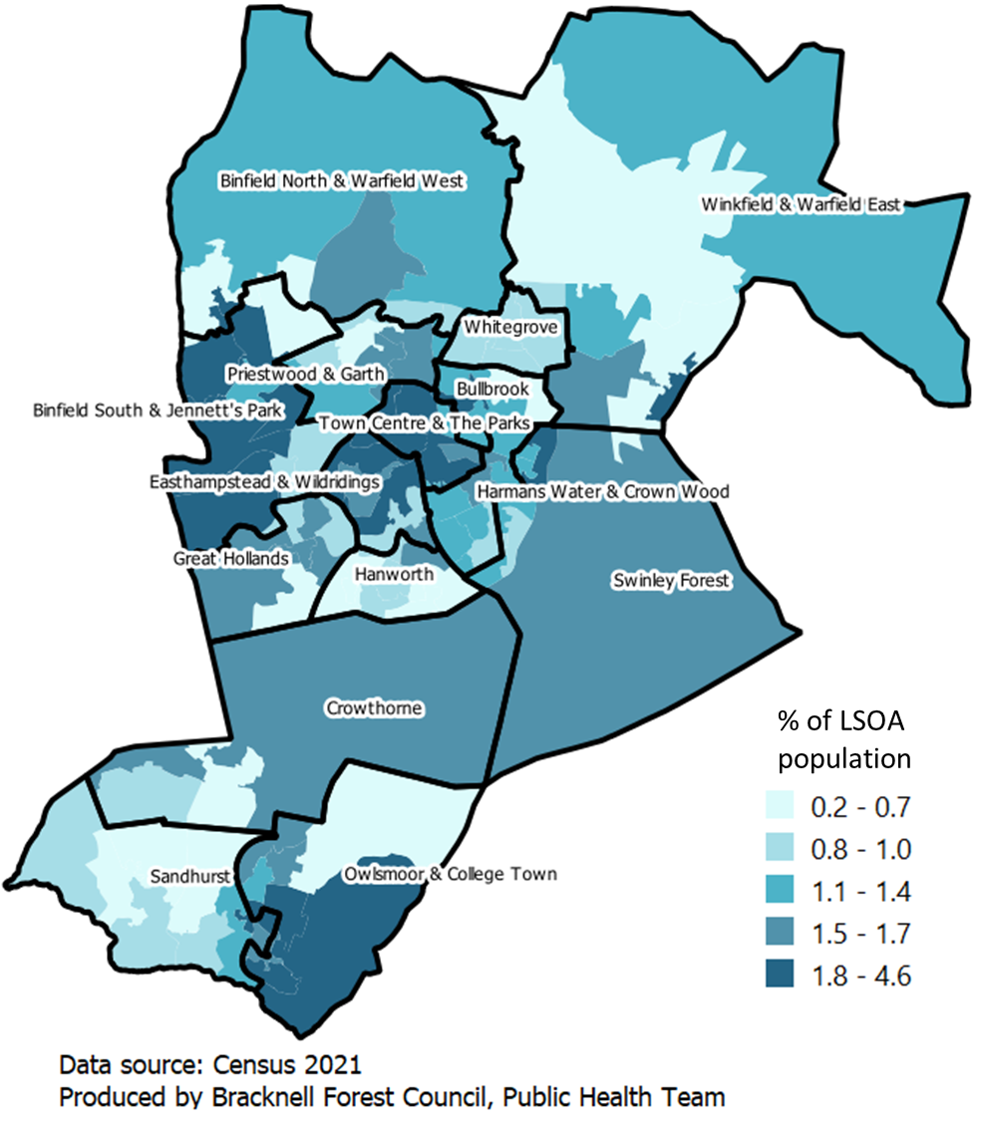
Distribution of Mixed and Other ethnic groups
LSOAs with highest proportion of
Mixed ethnic population were located in the central parts of Bracknell Forest and in Swinley Forest ward.
Other ethnic population were located in Swinley Forest ward and in the central parts of Bracknell Forest.
Mixed ethnic group
Other ethnic groups
Source: ONS Census 2021, Ethnic Group

Slide 11
Country of Birth
England was the country of birth for 79.9% (99,622) of the Bracknell Forest population in 2021, down from 83.4% in 2011. This was almost similar to the regional (81.7%) and national (80.3%) averages.
The second most common country of birth in Bracknell Forest in 2021 was India (1,921; 1.5%), followed by Scotland (1,617; 1.3%).
Other countries of birth where notable numbers of residents were recorded were Poland (1,567 ;1.3%), South Africa (1,476; 1.2%), Wales (1,310; 1.1%) and Romania (1,013, 0.8%).
At regional and national level, there were decreases in the proportion of residents born in England, Scotland and Wales with similar increases seen in the number of residents born in India, Poland and Romania.
Changes in the proportion of resident country of birth as share of the total population in Bracknell Forest, South East region and England (2011 to 2021)
Source: ONS Census 2021, Country of Birth

Slide 12
Nationality
Passports held by residents serves as a proxy for nationality rather than national identity. In 2021, 80.9% of the Bracknell Forest population were UK nationals, up from 80.3% from 2011. This is similar to South-East region (79.6%) and slightly higher than the national average (76.6%) in 2021.
Residents holding Polish (1,508) and Romanian (1,206) nationalities represented 1.2% and 1.0% of the Bracknell Forest population, respectively. The number of residents with Romanian nationality increased ten-fold between 2011 (118) and 2022 (1,206).
9.0% of Bracknell Forest residents did not hold a passport in 2021, down from 11.9% in 2011. The proportion of non-passport holders in 2021 was higher in the South-East region (11.3%) and England (13.2%).
Changes in the proportion of resident nationality between the 2011 and 20222 census for Bracknell Forest, South East region and England
Source: ONS Census 2021, Passports held

Slide 13
Religion
One of the key insights from the 2021 census is the increase in the number of people, both locally and nationally, no longer affiliated with any religion. 50,300 residents reported to not follow any religion in 2021 compared with 32,184 residents in 2011, this represents a 36.0% increase.
As a share of the total population, 40.5% of all residents do not follow any religion in 2021, up from 28.4% in 2011. Significant increases in the ‘non religious’ population were also seen in the South-East (36.0%) and England (37.0%) between 2011 and 2021.
The number of residents identifying as Christians in Bracknell Forest decreased by 13.7%, from 68,524 to 59,141, between 2011 and 2021. For the first time, residents identifying as Christians in Bracknell Forest represented less than half of the population (47.5%) in 2021, down from 60.5% in 2011.
The decrease in the number of people affiliating with Christianity is not isolated to Bracknell Forest. Christians represent only 46.5% of the South-East population (down from 59.8% in 2011) and 46.3% of the England population (down from 59.4% from 2011).
Although they only represent 4.2% of the total population, there were also notable increases in residents affiliated with Islam (2,216, up 73.7%) and Hinduism (2,942, up 61.3%) between 2011 and 2021
Changes in resident religious affiliation for Bracknell Forest, South East region and England (2011 to 2021)
Source: ONS Census 2021, Household composition

Slide 14
Household composition
There were a total of 50,244 households in Bracknell Forest in 2021, up 9.5% (4,366) from 2011.
There are three main categories of households: one person (13,462, single family (33,651) and multiple-family (3,131). The proportion of households belonging to one of these three categories has not substantially changed (<1%) at local, regional and national level, between 2011 and 2021.
Single family households are the most common household type in Bracknell Forest, comprising 67.0% of all households. It was also the most common household type in the South-East region (65.0%) and in England (63.0%).
26.8% of households in Bracknell Forest were one person household. This was lower than the South-East region (28.4%) and England (30.1%).
Multiple-family household comprised just 6.2% of households in Bracknell Forest in 2021, similar to the regional (6.6%) and national averages (6.9%)
A more detailed breakdown of the household types and changes between 2011 and 2021 can be found in the appendices.
Household composition in Bracknell Forest, South-East Region and England in 2021
Source: ONS Census 2021, Household composition

Slide 15
Household composition (with dependents)
Households with at least one dependent (16,011) comprise 31.9% of all households in Bracknell Forest in 2021, down from 32.6% in 2011. This was higher than the South-East (29.1%) and England (28.5%) averages for 2021. This is explained by the younger population in Bracknell Forest compared to South-East and England.
In terms of household types, between 2011 and 2021, there was a 1.2% decrease in the proportion of married and civil partnership families (with dependents), with corresponding increase in co-habiting households. Although there was also a decrease in lone parent families, this type of household still constitutes the second most common type of household with at least one dependent. The household type ‘multi-family households’ first appeared in the 2021 census, accounting for 2.5% of all households.
Regional (South-East) and national (England) trends show similar overall decreases in the households with dependents between 2011 and 2021 with co-habiting couple families increasing.
Proportion of household with at least one dependent in Bracknell Forest by household type (2011 vs 2021)
Proportion of households with at least one dependent in Bracknell Forest, South-East and England by household type (2021)
Source: ONS Census 2021, Household composition

Slide 16
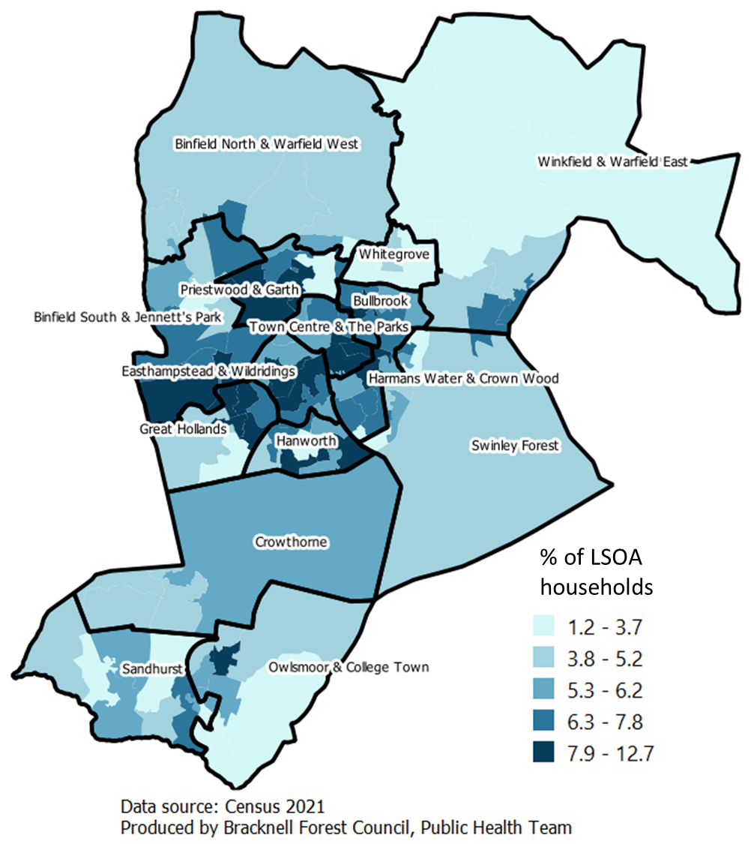
Households Composition
Most LSOAs in the central parts of Bracknell Forest had highest proportion of households with at least one dependent and also lone parent households with dependents.
Proportion of households with at least one dependent in Bracknell Forest, 2021
Proportion of lone parent households with dependents in Bracknell Forest, 2021
Source: ONS Census 2021, Household composition

Slide 17
Household composition (66 and over population)
Proportion of households with at least one person aged 66 and over in Bracknell Forest, South-East and England by household type (2021)
18.1% of Bracknell Forest households had a resident aged 66 and over living alone or all residents living in a single family household were aged 66 and over in 2021.
This is significantly lower than the South-East (23.4%) and England (22.0%) averages.
It was not possible to compare the data for households with at least one person aged 66 and over from 2021 with 2011 due to changes in the definition for this category.
This is because the 2011 census captured data for persons aged 65 and over in one person and single family households.
Source: ONS Census 2021, Household composition

Slide 18
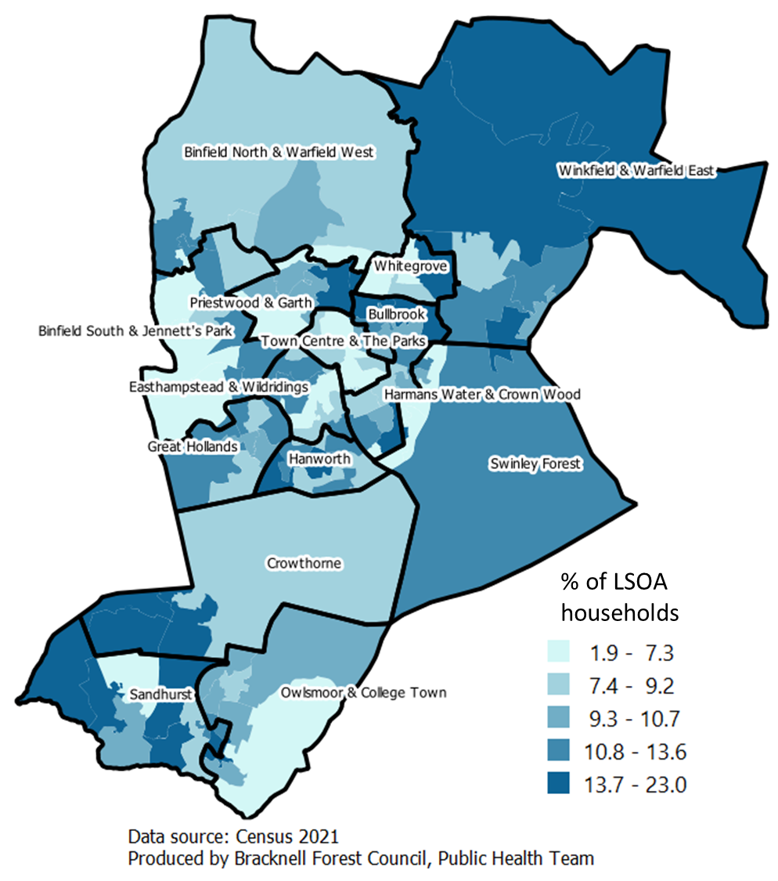
Households Composition
Some LSOAs in the central and southern parts of Bracknell Forest had highest proportion of households with people living alone, of which most of them are aged 66 years and over.
Proportion of households with people living alone in Bracknell Forest, 2021
Proportion of households with people aged 66 and over living alone in Bracknell Forest, 2021
Source: ONS Census 2021, Household composition

Slide 19
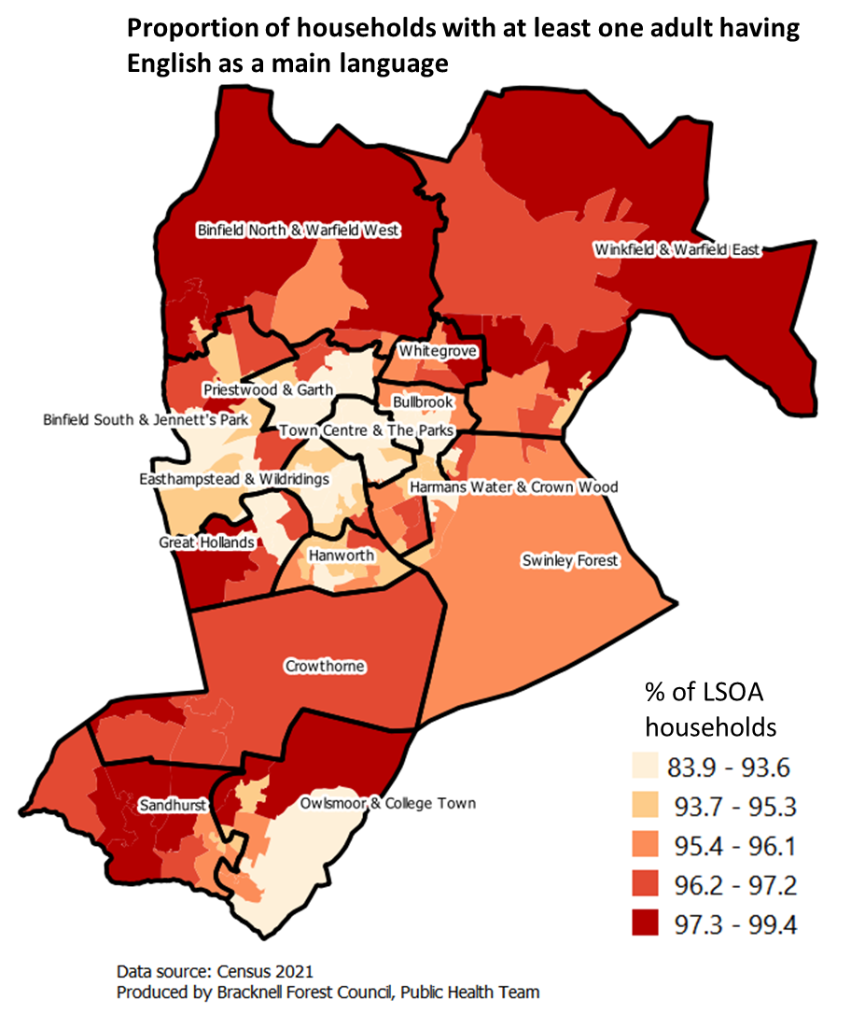
Household main Language
English was the predominant language for adults in 94.9% of the 50,248 households in Bracknell Forest.
lower than South East region (95.1%)
higher than the national average (93.1%).
Households in which English is the main language for
all adults: 91.0%
at least one, but not all adults: 3.9%
No adult: 5.1%
(This is made up of no adult, only children (aged 3-15): 1.4% and no one at all: 3.7%)
LSOAs in central and some patches in the southern parts of Bracknell Forest have the highest proportion of households with no adult who has English as a main language (shown by lighter colours).
Source: ONS Census 2021, Household language
Please note: The 2021 Census is the first time household language was captured.

Slide 20
Household deprivation
The ONS classifies household deprivation by four dimensions of deprivation: Employment, Education, Health and disability, and Housing:
Employment: A household is classified as deprived in the employment dimension if any member, not a full-time student, is either unemployed, permanently sick or disabled.
Education: A household is classified as deprived in the education dimension if no one has at least level 2 education and no one aged 16 to 18 years is a full-time student.
Health and disability: A household is classified as deprived in the health dimension if any member is disabled.
Housing: A household is classified as deprived in the housing dimension if the household’s accommodation is either overcrowded, in a shared dwelling, or has no central heating.
Households are categorised as: not deprived in any dimension, deprived in one dimension, deprived in two dimensions, deprived in three dimensions or deprived in in four dimensions
Source: ONS Census 2021, Household deprivation variable definition

Slide 21
Household deprivation
Households in Bracknell Forest are some of the least deprived in England.
56.4% of households were not deprived in any of the four dimensions (employment, education, health and housing) in 2021. This was up from 53.0% in 2011. The proportion of households not deprived in any dimensions in Bracknell Forest was higher than the South-East (52.0%) and England (48.4%) averages in 2021.
31.1% of households were deprived in one dimension with a further 10.2% deprived in two of the four dimensions in 2021, a change from 2011 of 0.8% and -3.4%, respectively. Household deprived in one or two dimension comprise a greater share of the total number of households in the South-East (32.8%; 12.2%) and England (33.5%; 14.2%).
Households deprived in three (1,069; 2,1%) or four (79; 0.2%) dimensions accounted for 2.3% of households in Bracknell Forest in 2021. This represented a decrease from 2011 of 0.6% and 0.2%, respectively
Household Deprivation by Dimensions in Bracknell Forest, South-East Region and England in 2021
Source: ONS Census 2021, Household by deprivation dimension
*Please note, the data published by the ONS did not include which specific dimensions households were deprived in.

Slide 22
Household deprivation
Proportion of households deprived in at least 1 dimension were highest in the central parts of Bracknell Forest, both in 2011 and 2021.
Proportion of population deprived with at least 1 dimension in Bracknell Forest, 2021
Proportion of population deprived with at least 1 dimension in Bracknell Forest, 2011
Source: ONS Census 2021, Household by deprivation dimension

Slide 23
Main Languages Spoken
English was the main language spoken by residents (over the age of 3) in Bracknell Forest in 2021.
92.3% of all residents identified English as their main spoken language, down from 94.0% in 2011. This was similar to the South East region (92.8%) but higher than England (90.8%).
Conversely, 7.7% of residents reported speaking a language other than English as their main language (up from 6.0% in 2011).
Other languages with notable numbers of speakers are Nepalese (1,256), Polish (1,132) and Romanian (989).
English as main language in Bracknell Forest, South East and England (2021)
Table 5: Main Languages spoken by Bracknell Forest residents in 2021
Main Language | Census 2021 | Census 2011 | % Change in Population
English | 111,127 | 101,781 | 9.2%
Nepalese | 1,256 | 988 | 27.1%
Polish | 1,132 | 761 | 48.8%
Romanian | 989 | 105 | 841.9%
Hungarian | 494 | 219 | 125.6%
Portuguese | 450 | 216 | 108.3%
Spanish | 376 | 276 | 36.2%
Russian | 305 | 194 | 57.2%
Tagalog or Filipino | 254 | 362 | -29.8%
Lithuanian | 196 | 78 | 151.3%
Tamil | 196 | 79 | 148.1%
Panjabi | 190 | 92 | 106.5%
Source: ONS Census 2021, Main language

Slide 24
Proficiency in English
In 2021 there were 9,724 (7.7% of the total population) Bracknell Forest residents who did not report English as their main spoken language and reported how well they could speak English, up from 6,512 (6.0% of the total population) in 2011.
Of those 9.724 residents, 54.5% (5,053) could speak English very well. This was significantly higher than the South-East (50.8%) and England (43.9%) in 2021.
33.3% (3,091) of residents who did not report English as their main spoken language, reported to speak English well, similar to the regional (34.1%) and national (35.8%) averages.
10.0% (972) of Bracknell Forest residents could not speak English well with a further 2.2% (206) not able to speak English.
English proficiency level of residents who did not report English as main language in Bracknell Forest, South-East Region and England (2021)
English proficiency level of Bracknell Forest residents who did not report English as main language in 2011 and 2021
Percentage change in English proficiency level of Bracknell Forest residents, as share of the total population, between 2011 and 2021
Source: ONS Census 2021, Proficiency in English

Slide 25
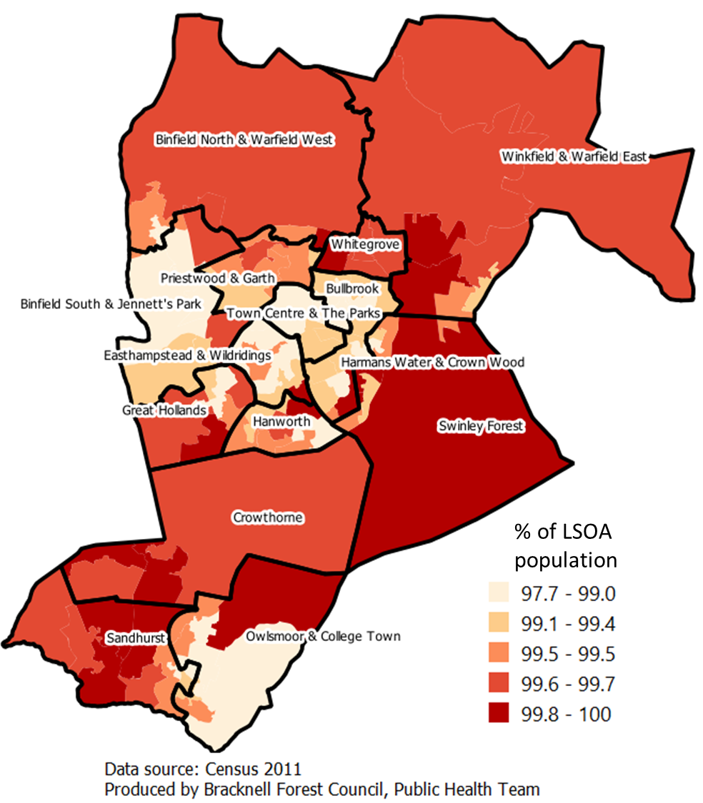
Proficiency in English
LSOAs in the central parts of Bracknell Forest have the lowest proportion of people who can at least speak English well, both in 2011 and 2021.
However, there was a general decrease in the proportion of Bracknell Forest population that can at least speak English well, shown by decrease from a minimum of 97.7% in 2011 to a minimum of 91.2% in 2021.
Proportion of population who can speak English well in Bracknell Forest, 2021
Proportion of population who can speak English well in Bracknell Forest, 2011
Source: ONS Census 2021, Proficiency in English

Slide 26
Economic Activity Status
Economic activity status is a measure of whether or not a person was an active participant in the labour market during the census period (15th March to 21 March 2021).
Residents, aged 16 and over, were classified as being ‘economically active’ if they were:
In employment (employee of self-employed)
Unemployed, but looking for work and could start within two weeks)
Unemployed, but waiting to start a job that had been offered and accepted.
Residents were classified as being economically inactive if there were:
Retired
Students (16+)
Looking after home or family
Long-term sick or disabled
Any other reason
Source: ONS Census 2021, Economic activity status variable definition

Slide 27
Economic Activity Status
69.4% (69,400) of the population in Bracknell Forest, aged 16 and over, were classed as economically active in 2021. This is down from 78.4% in 2011.
The proportion of residents who were economically active in Bracknell Forest was higher than the South-East (62.2%) and England (60.9%) figures.
Notably, there was an increase in the proportion of residents classed as economically inactive, from 21.6% in 2011 to 30.6% (30,534) in 2021.
The increase in economically inactive residents between the two census dates was not isolated to Bracknell Forest. Similar picture to
South-East Region: increase from 27.9% to 37.8%
England: increase from 30.1% to 39.1%
Economic activity status, as proportion of the population, of residents in Bracknell Forest, South-East region and England (2021)
Percentage change in economic activity status, as proportion of the population, for residents in Bracknell Forest, South-East and England between 2011 and 2021
Source: ONS Census 2021, Economic activity status

Slide 28
Economic Activity Status
The economically active population was concentrated in the central parts of Bracknell Forest in 2021, while the economically inactive population was concentrated in the northern and eastern parts of the local authority.
Proportion of economic active population in Bracknell Forest, 2021
Proportion of economic inactive population in Bracknell Forest, 2021
Source: ONS Census 2021, Economic activity status

Slide 29
Economic Activity Status: Economically Active
69.4% (69,400) of the Bracknell Forest population were economically active in 2021, down from 78.6% in 2011.
Residents classified as economically active can be categorised in three groups: employed, self-employed or unemployed.
56.4% (56,412) of the Bracknell Forest population were in employment (full-time or part-time). This was noticeably higher than the regional (South-East; 48.4%) and national (England; 47.7%) figures in 2021.
Residents who were self-employed (9,985), with or without employees, were 10.0% of the population.
3.0% (3,003) of the population were unemployed but seeking work or waiting to start a job already obtained.
Economic activity category, as percentage of the total population (16+), in Bracknell Forest, South-East region and England (2011 vs 2021)
Economic activity category, as percentage of the total population (16+), in Bracknell Forest in 2011
The 2021 census no longer includes economically-active full time students as a separate category. No direct comparisons could be made with the 2011 census.
Source: ONS Census 2021, Economic activity status

Slide 30
Economic Activity Status: Economically Inactive
One of the key changes in the labour market between 2011 and 2021 is the increase in the proportion of the population that is now economically inactive.
The key driver of this change is the increase in the number of retired residents, a key marker of an ageing population.
Retired residents represented 18.0% of the population (aged 16+) in 2021, up from 10.2% in 2011.
The increase in the retired population was more pronounced in South-East region (13.7% to 22.5%) and England (13.7% to 21.5%).
This is likely due to Bracknell Forest having a younger population profile compared with the South East and England averages.
Reasons for economic inactivity for Bracknell Forest residents as percentage of the total population (2011 vs 2021)
Percentage economically inactive (retired), as proportion of the population, of residents in Bracknell Forest, South-East region and England (2011 vs 2021)
Source: ONS Census 2021, Economic activity status

Slide 31
Economic Activity Status
The proportion of unemployed economically active population (excluding students) was highest in the central parts of Bracknell Forest in 2021.
The proportion of retired population aged 16 and over were highest in the northern and southern parts of the local authority.
% of unemployed population, economic active and not a student, 2021
% of population that were retired, 2021
Source: ONS Census 2021, Economic activity status

Slide 32
Distance travelled to work
One of the key insights that has come from the 2021 census is the changes in both distance travel to work and place of work since the 2011 census. Much of this can be attributed to the COVID-19 pandemic.
39.9% (26,512) of residents in Bracknell Forest, aged 16 and over, worked mainly from home. In 2011, only 11.1% of working age residents worked from home. Similar increases are seen for the South-East region (35.8%, up from 11.8%) and England (31.5%, up from 10.3%)
A further 14.1% (9.358) stated to be working mainly in no fixed place or outside of the UK (up from 8.4% in 2011). This is in line with South-East (14.8%) and England (14.5%) in 2021
27.5% of Bracknell Forest residents travelled up to 10 kilometres (km), equivalent to 6.2 miles, to their place of work compared to 45.6% in 2011.
10.8% of Bracknell Forest residents travel between 10 and 20 km (equivalent to 12.4 miles) to their place of work compared to 18.6% in 2011.
Those travelling more than 20 km to their place of work comprised on 7.8% of residents in 2021, also down considerably from 2011 (16.3%).
Distance travelled to place of work by Bracknell Forest residents (2011 vs 2021)
Please note: “Does not apply” accounted for 46.7% of the responses in 2021. This category includes those who were furloughed due to the Covid-19 restrictions in 2021. This was not the case in 2011
Source: ONS Census 2021, Distance travelled to work

Slide 33
Proportion of population travelling less than 10km to work or working from home in Bracknell Forest
Over 95% of LSOAs in Bracknell Forest had had an increase in population travelling less than 10km to work/working from home, from less than 63.4% in 2011 to 63.4% and higher in 2021. This could be attributed to Covid-19 restrictions in 2021.
2021
2011
Source: ONS Census 2021, Distance travelled to work
Please note: “Does not apply” accounted for 46.7% of the responses in 2021. This could be due to Covid-19 restrictions in 2021.

Slide 34
Method used to travel to work
The most common method of travel to work for residents in Bracknell Forest is by driving a car or van (45.5%), a decrease from 65.3% in 2011.
Travel on foot is the second most common form of travel to work accounting for 5.7%, down from 7.7% in 2011.
Passenger travel by car, van, taxi (3.6%) or public transport (2.7%) or less common form of travel to work in 2021.
The COVID-19 pandemic and the accompanying changes to place of work is primarily responsible for the decreases in the methods of travel to work.
Source: ONS Census 2021, method used to travelled to work

Slide 35
Occupations
The 2021 census has grouped 104 occupations into nine broad categories.
Of all Bracknell Forest residents aged 16 and over, in employment in 2021:
52.2% were employed in managerial, professional or technical occupations in 2021. This is up from 46.9% in 2011
20.7% (13,742) were employed in professional occupations.
Professional occupations were also the largest broad occupation category regionally (South-East, 21.2%) and nationally (England, 20.3%) in 2021.
16.2% were employed in associate professional and technical occupations and 15.3% of those in employment were managers, directors and senior officials.
Conversely, there was a decrease in the proportion of those working in the other occupations, in particular administrative and secretarial occupations (10.0%, from 12.2% in 2011 ) and elementary occupations (7.9%, from 9.0% in 2011)
Occupations Bracknell Forest residents, aged 16 and over, were employed in 2011 and 2021
Source: ONS Census 2021, Occupations

Slide 36
Occupations
Table 6: The 10 most common occupations in Bracknell Forest in 2021
Occupation category | Occupation | Census 2021 | % of all in employment (2021) | % Change in number of people employed in occupation since 2011
Professional occupations | Information Technology Professionals | 3,214 | 4.8% | -0.8%
Managers, directors and senior officials | Functional Managers and Directors | 3,164 | 4.8% | 67.2%
Associate professional and technical occupations | Sales, Marketing and Related Associate Professionals | 2,970 | 4.5% | 11.5%
Sales and customer service occupations | Sales Assistants and Retail Cashiers | 2,710 | 4.1% | -11.1%
Caring, leisure and other service occupations | Caring Personal Services | 2,569 | 3.9% | -36.4%
Professional occupations | Teaching and other Educational Professionals | 2,110 | 3.2% | -6.8%
Skilled trades occupations | Construction and Building Trades | 1,984 | 3.0% | 15.9%
Process, plant and machine operatives | Road Transport Drivers | 1,694 | 2.6% | 14.5%
Administrative and secretarial occupations | Other Administrative Occupations | 1,677 | 2.5% | -4.6%
Managers, directors and senior officials | Production Managers and Directors | 1,581 | 2.4% | 39.2%
Source: ONS Census 2021, Occupations

Slide 37
Socio-Economic classification
The national-statistics socio-economic classification (NS-SEC) provides an indication of socio-economic position of residents (16 and over), based on responses to economic activity status, occupation and employment history.
55.4% of Bracknell Forest residents were in the higher managerial (17.5%), lower managerial (23.7%) and intermediate (13.3%) professional occupations in 2021. This is comparable to the proportion of residents in these occupations (55.1%) in 2011.
Residents in those three higher NS-SEC categories comprised a higher share of the population in Bracknell Forest than the South-East (49.6%) and England (44.6%) in 2021.
Residents who never worked and long-term unemployed (5,242) has increased since 2011. They now constitute 5.2% of the population in 2021 compared with just 2.2% (2,448) in 2011.
However, residents in this NS-SEC category still comprised a smaller share of the population in Bracknell relative to the South-East region (6.4%) and England (8.5%)
National-statistics socio-economic classification for Bracknell Forest residents (2011 vs 2021)
Source: ONS Census 2021, Socio-economic classification

Slide 38
Hours worked
One area of the labour market where there has not been notable change since the 2011 census is the number of hours worked per week by residents
In 2021, 25.0% of residents in employment worked part-time with 75.0% working full-time. This is comparable to 2011 (part-time 24.1%; full-time 75.9%).
The majority of residents in employment worked between 31 and 48 hours a work (63.3%), up from 60.0% in 2011.
The proportion of residents working 15 hours or less (8.9%) and 16 to 30 hours (16.0%) slightly increased from 2011 (8.5%, 15.6%).
Conversely, those working 49 hours or more (11.7%) represent a smaller proportion of the labour market relative to 2011 (15.9%)
Residents in part-time work comprised smaller proportions of those in employment compared to the South-East (29.5%) and England (29.8%).
As demonstrated in the chart on the right, the proportion of residents in the South-East and England working part-time hours (15 hours of less and 16 to 30 hours) was higher than Bracknell Forest
Number of hours worked per week by Bracknell Forest residents (2011 vs 2021)
Number of hours worked per week by residents in Bracknell Forest, South-East and England in 2021
Source: ONS Census 2021, Hours worked

Slide 39
Caveats
Comparisons between 2021 census and 2011 census data was done if the definitions were still the same. For example, household data for population aged 65 and over in 2011 was not compared due to the change in definition in 2021 to population aged 66 and over.
Ethnicity classification of Chinese ethnic group was changed to “Asian” from Census 2011 onwards. This was the classification used in this analysis. However, it should be noted that National Health Service (NHS) data still refers to “Chinese and other” classification.
Census 2021 took place during the coronavirus (COVID-19) pandemic, a period of unparalleled and rapid change; the national lockdown, associated guidance and furlough measures will have affected the data on Labour market and travel to work such as distance travelled to work and method to travel to work.

Slide 40
Appendices

Slide 41
Ethnic Groups: Detailed Comparison (2021 vs 2011)
Ethnic Groups | Census 2021 | Census 2011 | % Change in Population
Asian, Asian British or Asian Welsh: Bangladeshi | 219 | 134 | 63.4%
Asian, Asian British or Asian Welsh: Chinese | 828 | 556 | 48.9%
Asian, Asian British or Asian Welsh: Indian | 3,774 | 1,989 | 89.7%
Asian, Asian British or Asian Welsh: Pakistani | 947 | 518 | 82.8%
Asian, Asian British or Asian Welsh: Other Asian | 3,111 | 2,467 | 26.1%
Black, Black British, Black Welsh, Caribbean or African: African | 2,072 | 1,586 | 30.6%
Black, Black British, Black Welsh, Caribbean or African: Caribbean | 554 | 402 | 37.8%
Black, Black British, Black Welsh, Caribbean or African: Other Black | 367 | 201 | 82.6%
Mixed or Multiple ethnic groups: White and Asian | 1,337 | 808 | 65.5%
Mixed or Multiple ethnic groups: White and Black African | 565 | 297 | 90.2%
Mixed or Multiple ethnic groups: White and Black Caribbean | 970 | 656 | 47.9%
Mixed or Multiple ethnic groups: Other Mixed or Multiple ethnic groups | 971 | 542 | 79.2%
White: English, Welsh, Scottish, Northern Irish or British | 96,950 | 96,080 | 0.9%
White: Irish | 1,038 | 984 | 5.5%
White: Gypsy or Irish Traveller | 161 | 118 | 36.4%
White: Roma | 164 | -
White: Other White | 8,956 | 5,372 | 40.0%
Other ethnic group: Arab | 310 | 201 | 35.2%
Other ethnic group: Any other ethnic group | 1,311 | 294 | 77.6%

Slide 42
Household Composition: Detailed Comparison (2021 vs 2011)
% change in share of all households in Bracknell Forest since 2011
Household composition | Household Type | Number of households | % of all households | % change since 2011
Single family household | Married or civil partnership couple: Dependent children | 9,251 | 18.4% | -1.2%
One person household | Other | 8,267 | 16.5% | -1.5%
Single family household | Married or civil partnership couple: No children | 5,814 | 11.6% | -1.9%
One person household | Aged 66 years and over | 5,195 | 10.3% | 0.6%
Single family household | All aged 66 years and over | 3,877 | 7.7% | 1.2%
Single family household | Cohabiting couple family: No children | 3,713 | 7.4% | 1.0%
Single family household | Lone parent family: With dependent children | 3,062 | 6.1% | -0.5%
Single family household | Married or civil partnership couple: All children non-dependent | 3,019 | 6.0% | 0.3%
Single family household | Cohabiting couple family: With dependent children | 2,440 | 4.9% | 0.9%
Multiple-family household | Other, including all full-time students and all aged 66 years and over | 1,873 | 3.7% | N/A
Single family household | Lone parent family: All children non-dependent | 1,870 | 3.7% | 0.6%
Multiple-family household | With dependent children | 1,258 | 2.5% | N/A
Single family household | Cohabiting couple family: All children non-dependent | 329 | 0.7% | 0.2%
Single family household | Other single family household: Other family composition | 276 | 0.5% | N/A

Slide 43
Census 2021: Release schedule (1)
Census topics | Subtopics | Data (lowest geographic level) | Release date
Demography and migration | Unrounded population estimates | Age by single year (MSOA); Number of households (LSOA); Population density (LSOA); Sex (LSOA); Sex by single year (LSOA) | 02 November 2022
 | Household characteristics | Household composition (LSOA); Household size (LSOA); Households by deprivation dimension (LSOA); Legal partnership status (LSOA); Living arrangement (MSOA); Number of usual residents in households and communal establishments (LSOA)
 | Migration | Age of arrival in the UK (LSOA); Country of birth; Country of birth detailed (LA); Length of residence (LSOA); Migration indicator (LSOA); Number of non-UK short-term residents by sex (LSOA); Passports held (LSOA); Passports held detailed (MSOA); Year of arrival in the UK (LSOA).
Ethnic group, national identity, language, and religion | Ethnicity | Ethnic group (LSOA); Ethnic group [detailed] (MSOA); Multiple ethnic groups in household (LSOA) | 29 November 2022
 | National identity | National identity – UK (LSOA); National identity [detailed] (MSOA)
 | Language | Main language (detailed); Household language; Multiple main languages in household; Proficiency in English
 | Religion | Religion; religion (detailed); Multi-religion household
Labour market and travel to work | Labour Market | Economic activity status (LSOA); Hours worked (LSOA); Industry (LSOA); Occupation (LSOA); Occupation [minor groups] (MSOA); Socio-economic classification (LSOA) | 8 December 2022
 | Travel to work | Distance travelled to work (LSOA); Methods used to travel to work (LSOA)

Slide 44
Census 2021: Release schedule (2)
Census topics | Subtopics | Data (lowest geographic level) | Release date
Housing | - | Accommodation type (LSOA); Car or van availability (LSOA); Central heating (LSOA); Communal establishment management and type (MSOA); Communal establishment management by age and sex (MSOA); Number of bedrooms (LSOA); Number of rooms (LSOA); Second address indicator (LSOA); Occupancy rating for bedroom (LSOA); Purpose of second address (LSOA); Tenure (LSOA); Occupancy rating for rooms (LSOA) | 05 January 2023
Sexual orientation and gender identity | - | Gender identity (MSOA); Gender identity [detailed] (LA); Sexual orientation (MSOA); Sexual orientation [detailed] (LA) | 06 January 2023
Education | - | Highest level of qualification (LSOA); School children and full-time students (LSOA) | 10 January 2023
Health, disability, and unpaid care |  | General health (LSOA); General health, age-standardised proportions (LA); Disability (LSOA); Provision of unpaid care (LSOA); Provision of unpaid care, age-standardised proportions; Number of disabled people in the household (LSOA); | 19 January 2023

