Slide 1
Inclusion Health Groups in Frimley ICS: An overview of available data and published evidence
Office for Health Improvement and Disparities (OHID) South East &
South East Local Knowledge and Intelligence Service
December 2023

Slide 2
How to use the datapack
This datapack is intended to provide a one-off summary of available data and evidence for inclusion health groups in the South East at an ICB level. It was developed to complement the Spotlight tool, which includes mainly national level data and where new data is currently being added.
It presents an initial overview to support systems to understand need in their area and provide a resource including data and summaries that can be taken out and used as required, as well as be further developed by local Systems.
For each inclusion health group, the key messages for systems are presented, followed by an overview of health issues and available data. The end of each section includes links to further resources and organisations.
Each slide includes a link back to the main contents page for ease of navigation and the contents page for each section includes links to key slides.
For each summary, there are links to websites in the text with references to published papers included in the notes section.
For data slides, notes and further information is included in the notes section of each slide.
It is recommended that the datapack is used in conjunction with the newly published National Framework for NHS Action on Inclusion Health.
If you have any feedback on this datapack, please contact: OHIDSEBST@dhsc.gov.uk

Slide 3
Reflections on data
The purpose of this resource is to provide systems with local data relating to inclusion health groups in their area. One of the challenges for these populations is that they are often not represented in routinely collected data.
This makes it difficult for local integrated care systems to both fully understand the health need of their inclusion health populations, but also to evaluate the outcomes and impact of interventions.
While the Spotlight tool provides an overview on inclusion health groups at a national level, the aim of this resource is to understand what data exists at a local level, which will potentially also be captured by Spotlight in the future.
Data sources for this datapack include publicly available data from the Office for National Statistics (ONS), OHID Fingertips, Local Government data, data from the Home Office, Department for Levelling up, Housing and Communities (DLUHC) and experimental analysis using Hospital Episode Statistics.
Further sources explored included screening and immunisations data, health and justice data, police data as well as other sources. A recurrent theme was that data was often not available broken down by inclusion health groups, particularly for preventative interventions, or data was either not collected in a robust manner, or not publicly available.
Therefore, we know that data outlined in this datapack will often be an under-representation of the need or impact for these populations.
Acknowledging and outlining the challenges in compiling data at an ICS level for this resource is hoped to encourage local systems to review their data collection processes and to look beyond routinely available data, working creatively with all residents and groups to seek wider sources of information.
Return to Contents

Slide 4
Contents
Overview
The statutory duties placed on public bodies
SPOTLIGHT: Improving Health Outcomes
Kings Fund: Pockets of excellence
National Framework for NHS action on Inclusion Health
Reducing healthcare inequalities: Core 20+5
NHS Frimley ICB Boundaries
Homelessness and Rough Sleeping
Gypsy Roma Travellers
Sex workers
Vulnerable migrants
Victims of modern slavery
Prisons and those in contact with the criminal justice system
People with drug and alcohol dependence

Slide 5
Overview
Inclusion health describes population groups who are socially excluded, who typically experience multiple overlapping risk factors for poor health and are often not accounted for in electronic records. This includes people who experience homelessness, vulnerable migrants, Gypsy, Roma and Traveller communities, sex workers, people in contact with the justice system, those with drug and alcohol dependence and victims of modern slavery but can also include other socially excluded groups.
People in inclusion health groups often face barriers to accessing primary and preventative care, relying on emergency services to manage acute health needs. This can both further exacerbate health inequalities, but also come at a greater use of emergency services and subsequent financial cost. It has been estimated, for example, that preventing homelessness for one year would result in a reduction in public expenditure of £9,266 per person, through costs otherwise resulting from a much higher than typical contact with the NHS, mental health services and criminal justice system¹.
This resource aims to highlight the needs and challenges faced by inclusion health groups within an ICS area and therefore help improve understanding of the issues that people face. Due to the nature of these groups, there is not always a large amount of data available. However, we have aimed to use the best possible data available and included latest evidence to outline the challenges and health needs for these groups. This also highlights gaps in the system and provides an indication of where more needs to be done to collect data on these groups to identify and address inequality.
Inclusion health groups face extreme health inequity and addressing this will require intensive cross-sectoral policy and service action. Everyone across an Integrated Care System (ICS) has a role and responsibility to take action to improve outcomes for inclusion health groups to address the systematic health inequalities they face.
Return to Contents
Notes:
1. Pleace, N. & Culhane, D.P. (2016) Better than Cure? Testing the case for Enhancing Prevention of Single Homelessness in England. London: Crisis

Slide 6
Inclusion Health
Groups
Homelessness & Rough Sleeping
Gypsy, Roma Travellers
Sex Workers
People with drug and alcohol dependence
Prisons & those in contact with the criminal justice system
Vulnerable Migrants
Victims of modern slavery
People in inclusion health groups often experience stigma and discrimination with frequent barriers in access to healthcare.
Individuals may belong to more than one inclusion health group, experiencing multiple and overlapping risk factors for poor health including poverty, adverse childhood experiences, violence, substance use, mental illness and complex trauma. This results in very poor health outcomes, often much worse than the general population and a lower average age of death.
It is important to note that these are not a homogenous group though, with different health and social care needs both within and between different inclusion health groups and these must be understood and responded to appropriately.
Addressing the needs of inclusion health groups is fundamental to promoting health equity and addressing health disparities among marginalised and vulnerable populations.
Return to Contents

Slide 7
The statutory duties placed on public bodies
The NHS Constitution states that the NHS has a duty to “…pay particular attention to groups or sections of society where improvements in health and life expectancy are not keeping pace with the rest of the population”.
This is reflected in the National Health Service Act 2006 (as amended by the Health and Social Care Act 2012 and 2022), which introduced for the first-time legal duties to reduce health inequalities.
NHS England and Integrated Care Boards (ICBs) have a legal duty to have regard to reducing inequalities associated with access to and outcomes from NHS services. This means that health inequalities must be properly and seriously considered when making decisions or exercising functions, including balancing those needs against any other challenging factors. ICBs and NHS trusts must also provide annual narrative for progress to address inequalities.
ICBs have statutory duties to support partnership working, where this would help to tackle inequalities.
The Homelessness Reduction Act 2017 places several duties on local authorities to assess, prevent and relieve homelessness.
Duty of every local authority in England to provide advisory services
Duty to assess every eligible applicant’s case and agree a plan
Duties to those who are homeless or threatened with homelessness
Duty on public authorities in England to refer cases (A guide to the duty to refer )
Return to Contents

Slide 8
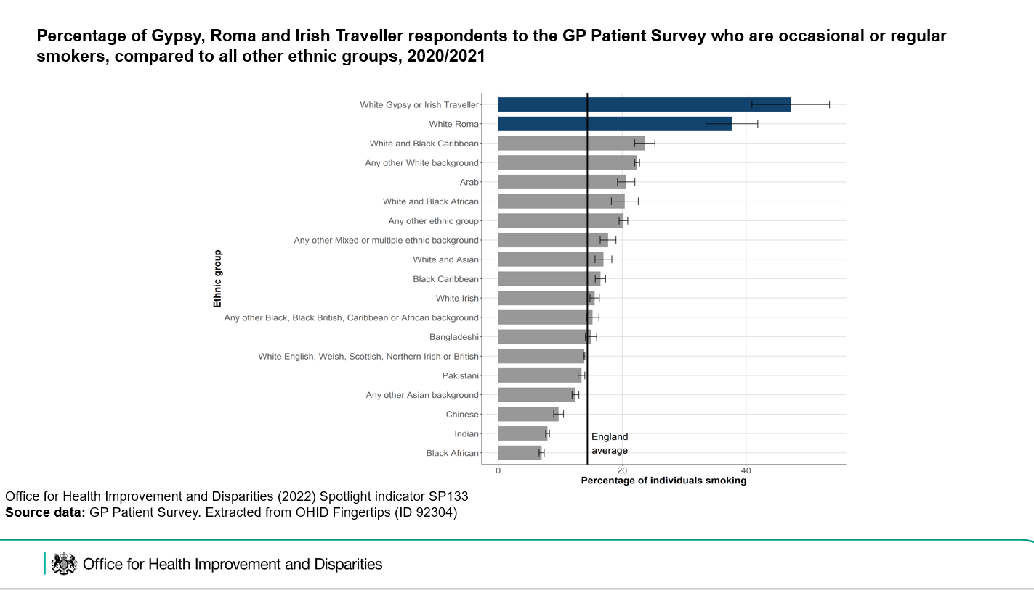
SPOTLIGHT: Improving Inclusion Health Outcomes
Spotlight is a data dissemination platform produced by the Office for Health Improvement and Disparities (OHID). It collates and presents key statistics related to the public health outcomes of inclusion health groups across the following themes:
access to and utilisation of health care;
preventative care;
health outcomes; and
wider determinants of health.
The aim of Spotlight is to improve accessibility and visibility of data and evidence related to inclusion health populations.
Spotlight and instructions on how to use it can be found here.
Example of data as provided within the Spotlight tool
Return to Contents

Slide 9
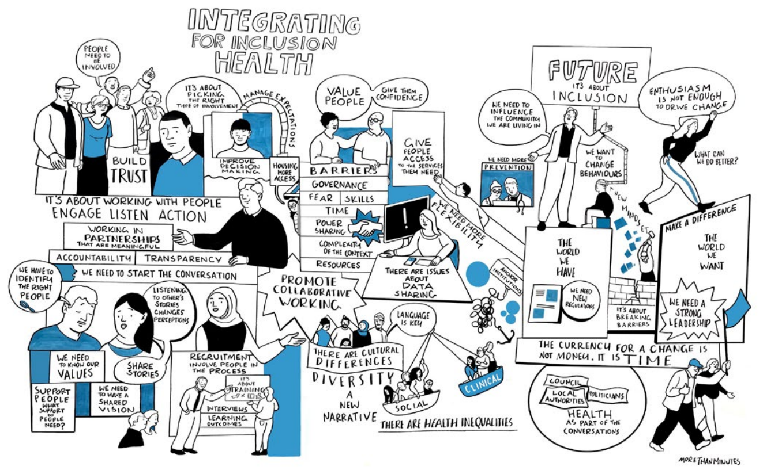
Kings Fund Pockets of Excellence
The King’s Fund has led a shared learning programme of work with Pathway and with Groundswell, looking at:
developing consistently good services across the whole inclusion health cohort
how to scale up from examples of good practice in a given neighbourhood to achieve system wide success.
Two ICS areas in the South East were part of this first cohort – Hampshire & the Isle of Wight and Sussex.
Findings from the programme provide senior NHS and ICS system leaders with the case for inclusion health and describes a strategic better service road map for inclusion health groups.
There is also shared learning from programme participants who considered what good services should look like and identifies some of the levers and enablers that participants thought from their experience can help systems to create the conditions for success.
Pockets of Excellence Report
Return to Contents

Slide 10
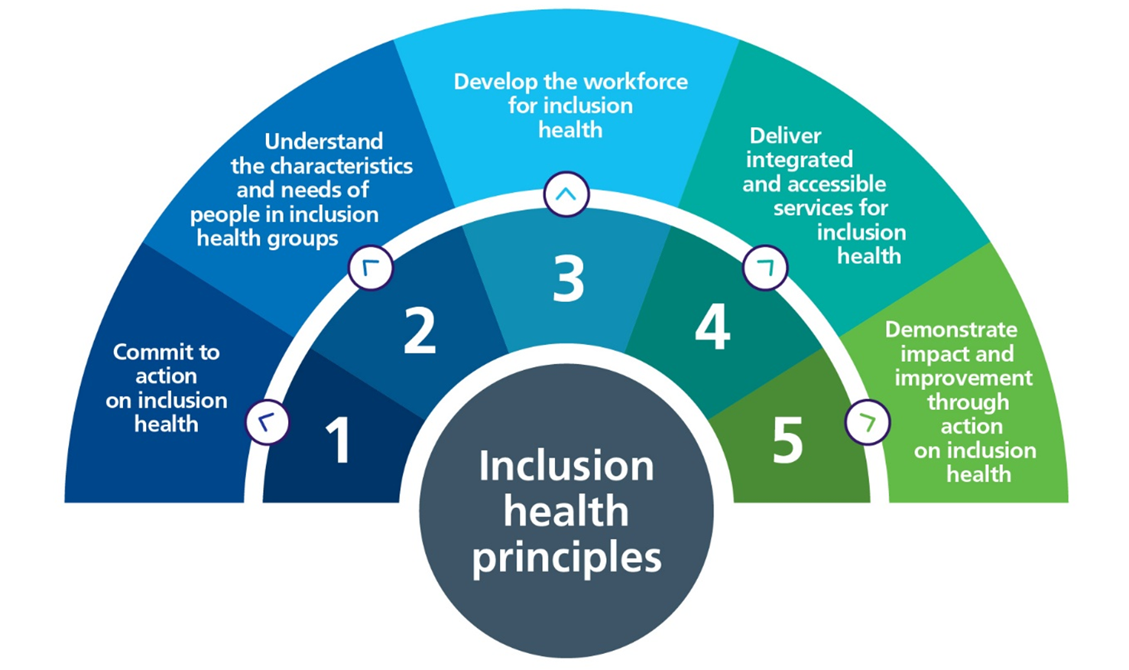
National Framework for NHS - Action on Inclusion Health
The national framework for NHS - action on inclusion health was published in October 2023. It is intended to support systems to plan, develop and improve health services to meet the needs of people in inclusion health groups. The framework is based on five principles for action on inclusion health, outlining actions to address issues which are common across inclusion health groups. The framework focuses on the role that the NHS plays in improving healthcare, highlighting the importance of working in partnership across sectors and with other members of the Integrated Care System.
NHS England » A national framework for NHS – action on inclusion health
Return to Contents

Slide 11
Reducing healthcare inequalities: Core 20+5
Core 20+5 is a national NHS England approach to inform action to reduce healthcare inequalities at both national and system level. Initially focused on adults, it was later expanded to include reducing healthcare inequalities for children and young people. Core20 refers to the most deprived 20% of the national population – as identified by the Index of Multiple Deprivation (IMD). “Plus” population groups are identified at an ICS level, identifying those within their population who are experiencing poorer than average health access, experience and/or outcomes. Inclusion health groups are expected to form part of the “plus” population groups, as action to address healthcare inequalities experienced by these groups is fundamental in order to reduce healthcare inequalities across the whole population.
Return to Contents

Slide 12
Integrated Care Board (ICB) Boundaries
Return to Contents

Slide 13
NHS Frimley ICB
As ICB boundaries are often not co-terminous with their local authority boundaries, the table below describes the population and percentage of each local authority area included in the ICB. The following map outlines the geographical boundary of Frimley ICB. Data throughout this pack is often only available at local authority level and so ICB values are calculated from local authority figures using the PHE aggregations method where possible.
Local Authority | Total local authority population | Total of local authority population in Frimley ICB | Total Frimley ICB population | Proportion of Frimley ICB from local authority (%) | Proportion of local authority in Frimley ICB (%)
Bracknell Forest | 124,165 | 124,165 | 746,739 | 16.6 | 100
Guildford | 150,352 | 20,492 | 746,739 | 2.7 | 13.6
Hart | 97,608 | 73,206 | 746,739 | 9.8 | 75
Runnymede | 90,327 | 13,630 | 746,739 | 1.8 | 15.1
Rushmoor | 94,387 | 94,387 | 746,739 | 12.6 | 100
Slough | 149,577 | 149,577 | 746,739 | 20 | 100
Surrey Heath | 89,204 | 75,899 | 746,739 | 10.2 | 85.1
Waverley | 126,556 | 44,110 | 746,739 | 5.9 | 34.9
Windsor and Maidenhead | 151,273 | 151,273 | 746,739 | 20.3 | 100
Return to Contents

Slide 14
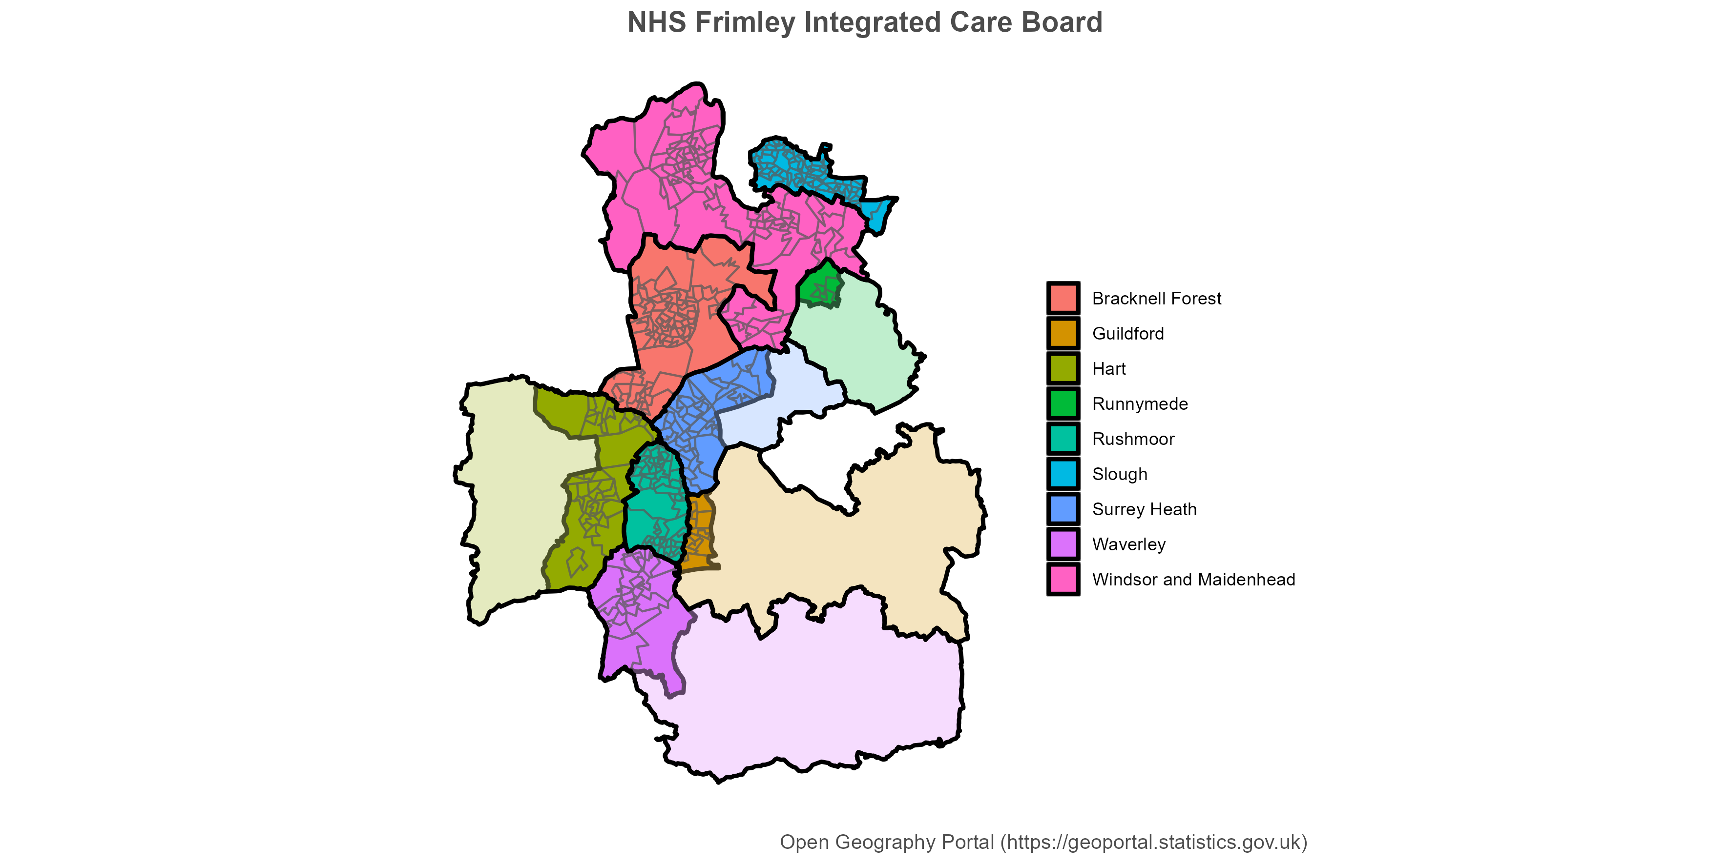
NB: lighter shaded areas indicate where part of the local authority belongs to an adjoining ICB area.
Return to Contents

Slide 15
Homelessness and Rough Sleeping
Return to Contents

Slide 16
Homelessness and Rough Sleeping: Contents
Homelessness definitions
Homelessness and Rough Sleeping Key messages
NICE Guidance 214: Integrated health and social care for people experiencing homelessness
Duty to refer
Health outcomes for people experiencing homelessness
Rough sleeping snapshot in England: Autumn 2022
The Rough Sleeping Data Framework
Adult Safeguarding Reviews
Experimental data analysis: Homelessness and Hospital admissions in the South East
Homelessness - Households owed a relief duty under the Homelessness Reduction Act
Homelessness - Temporary Accommodation
Homelessness – Mental Health
Homelessness – Deaths
Homelessness Resources/Organisations
Return to Contents

Slide 17
Homelessness definitions
Homelessness: a household that has no home in the UK or anywhere else in the world available and reasonable to occupy (legal definition). This includes:
Rooflessness: without a shelter of any kind, sleeping rough
Houselessness: with a place to sleep, but temporary in institutions or a shelter
Living in insecure housing: threatened with severe exclusion due to insecure tenancies, eviction, domestic violence, or staying with family and friends (“sofa-surfing”)
Living in inadequate housing: in caravans on illegal campsites, in unfit housing, in extreme overcrowding.
Temporary Accommodation: Households might be placed in temporary accommodation pending the completion of inquiries into an application, or they might spend time waiting in temporary accommodation after an application is accepted, until suitable secure accommodation becomes available.
Return to Contents

Slide 18
Homelessness and Rough Sleeping: Key messages
Homelessness is more than rough sleeping. It includes people living in sheds, garages and other unconventional buildings; sofa surfing; hostels and unsuitable temporary accommodation, such as B&Bs. It places people at a high risk of social exclusion, exacerbating or resulting in poor health, limiting education and personal development and may also contribute to people being excluded from general service provision or more specialist support services.
People experiencing homelessness have far worse health and social care outcomes than the general population. The average age of death for people experiencing homelessness is 43 for women and 45 for men.
The costs of homelessness to society are significant. NICE guidance suggests most interventions that address homelessness are likely to be cost effective or even cost saving from the wider public sector perspective.
Return to Contents

Slide 19
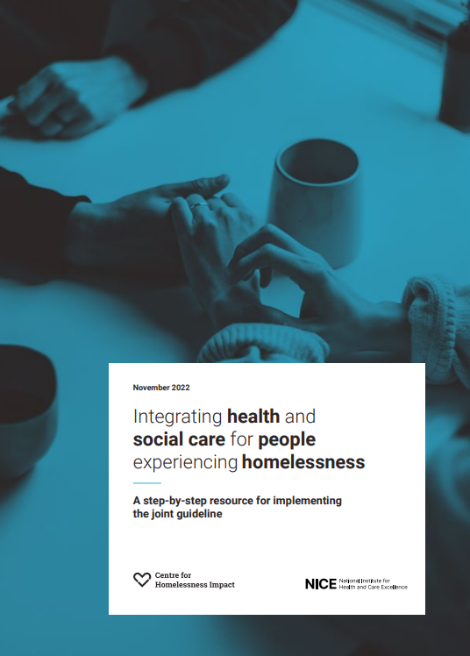
NICE Guidance 214: Integrated health and social care for people experiencing homelessness
Research has shown that people affected by homelessness often experience poor healthcare and social care. Mainstream services are largely not geared to provide accessible and trauma informed care for those experiencing rough sleeping and homelessness. The National Institute for Health and Care Excellence (NICE) and the Centre for Homelessness Impact (CHI) have developed new guidance which covers providing integrated health and social care services for people experiencing homelessness. It aims to improve access to and engagement with health and social care, and ensure care is coordinated across different services.
A step by step implementation manual is available which highlights the main recommendations, presents the evidence base and provides practical suggestions and checklists.
A series of short awareness films are being developed by CHI for the front line workforce in health, social care, and for commissioners and managers.
Return to Contents

Slide 20
Duty to refer
The Homelessness Reduction Act 2017 (HRA) places a statutory duty on Hospital Trusts, NHS walk-in centres and Accident and Emergency departments. They are required to refer (with consent) any patient who is homeless, or at risk of homelessness in the next 56 days. Referrals without consent may be made to safeguard children or vulnerable adults, in accordance with safeguarding procedures. For patients, this means they can recover in appropriate accommodation and can access health and social care services for ongoing support. For hospitals, it is the chance to break the cycle of costly repeat admissions.
Homelessness may include patients residing in hostels or unsuitable accommodation, people in insecure accommodation or people sleeping rough. Helpful guidance is available.
The Faculty for Homeless and Inclusion Health has produced Standards For Commissioners and Service Providers and offers advice and best practice in the care of excluded patients.
Royal College of Physicians guidance advises that hospitals supporting 30 or more homeless patients each year develop specific responses, and those supporting more than 200 homeless patients per year consider developing a Pathway homeless hospital team to ensure timely discharge and reduced readmission. Contact Pathway for advice on developing a team.
A new report from Crisis and Pathway, Beyond the Ward – Exploring the Duty to Refer in Hospital Settings, highlights examples of good practice where the integration of services across organisations have been developed.
Return to Contents

Slide 21
Health outcomes for people experiencing homelessness 1/2
The latest national official figures show a 26% increase in rough sleeping and the highest rates of people living in temporary accommodation on record.¹
Homelessness is associated with poor health outcomes, with mortality risks of three to six times higher than for the general population^{2,3}. People experiencing homelessness have substantially increased risk of death due to respiratory and cardiovascular diseases⁴. Some studies have shown the increased risk of mortality is also present for those sofa surfing and squatting⁵. Studies excluding these more prevalent forms of homelessness, and use of low-cost hotels, may have underestimated their impact on mortality.
There are few studies of morbidity among homeless people. Most research has focused on infections and mental health problems and found high relative and absolute prevalence⁴. Those studies which have looked at broader outcomes have found that respiratory diseases, dental problems, headaches and skin diseases are also more common among homeless people than the general population.
Increasingly, frailty and premature aging is being seen in the homeless population. Research by Pathway, the Marie Curie Palliative Care Research Department and Institute of Epidemiology & Health Care at UCL, involved the first exploration of premature aging among people experiencing homelessness in the UK. Although the average age of participants was 56 years (range 38-74), the levels of frailty were comparable to 89-year-olds in the general population. Conditions usually associated with old age were common, with more than half experiencing falls, visual impairment, low grip strength, and mobility impairment. Cognitive impairment was also found to be prevalent but under recognised and rarely diagnosed. In addition, all participants had more than one long-term health condition, with an average of 7 long-term conditions identified per person. This is greater by far than even the oldest people in the general population⁶.
Return to Contents
Notes:
1 Government won’t meet its target to end rough sleeping by 2024 says panel of experts – The Kerslake Commission (commissiononroughsleeping.org)
2 Lewer D, Aldridge RW, Menezes D, et al. Health-related quality of life and prevalence of six chronic diseases in homeless and housed people: a cross-sectional study in London and Birmingham, England BMJ Open 2019;9:e025192. doi: 10.1136/bmjopen-2018-025192 e025192.full.pdf (bmj.com)
3 Morrison DS. Homelessness as an independent risk factor for mortality: results from a retrospective cohort study. Int J Epidemiol 2009;38:877–83.
4. Fazel S, Geddes JR, Kushel M. The health of homeless people in high-income countries: descriptive epidemiology, health consequences, and clinical and policy recommendations. Lancet 2014;384:1529–40. BMJ Open 2019;9:e025192. doi: 10.1136/bmjopen-2018-025192
5 James White, Meg Fluharty, Rosa de Groot, Steven Bell, G David Batty, Mortality among rough sleepers, squatters, residents of homeless shelters or hotels and sofa-surfers: a pooled analysis of UK birth cohorts, International Journal of Epidemiology, Volume 51, Issue 3, June 2022, Pages 839–846, https://doi.org/10.1093/ije/dyab253
6 Rogans-watson R, Hudson B, Lewer D, et al, 21 Assessing frailty in people experiencing homelessness: developing and piloting a tool for hostel staff BMJ Supportive & Palliative Care 2022;12:A9. Frailty among the homeless population comparable to that of 89-year-olds in the general population - Pathway

Slide 22
Health outcomes for people experiencing homelessness 2/2
In 2022, Homeless Link published The Unhealthy State of Homelessness. The findings from 31 Homeless Health Needs Audits (HHNAs), representing 2,776 individuals showed:
People experiencing homelessness suffer from worse physical and mental health than the general population and on many measures, the situation has worsened since the first HHNA in 2014.
Nutrition presents a big challenge with a third of respondents reporting that on average, they eat only one meal a day.
76% (378) of respondents reported that they smoke cigarettes, cigars or a pipe, compared to 13.8% of adults in the general population who are either ‘occasional’ or ‘regular’ smokers.
Between 2018–2021, 63% of respondents reported they had a long term illness, disability or infirmity.
The number of people with a mental health diagnosis has increased substantially from 45% in 2014 to 82% in 2018–2021.
45% of respondents reported they are self-medicating with drugs or alcohol to help them cope with their mental health.
Barriers in accessing needed support for physical and mental health means people experiencing homelessness are over reliant on emergency health care services, with 48% of respondents having used A&E services in the last year: three times more than the general population.
Between 2018 - 2021 a total of 38% of respondents had been admitted to hospital in the 12 months before participating in a Homeless Health Needs Audit. The most common reason for hospital admission related to a physical health condition (37%), and 28% related to either a mental health condition or self-harm or attempted suicide.
For those who had been admitted to hospital nearly a quarter (24%) had been discharged to the streets.
Return to Contents

Slide 23
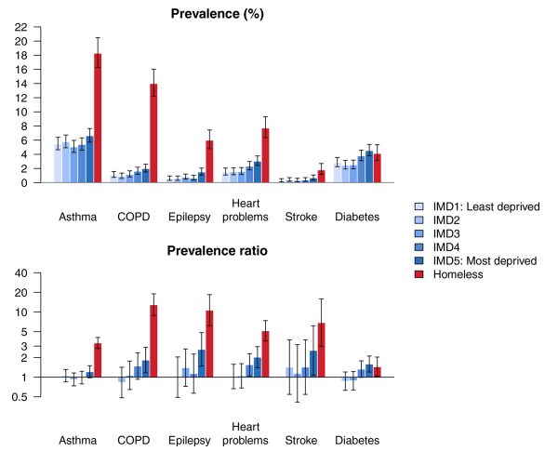
Prevalence of long-term conditions by deprivation and homelessness
Research has found that homeless people report substantially worse health than those in stable accommodation and are three times more likely to report a chronic disease¹.
The chart opposite demonstrate prevalence and prevalence ratios of different long-term conditions compared to deprivation and homelessness in homeless and housed people in London and Birmingham¹.
When comparing some of the health conditions, that are identified in CORE 20+5, across deprivation quintiles (blue), there is a "slope" in health outcomes, but factor in homelessness (red) and the inequalities are significantly greater for conditions such as Chronic Obstructive Pulmonary Disease (COPD), Cardiovascular Disease (CVD), asthma and epilepsy.
The same study also found that homeless people report worse quality of life and are more than twice as likely to report problems with anxiety¹.
Return to Contents
Notes:
1. Lewer D, Aldridge RW, Menezes D, et al. Health-related quality of life and prevalence of six chronic diseases in homeless and housed people: a cross-sectional study in London and Birmingham, England. BMJ Open 2019;9:e025192. doi: 10.1136/bmjopen-2018-025192

Slide 24
A person who is homeless is:
34X more likely to have tuberculosis
50X more likely to have
Hepatitis C
12X more likely to have epilepsy
6X more likely to have heart disease
5x more likely to have a stroke
2.5x more likely to have asthma
People who are homeless (compared with the general population):
Attend A&E 6x as often
Are admitted to hospital 4X as often
Stay 3X as long
Taken from Pathway
Return to Contents

Slide 25
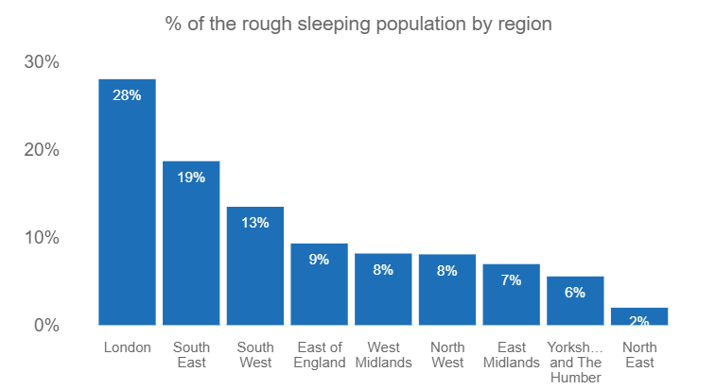
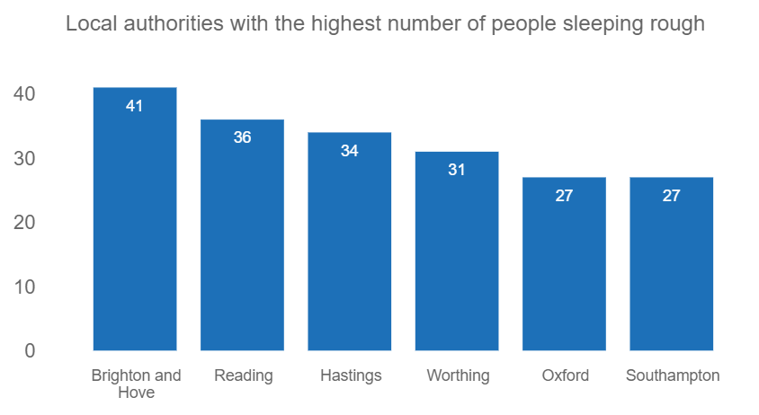
Rough Sleeping Snapshot in England: Autumn 2022
The number of people sleeping rough in England, on a single night in autumn 2022 was estimated to be 3,069 which was the first increase in four years. This number is lower than in 2019, before the Covid-19 pandemic, but is higher than 2010 when the snapshot was first introduced. In the South East, there was an estimated 572 people sleeping rough on a single night. Data by local authority area can be found on the interactive map.
The South East has the second highest proportion of people sleeping rough on a single night, almost 20%, with only London having a higher proportion.
In the South East, Brighton and Hove had the highest number of people sleeping rough, following by Reading and then Hastings.
Source: Department for Levelling Up, Housing & Communities
Return to Contents
Notes:
Technical notes:
These statistics provide a way of estimating the number of people sleeping rough across England on a single night in autumn and assessing change over time. Accurately estimating the number of people sleeping rough within a local authority is inherently difficult given the hidden nature of rough sleeping. Furthermore, there are a range of factors that can impact on the number of people seen or thought to be sleeping rough on any given night. These include the weather, where people choose to sleep, the date and time chosen, and the availability of alternatives such as available night shelters.

Slide 26
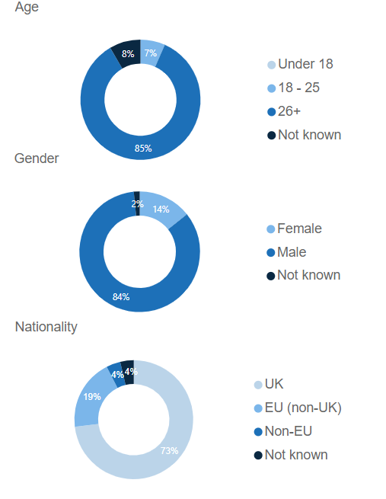
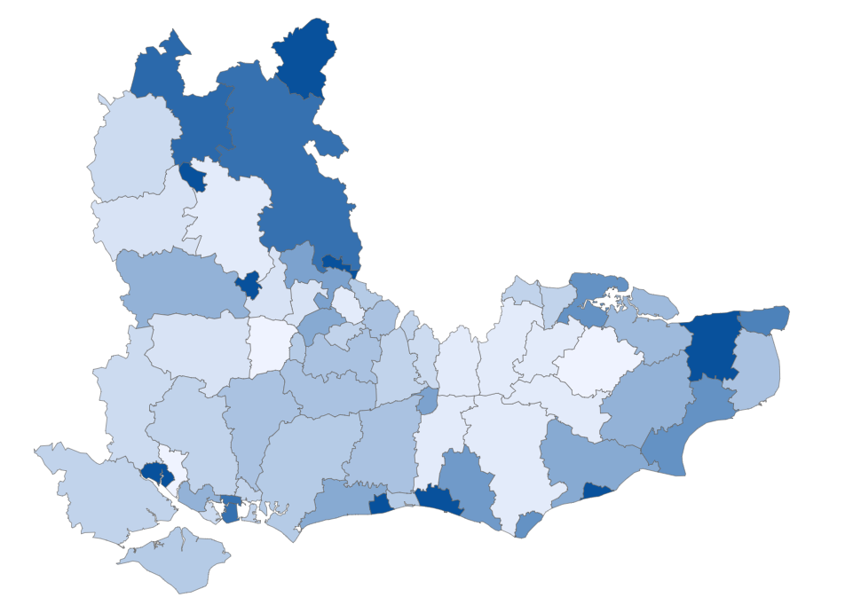
Number of people sleeping rough in the South East on a single night in autumn 2022
This map demonstrates the spread of rough sleeping across the South East, as measured by the rough sleeping snapshot in autumn 2022, along with the breakdown by age, gender and nationality.
Source: Department for Levelling Up, Housing & Communities
Return to Contents

Slide 27
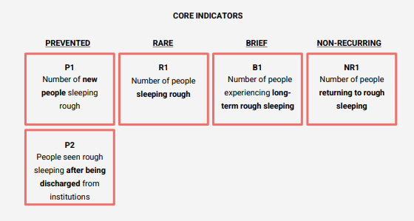
The Rough Sleeping Data Framework
The new Rough Sleeping Data Framework was launched in 2023 to help local authorities to identify and address the specific needs of their local areas.
The framework was created collaboratively by the Centre for Homelessness Impact (CHI) and the Department for Levelling Up, Housing and Communities (DLUHC) to provide a new national data-led approach to measure progress towards ending rough sleeping.
The Framework consists of five core indicators (see picture) enabling every local area to understand what is needed, to track the progress they are making and to be held accountable locally. Nationally, DLUHC is using the data to support cross-government work and better understand local challenges.
The Ending Rough Sleeping Data Framework Dashboard includes the first round of framework data, published in November 2023.
The single night count reflects trends but does not capture the complexity of rough sleeping and homelessness, which the Framework seeks to address.
A guide on how to use the Framework is available.
Return to Contents

Slide 28
Adult Safeguarding Reviews
Rough sleeping and multiple disadvantage is a safeguarding issue. The government's Rough Sleeping Strategy highlights The Care Act 2014 and the responsibility of local authorities and partners to provide assurance that local safeguarding arrangements are acting to help and protect adults with care and support needs who they suspect are at risk of abuse or neglect (including self-neglect).
In line with the recommendations of the National Institute for Health and Care Excellence (NICE) guidelines, both DLUHC and DHSC strongly recommend that every Safeguarding Adult Board(SAB) has a named member advocating for people sleeping rough, whom experience the most severe disadvantage and multiple and complex needs. Safeguarding Adult Boards should also ensure, in their partnerships with housing teams, that there is clear accountability for people sleeping rough.
SABs have an absolute duty to conduct a SAR where an adult with care and support needs has died as a result of abuse and/or neglect, including self-neglect, whether known or suspected, and there is concern that partner agencies could have worked more effectively to protect the person. There is a comparable absolute duty where the person has experienced serious abuse and/or neglect but survived. In these circumstances a review is mandatory.
Twenty-five cases in the first national analysis of SARs in England (Learning from Safeguarding Adult Reviews, 2021) involved individuals who were or had experienced homelessness. This represented 11% of the sample. An earlier thematic review contained 14 reviews where homelessness was a factor¹.
Return to Contents
Notes:
1. Martineau, S. and Manthorpe, J. (2020), "Safeguarding adults reviews and homelessness: making the connections", The Journal of Adult Protection, Vol. 22 No. 4, pp. 181-197. https://doi.org/10.1108/JAP-02-2020-0004

Slide 29
Experimental data analysis: Homelessness and Hospital admissions in the South East 1/2
People experiencing homelessness are less likely to access both preventative and primary healthcare, with studies showing that homeless patients use hospital services at a higher rate than those who are not homeless^{1,2}. In view of this, experimental data analysis was undertaken by OHID SE to identify numbers of hospital admissions for people experiencing homelessness at an ICB level in the South East. In addition, the reasons for admission were also explored.
This data has been calculated using Hospital Episode Statistics (HES) available through UKHSA’s Data Lake. HES contains details about inpatient admissions, outpatient appointments and Accident and Emergency attendances at NHS hospitals in England. It is a record based system that covers all NHS Trusts in England, and covers all medical specialities and:
NHS patients treated in NHS Trusts
NHS patients treated in private hospitals
Private patients treated in NHS hospitals
Definition of admission for a homeless person used in this analysis
The analysis contained in this section covers inpatient admissions for homeless people/people of no fixed abode in NHS Trusts in the South East. There is no current agreed methodology within OHID for identifying admissions for homeless people and so the approach taken in this analysis is therefore experimental.
An admission episode for a homeless person is defined is an episode with an ICD-10 code of homelessness, Z59.0, in the secondary diagnosis position. An admission episode for a person of no fixed abode is defined as an episode where the current local authority district of residence of the patient is “No fixed abode” (RESLADST_ONS = “U”). Hereinafter, an admission that meets either of these definitions is referred to as an admission for a homeless person.
Return to Contents
Notes:
Moss C, Sutton M, Cheraghi-Sohi S, et al. Comparative 4-year risk and type of hospital admission among homeless and housed emergency department attendees: longitudinal study of hospital records in England 2013–2018. BMJ Open 2021;11:e049811. doi: 10.1136/bmjopen-2021-049811
Vohra, N., Paudyal, V. & Price, M.J. Homelessness and the use of Emergency Department as a source of healthcare: a systematic review. Int J Emerg Med 15, 32 (2022). https://doi.org/10.1186/s12245-022-00435-3

Slide 30
Experimental data analysis: Homelessness and Hospital admissions in the South East 2/2
Attributing an admission to an ICB
Episodes were counted towards an ICB by treatment area according to where the NHS Trust is situated. Please note that this represents a departure from the usual approach to allocating episodes to place, which uses the patient’s usual place of residence via the Lower Layer Super Output Area (LSOA). This approach is precluded for admissions for homeless people because of the large proportion of missing LSOA values for these admissions. Counts for ICB are aggregated to form the counts for NHS South East. Counts between 1 and 7 have been suppressed and all other counts are rounded to the nearest 5.
Analysis of data for 2022/23
In order to provide a recent view of admissions for homeless people, this analysis includes admissions data for 2022/23, which has been generated from monthly HES data for 2022/23.
It should be noted that no HES data was available for Frimley Health NHS Foundation Trust from mid-June 2022 to March 2023. As this Trust is situated within the NHS Frimley ICB boundary, this will have impacted on counts for this ICB as well as the counts for South East.
Additional points to note
This analysis is based on finished admission episodes. An examination of the data has found that for some episodes, the ICD-10 code of homelessness, Z59.0, is not present on the admission episode but is present on subsequent episodes within the spell. These episodes will therefore not be included in this analysis, leading to the potential of undercounting. Work is underway to quantify the number of subsequent episodes that contain the Z59.0 code where it is not present in the admission episode. The footnotes attached to each analysis provide additional caveats to aid interpretation.
Return to Contents

Slide 31
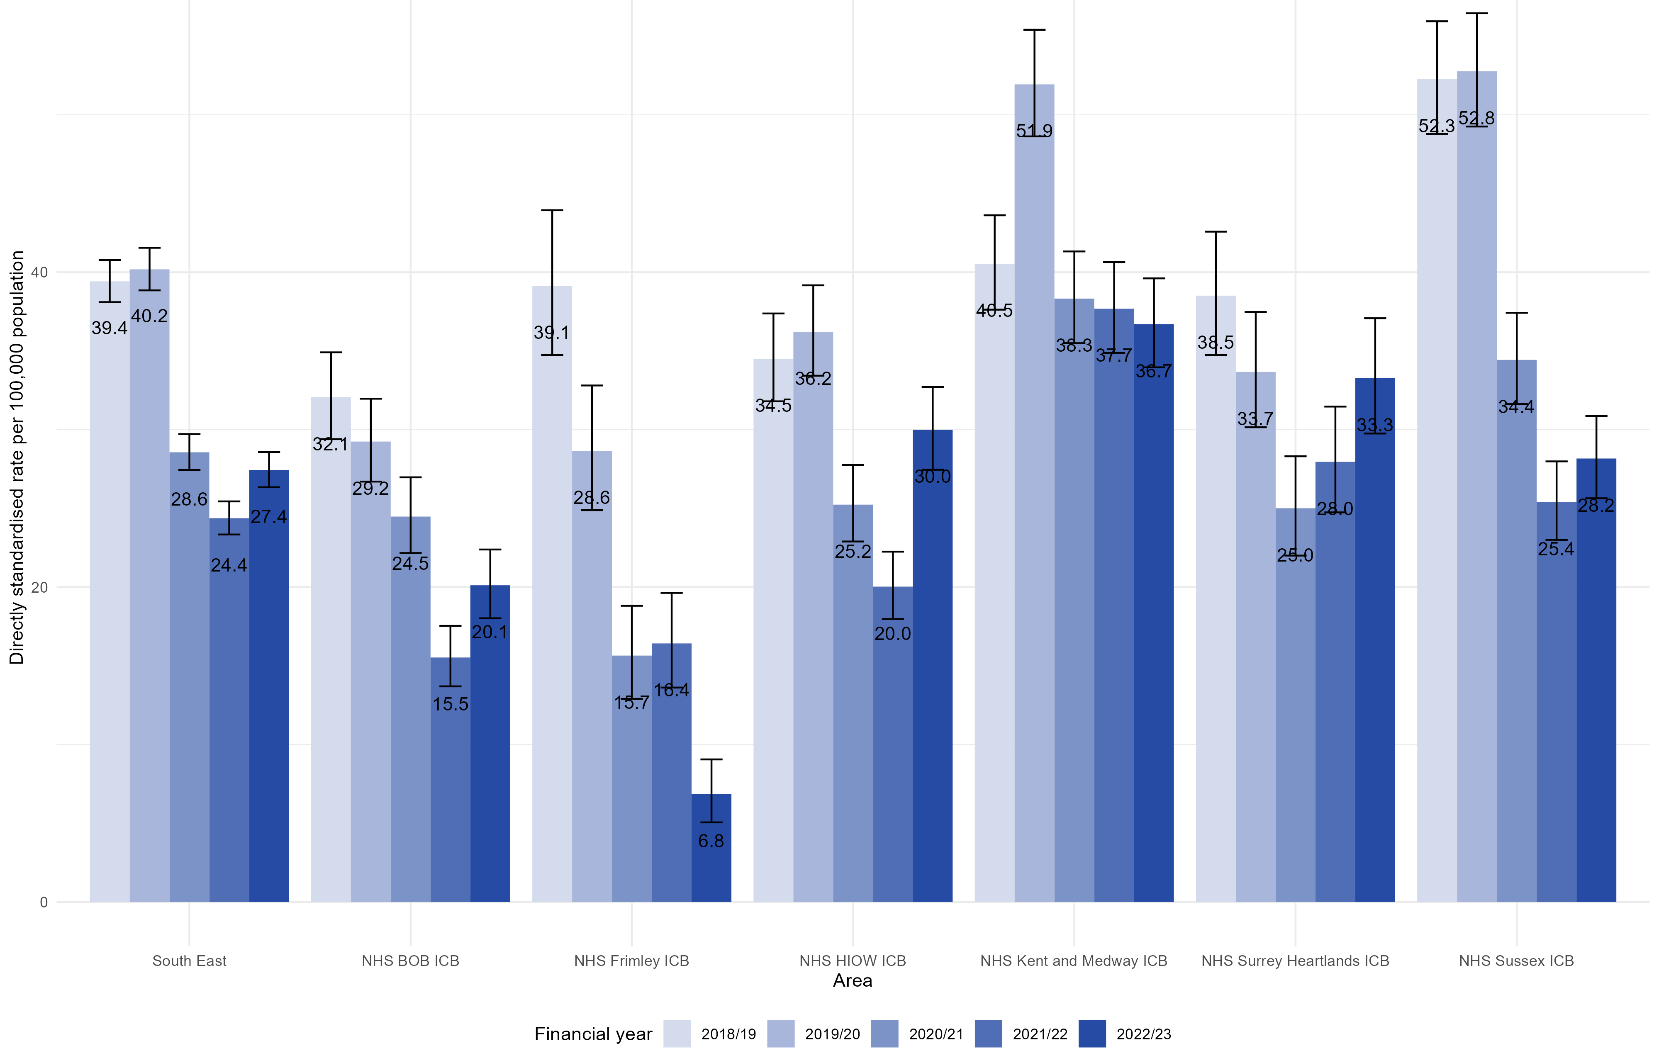
Admissions for homeless people, directly standardised rate per 100,000 population: South East and NHS ICBs 2018/19 to 2022/23
This graph demonstrates the trend in those identified as homeless among hospital admissions, for both the South East and each individual ICB from 2018/19 to 2022/23. There are some limitations to the data as described in the notes.
Most ICB areas showed a decline in rates of homeless people being admitted to hospital from 2020/21 to 2021/22, although numbers appear to be increasing again in the most recent data. Kent & Medway and Sussex ICBs had the highest rate of admissions for homeless people in 2019/20, compared to the other ICBs in the South East.
Return to Contents
Notes:
Source: Hospital Episode Statistics (HES) admitted patient care (APC) Copyright © 2023. Reused with the permission of NHS Digital. All rights reserved
Notes:
There were 13, 960 admissions for homeless people/people of no fixed abode in the South-East between 2018/19 and 2022/23, 290 (2%) of these did not have a valid STARTAGE. They have therefore been excluded from the rate calculations.
Rates are calculate using the ONS 2018 – based population projections.
Rates are shown with 95% confidence intervals calculated using Byar’s method.
No admissions data was available for Frimley NHS Foundation Trust from mid-June 2022 to March 2023. This will impact on Frimley’s rates for 2022/23 as well as that for the South East.

Slide 32
Hospital admissions: Number of people identified as homeless - South East 2018/19 – 2020/23
The number of people identified as homeless among those admitted to hospital in the South East between 2018/19 and 2020/23 is demonstrated in this chart. The highest number was in 2019/20, when 3520 people admitted to hospital were identified as being homeless.
The number reduced to 2490 in 2020/21, which may in part be due to the Covid-19 pandemic and the national “Everyone In” initiative which aimed to support those experiencing homelessness and accommodate them, ensuring that as few as people as possible returned to life on the streets.
Numbers were at their lowest in 2021/22 with 2145 people admitted to hospital in the South East being identified as homeless.
Of note, no admissions data was available for Frimley NHS Foundation Trust from mid-June 2022 to March 2023, which will impact numbers for the South East.
Source: Hospital Episode Statistics Admitted Patient Care (APC) Copyright © 2023
Return to Contents
Notes:
Source: Hospital Episode Statistics (HES) admitted patient care (APC) Copyright © 2023. Reused with the permission of NHS Digital. All rights reserved
Numbers have been rounded to the nearest 5
No admissions data was available for Frimley NHS Foundation Trust from mid-June 2022 to March 2023. This will impact on NHS Frimley’s number for 2022/23 as well as the South East’s.

Slide 33
Hospital admissions - number of people identified as homeless: NHS Frimley ICB 2018/19 – 2022/23
Numbers of people admitted to hospital who were identified as homeless across Frimley ICB has steadily reduced since 2018/19. However, no admissions data was available for Frimley NHS Foundation Trust from June 2022 – March 2023 which will have impacted numbers over this time.
Although relatively small numbers, people experiencing homelessness are likely to have complex physical and mental health issues – often either undiagnosed, or under-treated. The higher use of the Emergency Department represents a high cost and resource intense environment.
In addition, these numbers are likely to be an underestimate due to the methodology challenges and data at an ICB level will mask inequalities seen across the system and at a Place level.
Source: Hospital Episode Statistics Admitted Patient Care (APC) Copyright © 2023
Return to Contents
Notes:
Source: Hospital Episode Statistics (HES) admitted patient care (APC) Copyright © 2023. Reused with the permission of NHS Digital. All rights reserved
Numbers have been rounded to the nearest 5
No admissions data was available for Frimley NHS Foundation Trust from mid-June 2022 to March 2023. This will impact on NHS Frimley’s number for 2022/23 as well as the South East’s.

Slide 34
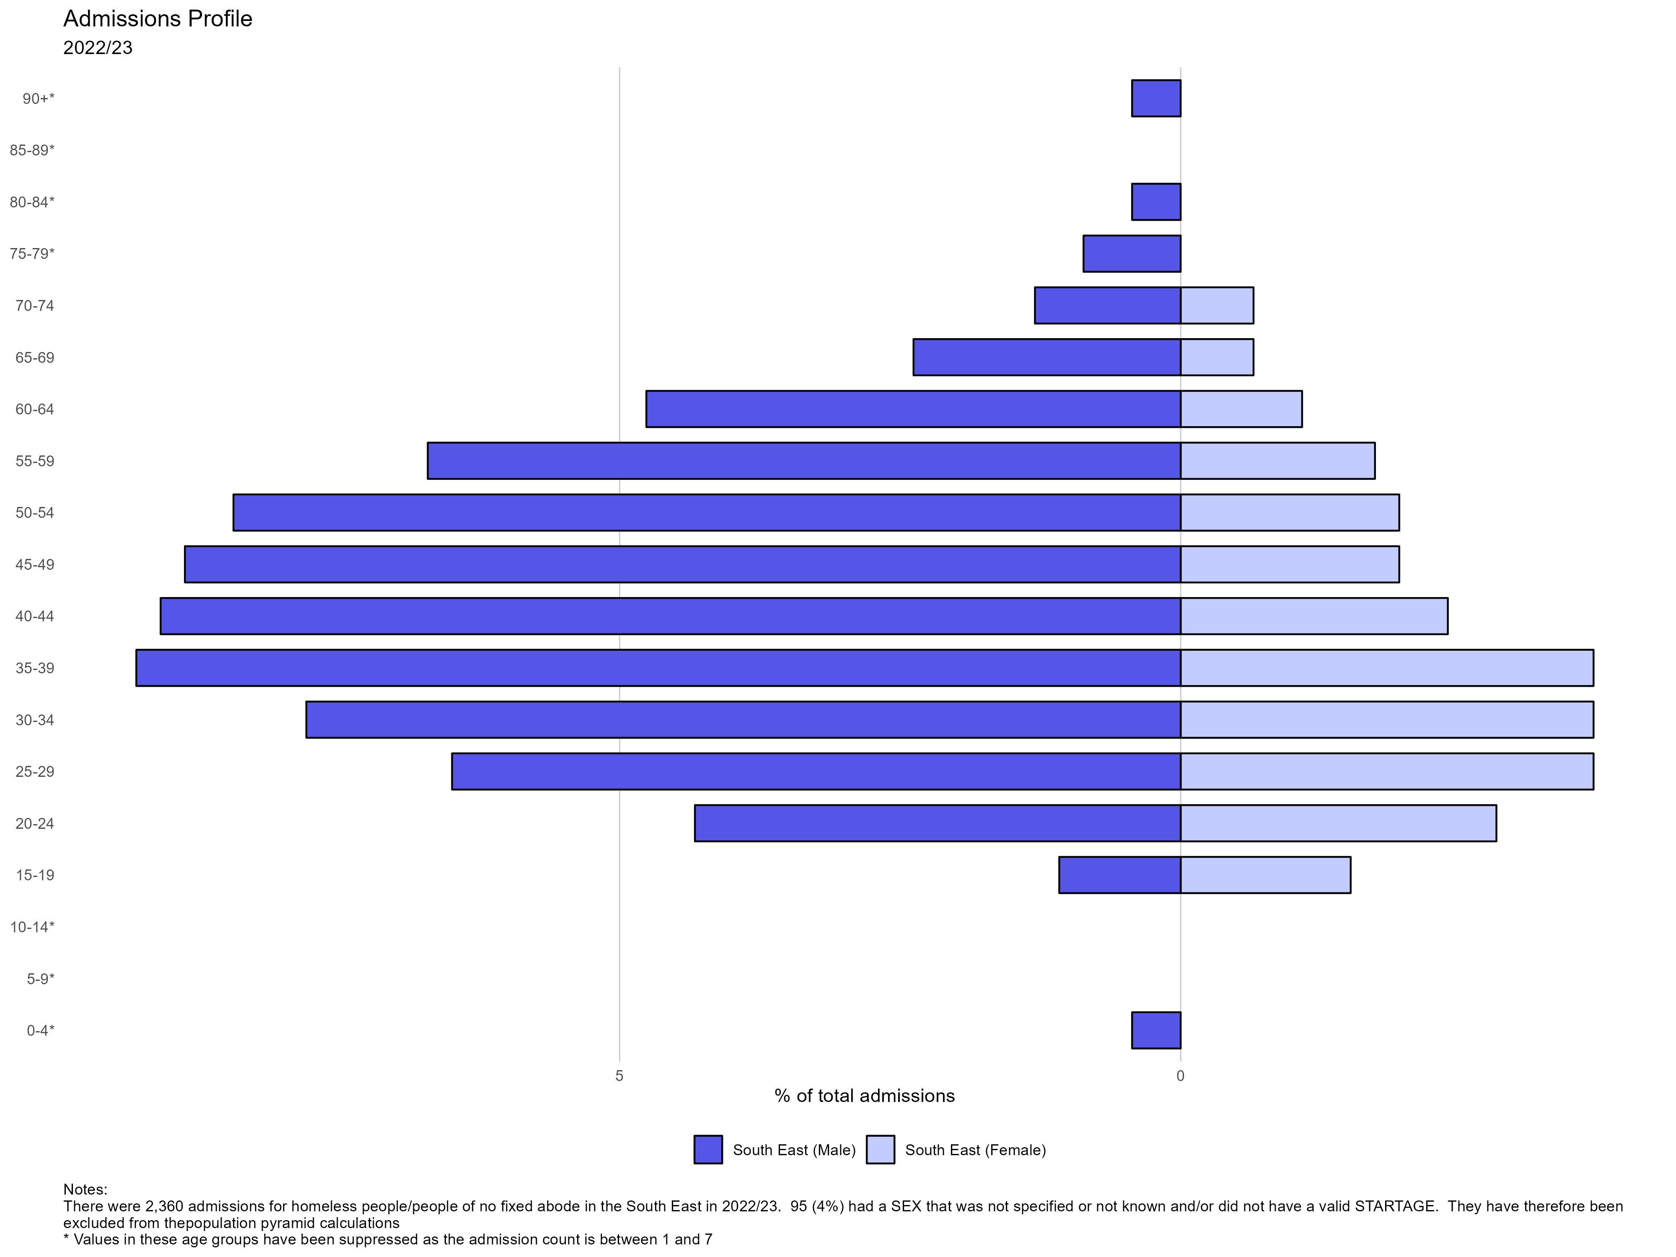
Homeless Admissions profile in the South East: 2022/23
This population pyramid demonstrates the percentage of hospital admissions among those identified as homeless, by age and gender.
Across the South East in 2022/23, most of those identified as homeless population were men with the highest percentage of being in the 35–39 age group. For females, the highest percentage of admissions across the 25–39 age range.
Data from the Office of National Statistics has previously identified that 8 out of 10 people sleeping rough are male. However, homelessness encompasses more than rough sleeping. Although this pyramid gives a snapshot of those admitted to hospital and identified as homeless by age and gender, it does not enable us to describe who within the homeless population may be at a higher risk of admission.
Return to Contents
Notes:
Source: Hospital Episode Statistics (HES) admitted patient care (APC) Copyright © 2023. Reused with the permission of NHS Digital. All rights reserved

Slide 35
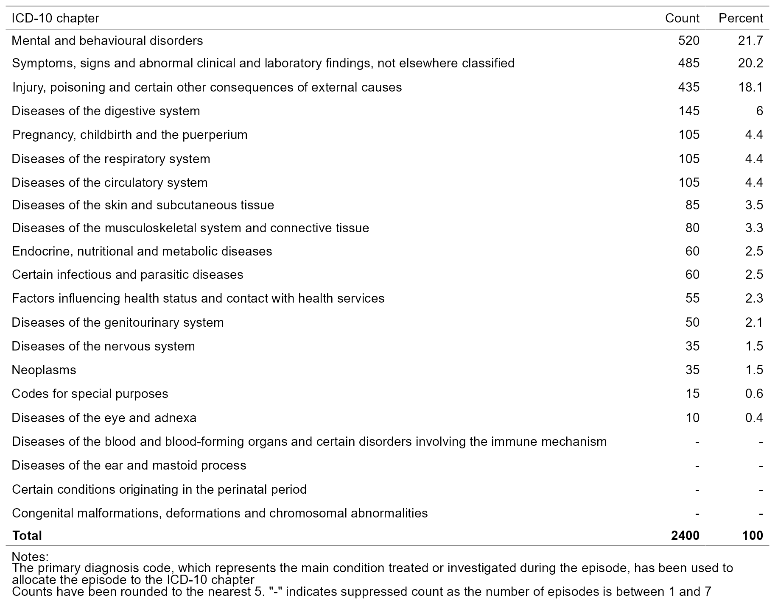
Homeless admissions: Reason for admission in the South East by count and percentage (2022/23)
The table outlines the primary cause for admission among those identified as homeless in the South East in 2022/23.
The most common reason for admission was due to mental and behavioural disorders (21.7%), followed by “not elsewhere classified” (20.2%) and “injury, poisoning and certain other consequences of external causes” (18.1% of admissions).
Admissions in this table are only classified on the basis of their primary diagnosis code and it is acknowledged that patients may have a number of co-occurring medical conditions, which are not reflected in this analysis.
Return to Contents
Notes:
Source: Hospital Episode Statistics (HES) admitted patient care (APC) Copyright © 2023. Reused with the permission of NHS Digital. All rights reserved

Slide 36
Reasons for admission: Homeless admissions compared to South East resident admissions 2022/23 (all ages)
Table 1: ordered by SE homeless admissions | SE homeless admissions |  |  | SE resident admissions
ICD-10 chapter | Count | % |  | Count | %
Mental and behavioural disorders | 520 | 21.7 |  | 16,215 | 0.9
Symptoms, signs and abnormal clinical and laboratory findings, not elsewhere classified | 485 | 20.2 |  | 253,520 | 13.3
Injury, poisoning and certain other consequences of external causes | 435 | 18.1 |  | 126,455 | 6.6
Total | 2,400 | 100 |  | 1,902,625 | 100
For those admitted to hospital in the South East, who were identified as being homeless, the most common cause of admission was mental and behavioural disorders. This accounted for 21.7% of admissions, compared to 0.9% of admissions among the overall South East resident population in 2022/23.
This ICD code can be broken down further and for those experiencing homelessness, the most common cause of admission within the mental and behavioural disorders chapter, was due to alcohol – which accounted for 10.2% of total admissions for this population group. However, alcohol only accounted for 0.2% of admissions for the overall South East resident population. This was followed by “symptoms and signs involving emotional state (5.5% of admissions) which contributed to the “symptoms, signs and abnormal clinical and laboratory findings not elsewhere classified” chapter. In comparison, this only accounted for 0.2% of admissions for the overall South East resident population.
Return to Contents
Notes:
Source: Hospital Episode Statistics (HES) admitted patient care (APC) Copyright © 2023. Reused with the permission of NHS Digital. All rights reserved

Slide 37
Homelessness – Households Owed a Relief Duty
Under section 189B of the 1996 Homelessness Reduction Act, the “Relief duty” requires housing authorities to help people who are homeless to secure accommodation. The duty applies when the housing authority is satisfied that the applicant is both homeless and eligible for assistance and requires an authority to “take reasonable steps to help the applicant to secure suitable accommodation with a reasonable prospect that it will be available for their occupation for at least six months”.
The charts on the following slides look at the scale of the issue of homelessness by capturing the number of households owed a relief duty under the Homelessness Reduction Act as crude rate.
Rates are shown per 1,000 households. For example, on the following slide, the South East has a value of 4.7, this implies that in the South East, 4.7 households out of 1,000 households are owed a relief duty.
The data is broken down at a local authority level; where no figure is shown for a local authority this implies that the source data for that local authority is missing.
ICB values have been calculated from local authority figures using the PHE aggregations method where possible. The data for any LA, which is only partly in an ICB, is for the whole LA and not for the part within the ICB. The proportion for the ICB (where available) is aggregated from the data for each LA which has been weighted for the part of the population within the ICB. In cases where a local authority value is missing, the ICB value cannot be calculated. Confidence intervals for ICBs cannot be calculated where local authority geographies used to build up to the ICB geography are overlapping (further details are outlined in the Technical Guidance for the aggregation method).
Full details on numerator and denominator definitions are provided in the notes on each slide.
Return to Contents

Slide 38
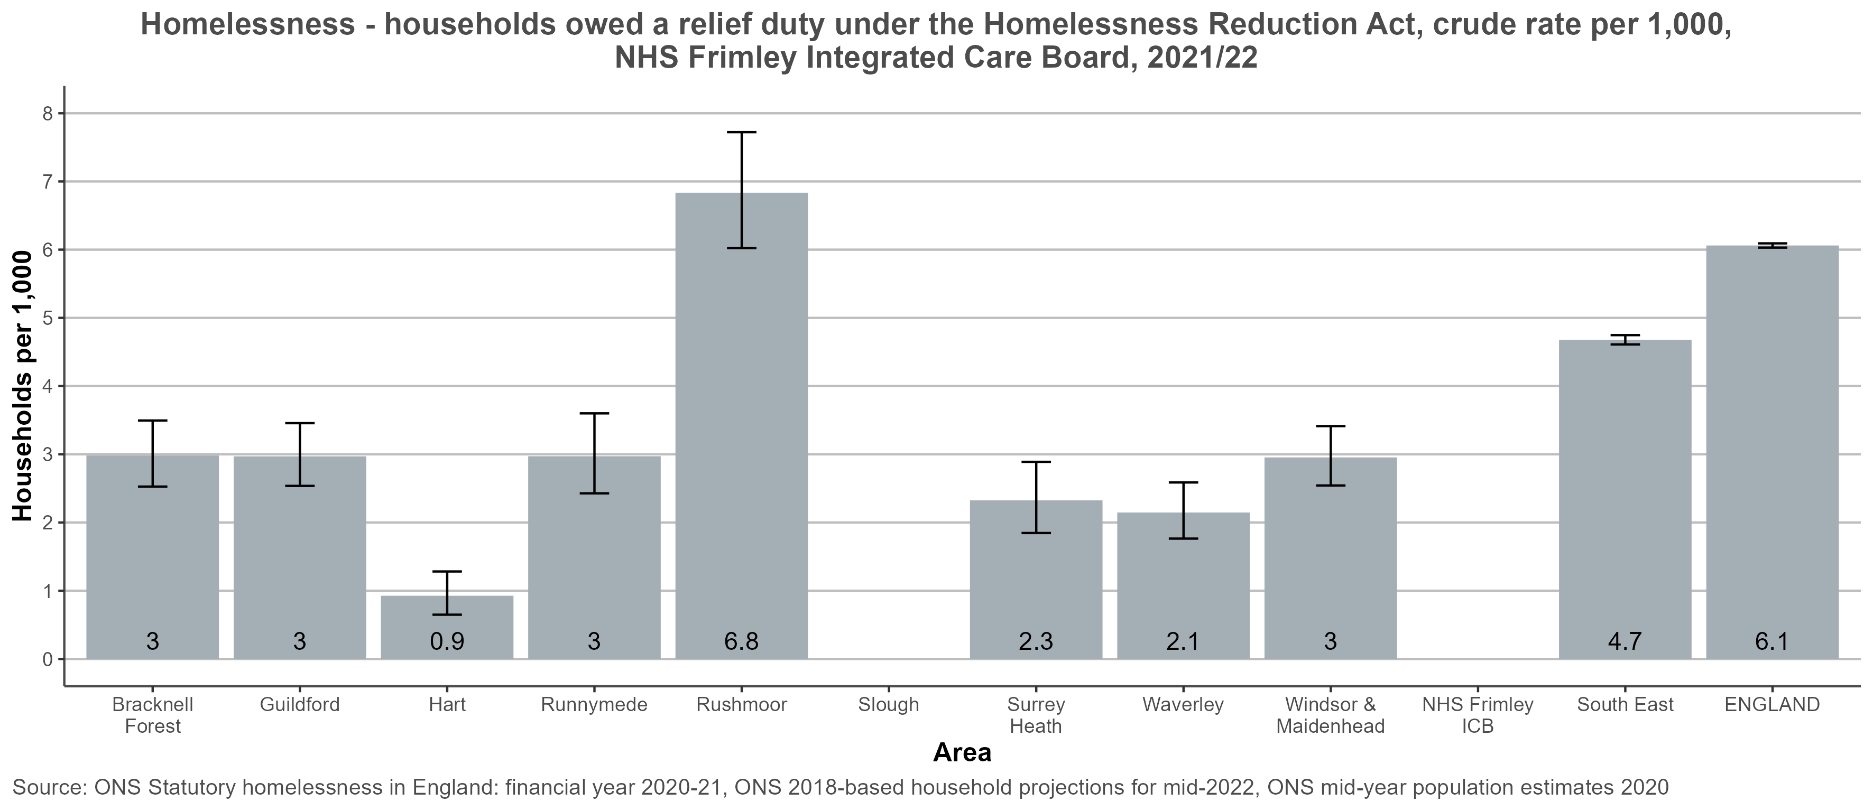
Households owed a relief duty under the Homelessness Reduction Act - NHS Frimley ICB
Return to Contents
Notes:
Values for ICBs have been calculated from local authority figures using the PHE aggregations method. The data for any LA, which is only partly in an ICB, is for the whole LA and not for the part within the ICB. The proportion for the ICB (where available) is aggregated from the data for each LA which has been weighted for the part of the population within the ICB.
Cases where a local authority figure have not been provided is due to missing data. ICB values are not shown when local authority source data used to estimate the ICB value is missing.
Full details of the method can be found in the Technical Guide – Aggregation. (copy and paste into browser for link).

Slide 39
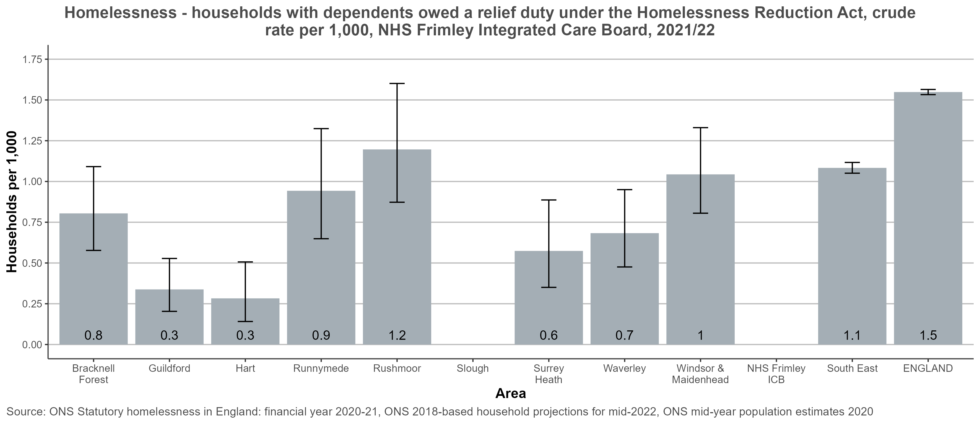
Households with dependents owed a relief duty under the Homelessness Reduction Act - NHS Frimley ICB
Return to Contents
Notes:
Values for ICBs have been calculated from local authority figures using the PHE aggregations method. The data for any LA, which is only partly in an ICB, is for the whole LA and not for the part within the ICB. The proportion for the ICB (where available) is aggregated from the data for each LA which has been weighted for the part of the population within the ICB.
Cases where a local authority figure have not been provided is due to missing data. ICB values are not shown when local authority source data used to estimate the ICB value is missing.
Full details of the method can be found in the Technical Guide – Aggregation. (copy and paste into browser for link).

Slide 40
Homelessness – Temporary Accommodation
Return to Contents

Slide 41
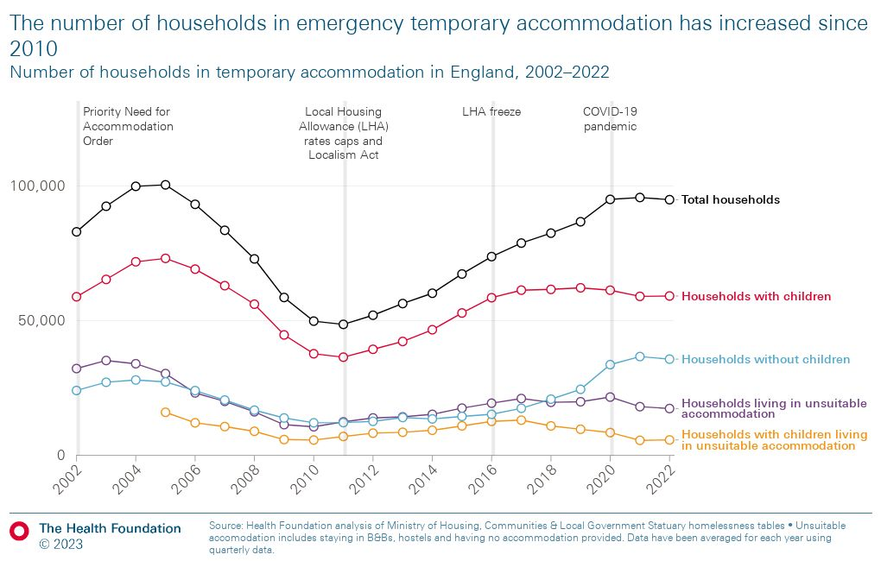
Households in emergency temporary accommodation in England
Temporary accommodation (TA) is a broad term given to the housing which local authorities provide for people who are deemed as being in priority need (mostly families with children, pregnant women, or people with disabilities) and eligible (dependent on immigration status), when the authority does not have anywhere suitable straight away. It can include B&Bs, hostels, hotels, private rented houses or flats, and council or housing association properties.
The chart shows the number of households that have been placed in temporary accommodation in England since 2002 – people who have been classed by their local authority as being, or becoming, homeless and in need. The overall number of households in temporary accommodation has risen by 95% since 2011 (The Health Foundation).
On 31 March 2023, 104,510 households were in temporary accommodation, up 10.0% from the same period in 2022. The most common length of time for households with children to be in temporary accommodation was for 2 to 5 years accounting for 26.3% of households with children (Statutory homelessness in England 2022-2023).
Return to Contents

Slide 42
Health Impacts of Temporary Accommodation
Data from Shelter in 2022 revealed two-thirds of families living in Temporary accommodation have been there for more than 12 months (more than four-fifths for those in London). Two in three people report temporary accommodation as having a negative impact on their physical or mental health with 71% reporting that their stress or anxiety had worsened because of their living situation (Shelter). A significant proportion of people in temporary accommodation have physical health problems but, like other types of homelessness, they often experience barriers to accessing health services, particularly primary and preventative healthcare.
Growing up in temporary accommodation can have a profound effect on the health outcomes of children and young people¹, in particular those under the age of five years². It can affect their life chances by limiting access to universal healthcare, e.g. immunisation; disrupting education; and loss of social and family support if the family is placed "out of area". One evidence review found children who have been in temporary accommodation for more than a year are over three times more likely to demonstrate mental health problems such as anxiety and depression than non-homeless children. They were also at greater risk of infections and accidents³.
A 2023 report by the All Party Parliamentary Group for Households in Temporary Accommodation, reviewed child deaths in the National Child Mortality Database reported between 1 April 2019 and 31 March 2022. They found there were at least 200 individual records where homelessness or living in temporary accommodation were recorded as present in the child’s mother, child, or child’s family life at some stage. In the finalised case reviews, 34 cases had homelessness and temporary accommodation recorded by the independent child death overview panel as factors that may have contributed to the child’s vulnerability, ill health or death. In a further 39 child death reviews, overcrowding, threats/enforcement of evictions, and extended family accommodation were recorded as factors that may have contributed to the child’s vulnerability, ill health or death. Most of the children were under the age of 1 year.
Return to Contents
Notes:
Shelter (2023) Still living in limbo. Why the use of temporary accomodation must end. Still_Living_in_Limbo.pdf (ctfassets.net)
Rosenthal DM, Lewis C, Heys M, Schoenthaler AM, Ucci M, Hayward A, et al. (2021) Barriers to Optimal Health for Under 5s Experiencing Homelessness and Living In Temporary Accommodation in High-Income Countries: A Scoping Review. Ann Public Health Res 8(1): 1103. Barriers to Optimal Health for Under 5s Experiencing Homelessness and Living In Temporary Accommodation in High-Income Countries: A Scoping Review (ucl.ac.uk)
Shelter (2006) Chance of a lifetime. The impact of bad housing on children's lives. Chance_of_a_Lifetime.pdf (ctfassets.net)

Slide 43
Homelessness – Households in Temporary Accommodation
The charts on the following slides look at scale of the issue of homelessness by capturing the number of households in temporary accommodation as of June 30th 2022.
Rates are shown per 1,000 households. For example, on the following slide, the South East has a value of 2.9, this implies that in the South East, 2.9 households out of 1,000 households are owed a relief duty.
The data is broken down at a local authority level; where no figure is shown for a local authority this implies that the source data for that local authority is missing.
ICB values have been calculated from local authority figures using the PHE aggregations method where possible. The data for any LA, which is only partly in an ICB, is for the whole LA and not for the part within the ICB. The proportion for the ICB (where available) is aggregated from the data for each LA which has been weighted for the part of the population within the ICB. In cases where a local authority value is missing, the ICB value cannot be calculated. Confidence intervals for ICBs cannot be calculated where local authority geographies used to build up to the ICB geography are overlapping (further details are outlined in the Technical Guidance for the aggregation method).
Full details on numerator and denominator definitions are provided in the notes on each slide.
Return to Contents

Slide 44
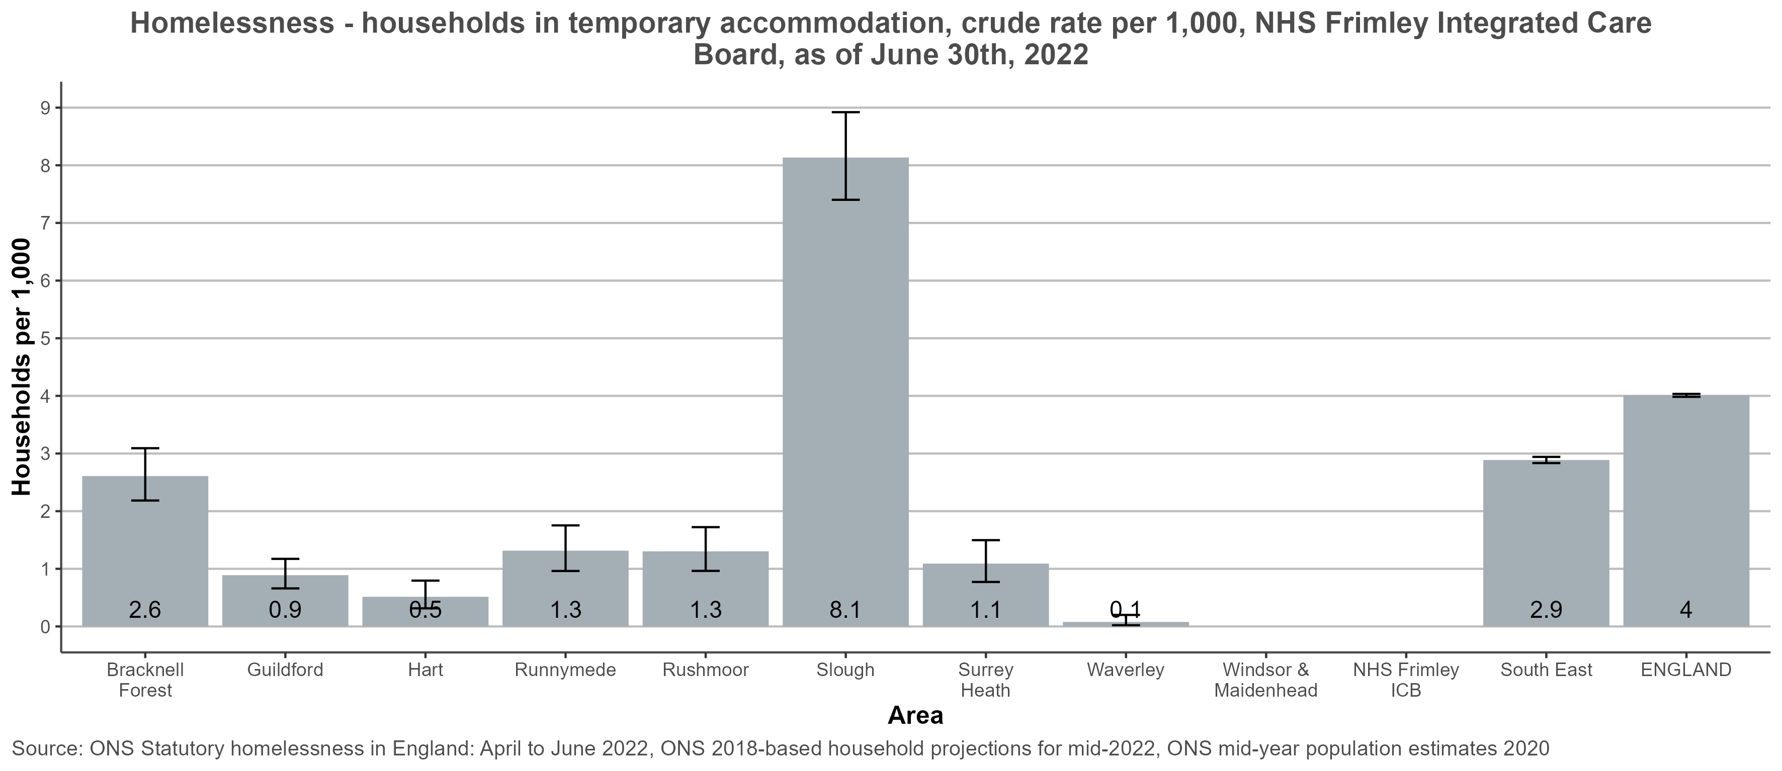
Households in temporary accommodation - NHS Frimley ICB
Return to Contents
Notes:
Definition:
Households in temporary accommodation, crude rate per 1,000 estimated total households. This is a snapshot of all the households living in temporary accommodation as of June 30th 2022.
Definition of numerator:
The numerator is the number of households in temporary accommodation. That is, households living in temporary accommodation secured by a local housing authority under their statutory homelessness functions. There is no standard definition of the duration of “temporary” accommodation. For single people or couples, the average wait in temporary accommodation can be 12 or more months and for families, the average wait is often even longer https://commonslibrary.parliament.uk/research-briefings/sn02110/ Local authorities use a variety of types of accommodation as temporary housing for homeless households, including: private sector rented housing, social housing let on short term tenancies, hostel or refuge accommodation (sometimes with shared cooking or washing facilities), bed and breakfast accommodation, and others, such as supported lodgings and mobile homes.
Definition of denominator: The denominator is the estimated total number of households within each area. A household is defined as one person living alone or a group of people (not necessarily related) living at the same address who share cooking facilities and share a living room or sitting room or dining area. This includes sheltered accommodation units in an establishment where 50% or more have their own kitchens (irrespective of whether there are other communal facilities) and all people living in caravans on any type of site that is their usual residence. This will include anyone who has no other usual residence elsewhere in the UK. For further details see: Methodology used to produce household projections for England: 2018 based https://www.ons.gov.uk/peoplepopulationandcommunity/populationandmigration/populationprojections/methodologies/methodologyusedtoproducehouseholdprojectionsforengland2018based
Caveats on ICB values:
Values for ICBs have been calculated from local authority figures using the PHE aggregations method. The data for any LA, which is only partly in an ICB, is for the whole LA and not for the part within the ICB. The proportion for the ICB (where available) is aggregated from the data for each LA which has been weighted for the part of the population within the ICB. Cases where a local authority figure have not been provided is due to missing data. ICB values are not shown when local authority source data used to estimate the ICB value is missing.
Full details of the method can be found in the Technical Guide – Aggregation.

Slide 45
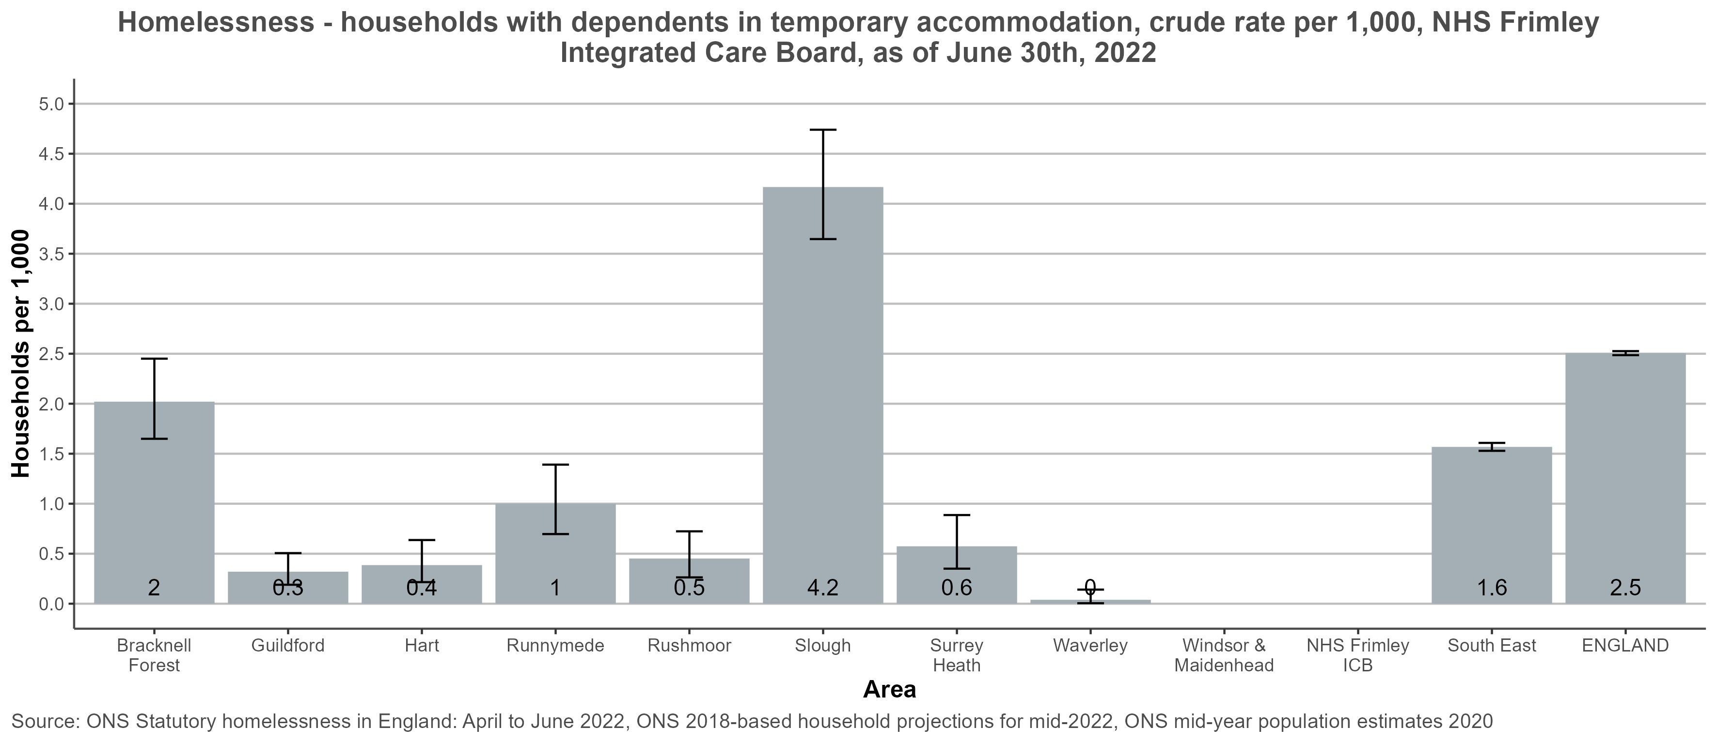
Households with dependents in temporary accommodation - NHS Frimley ICB
Return to Contents
Notes:
Definition:
Households with at least one or more dependents in temporary accommodation, crude rate per 1,000 estimated total households. This is a snapshot of all the households living in temporary accommodation as of June 30th 2022. Children should count as dependent if they're under 18 and living at home. An 18 year old can also count as dependent if they're in full time education or can't support themselves for other reasons, and they live at home.
Definition of numerator:
The numerator is the number of households with at least one or more dependents in temporary accommodation. That is, households with at least one or more dependents living in temporary accommodation secured by a local housing authority under their statutory homelessness functions. There is no standard definition of the duration of “temporary” accommodation. For single people or couples, the average wait in temporary accommodation can be 12 or more months and for families, the average wait is often even longer https://commonslibrary.parliament.uk/research-briefings/sn02110/ Local authorities use a variety of types of accommodation as temporary housing for homeless households, including: private sector rented housing, social housing let on short term tenancies, hostel or refuge accommodation (sometimes with shared cooking or washing facilities), bed and breakfast accommodation, and others, such as supported lodgings and mobile homes.
Definition of denominator: The denominator is the estimated number of households within each area where the household includes at least one dependent child. A household is defined as one person living alone or a group of people (not necessarily related) living at the same address who share cooking facilities and share a living room or sitting room or dining area. This includes sheltered accommodation units in an establishment where 50% or more have their own kitchens (irrespective of whether there are other communal facilities) and all people living in caravans on any type of site that is their usual residence. This will include anyone who has no other usual residence elsewhere in the UK. For further details see: Methodology used to produce household projections for England: 2018 based https://www.ons.gov.uk/peoplepopulationandcommunity/populationandmigration/populationprojections/methodologies/methodologyusedtoproducehouseholdprojectionsforengland2018based
Caveats on ICB values:
Values for ICBs have been calculated from local authority figures using the PHE aggregations method. The data for any LA, which is only partly in an ICB, is for the whole LA and not for the part within the ICB. The proportion for the ICB (where available) is aggregated from the data for each LA which has been weighted for the part of the population within the ICB. Cases where a local authority figure have not been provided is due to missing data. ICB values are not shown when local authority source data used to estimate the ICB value is missing.
Full details of the method can be found in the Technical Guide – Aggregation.

Slide 46
Homelessness – mental health
Return to Contents

Slide 47
Homelessness – Households with mental health problems
In the latest Homeless Link Homelessness Health Needs Assessment, the number of people with a mental health diagnosis had increased substantially from 45% in 2014 to 82% in 2018 – 2021¹. The most frequently reported mental health conditions were depression, anxiety disorder or phobia, and dual diagnosis with a drug or alcohol problem. Serious mental health issues such as schizophrenia, bipolar and post traumatic stress disorder (PTSD) are far more common amongst homeless people. In 2021, alcohol specific causes and suicide accounted for 9.6% and 13.4% of estimated deaths of homeless people (ONS 2022).
NHS England has funded a number of outreach services, providing co-ordinated efforts to ensure that rough sleepers have better access to NHS mental health support, joining up care with existing outreach, accommodation, drug and alcohol and physical healthcare services.
The charts on the following slides show the proportion of households owed a main duty where one or more members of the household suffer from mental health problems. This is presented as a percentage of the total number of households owed a main duty. For example, the South East has a value of 13.2%, this implies that in the South East, 13.2% of households owed a main duty have a member of the household with mental health problems.
The data is broken down at a local authority level; where no figure is shown for a local authority implies that the source data for that local authority is missing. ICB values have been calculated from local authority figures using the PHE aggregations method where possible. The data for any LA, which is only partly in an ICB, is for the whole LA and not for the part within the ICB. The proportion for the ICB (where available) is aggregated from the data for each LA which has been weighted for the part of the population within the ICB.
Return to Contents

Slide 48
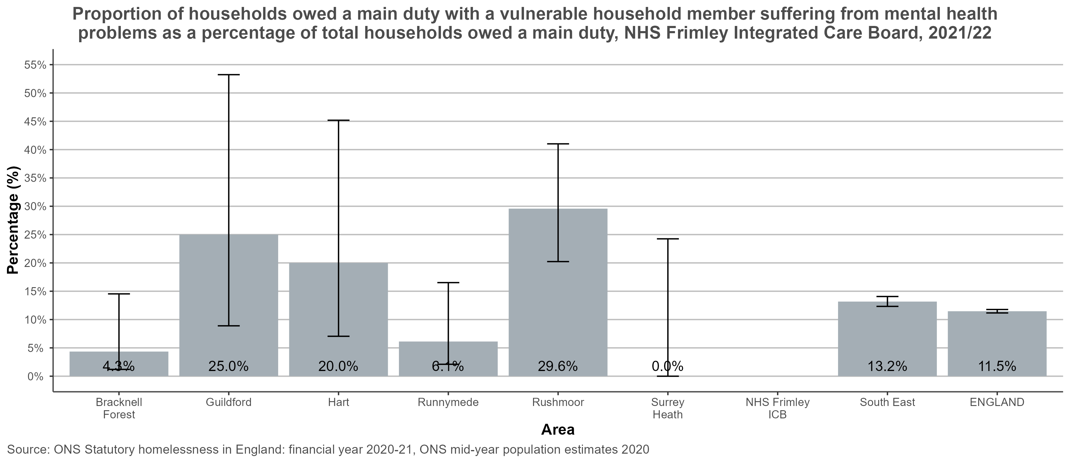
Households with mental health owed a main duty:
NHS Frimley ICB
Return to Contents
Notes:
Definition: Percentage of households owed a main duty, with a support need recorded indicating the household includes one or more individuals with a history of mental health problems, in 2021/2022
Definition of numerator:
Number of all households owed a main duty, who have a support need recorded indicating the household includes one or more individuals with a history of mental health problems, in 2021/2022
Definition of denominator:
Number of all households owed a main duty in 2021/2022 Caveats on ICB values:
Values for ICBs have been calculated from local authority figures using the PHE aggregations method. The data for any LA, which is only partly in an ICB, is for the whole LA and not for the part within the ICB. The proportion for the ICB (where available) is aggregated from the data for each LA which has been weighted for the part of the population within the ICB. Cases where a local authority figure have not been provided is due to missing data. ICB values are not shown when local authority source data used to estimate the ICB value is missing.
Full details of the method can be found in the Technical Guide – Aggregation.
Other Caveats
Support needs are self-reported, so this indicator is subject to the limitations of self-reported data.

Slide 49
Homelessness – Deaths
Return to Contents

Slide 50
Deaths whilst experiencing homelessness: National data
In 2021, there were an estimated 741 deaths of homeless people in England and Wales. Although this was statistically similar to the estimated number of deaths during 2018 – 2021, the estimate in 2021 is significantly higher than the estimates for the period 2013 to 2017, indicating an upward trend. The estimate for 2021 was 53.7% higher than the first estimate in 2013, representing an additional 259 deaths.
The main causes of death in 2021 were as follows:
Drug poisoning – 35% of deaths
Suicide – 13.4% of deaths
Alcohol specific deaths – 9.6% of deaths
Related to coronavirus – 3.5% of deaths
The vast majority of deaths (87.3%) were amongst men, consistent with findings in previous years. The mean age of death was 45.4 years for men and 43.2 years for women.
Of note, the definition used here relies on information provided on death certificates and does not align with official statistics on homelessness produced by public bodies. For example, these statistics do not use the same definition of homelessness as rough sleeper counts or statutory homelessness. In addition, statistics are based on the year of death registration, not necessarily when the death occurred.
See further information on Safeguarding Adult Reviews.
.
Source: Source: Deaths of homeless people in England and Wales - Office for National Statistics (ons.gov.uk)
Return to Contents

Slide 51
Numbers of deaths of homeless people in English region and Wales, deaths registered in 2021
In 2021, the South East region had the third highest number of estimated deaths of homeless people in England.
It should be noted that there is significant variation across the region.
The ONS figures reported here are the total estimated numbers, except for identified records. The method used provides a robust but conservative estimate, so the real numbers may still be higher.
Deaths of homeless people in England and Wales - Office for National Statistics (ons.gov.uk)
Return to Contents

Slide 52
Deaths of homeless people per million population: 2013 - 2021
This chart demonstrates the trend in estimated deaths of homeless people for both England and the South East from 2013 – 2021.
Deaths are identified from death registration records held by ONS and allocated to the year of death registration. This is likely to be an under-estimate of the actual numbers.
On the following slide, data is presented at ICB level, describing the number of deaths occurring in people experiencing homelessness in 2021
Source: Deaths of homeless people in England and Wales - Office for National Statistics (ons.gov.uk)
Return to Contents
Notes:
Notes
Deaths of homeless people were identified from the death registration records held by ONS, and a statistical method called capture-recapture modelling was applied to estimate the most likely number of additional registrations not identified as homeless people. The figures reported here are the total estimated numbers, except where specifically described as being based on identified records only. The method used provides a robust but conservative estimate, so the real numbers may still be higher.

Slide 53
Deaths occurring in people experiencing homelessness (2021):
NHS Frimley ICB
Area Name | Identified deaths | Estimated deaths | Estimated deaths per million total population
Bracknell Forest | 0 | 0
Slough | 0 | 0
Windsor and Maidenhead | 1 | 2
Hart | 0 | 0
Rushmoor | 0 | 0
Guildford | 2 | 3 | 26.6
Runnymede | 0 | 0
Surrey Heath | 0 | 0
Waverley | 0 | 0
Source: Source: Deaths of homeless people in England and Wales, Office for National Statistics.
Available from Deaths of homeless people in England and Wales - Office for National Statistics (ons.gov.uk)
Return to Contents
Notes:
Definitions
Homelessness: The definition of homelessness used in this release follows from what is available in death registrations data to identify affected individuals. Our statistics mainly include people sleeping rough or using emergency accommodation such as homeless shelters and direct access hostels, at or around the time of death. An upper age limit of 74 years is applied to avoid accidental inclusion of elderly people who died in some institutional settings. This means that a small number of genuine deaths of homeless people aged 75 years or over might have been excluded. We also exclude deaths for those below the age of 15 due to it being difficult to unambiguously identify homelessness in this group with the data we have.
Identified and estimated deaths: Deaths of homeless people were identified from the death registration records held by ONS, and a statistical method called capture-recapture modelling was applied to estimate the most likely number of additional registrations not identified as homeless people. The figures reported here are the total estimated numbers, except where specifically described as being based on identified records only. The method used provides a robust but conservative estimate, so the real numbers may still be higher.
Notes
- Some local authorities will appear on for multiple ICBs where part of the local authority exists within the ICB (regardless of the portion of the local authority within the ICB)
- Figures are for deaths registered, rather than deaths occurring in each calendar year.
- Figures for England and Wales may include deaths of non-residents.
- For definitions, including why the data are only for those aged 15 to 74 years, see 'definition' tab in this workbook.
- Rates are based on total population of England and Wales aged 15 to 74 years, NOT total numbers of homeless people.
- Rates calculated where there are fewer than 20 deaths need to be treated with caution as they are potentially unreliable. Rates were not calculated where there were fewer than 3 deaths estimated
- Where it has not been possible to calculate a rate due to the number of deaths being 3 or below, these have been marked with a colon (:).
More information on deaths in the homeless population can be found at a national level on the Spotlight tool:
https://analytics.phe.gov.uk/apps/spotlight/

Slide 54
Homelessness Resources & Organisations
Resources
Homelessness: applying All Our Health
NICE Guideline 214 – Integrated health and social care for people experiencing homelessness
Homeless and Inclusion Health standards for commissioners and service providers
Guidance on the duty to refer
Beyond the ward: Exploring the Implementation of the Duty to Refer in Hospital Settings
Homeless and Inclusion Health Programme – The Queen’s Nursing Institute
Supporting people experiencing homelessness in an accident and emergency setting
Citizens Advice cost-of-living data dashboard
Ending rough sleeping for good
Better than cure? | Crisis UK
Organisations
Homeless Link
Pathway
Crisis
Groundswell
Return to Contents

Slide 55
Gypsy, Roma, Travellers
Return to Contents

Slide 56
Gypsy, Roma Travellers: Contents
Gypsy, Roma Travellers: Key messages
Gypsy, Roma Travellers: an overview
Inequalities experienced by Gypsy, Roma Travellers
Gypsies’ and Traveller’s lived experiences, overview in England and Wales
Gypsy, Roma Traveller populations (2021 Census data)
Number of traveller caravans on authorised sites in the South East
Count of Traveller caravans by site type
Gypsy, Roma Travellers: Organisations
Return to Contents

Slide 57
Gypsy, Roma Travellers: Key messages
Gypsy, Roma Traveller communities are among the most disadvantaged minority groups in the UK with life expectancies 10 – 25 years shorter than the general population.
They face significant discrimination and stigma, resulting in lower access to both preventative services and healthcare, leading to worse health outcomes across a range of measures, including an infant mortality rate which is 3 times higher than that of the general population¹.
Despite being an available ethnic category within NHS services, Gypsy, Roma Travellers are often not recognised in the data. As a result, healthcare services are often unaware of the severe inequalities that exist and are unable to measure progress against tackling them.
Return to Contents
Notes:
1. O’Reilly P, Jenkinson A, Martin T, et al. G294(P) Health and disease in children of the ‘ irish traveller’ community. Archives of Disease in Childhood 2018;103:A120.

Slide 58
Gypsy, Roma, Travellers: an overview
The 2021 census identified 63,443 Gypsy or Irish Travellers in England and Wales, with over 100,000 people identifying as Roma¹. This is likely to be an underestimate with the biannual Traveller caravan count and school roll figures suggesting there are around 200,000 – 300,000 Romany Gypsy and Traveller people living in England and Wales.
Gypsy, Roma and Traveller communities are among the most disadvantaged minority groups in the UK. They are vulnerable to a range of negative health outcomes, created through a combination of health conditions, delayed healthcare seeking and barriers to accessing healthcare. They can experience challenges to registering with a GP surgery, with subsequent barriers to accessing screening and preventative healthcare.
Issues relating to stigma and discrimination may mean that individuals are less likely to self-declare as being a member of this community, resulting in this population often not being recognised in data sets. Therefore, local data is often lacking on health outcomes. Services often fail to recognise and account for the premature onset of typically age-related conditions in this community. The average health of a Romany or Traveller person in their 60s is comparable to that of a White person in their 80s¹, meaning a much younger onset of conditions such as frailty, falls and dementia.
Return to Contents
Notes:
1. Watkinson RE, Sutton M, Turner AJ. Ethnic inequalities in health-related quality of life among older adults in England: secondary analysis of a national cross-sectional survey. Lancet Public Health. 2021 Mar;6(3):e145-e154. doi: 10.1016/S2468-2667(20)30287-5. Epub 2021 Jan 29. PMID: 33516278.

Slide 59
Inequalities experienced by Gypsy, Roma Travellers
The suicide rate for Irish Traveller women is 6 times higher than the general population and seven times higher for Irish Traveller men¹.
Romany and Traveller people face life expectancies between 10 and 25 years shorter than the general population².
In 2016 – 2017, Gypsy or Irish traveller people aged 65 and over had the lowest health related quality of life of all ethnic groups³.
Children from Irish Traveller families are over 3 times as likely to be eligible for free school meals than White British Children⁴.
Infant mortality rate among the Irish Traveller population is 3.5 times that of the general population with 10% of Traveller children dying before their second birthday⁵.
At all key stages, Gypsy, Roma and Irish traveller pupil’s attainment was below the national average³.
Gypsies, Travellers and Roma are less likely to access immunisation with barriers cited including language, low literacy, discrimination and low trust⁶.
Gypsies and Travellers are three times as likely to suffer from anxiety and twice as likely to suffer from depression compared to the general population⁷.
42% of Gypsies and Travellers are affected by a long-term condition, compared to 18% of the general population⁸.
Return to Contents
Notes:
All Ireland Traveller Health Study
Gypsies and Travellers: simple solutions for living together | Equality and Human Rights Commission (equalityhumanrights.com)
Gypsy, Roma and Irish Traveller ethnicity summary - GOV.UK Ethnicity facts and figures (ethnicity-facts-figures.service.gov.uk)
Latest percentage eligible for Free School Meals by ethnicity - a Freedom of Information request to Department for Education – WhatDoTheyKnow
G294(P) Health and disease in children of the ‘ irish traveller’ community | Archives of Disease in Childhood (bmj.com)
Jackson, C., Bedford, H., Cheater, F.M. et al. Needles, Jabs and Jags: a qualitative exploration of barriers and facilitators to child and adult immunisation uptake among Gypsies, Travellers and Roma. BMC Public Health 17, 254 (2017). https://doi.org/10.1186/s12889-017-4178-y
Parry G, Van Cleemput P, Peters J, Walters S, Thomas K, Cooper C. (2007). Health status of Gypsies and Travellers in England. J Epidemiol Community Health. 2007 Mar;61(3):198-204. doi: 10.1136/jech.2006.045997.
Improving access to Healthcare for Gypsies and Travellers, homeless people and sex workers. Royal College of General Practioners. September 2013.

Slide 60
Gypsies’ and Travellers' lived experiences: England and Wales 2022
In November 2021, the Office for National Statistics (ONS) commissioned Derbyshire Gypsy Liaison Group to collaborate on a research project into the experiences, priorities and needs of Gypsy and Traveller communities in England and Wales.
Key findings included:
The importance of close-knit family and social groups and of shared moral values was described as fundamental to Gypsy and Traveller culture, communities and wellbeing
Participants' living situations varied greatly from houses or flats, to chalets on private land and large sites owned and managed by the local authority. The lack of authorised stopping places was described, along with an apprehension of being moved on by Police.
Barriers to employment include a lack of skills, education or formal qualifications and perceived discrimination from employers, colleagues and the settled community
A range of health conditions was described, along with delayed healthcare seeking and barriers to accessing healthcare which were highlighted as potentially creating vulnerability to negative health outcomes. Particular challenges included:
Environmental factors including site locations and standards
Challenges in registering with a GP surgery without a fixed address
Delays in diagnosis and treatment along with delayed access to screening and preventative care
Perceived discrimination and derogatory attitudes of healthcare providers
Familiarity, understanding and open communication with trusted health practitioners were described as supportive to access and engagement with healthcare.
Gypsies’ and Travellers’ lived experiences, overview, England and Wales (ONS)
Return to Contents

Slide 61
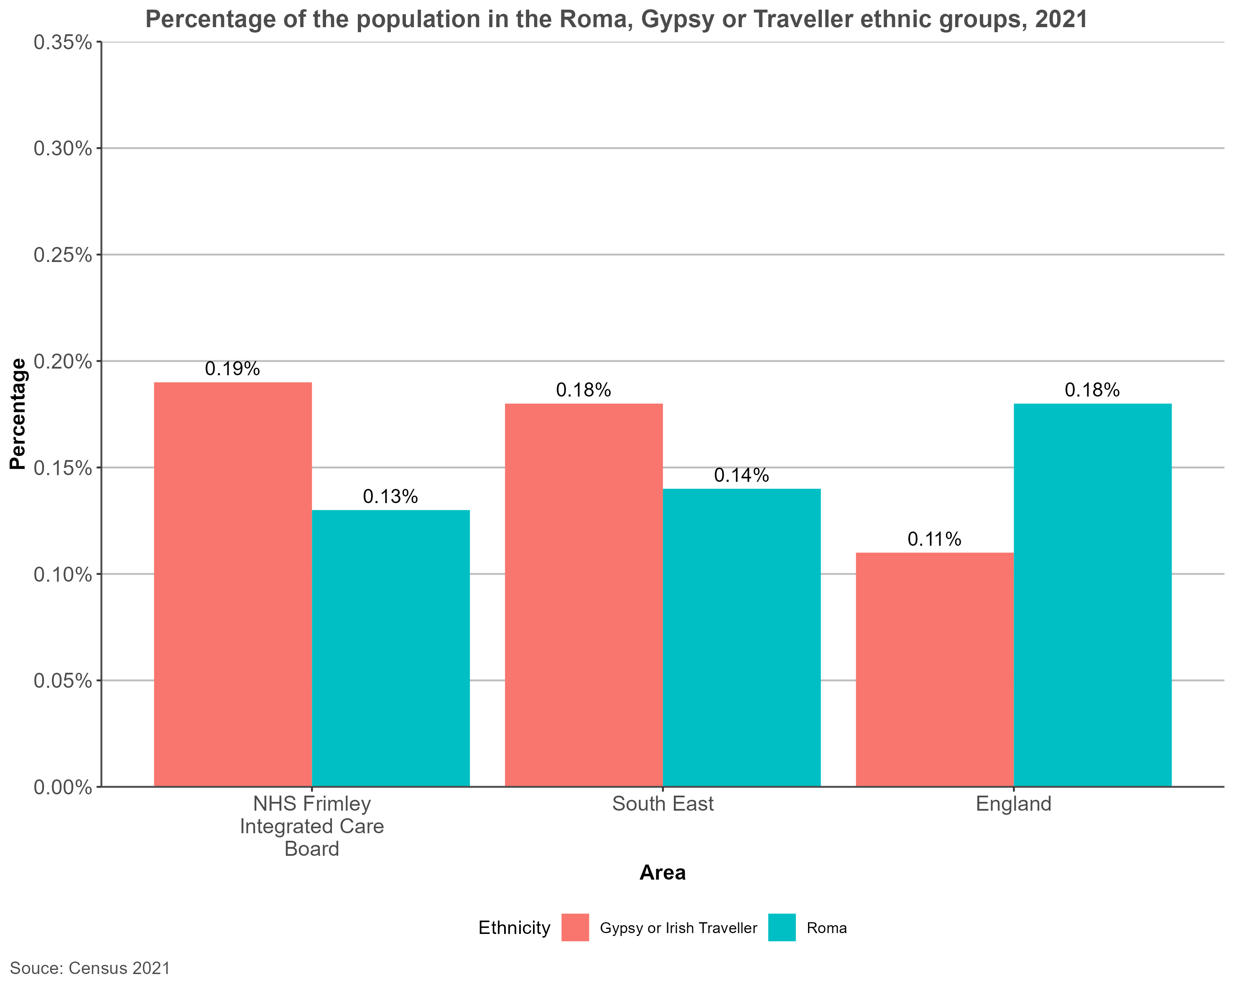
Roma, Gypsy and Irish Travellers: NHS Frimley ICB
0.13% (1,018) of the population of NHS Frimley Integrated Care Board identify as Roma. This can be compared to 0.14% (12,202) for the South East and 0.18% (99,102) for England Similar figures are seen for the Gypsy or Irish Traveller group where 0.19% (1,420) of the population of NHS Frimley Integrated Care Board identify as Gypsy or Irish Traveller. Compared to 0.18% (16,598) for the South East and 0.11% (64,214) for England Due to the nature of these groups, very limited data is available when looking at health inequalities and breakdowns.
Source: 2021 Census. Available from Nomis - Official Census and Labour Market Statistics (nomisweb.co.uk)
Return to Contents

Slide 62
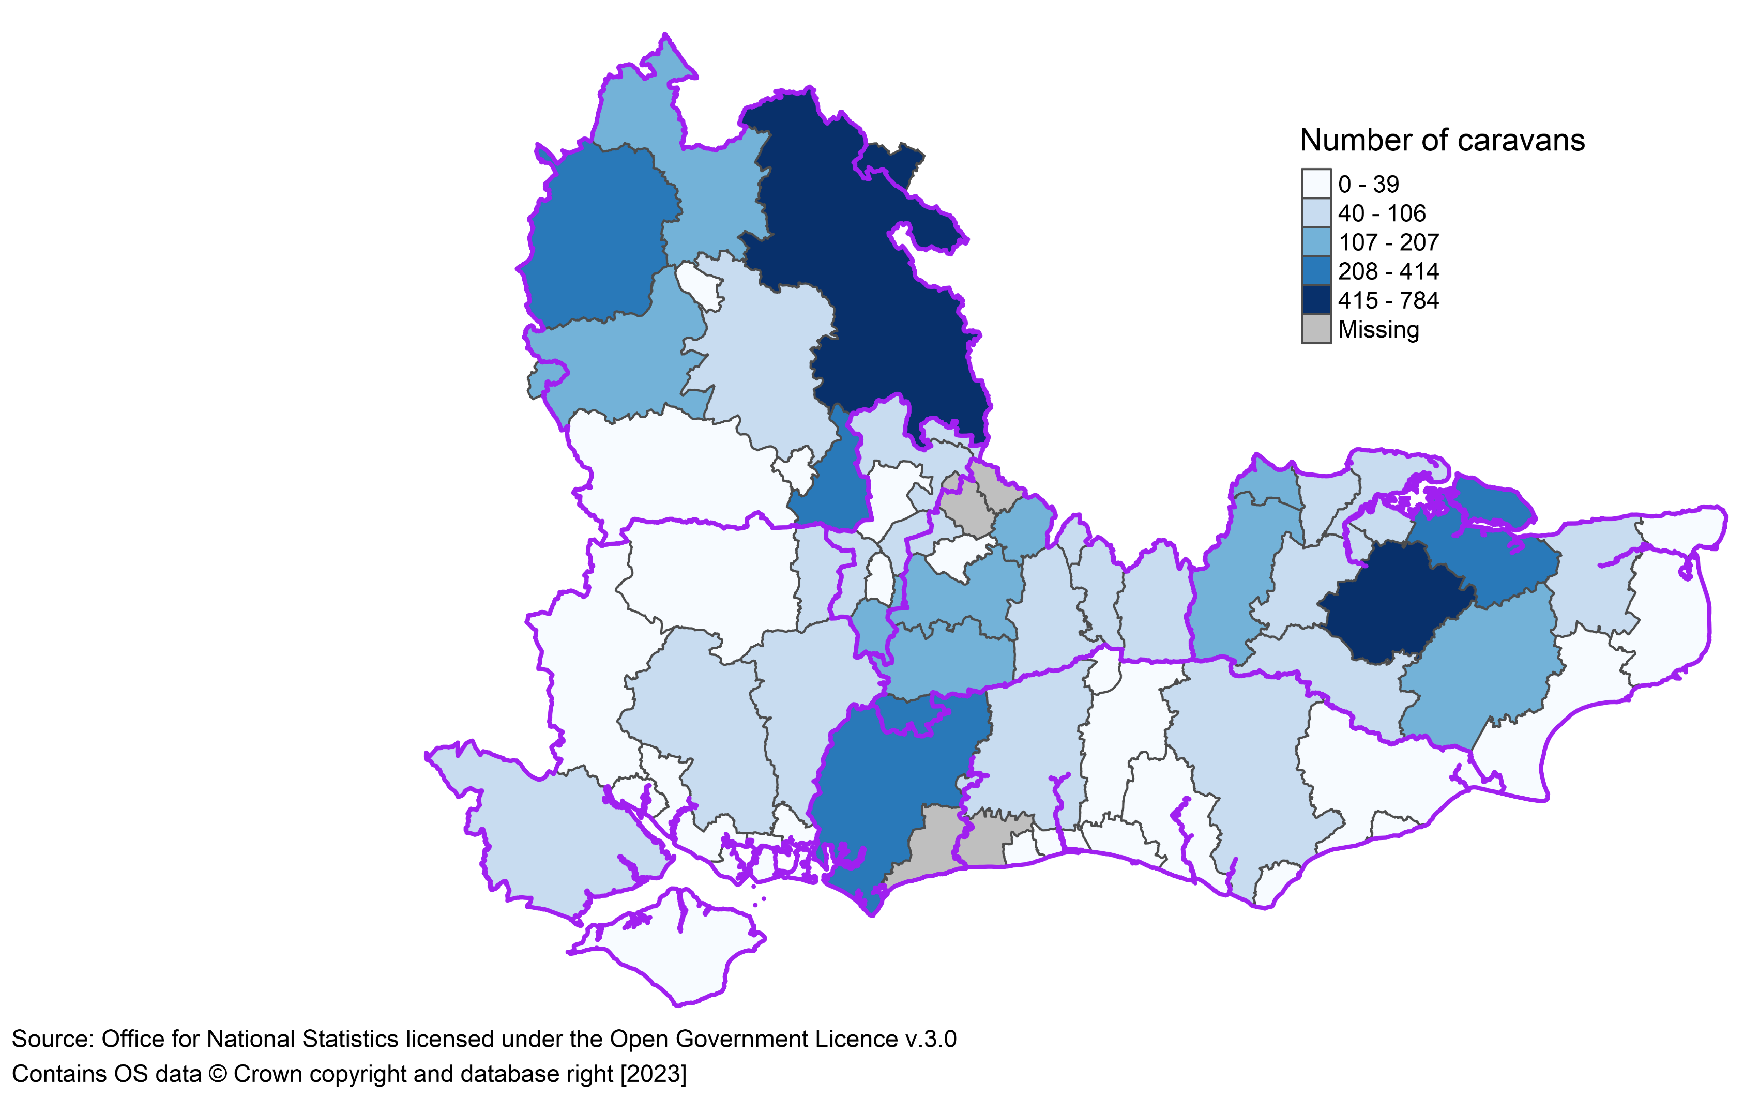
Number of traveller caravans on authorised sites in the South East, by lower tier local authority, July 2022
Buckinghamshire and Maidstone had the highest number of traveller caravans on authorised sites in the South East in July 2022 (784 and 608 caravans respectively)
ICB boundaries
Source: Count of Traveller Caravans, Department for Levelling Up, Housing & Communities (2022). Available from Traveller caravan count - GOV.UK (www.gov.uk)
Return to Contents
Notes:
Data Source: Count of Traveller caravans, July 2022: England - GOV.UK (www.gov.uk): Department for Levelling Up, Housing & Communities, (2022)
In the South East in July 2022, data for Canterbury and Chichester have been partially or totally imputed due to non-submission or data quality issues.

Slide 63
Count of Traveller caravans by site type – South East, July 2022 (excluding Milton Keynes)
 | Number of Traveller caravans, July 2022 | Percentage of total caravans, July 2022
Caravans on authorised sites (with planning permission) | 5,415 | 86.5%
Socially rented caravans | 1,154 | 18.4%
Private caravans Temporary planning permission Permanent planning permission | 4,261 178 4,083 | 68.1% 2.8% 65.3%
Caravans on unauthorised sites (without planning permission) | 842 | 13.5%
Caravans on sites on Travellers' own land Tolerated Not tolerated | 775 222 553 | 12.4% 3.5% 8.8%
Caravans on sites not on Travellers' own land Tolerated Not tolerated | 67 20 47 | 1.1% 0.3% 0.8%
Total all Traveller caravans | 6,257 | 100.0%
Source: Count of Traveller Caravans, Department for Levelling Up, Housing & Communities (2022). Available from Traveller caravan count - GOV.UK (www.gov.uk)
Return to Contents
Notes:
Local authorities count the number of Traveller caravans every two years. The data are submitted to the Department for Levelling Up, Housing & Communities. Not all local authorities provided a count and some data were imputed due to non-submission or data quality issues.
In the South East in July 2022, data were not submitted for at least 3 consecutive counts in Arun, Runneymede and Spelthorne.
In the South East in July 2022, data for Canterbury and Chichester have been partially or totally imputed due to non-submission or data quality issues.
Notes:
The Traveller Caravan Count publication is compiled from information submitted by local authorities in England in order to provide local data on the number and seasonal movement of caravans. The count of traveller caravans’ publication is collected on a particular count day, providing a snapshot of the number of caravans on the day of the count. Local authorities carried out the July 2021 count on or around 22 July 2021.
The Traveller Caravan Count was previously known as the ‘Gypsy and Traveller Caravan Count’, however, there has been no change in the coverage of the count. It continues to include caravans lived in by Traditional and Ethnic Gypsies and Travellers as well as members of the non-traditional New Traveller groups who live in caravans or other moveable dwellings. The department does not collect information on the number of occupants residing in these caravans or caravan sites, ethnicity or any other characteristics of caravan occupants
Definition of 'Gypsy/Traveller':
a) a person with a cultural tradition of nomadism or of living in a caravan; and
b) all other persons of a nomadic habit life, whatever their race or origin including –
i) such persons who, on grounds only of their own or their family's or dependant's educational or health needs or old age, have ceased to travel temporarily or permanently; and
ii) members of an organised group of travelling show people or circus people (whether or not travelling together as such).
Definition of 'caravan':
a) all mobile homes, caravans, trailers and other living vehicles on Gypsy/Traveller sites and encampments, whether or not they meet the strict legal definition of a caravan
b) touring caravans on Gypsy and Traveller sites and encampments even if not lived in permanently c) tents, benders or yurts where these are the ‘permanent’ living accommodation of Gypsies or Travellers.
Definition of a ‘pitch’: an area of land on a Gypsy and Traveller site normally occupied by one licensee family, sometimes referred to as a plot. Pitches can vary in size and the maximum number of caravans able to be located at each pitch depends on the size of the pitch, but must not exceed four caravans on any one pitch.
Types of sites:
Authorised public sites – operated by local authorities and private registered providers of social housing, including housing associations, trusts and cooperatives;
• authorised private sites – privately funded sites with planning permission;
• unauthorised developments – sites on land owned by travellers for which planning permission had not been granted at the time of count;
Unauthorised encampments – sites on land not owned by travellers and which do not have planning permission.
Types of unauthorised sites: Unauthorised sites are classified as either ‘Tolerated’ or ‘Not Tolerated’ A 'Tolerated' site is one where the local authority has decided not to seek the removal of the encampment, and where the encampment has been, or is likely to be, allowed to remain for an indefinite period of time.
Some examples of a site which would be classified as 'Not Tolerated' are where:
- A planning enforcement notice has been served (including Temporary Stop Notices),
- The results of a planning enquiry are pending,
- An injunction has been sought,
- The compliance period has been extended.
Transit, residential/permanent and Travelling Showpeople pitches/sites:
Transit pitches/sites are authorised sites that are used for short stays by Gypsies and Travellers. The sites are usually provided on a permanent basis (but intended for temporary use by residents) by local authorities and have basic amenities and services, such as water supply, shared toilets, washing facilities/utility room and waste disposal. They may be used for days or weeks, up to a maximum of three months. The length of stay generally varies between 28 days and 13 weeks.
Residential pitches/sites are either provided by local authorities or are owned by Gypsies and Travellers themselves. The sites are used as long-term residences. Sites often contain a number of separate pitches, occupied by each Gypsy or Traveller household, although single pitch sites are also common. Council-owned residential sites are managed by either the local authority or a local housing partner and have a number of amenities, including water supply, electricity, individual toilets and utility rooms.

Slide 64
Count of Traveller caravans by site type – NHS Frimley ICS, July 2022
 | Caravans on authorised sites (with planning permission) |  |  | Caravans on unauthorised sites (without planning permission)
Local Authority | Socially rented caravans | Private caravans | Total caravans on authorised sites | Caravans on Traveller's own land | Caravans on sites not on Travellers' own land | Total unauthorised caravans | Total traveller caravans
Bracknell Forest | 13 | 22 | 35 | 0 | 0 | 0 | 35
Slough | 60 | 0 | 60 | 12 | 0 | 12 | 72
Windsor & Maidenhead | 32 | 66 | 98 | 14 | 7 | 21 | 119
Hart | 31 | 60 | 91 | 0 | 0 | 0 | 91
Rushmoor | 0 | 0 | 0 | 0 | 0 | 0 | 0
Guildford | 82 | 90 | 172 | 5 | 0 | 5 | 177
Runnymede** | - | - | - | - | - | - | -
Surrey Heath | 49 | 17 | 66 | 3 | 0 | 3 | 69
Waverley | 11 | 196 | 207 | 0 | 0 | 0 | 207
** data not submitted for at least 3 consecutive counts
Source: Count of Traveller Caravans, Department for Levelling Up, Housing & Communities (2022). Available from Traveller caravan count - GOV.UK (www.gov.uk)
Return to Contents
Notes:
Notes
Some local authorities will appear on multiple ICBs where part of the local authority exists within the ICB (regardless of the portion of the local authority within the ICB)
Counts could not be estimated for the ICB because the source area data is incomplete
The Traveller Caravan Count publication is compiled from information submitted by local authorities in England in order to provide local data on the number and seasonal movement of caravans. The count of traveller caravans’ publication is collected on a particular count day, providing a snapshot of the number of caravans on the day of the count. Local authorities carried out the July 2021 count on or around 22 July 2021.
The Traveller Caravan Count was previously known as the ‘Gypsy and Traveller Caravan Count’, however, there has been no change in the coverage of the count. It continues to include caravans lived in by Traditional and Ethnic Gypsies and Travellers as well as members of the non-traditional New Traveller groups who live in caravans or other moveable dwellings. The department does not collect information on the number of occupants residing in these caravans or caravan sites, ethnicity or any other characteristics of caravan occupants
Definition of 'Gypsy/Traveller':
a) a person with a cultural tradition of nomadism or of living in a caravan; and
b) all other persons of a nomadic habit life, whatever their race or origin including –
i) such persons who, on grounds only of their own or their family's or dependant's educational or health needs or old age, have ceased to travel temporarily or permanently; and
ii) members of an organised group of travelling show people or circus people (whether or not travelling together as such).
Definition of 'caravan':
a) all mobile homes, caravans, trailers and other living vehicles on Gypsy/Traveller sites and encampments, whether or not they meet the strict legal definition of a caravan
b) touring caravans on Gypsy and Traveller sites and encampments even if not lived in permanently c) tents, benders or yurts where these are the ‘permanent’ living accommodation of Gypsies or Travellers.
Definition of a ‘pitch’: an area of land on a Gypsy and Traveller site normally occupied by one licensee family, sometimes referred to as a plot. Pitches can vary in size and the maximum number of caravans able to be located at each pitch depends on the size of the pitch, but must not exceed four caravans on any one pitch.
Types of sites:
Authorised public sites – operated by local authorities and private registered providers of social housing, including housing associations, trusts and cooperatives;
• authorised private sites – privately funded sites with planning permission;
• unauthorised developments – sites on land owned by travellers for which planning permission had not been granted at the time of count;
Unauthorised encampments – sites on land not owned by travellers and which do not have planning permission.
Types of unauthorised sites: Unauthorised sites are classified as either ‘Tolerated’ or ‘Not Tolerated’ A 'Tolerated' site is one where the local authority has decided not to seek the removal of the encampment, and where the encampment has been, or is likely to be, allowed to remain for an indefinite period of time.
Some examples of a site which would be classified as 'Not Tolerated' are where:
- A planning enforcement notice has been served (including Temporary Stop Notices),
- The results of a planning enquiry are pending,
- An injunction has been sought,
- The compliance period has been extended.
Transit, residential/permanent and Travelling Showpeople pitches/sites:
Transit pitches/sites are authorised sites that are used for short stays by Gypsies and Travellers. The sites are usually provided on a permanent basis (but intended for temporary use by residents) by local authorities and have basic amenities and services, such as water supply, shared toilets, washing facilities/utility room and waste disposal. They may be used for days or weeks, up to a maximum of three months. The length of stay generally varies between 28 days and 13 weeks.
Residential pitches/sites are either provided by local authorities or are owned by Gypsies and Travellers themselves. The sites are used as long-term residences. Sites often contain a number of separate pitches, occupied by each Gypsy or Traveller household, although single pitch sites are also common. Council-owned residential sites are managed by either the local authority or a local housing partner and have a number of amenities, including water supply, electricity, individual toilets and utility rooms.

Slide 65
Gypsy, Roma Travellers: Organisations
Friends, Families & Travellers
The Traveller Movement
Margaret Clitherow Trust
Leeds Gate Gypsy & Traveller Exchange
Pavee Point: Traveller and Roma Centre
Roma Support Group
Return to Contents

Slide 66
Sex workers
Return to Contents

Slide 67
Sex workers: Contents
Sex workers: Key messages
Sex workers overview
Sex workers and the law
Visual representation of the various "sectors" of sex work
Exploring the Health and Wellbeing (HWB) needs of Sex Workers in two English Regions
Sex workers: demographics
Health outcomes for sex workers
Sex workers: Resources and organisations
Return to Contents

Slide 68
Sex workers: Key messages
Studies have shown that the population of sex workers is diverse and rapidly changing but there is a lack of data and insight which makes analysis difficult. Whilst routine data does not exist at national, regional or local level, this does not mean that addressing the health and care needs of sex workers are not important.
Many sex workers experience a syndemic, where a multitude of social problems, such as poverty, violence and homelessness, combine to negatively impact on health in a way that is more severe than if they were affected by just a single social issue.
Sex work is associated with high levels of social stigma. Fear of stigmatisation and of criminalisation result in reduced contact with health and other support services, compounding health issues and leading to greater social exclusion.
Return to Contents

Slide 69
Sex workers overview 1/2
Limited data was found regarding sex workers in the UK. A systematic review and meta-analysis of four inclusion health populations found that sex workers were the least well investigated^{1.} The NIHR is currently offering funding as part of the Public Health Research Programme to look at what interventions improve health outcomes for sex workers². The lack of data is in part due to the following reasons³: Criminalization: Sex work is largely criminalized in the UK, which means that sex workers often operate underground and may be reluctant to share information about their work. This can make it difficult to gather accurate data. Stigma: There is a significant social stigma attached to sex work, which can make sex workers hesitant to reveal their identities or provide information about their work. This can lead to underreporting and inaccurate data. Methodological challenges: Conducting research on sex work can be methodologically challenging. For example, it can be difficult to obtain a representative sample of sex workers, as they may be dispersed across different locations and may be difficult to identify. It can also be challenging to develop questions that are sensitive to the experiences of sex workers and that will elicit accurate and meaningful responses. One study, which surveyed sex workers aged 19 years or older, found 37% of participants did not disclose their occupation to healthcare providers³.
The lack of routinely collected data means this pack does not include data at an ICB level. It is however recognised that local data may be available as part of bespoke pieces of work or needs assessments. While routine data does not exist at national, regional or local level, this does not mean the issue is not important.
Return to Contents
Notes:
1. Aldridge R.W. et al (2018) Morbidity and mortality in homeless individuals, prisoners, sex workers, and individuals with substance use disorders in high-income countries: a systematic review and meta-analysis. Lancet; 391:241-50 Morbidity and mortality in homeless individuals, prisoners, sex workers, and individuals with substance use disorders in high-income countries: a systematic review and meta-analysis - The Lancet
2. National Institute for Health and Care Research (2023) 23/27 Interventions to improve health outcomes for sex workers
3. Benoit C, Smith M, Jansson M, Magnus S, Maurice R, Flagg J, et al. Canadian Sex Workers Weigh the Costs and Benefits of Disclosing Their Occupational Status to Health Providers Sex Res Soc Policy. 2019;16:329-41 Available from: doi:10.1007/s13178-018-0339-8

Slide 70
Sex workers overview 2/2
"Sex work lies in the intersection of a broad range of health inequalities. The complexity of the issue and morality politics cannot stand in the way of recognising the health risks sex workers face. It is time to put the health and safety of sex workers at the forefront of policy decisions and crucial to offer a structure for the implementation of effective policy interventions, protection, and research."​
The Lancet editorial, February 2023​
Sex workers are a diverse population, based on the type of services they provide, so their health and wellbeing needs vary. In the UK, sex work is associated with a number of poor health outcomes and sex workers are disproportionately at risk of poor physical and mental health. Street-based sex workers are highly marginalised, facing face disproportionate health inequities and harms related to: substance use; blood borne viruses, such as HIV, hepatitis B, and hepatitis C; and sexually transmitted infections (STIs)^{1,2,3}.
Sex workers can encounter high rates of physical, verbal, and sexual violence from intimate partners, with perpetrators posing as clients¹. Reporting these offences is largely dependent on the quality of local relationships with police⁵. Some sex workers encounter additional stigma, for example, people who are from gender or sexual minority populations. The changing nature of sex work means that increasingly, work is being carried out in off the street and online environments, using digital platforms for engagement⁴. Not all sex work is experienced in the same way with the type of sex work and the entry and exit points into the work varying significantly. It, therefore, may be difficult to distinguish sex workers from other patients.
It is important to recognise that the varied type of sex work means there is a broad range of occupational experiences. This population group reflects the intersectionality with other inclusion health groups, such as homelessness, modern slavery, drug and alcohol dependence and contact with the criminal justice system.
Return to Contents
Notes:
Johnson L, Potter LC, Beeching H, Bradbury M, Matos B, Sumner G, Wills L, Worthing K, Aldridge RW, Feder G, Hayward AC, Pathak N, Platt L, Story A, Sultan B, Luchenski SA. Interventions to improve health and the determinants of health among sex workers in high-income countries: a systematic review. Lancet Public Health. 2023 Feb;8(2):e141-e154. doi: 10.1016/S2468-2667(22)00252-3. Epub 2022 Nov 2. PMID: 36334613; PMCID: PMC10564624.
Creighton S, Tariq S, Perry G. Sexually transmitted infections among UK street-based sex workers. Sex Transm Infect. 2008;84(1):32–3.
Mc Grath-Lone L, Marsh K, Hughes G, et al. The sexual health of female sex workers compared with other women in England: analysis of cross-sectional data from genitourinary medicine clinics. Sexually Transmitted Infections 2014;90:344-350.
National Institute for Health and Care Research (2023) 23/27 Interventions to improve health outcomes for sex workers
Platt L, et al. Associations between sex work laws and sex workers’ health: A systematic review and meta-analysis of quantitative and qualitative studies. PLOS Medicine. 2018;15(12):e1002680.

Slide 71
Visual representation of the various "sectors" of sex work
Sex workers: A guide for professionals (2021)
Return to Contents

Slide 72
Sex workers and the law
The exchange of sexual services for money is legal in the UK (apart from in Northern Ireland where it's illegal to pay for sex). 'Sex work' can be prostitution, stripping or lap dancing, performing in pornography, phone or internet sex, or any other sexual services in return for money, goods, or other agreed items.
The National Ugly Mugs charity defines sex work as "the exchange of sexual services for money or resources. This definition incorporates a range of different modes of sex work, including, but not limited to: street sex work, brothel work, escorting, adult film, stripping, professional BDSM services, phone sex and camming".
The following activities are illegal under the Sexual Offences Act 2003:
soliciting (trying to get clients) on the street or other public place, including someone in a vehicle
paying for the services of a sex worker who is forced or threatened into it
owning or managing a brothel (any premises which is used by more than one person for sex work)
pimping (someone who has control over sex workers and the money they earn)
advertising sexual services, including putting cards in phone boxes.
Return to Contents

Slide 73
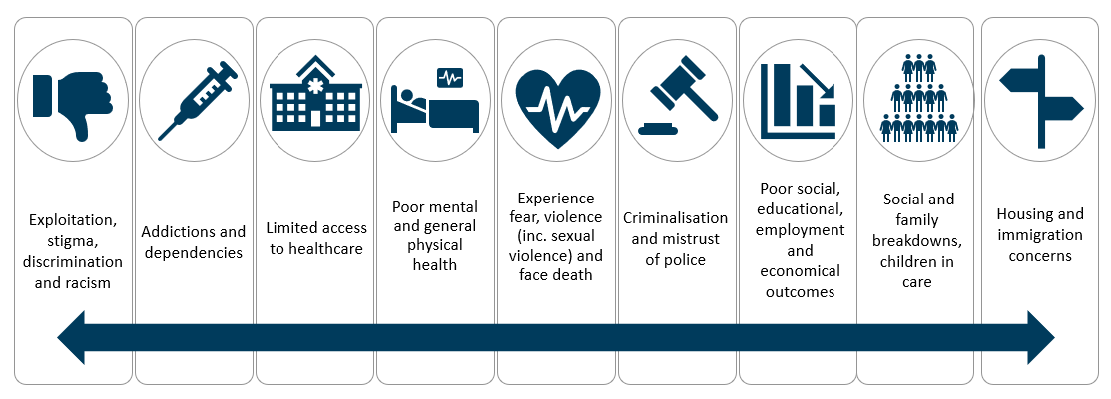
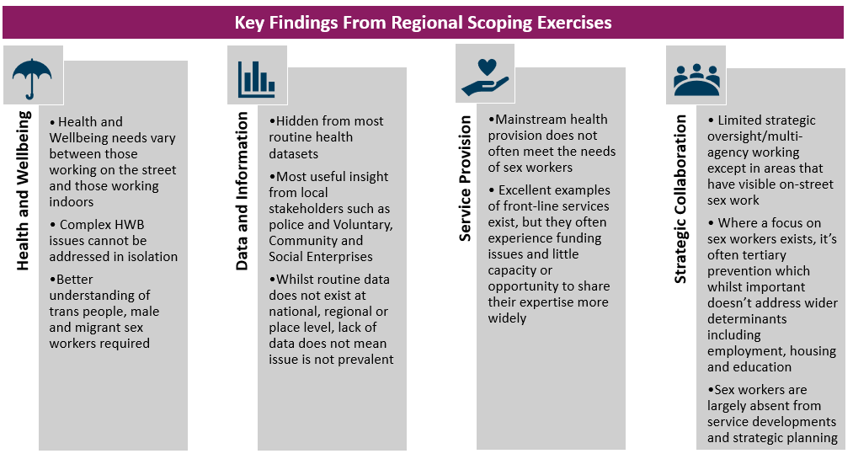
Exploring the Health and Wellbeing (HWB) needs of Sex Workers in two English Regions
Georgina Wilkinson, Shahin Parmar: UK Health Security Agency, 61 Colindale Avenue, London NW9 5EQ
Cathie Railton: Office for Health Improvement and Disparities, Quarry House, Quarry Hill, Leeds, LS2 7UA
INTRODUCTION
FURTHER WORK
As an inclusion health group, sex workers often experience the most extreme health inequalities (Figure 1). This population is however largely unidentified (even within broader inclusion health work) due various factors including stigma and the hidden - often transient - nature of sex work.
Work is ongoing to respond to the issues identified from the scoping exercises:
Multi-agency steering group, including lived experience representation, established to take Yorkshire and Humber work forward
Development of a public health approach to sex work resource
Research proposal submitted for a multi-sited evaluation of third sector-led health interventions for street sex workers in the North of England
Self-assessment tool aimed at all key partners
Introduction of Law Enforcement Public Health tool for frontline police officers
Case study template for local government, service providers, the police and voluntary sector
Sex worker Ladder of Interventions produced to determine if a measure is deemed acceptable or not
Library of research, policy and best practice via open access Knowledge Hub platform
METHODS
Work was initiated in two English regions (East of England and Yorkshire and Humber) for different reasons. The East of England saw an increase in syphilis in a group of sex workers whilst Yorkshire and Humber recognised that sex workers were not considered in broader inclusion health work. Scoping work was undertaken to better understand the needs, scale, range, and distribution of sex worker populations across both regions.
Figure 1: Inequalities experienced by sex workers
OUTCOMES and SUMMARY
Figure 2 highlights the common findings and outcomes of investigations from each area.
Sex workers are not being recorded within health datasets and can therefore be absent from service developments and strategic planning. Effective partnership working, and strong relationships need to be established across health, public health, local government, third sector, and police to address this complex and sensitive issue.
ACKNOWLEDGEMENTS
We would like to acknowledge all stakeholders and people with lived experiences across both regions who have contributed towards work to date and for their ongoing support.
Figure 2: Common findings from each regional scoping exercise
Notes:
This poster was presented at the UKHSA Annual Conference in November 2023. Included with thanks to the authors. https://www.yhphnetwork.co.uk/links-and-resources/coi/inclusion-health/sex-work/

Slide 74
Sex workers: demographics
Studies indicate a diverse and rapidly changing population but lack of data and information makes analysis difficult.
The exact number of sex workers in the UK is unknown but the general consensus suggests the population is between 50,000 and 80,000¹
Women make up the majority of the sex work population, estimated around
85-90% ²
The remaining population is made up of men and transgender sex workers
It is estimated that around 37% of UK commercial sex workers are migrants with as many as 52% of migrants coming from Eastern Europe^{1.}
Population surveys in the United Kingdom have documented an increase in the number of men paying for sex from 5.6% in 1990 to 8.8% in 2000^{3.}
Sex workers can come from diverse socio-economic backgrounds⁴
Many factors drive entrance into sex work: financial factors (debt, poverty, cost of living), homelessness and/or insecure housing, drug and alcohol dependence, violence, family breakdown/leaving care, low education, mental health⁴;
Return to Contents
Notes:
UK Network of Sex Work Projects [UK NSWP] Working with Migrant Sex Workers. Good practice guidance. London: UK NSWP.
Scambler, G. (2007) Sex Work Stigma: Opportunist Migrants in London. Sociology, 41: 1079.
Johnson A M, Mercer C H, Erens B.et al Sexual behaviour in Britain: partnerships, practices, and HIV risk behaviours. Lancet 20013581835–1842.
Balfour, R, Allen J, (2014) A Review of the Literature on Sex Workers and Social Exclusion By the UCL Institute of Health Equity for Inclusion Health, Department of Health April 2014

Slide 75
Health outcomes for sex workers 1/2
Studies show sex workers experience poor mental health, with increased rates of anxiety, depression, loneliness, post-traumatic stress disorder, self-harm, and suicide¹.
Many sex workers face large barriers to accessing health and social care, despite their need. There are few specialist services for this community, and mainstream services are often unaware of sex working and are not tailored to sex workers' needs. A study showed that sex workers have access to high-quality care through the GUM clinic network, but there is evidence of geographical inequality in access to these services².
Despite high rates of chronic disease, reproductive health need, respiratory disease and health problems related to substance misuse, most clinical services for Street Sex Workers (SSW) predominantly focus on sexual health². There is an absence of high-quality evidence for effective healthcare provision for SSWs³ but research has described the main challenges in providing healthcare to SSWs as services being inflexible, poorly-resourced services and services not being trauma-informed.
In addition to their high burden of unmet health need⁴, sex workers face severe, complex social inequity, which can often contribute to their many health issues, such as homelessness or insecure housing, unemployment, adverse childhood experiences, gender and racial inequality, poverty, sex work criminalisation, violence and exploitation, and the setting of sex work³.
During and post-Covid, reports have shown how sex workers were often excluded from government health protection and financial support resources. A recent report from the UK national charity, National Ugly Mugs, highlighted the experiences of sex workers facing the cost-of-living crisis, with workers saying they are facing fewer clients and having to "offer riskier and more emotionally draining services“.
Return to Contents
Notes:
Martín-Romo, L, Sanmartín, FJ, Velasco, J. Invisible and stigmatized: A systematic review of mental health and risk factors among sex workers. Acta Psychiatr Scand. 2023; 148(3): 255-264. doi:10.1111/acps.13559
Mc Grath-Lone L, Marsh K, Hughes G, et al. The sexual health of female sex workers compared with other women in England: analysis of cross-sectional data from genitourinary medicine clinics. Sexually Transmitted Infections 2014;90:344-350.
Potter, L.C., Horwood, J. & Feder, G. Access to healthcare for street sex workers in the UK: perspectives and best practice guidance from a national cross-sectional survey of frontline workers. BMC Health Serv Res 22, 178 (2022). https://doi.org/10.1186/s12913-022-07581-7
Aldridge R.W. et al (2018) Morbidity and mortality in homeless individuals, prisoners, sex workers, and individuals with substance use disorders in high-income countries: a systematic review and meta-analysis. Lancet; 391:241-50 Morbidity and mortality in homeless individuals, prisoners, sex workers, and individuals with substance use disorders in high-income countries: a systematic review and meta-analysis - The Lancet

Slide 76
Health outcomes for sex workers 2/2
Female sex workers are twice as likely to be diagnosed with chlamydia and 3 times more likely to be diagnosed with gonorrhoea than other female sexual health clinic attendees in England ^{1.}
Sexually Transmitted Infection (STI) risk is estimated to be higher in street based sex workers, who are at greater risk of unsafe sex and less likely to access sexual health services^{2.}
More than two thirds (68%) of female sex workers meet the criteria for post-traumatic stress disorder (PTSD)³. The more types of violence reported (childhood physical and sexual abuse, rape and physical assault while working), the greater the severity of PTSD symptoms.
A study of female sex workers in London, found their mortality rate was 12 times higher than women from the general population⁴.
Return to Contents
Notes:
Mc Grath-Lone L, Marsh K, Hughes G, et al. The sexual health of female sex workers compared with other women in England: analysis of cross-sectional data from genitourinary medicine clinics. Sexually Transmitted Infections 2014;90:344-350. (The sexual health of female sex workers compared with other women in England: analysis of cross-sectional data from genitourinary medicine clinics | Sexually Transmitted Infections (bmj.com))
Jeal N, Salisbury C. A health needs assessment of street-based prostitutes: cross-sectional survey. J Public Health (Oxf). 2004 Jun;26(2):147-51. doi: 10.1093/pubmed/fdh124. PMID: 15284317. (A health needs assessment of street-based prostitutes: cross-sectional survey - PubMed (nih.gov)
Farley M, Barkan H. Prostitution, violence and posttraumatic stress disorder. Women and Health. 1998;27:37–49
Ward H, Day S, Weber J. Risky business: health and safety in the sex industry over a 9 year period. Sex Transm Infect. 1999 Oct;75(5):340-3. doi: 10.1136/sti.75.5.340. PMID: 10616360; PMCID: PMC1758230.

Slide 77
Sex workers: Resources and groups
Resources:
Sex Workers a guide for professionals
Mental Health Resources: Mental Health Resources – National Ugly Mugs
A scoping to understand the health and wellbeing needs of sex workers in Yorkshire and the Humber Sex Work (yhphnetwork.co.uk)
Organisations:
National Ugly Mugs: There is organisation membership for practitioners doing front-line work with sex workers. It is free to join: Information for Practitioners – National Ugly Mugs
Beyond the Streets
English Collective of Prostitutes
Return to Contents

Slide 78
Vulnerable migrants
Return to Contents

Slide 79
Vulnerable migrants: Contents
Vulnerable migrants: Key Messages
Vulnerable migrants: An overview
Health outcomes for vulnerable migrants
Unaccompanied Asylum Seeking Children (UASC)
Safe and legal routes for refugees to come to the UK
South East Migration Schemes Data Explorer
Health Intelligence Pack for Migrant Health
Asylum applications over time: including breakdown by nationality
Migrant Statistics (Totals)
Percentage of live births to mothers born outside of the UK
Supported Asylum seekers: Section 95 support
Immigration Groups: England, South East and Local Authorities
Number of visa applications, visas issued and arrivals in the UK by sponsor location
Vulnerable migrants: Resources
Return to Contents

Slide 80
Vulnerable migrants: Key messages
Vulnerable migrants can have a range of physical and mental health issues related to their previous experiences, which may then be exacerbated by the asylum process and experience of insecure housing, barriers to accessing healthcare, discrimination and stigma, among many other challenges.
Unaccompanied Asylum Seeking Children currently account for 9% of Looked After Children in England, and present with particular challenges such as dental health, emotional disorders including sleep difficulty and issues associated with navigating a new culture, language and education system.
Front line services, who incorporate the principles of psychological first aid and implement culturally competent, trauma informed practice, are key to providing support and addressing barriers to accessing health and other services.
Return to Contents

Slide 81
Vulnerable migrants: An overview
Although many migrants come to the UK to work or study and so are young and healthy, some groups of migrants may have increased health needs associated with their experiences either before, during or after migration which can make them particularly vulnerable to potential health needs. This includes the following groups:
Asylum seekers: a person who has applied for permission to stay in the UK
Refugees: a person given permission to stay in the UK
Unaccompanied children
People who have been trafficked: someone who has been moved to the UK to be exploited through forced labour, slavery or prostitution
Undocumented migrants (those living in the UK with no legal status)
Low paid migrant workers.
The OHID Migrant Health Guide includes comprehensive advice and guidance for healthcare practitioners on the health needs of migrant patients in relation to access to healthcare, assessing and treating patients, communicable and non-communicable disease, outbreak management and nutrition in relation to migrant patients.
Specialist support may be required for some refugees and asylum seekers due to their experience of violence and trauma. Language barriers can make it difficult to engage and access safe and effective healthcare.
Return to Contents

Slide 82
Health outcomes for vulnerable migrants
Vulnerable migrants can experience a wide range of health needs including:
On arrival to the UK, vulnerable migrants may have to navigate a new culture and language, along with an often complex legal immigration process. They may have vulnerabilities from their experiences which along with uncertainty for the future and resettlement can lead to an increased risk of psychological distress and suicide¹. This can be exacerbated by experiences including trauma, exposure to detention settings and social isolation.
Refugees and asylum seekers are often subject to inequalities under the wider determinants of health, which impact both physical and mental health. They are likely to experience poorer socio-economic status on arrival in a new country, with potentially limited access to services and welfare support. Restricted opportunities for employment can impact food and housing security, as well as the ability to settle in a supportive community² along with delayed access to education for their children. They may experience a loss of identify and status with challenges to integration, a lack of family and community support along with racism and discrimination. There are often barriers to accessing healthcare, including through both through language and digital exclusion.
All of these factors can exacerbate vulnerability, leaving people at risk of exploitation.
Communicable diseases Incomplete vaccination history Non-Communicable diseases Malnutrition and nutrient deficiencies Anaemia | Oral diseases Sexually transmitted infections Female Genital Mutilation Psychological disturbance due to violence and trauma
Return to Contents
Notes:
Kokou-Kpolou CK, Moukouta CS, Masson J, Bernoussi A, Cenat JM, Bacque MF. Correlates of grief-related disorders and mental health outcomes among adult refugees exposed to trauma and bereavement: a systematic review and future research directions. J Affect Disord. 2020;267:171–84.
Hynie M. The social determinants of refugee mental health in the post-migration context: a critical review. Can J Psychiatry. 2017;6(5):7.

Slide 83
Unaccompanied Asylum Seeking Children (UASC) (1/2)
The Home Office defines an Unaccompanied Asylum Seeking Child (UASC) as an individual who is under 18 when the asylum application is submitted, is not being cared for by an adult who by law has responsibility to do so, is separated from their parents and has applied for asylum in the United Kingdom in their own right. They are not a homogenous group but vary by age and background with a range of experiences of trauma, separation and loss, both before and during their asylum process.
Unaccompanied children are entitled to care and protection under the provisions of the Children Act 1989 (as amended by the Children and Young Persons Act 2008). The responsibility for these children is devolved to local authorities and once they reach 18 years old, the duty is held within the Care Planning and Care Leavers Regulations 2010 (amended in 2014 to take account of unaccompanied asylum seeking children). UASC represent 9% of all Looked After Children in England with the numbers of UASC increasing by 42% since pre-pandemic 2019 figures (Children Looked After in England).
Statutory guidance exists for local authorities on the Care of unaccompanied migrant children and child victims of modern slavery, including the requirement for an initial health assessment with a plan setting out how the local authority intends to meet the child’s health needs. This assessment should be carried out within 28 days of the child being registered with the local authority. In addition, NICE guidance for Looked-after children and young people refers to UASCs and includes recommendations on positive relationships, placement stability, safeguarding as well as health and wellbeing acknowledging the impact of trauma and the need for language and culturally sensitive care needs along with the danger of going missing.
Return to Contents

Slide 84
Unaccompanied Asylum Seeking Children (UASC) (2/2)
These children and young people can have significant physical and mental health needs including tooth decay, continence issues, emotional problems, sleep difficulty, body pain and injuries, unknown vaccination history and potential sexual abuse during their journey along with post-traumatic stress and mood disorders^{1,2,3}.
They can face challenges entering education in the UK following a potentially fragmented previous experience of education, while also navigating a change in culture and language.
Unaccompanied children are at high risk of mental illness, with post-traumatic stress disorder (PTSD), mood disorders and agoraphobia being among the most commonly reported conditions. These may be due to the stressors they have been exposed to either in their home country (for example war) and upon arrival (due to uncertainty over status and discrimination)^{4.} The sustained lack of a parental figure increases their vulnerability to mental health issues.
These children and young people are at increased risk of exploitation due to their circumstances and may have arrived as an UASC due to trafficking.
These children and young people require extensive support along with stability to enable them to adapt to their new environment, recognising their particular needs and vulnerabilities.
Return to Contents
Notes:
1. Banerjee T, Ajmal S, Khan A, et al. G526(P) Health needs of unaccompanied asylum seeker children- observations from initial health assessment in community paediatric clinic
Archives of Disease in Childhood 2019;104:A212.
2. Banerjee T, Khan A, Ajmal S, et al. 36 Overview of health needs of looked after children: observations from initial health assessment. BMJ Paediatrics Open 2021;5:doi: 10.1136/bmjpo-2021-RCPCH.24
3. Cowling I, Fleeman M, Upatissa M, et al. 430 Assessing the health needs of unaccompanied asylum-seeking children in the West Midlands. Archives of Disease in Childhood 2023;108:A57.
4. Reed RV, Fazel M, Jones L, Panter-Brick C, Stein A. Mental health of displaced and refugee children resettled in low-income and middle-income countries: risk and protective factors. Lancet. 2012 Jan 21;379(9812):250-65. doi: 10.1016/S0140-6736(11)60050-0. Epub 2011 Aug 9. PMID: 21835460.

Slide 85
Safe and legal routes for refugees to come to the UK
Scheme | Description | Length of leave granted | How long until settlement | Refugee status? | Application process
UK Resettlement | There are three different general resettlement schemes in partnership with the UN Refugee agency (UNHCR) and the UK government. Full details are in the UK Refugee Resettlement Policy guidance and include the UK resettlement scheme, Community Sponsorship and Mandate Scheme. | Six months LOTR | ILR granted on arrival | Yes | No
Family reunion | Where a person has refugee status and has not naturalised as a British citizen, they are entitled to bring their partner and children to the UK where they meet the requirements. | In line with refugee sponsor | In line with refugee sponsor | No | Yes
Hong Kong | The Hong Kong British National (Overseas) Visa was announced in July 2020 and the Appendix Hong Kong British National (Overseas) was introduced in January 2021. The scheme is covered in detail here. | 2.5 or 5 years | After continuous residence in UK of 5 years | No | Yes (£)
ARAP | The Afghan Relocation and Assistance Policy (ARAP) was announced in August 2021 for Afghan citizens who worked for or with the UK Government in exposed or meaningful roles and may include an offer of relocation to the UK for those deemed eligible by the Ministry of Defence and who are deemed suitable for relocation by the Home Office. | 6 months LOTR | ILR granted on arrival | No | Can submit request for eligibility
ACRS | The Afghan Citizens Resettlement Scheme was opened in January 2022 and prioritises those who have assisted the UK efforts in Afghanistan and vulnerable people including women and girls at risk and members of minority groups at risk. | 6 months LOTR | ILR granted on arrival | No | No
Homes for Ukraine | The Homes for Ukraine Sponsorship scheme is open to Ukrainian nationals who were resident in the Ukraine prior to January 2022, enabling those with a named eligible sponsor in the UK, who can provide accommodation, to apply for a visa. | 3 years | N/A. settlement is not available | No | Yes
Ukraine Family Scheme | The Ukraine Family Scheme enables individuals to come to the UK if they are a family member of a British citizen, someone with permission to settle in the UK or someone with refugee status or humanitarian protection in the UK. | 3 years | N/A. Settlement is not available. | No | Yes
Safe and legal routes - GOV.UK (www.gov.uk)
Return to Contents
Notes:
ILR: Indefinite Leave to Remain
LOTR: Leave outside the rules – this is leave granted by the Home Office using their discretion to a person who does not meet immigration rules but where there are exceptional circumstances which mean that a refusal of entry clearance or leave to remain would result in unjustifiably harsh consequences for the applicant or their family, but which do not render refusal a breach of ECHR Article 8, refugee convention or obligations.

Slide 86
South East Migration Schemes Data Explorer
The South East Migration Schemes Data Explorer is a tool which brings together data sources on migration to outline the numbers of individuals under each migration scheme at County and District level.
The tool has been produced by the South East Strategic Partnership for Migration (SESPM) which provides a leadership, co-ordination and advisory function for migration in the South East. They are hosted by South East Councils and provide support to all 70 South East local authority areas.
Return to Contents

Slide 87
Health Intelligence Pack for Migrant Health
The OHID Local Knowledge and Intelligence Service (LKIS) have recently published the Health Intelligence Pack for Migrant Health. This presents the latest available data on migrant populations intended to support regional and local stakeholders. The pack includes a range of indicators relevant to migrant populations, available at a regional and local authority level.
Routinely collected health data on migrants is lacking, both in the UK but also globally. Where migration data exists, it is often not linked with health data. The OHID national Inclusion Health Intelligence team are working on improving the reporting and collection of data on migrant health.
Return to Contents

Slide 88
Asylum applications over time
The Home Office produces quarterly and annual statistics relating to those: coming to the UK, extending their stay, gaining citizenship, applying for asylum and being detained or removed as well as immigration for work, study and family reasons.
In the year ending September 2023, there were 75,340 asylum applications (main applicants only) in the UK. This was similar to the year ending September 2022 but lower than the previous peak in 2002 of 84,132 applications.
For the most recent data (released in November 2023), the final data point includes the year up to September 2023. In the year ending September 2023, there were 41, 858 initial decisions made on asylum applications. This is higher than the pre-pandemic levels of decisions (20,766 in 2019).
Source: Immigration statistics, year ending September 2023, Home Office
Available from Immigration system statistics, year ending September 2023 - GOV.UK (www.gov.uk)
Return to Contents

Slide 89
Breakdown by Nationality
Source: Immigration statistics, year ending September 2023, Home Office
Available from Immigration system statistics, year ending September 2023 - GOV.UK (www.gov.uk)
Return to Contents
Notes:
The Home Office provides an overview of the latest statistics on asylum, protection, and resettlement in the UK. These data accompany the commentary published as part of the Home Office quarterly Immigration System Statistics release.
More information on the terms and definitions used can be found in the User Guide to Home Office Immigration System Statistics. The Home Office has carefully considered the benefits and risks of publishing the Immigration System Statistics collection in this format.
This data includes main applicant only.
Detailed quarterly data on asylum applications, including age, sex and nationality breakdowns and information on whether claims were raised at port or in-country can be found in the Asylum applications dataset.

Slide 90
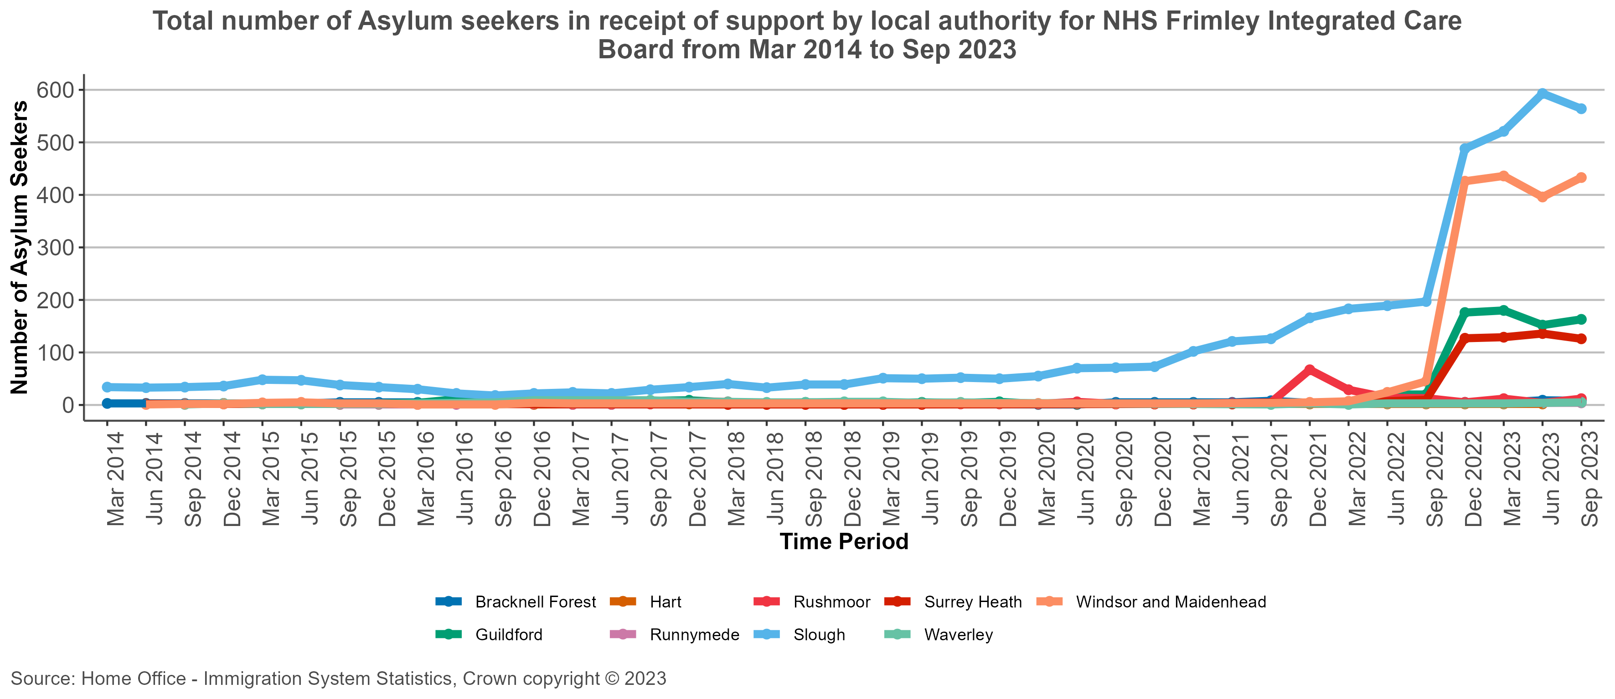
Migrant Statistics (Totals) - NHS Frimley Integrated Care Board
Available from: Immigration system statistics data tables
Return to Contents
Notes:
Notes
Data include main applicants and dependents.
Figures reflect the number of people in receipt of support as at the end of the period, rather than the total supported throughout the period.
Support type:
- Section 95 provides support for asylum seekers who have an asylum claim or appeal outstanding, and failed asylum seekers who had children in their household when their appeal rights were exhausted. - Section 98 is the temporary provision of accommodation for asylum seekers who would otherwise be destitute and who are: a) Awaiting a verdict on their section 95 support application b) Receiving section 95 support, but are waiting to be allocated their dispersal accommodation. - Section 4 support is available when an asylum application has been finally determined as refused but they are destitute and there are reasons that temporarily prevent them from leaving the UK.

Slide 91
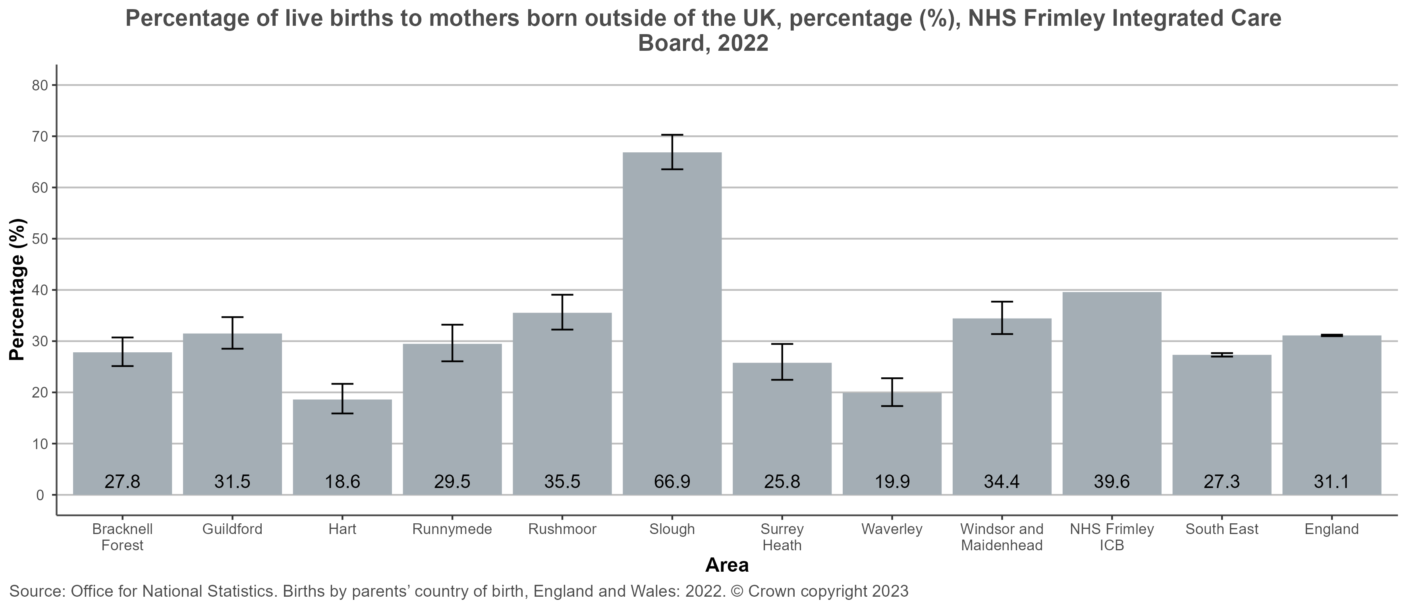
Percentage of live births to mothers born outside of the UK - NHS Frimley ICB
Return to Contents
Notes:
This chart shows the percentage of live births to Non-UK born mothers by lower tier local authority in the area selected. In 2022, the percentage of live births to non-UK-born women in England was 31.1% (from 29.6% in 2021). The statistics are derived from the total live births in each local authority population. Birth statistics for England, Wales and Scotland are based on the details collected when births are registered. By law, births should be registered within 42 days. Source link: https://www.ons.gov.uk/peoplepopulationandcommunity/birthsdeathsandmarriages/livebirths/datasets/parentscountryofbirth

Slide 92
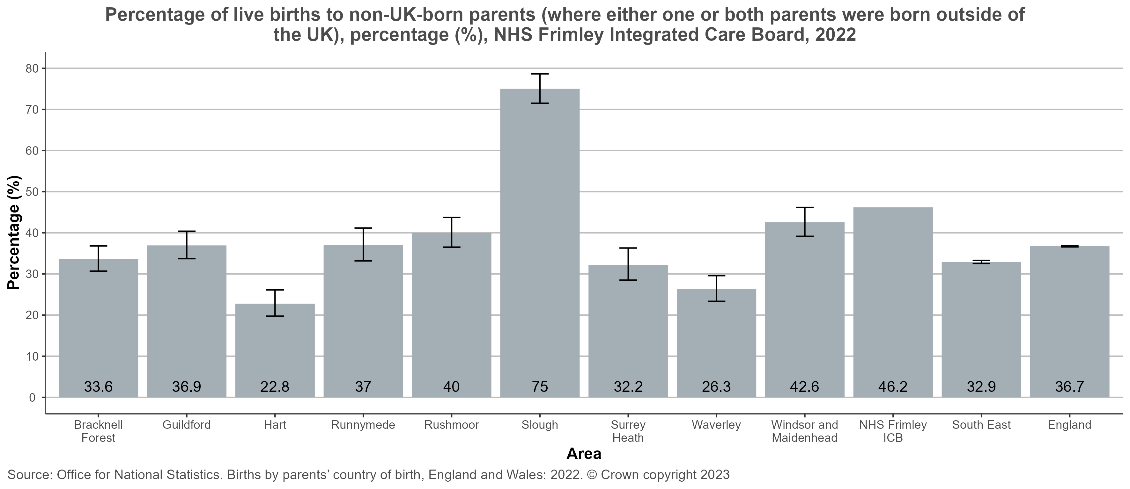
Percentage of live births to non-UK-born parents - NHS Frimley ICB
Return to Contents
Notes:
This chart shows the percentage of births to Non-UK born parents (where either one or both parents were born outside of the UK) by lower tier local authority in the area selected. In 2022, the percentage of live births to non-UK-born parents in England was 36.7 (from 35.1% in 2021). The statistics are derived from the total live births in each local authority population. Birth statistics for England, Wales and Scotland are based on the details collected when births are registered. By law, births should be registered within 42 days. Source link: https://www.ons.gov.uk/peoplepopulationandcommunity/birthsdeathsandmarriages/livebirths/datasets/parentscountryofbirth

Slide 93
Asylum Support
Section 95 Support: This refers to support provided by the government under Section 95 of the Immigration and Asylum Act 1999. It consists of accommodation and financial support and is available to those who have made an asylum claim and do not yet have a decision on their case. In order to qualify for this support, an asylum seeker would also need to demonstrate that they do not have adequate accommodation or enough money to meet living expenses for themselves and any dependents (the destitution test).
Section 98 support: This is emergency support for those who appear to be destitute and who are awaiting a decision on their application for Section 95 asylum support.
Section 4 support: This is available for some groups of asylum seekers who have previously made unsuccessful asylum claims. In order to meet the eligibility criteria for this support, an asylum seeker must be destitute and meet one of the five criteria, which includes for example being unable to leave the UK because of a serious medical problem which prevents taking a flight to their country of origin.
Return to Contents

Slide 94
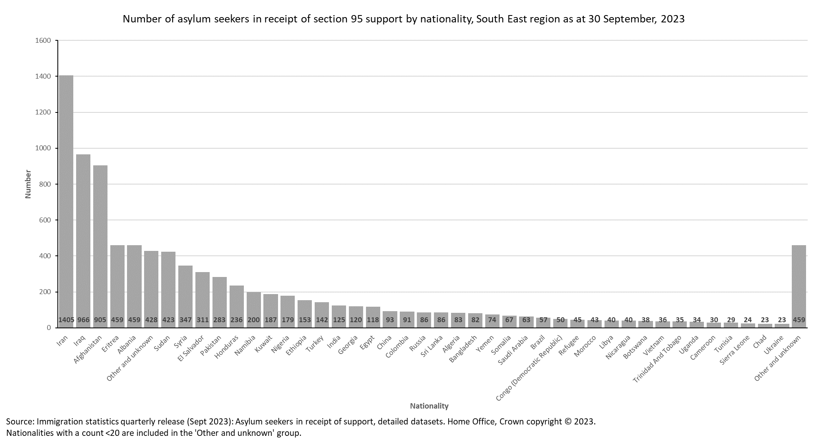
Supported asylum seekers: Section 95 support
15.3% of total supported asylum seekers in the South East are from Iran, 10.5% from Iraq and 9.9% from Afghanistan.
Source: Immigration statistics, year ending September 2023
Return to Contents
Notes:
South East region includes Milton Keynes (no breakdowns available by local authority)
Data includes main applicants and dependents.
Figures reflect the number of people in receipt of support at the end of the period, rather than the total supported throughout the period.
Support type:
- Section 95 provides support for asylum seekers who have an asylum claim or appeal outstanding, and failed asylum seekers who had children in their household when their appeal rights were exhausted. - Section 98 is the temporary provision of accommodation for asylum seekers who would otherwise be destitute and who are: a) Awaiting a verdict on their section 95 support application b) Receiving section 95 support, but are waiting to be allocated their dispersal accommodation. - Section 4 support is available when an asylum application has been finally determined as refused but they are destitute and there are reasons that temporarily prevent them from leaving the UK.

Slide 95
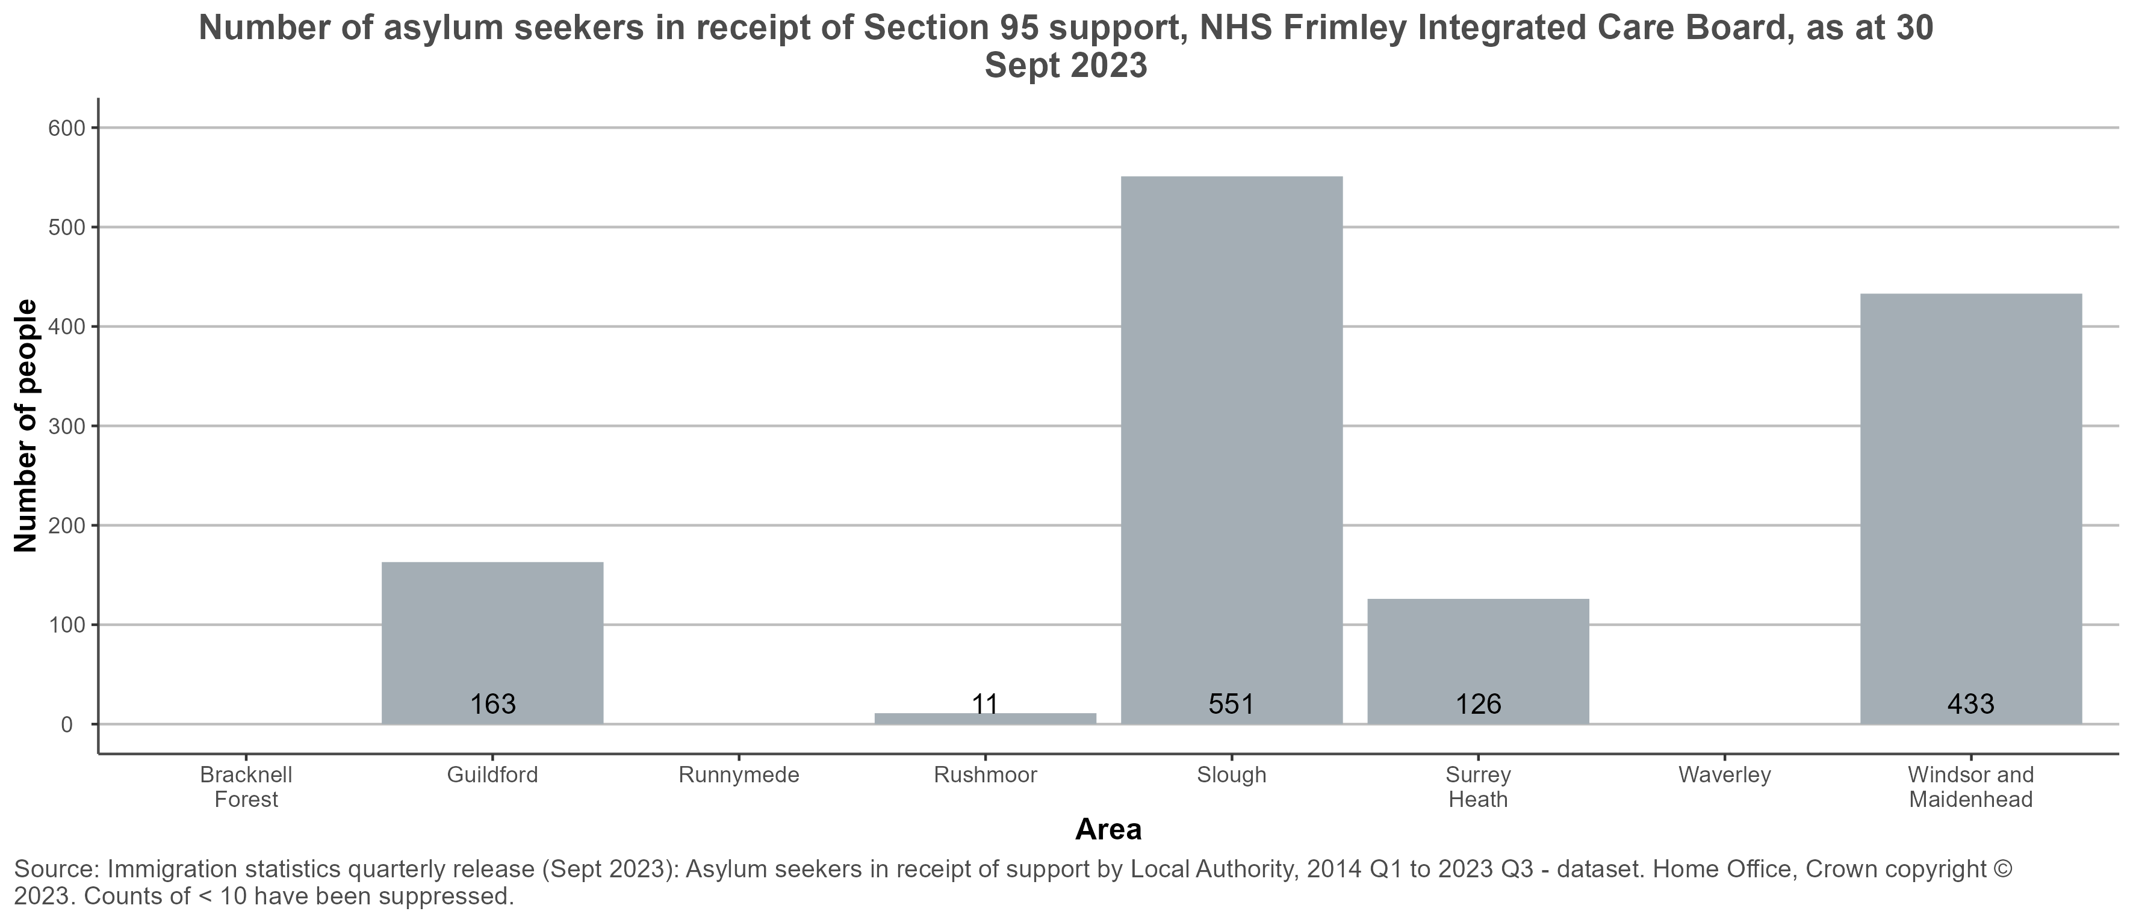
Supported asylum seekers: Section 95 support
NHS Frimley ICB
Source: Immigration statistics, year ending September 2023
Return to Contents
Notes:
There were 8,978 asylum seekers in receipt of Section 95 support across the South East (excluding Milton Keynes) as at 30 Sept 2023. Notes: Data include main applicants and dependants. Figures reflect the number of people in receipt of support as at the end of the period, rather than the total supported throughout the period. Section 95 provides support for asylum seekers who have an asylum claim or appeal outstanding, and failed asylum seekers who had children in their household when their appeal rights were exhausted. ICB totals have not been calculated due to missing or suppressed data.

Slide 96
Immigration groups year ending 30 September 2023: England and the South East
 | England | South East
Homes for Ukraine (arrivals) | 99,686 | 22,240
Afghan Resettlement Programme (population) | 13,968 | 2,557
of which - bridging accommodation | 1,368 | 721
of which - settled in LA housing | 9,817 | 1,496
of which - settled in PRS housing | 2,783 | 340
Supported Asylum population | 111,089 | 9,169
of which - initial accommodation | 1,845 | -
of which - Dispersed accommodation | 48,858 | 2,135
of which - Contingency accommodation | 55,918 | 6,671
of which - Subsistence only | 4,339 | 363
All 3 pathways (total) | 224,743 | 33,966
Population | 56,536,419 | 9,005,822
Per Capita | 0.40% | 0.38%
Source: Immigration system statistics quarterly release - GOV.UK (www.gov.uk)
Return to Contents
Notes:
General
This product brings together data from across the Home Office and Department for Levelling Up, Housing and Communities on specific immigration groups identified as of interest by LAs. These groups are: - arrivals through the Homes for Ukraine visa route - those settled and in bridging accommodation arriving through the Afghan citizens resettlement scheme (ACRS) and Afghan Relocations and Assistance Policy (ARAP) - those being supported following claims for asylum.
The information in this report has been extracted from local management information and databases. As such it should be treated as provisional and therefore subject to change. In particular, it should be understood that definitions and data may not match with data drawn from other sources such as directly from accommodation providers.
The data was correct as at the time of extraction (the last day of the quarter, or the closest date possible for data extraction). These numbers can change daily. Therefore, since the date of extraction, individuals may have moved location (or accommodation type).
Homes for Ukraine
The Homes for Ukraine data have been assigned to local authorities or country based on the postcode of the sponsor’s address, or of the accommodation address if the applicant is not planning to stay at the sponsor’s address. The data shows the number of arrivals into the UK, but is not necessarily reflective of the persons having arrived at the location noted in the table. It is not wholly comparable with the Afghan and Asylum data, which measure stock population (the number of people in the LA on the last day of the quarter).
These data are likely to include some duplicate records. As such they are a reflection of the information held in the system and may not be an exact record of the number of individuals who have been issued visas. Caution should therefore be exercised in using these figures.
These data do not contain numbers of arrivals for visas issued through the Ukraine Family Scheme.
Homes for Ukraine data in this report is from local management information (MI) databases. The data has not been quality assured to the level of Official Statistics. The data is therefore provisional and subject to change.
Afghan Resettlement Programme
This data relates to individuals under the Afghan Citizens Resettlement Scheme (ACRS) - Pathways 1, 2 and 3 - and the Afghan Relocations and Assistance Policy (ARAP).
The data are a measure of stock population - that is, the number of people who were in the location at the time the data was extracted (last day of the quarter).
The data in this report are from local management information (MI) databases. The data has not been quality assured to the level of Official Statistics. Work is underway to reconcile local MI and migrate it to official Home Office caseworking systems. The data is therefore provisional and subject to change.
Figures for 'bridging' relate to individuals in hotels.
Figures for 'settled - LA housing' relate to individuals in settled accommodation provided by local authorities. Figures for 'settled - PRS housing' relate to individuals in settled accommodation within the private rented sector (some of which receive LA funding, some of which do not).
The number of individuals in bridging and settled accommodation is lower than the total number of individuals evacuated from Afghanistan as not all evacuated individuals required relocation / support in the UK (e.g. evacuated British citizens).
Data recorded locally by caseworkers suggests the number of people in temporary accommodation may be lower than the published number shown here. This may be due to lags in data recording compared to the rapid and daily changes to the number of people in temporary accommodation. Work continues to ensure information on these individuals are recorded accurately, and the data will be updated in future releases to reflect these recording improvements.
Supported Asylum seekers
Figures refers to individuals (including dependants) in receipt of Home Office support, provided under the 1999 Immigration and Asylum Act (under statutory support provisions Section 98, Section 95 and Section 4). The data are a measure of stock population - that is, the number of people who were in the location at the time the data was extracted (last day of the quarter).
Location of individual is based on last recorded correspondence and may therefore include individuals who are in the process of being moved, or who have recently moved between locations. There are a small number of cases where location is 'Unknown' due to data recording issues.
Accommodation type: - Initial accommodation (IA) is provided to asylum seekers who have indicated that they are unable to support themselves or their families and are therefore at risk of destitution. It is made available in order to provide shelter while a request for asylum support is being assessed. Occupants of Initial accommodation who receive a positive outcome to their support request generally move to Dispersed (longer term) accommodation when suitable property becomes available. - Dispersed accommodation (DA) is provided to Asylum Seekers whose claim for Asylum Support has been agreed. Occupants of Dispersed Accommodation are permitted to stay there whilst they remain eligible for Asylum Support. - Contingency accommodation (CA) is temporary accommodation (including hotels) used when there is insufficient Initial or Dispersed accommodation available. People housed in contingency accommodation generally move to Dispersed Accommodation when suitable property becomes available. - Subsistence only relates to individuals who receive subsistence (cash) support but not accommodation.
Figures do not include unaccompanied asylum seeking children (UASC) or those leaving care. Data on UASC in England, by local authority, is published by the Department for Education.

Slide 97
Immigration groups for local authorities in NHS Frimley ICB as of 30 September 2023
Area Name | South East Region | NHS Frimley ICB | Bracknell Forest | Guildford | Hart | Runnymede | Rushmoor | Slough | Surrey Heath | Waverley | Windsor and Maidenhead
Homes for Ukraine (arrivals) | 22,240 | 1,543 | 200 | 506 | 250 | 214 | 140 | 109 | 199 | 584 | 432
Afghan Resettlement Programme (population) | 2,557 | 103 | 12 | 8 | 10 | 23 | 12 | 39 | 14 | 26 | 7
of which - bridging accommodation | 721 | - | - | - | - | - | - | - | - | - | -
of which - settled in LA housing | 1,496 | 59 | 12 | 8 | 10 | 19 | 9 | - | 14 | 21 | 7
of which - settled in PRS housing | 340 | 44 | - | - | - | 4 | 3 | 39 | - | 5 | -
Supported Asylum (population) | 9,169 | 1,149 | 8 | 163 | - | 4 | 12 | 564 | 126 | 5 | 433
of which - Initial Accommodation | - | - | - | - | - | - | - | - | - | - | -
of which - Dispersed Accommodation | 2,135 | 224 | 5 | - | - | 4 | 4 | 201 | 4 | 4 | 9
of which - Contingency Accommodation | 6,671 | 882 | - | 162 | - | - | - | 343 | 118 | - | 417
of which - Subsistence only | 363 | 42 | 3 | 1 | - | - | 8 | 20 | 4 | 1 | 7
All 3 pathways (total) | 33,966 | 2,794 | 220 | 677 | 260 | 241 | 164 | 712 | 339 | 615 | 872
Population | 9,005,822 | 767,572 | 125,174 | 143,929 | 100,293 | 87,739 | 100,068 | 158,289 | 90,645 | 128,878 | 153,921
Per Capita (%) | 0.38% | 0.36% | 0.18% | 0.47% | 0.26% | 0.27% | 0.16% | 0.45% | 0.37% | 0.48% | 0.57%
Source: Operational data, Home Office (HO) and Department for Levelling Up, Housing and Communities (DLUHC
Return to Contents
Notes:
Source: Operational data, Home Office (HO) and Department for Levelling Up, Housing and Communities (DLUHC)
Notes: A dashed line '-' represents where data is either missing or has been suppressed for disclosure control reasons
The Aggregations method outlined in the link below has been used to calculate ICB figures. Where are ICB figures are not shown is due to missing data in one of the local authorities that make up the ICB. Population estimates for 2020 have been used as these are the most recent population estimates available for the aggregation method.
https://fingertips.phe.org.uk/profile/guidance/supporting-information/PH-methods
Homes for Ukraine
The Homes for Ukraine data have been assigned to local authorities or country based on the postcode of the sponsor’s address, or of the accommodation address if the applicant is not planning to stay at the sponsor’s address. The data shows the number of arrivals into the UK, but is not necessarily reflective of the persons having arrived at the location noted in the table. It is not wholly comparable with the Afghan and Asylum data, which measure stock population (the number of people in the LA on the last day of the quarter).
These data are likely to include some duplicate records. As such they are a reflection of the information held in the system and may not be an exact record of the number of individuals who have been issued visas. Caution should therefore be exercised in using these figures.
These data do not contain numbers of arrivals for visas issued through the Ukraine Family Scheme.
Homes for Ukraine data in this report is from local management information (MI) databases. The data has not been quality assured to the level of Official Statistics. The data is therefore provisional and subject to change.
Afghan Resettlement Programme
This data relates to individuals under the Afghan Citizens Resettlement Scheme (ACRS) - Pathways 1, 2 and 3 - and the Afghan Relocations and Assistance Policy (ARAP).
The data are a measure of stock population - that is, the number of people who were in the location at the time the data was extracted (last day of the quarter).
The data in this report are from local management information (MI) databases. The data has not been quality assured to the level of Official Statistics. Work is underway to reconcile local MI and migrate it to official Home Office caseworking systems. The data is therefore provisional and subject to change.
Figures for 'bridging' relate to individuals in hotels.
Figures for 'settled - LA housing' relate to individuals in settled accommodation provided by local authorities. Figures for 'settled - PRS housing' relate to individuals in settled accommodation within the private rented sector (some of which receive LA funding, some of which do not).
The number of individuals in bridging and settled accommodation is lower than the total number of individuals evacuated from Afghanistan as not all evacuated individuals required relocation / support in the UK (e.g. evacuated British citizens).
Data recorded locally by caseworkers suggests the number of people in temporary accommodation may be lower than the published number shown here. This may be due to lags in data recording compared to the rapid and daily changes to the number of people in temporary accommodation. Work continues to ensure information on these individuals are recorded accurately, and the data will be updated in future releases to reflect these recording improvements.
Supported Asylum seekers
Figures refers to individuals (including dependants) in receipt of Home Office support, provided under the 1999 Immigration and Asylum Act (under statutory support provisions Section 98, Section 95 and Section 4). The data are a measure of stock population - that is, the number of people who were in the location at the time the data was extracted (last day of the quarter).
Location of individual is based on last recorded correspondence and may therefore include individuals who are in the process of being moved, or who have recently moved between locations. There are a small number of cases where location is 'Unknown' due to data recording issues.
Accommodation type: - Initial accommodation (IA) is provided to asylum seekers who have indicated that they are unable to support themselves or their families and are therefore at risk of destitution. It is made available in order to provide shelter while a request for asylum support is being assessed. Occupants of Initial accommodation who receive a positive outcome to their support request generally move to Dispersed (longer term) accommodation when suitable property becomes available. - Dispersed accommodation (DA) is provided to Asylum Seekers whose claim for Asylum Support has been agreed. Occupants of Dispersed Accommodation are permitted to stay there whilst they remain eligible for Asylum Support. - Contingency accommodation (CA) is temporary accommodation (including hotels) used when there is insufficient Initial or Dispersed accommodation available. People housed in contingency accommodation generally move to Dispersed Accommodation when suitable property becomes available. - Subsistence only relates to individuals who receive subsistence (cash) support but not accommodation.
Figures do not include unaccompanied asylum seeking children (UASC) or those leaving care. Data on UASC in England, by local authority, is published by the Department for Education.

Slide 98
Number of visa applications, visas issued and arrivals in the UK by sponsor location for upper tier local authorities in the NHS Frimley ICB as at 21 November 2023
Area Name | Number of visa applications | Number of visas issued | Number of arrivals in the UK by sponsor location
England | 152,120 | 123,466 | 102,945
South East Region | 31,236 | 26,900 | 22,806
NHS Frimley Integrated Care Board | 2,117 | 1,791 | 1,518
Bracknell Forest | 284 | 241 | 210
Hampshire | 4,498 | 3,955 | 3,333
Slough | 214 | 153 | 113
Surrey | 5,191 | 4,441 | 3,773
Windsor and Maidenhead | 579 | 513 | 446
Source: Operational data, Home Office (HO) and Department for Levelling Up, Housing and Communities (DLUHC
Return to Contents
Notes:
Source: Operational data, Home Office (HO) and Department for Levelling Up, Housing and Communities (DLUHC)
Notes:
1. From 22nd Nov 2022, total visa application submitted and visa application confirmed figures were amended to include applications which have since been withdrawn or refused, in order to align with Home Office reporting.
2. From 22nd Nov 2022, the analytical methodology to deduplicate the arrival figures at the local authority level was amended in order to align with Home Office Reporting.
3. The Aggregations method outlined in the link below has been used to calculate ICB figures. Where are ICB figures are not shown is due to missing data in one of the local authorities that make up the ICB. Population estimates for 2020 have been used as these are the most recent population estimates available for the aggregation method. https://fingertips.phe.org.uk/profile/guidance/supporting-information/PH-methods

Slide 99
Vulnerable Migrants: Resources
OHID Migrant Health Guide
NHS entitlements: migrant health guide - GOV.UK (www.gov.uk)
BMA refugee and asylum seeker health resource
Doctors of the World: Safer Surgeries Toolkit
Unaccompanied Asylum Seeking Children Toolkit
Asylum seeker and refugee mental health | Royal College of Psychiatrists (rcpsych.ac.uk)
City of Sanctuary UK
Return to Contents

Slide 100
Victims of modern slavery
Return to Contents

Slide 101
Victims of modern slavery: Contents
Victims of modern slavery: Key messages
Victims of modern slavery: Overview
Types of exploitation
Victims of modern slavery: Healthcare issues
Victims of modern slavery: Health outcomes
Indicators of modern slavery, both for adults and children
Indicators of modern slavery relating to children
National Referral Mechanism (NRM) and Duty to Notify
Referrals by exploitation type
NRM referrals by nationality
Referrals by broad type and age group
Trend in NRM referrals flagged as county lines, UK
NRM referrals by Police Force and age at exploitation in Police Force areas covering the South East, all persons, 2022
Victims of modern slavery: Resources and Organisations
Return to Contents

Slide 102
Victims of modern Slavery: Key messages
Modern slavery is a violation of human rights and has severe consequences for health and wellbeing at an individual and population level.
Modern slavery is largely viewed as a law enforcement issue in terms of policy, practice and research. This approach limits the approaches required to meet the needs of survivors and address the serious individual and population health impacts.
There are opportunities to make a difference, with those in a position to influence statutory and third sector engagement talking about modern slavery and raising public awareness. Workforce training and development in statutory organisations can help with the identification and support for victims.
Return to Contents

Slide 103
Victims of modern slavery: Overview
Modern slavery is a complex crime that covers all forms of slavery, trafficking and exploitation. Trafficking includes transporting, recruiting or harbouring an individual with a view to them being exploited. Modern slavery crimes may involve, or take place alongside, a wide range of abuses and other criminal offences such as grievous bodily harm, assault, rape or child sexual abuse.
Victims of modern slavery can be men, women and children of any age across the world. There is an assumption that victims of modern slavery are often trafficked to the UK from other countries, but residents of the UK are also among the victims that are exploited in the UK and other countries.
There were 16,938 potential victims of modern slavery referred to the Home Office in 2022, a 33% increase compared to 2021 (Home Office, 2023). This increase may have been driven by increased referrals from government agency first responders. The Home Office also received 4,580 reports of adult potential victims via the Duty to Notify (DtN) process, the highest annual number since the DtN began.
Modern slavery is not the same as people smuggling. People smuggling is an offence against the state, involving moving people illegally with their consent. Modern slavery and human trafficking are crimes against the individual, involving moving people without their consent.​
Return to Contents

Slide 104
Types of exploitation
There are five main types of exploitation that victims of modern slavery may experience:
labour exploitation: victims are forced to work for nothing, low wages or a wage that is kept by their owner; work is involuntary, forced and/or under the threat of a penalty, and the working conditions can be poor. For example: rural work, farms and agricultural work, factories, construction, food processing, hospitality industries, plantations, fishing, beauty industry, shops.
sexual exploitation: victims are exploited through non-consensual abuse or another person’s sexuality for the purpose of sexual gratification, financial gain, personal benefit or advantage, or any other non-legitimate purpose
domestic servitude: victims are domestic workers who perform a range of household tasks (for example, cooking and cleaning); some live with their employers and have low pay, if any at all
criminal exploitation: victims are forced to work under the control of criminals in activities such as forced begging, shoplifting, pickpocketing, cannabis cultivation, drug dealing and financial exploitation
organ harvesting: living or deceased victims are recruited, transported or transferred, by threat or force for money, for their organs
Return to Contents

Slide 105
Victims of modern Slavery: Healthcare issues
As this population group is largely hidden, data is very limited. Victims of modern slavery may only come to an organisation's attention when seriously ill or injured, or with an injury or illness that has been left untreated for a while. Health care issues may include:
evidence of long term multiple injuries
indications of mental, physical and sexual trauma
sexually transmitted infections
pregnant, or a late booking over 24 weeks for maternity care
disordered eating or poor nutrition
evidence of self-harm
dental pain
fatigue
non-specific symptoms of post-traumatic stress disorder
symptoms of psychiatric and psychological distress
back pain, stomach pain, skin problems; headaches and dizzy spells
Royal College of Nursing (2020) Modern Slavery and Trafficking | Royal College of Nursing (rcn.org.uk)
Return to Contents

Slide 106
Victims of modern slavery: Health outcomes
There is limited research and data available on the health outcomes for those who have experienced enslavement. However, studies have found physically demanding forced labour combined with long working hours, in poor, unsafe, working conditions, can result in a high incidence of physical injury; and sexual exploitation brings with it a high prevalence of sexually transmitted infections and trauma.
Research carried out by the Helen Bamber Foundation, on behalf of the Freedom Fund, found that modern slavery, in all its forms, has a "profound and devastating impact on human lives". The critical evidence review looked at the mental health impact of enslavement and the efficacy of specific mental health interventions. The review found mental health problems including depression, anxiety and Post-Traumatic Stress Disorder (PTSD) occur frequently in survivors, irrespective of the form of slavery to which they have endured. There was limited evidence to demonstrate the efficacy of specific treatment interventions. An integrated approach to care for survivors was likely to be more effective. Information is limited on the risk factors which increase the likelihood of major mental health consequences and on factors which may protect survivors from developing serious mental health problems.
Public Health England previously championed a call to action for: leaders in public health to influence statutory and third sector engagement by talking about modern slavery (for example, with housing associations, schools and allied health professionals) and by raising public awareness; and health professionals and other frontline staff to have a central role in better identifying and supporting victims.
Return to Contents

Slide 107
Indicators of modern slavery, both for adults and children
Distrustful of authorities
Signs of psychological trauma
Acts as if instructed by another
Injuries apparently a result of assault or controlling measures
Evidence of control over movement, either as an individual or as a group
Found in or connected to a type of location likely to be used for exploitation
Restriction of movement and confinement to the workplace or to a limited area
Passport or documents held by someone else
Limited social contact and contact with family
Unable, or reluctant to give details of accommodation or details such as work address
Perception of being bonded by debt
Money is deducted from salary for food or accommodation
Threat of being handed over to authorities
Threats against the individual or their family members
Being placed in a dependency situation
No or limited access to bathroom or hygiene facilities or medical care
Expression of fear or anxiety, avoiding eye contact
Malnourished and unkempt
Wears clothes unsuitable for type of work
Gives vague information, reluctant to explain how the injury occurred or provide a medical history
Accompanied by someone who appears controlling, who insists on giving information and speaking for them
Source: Royal College of Nursing, 2020
Return to Contents

Slide 108
Indicators of modern slavery relating to children
Entered the country illegally
Possesses money or goods not accounted for
Accompanied by an adult who insists remaining with the child at all time
Has a prepared story very similar to those that other children have given
Exhibits maturity not expected in a child of such age
Shows signs of physical or sexual abuse, and/or has contracted a sexually transmitted infection or has an unwanted pregnancy
Has a history with missing links and unexplained moves
Among a number of unrelated children found at one address
Known to beg for money
Performs excessive housework chores and rarely leaves the residence
Quality of the relationship between the child and their adult carers is not good
Not been registered with or attended a GP practice, or enrolled in school
Relationships which don't appear right – e.g. has adult boyfriend/girlfriend who provides money or gifts
Known to frequent various locations where Child Sexual Exploitation is a risk or moves between various locations with adults
Children dropped off/ picked up in private cars or taxis at unusual times and in places where it isn’t clear why they’d be there.
Source: Royal College of Nursing, 2020
Return to Contents

Slide 109
National Referral Mechanism and Duty to Notify
The National Referral Mechanism (NRM) was introduced in April 2009. It is a framework for identifying and referring potential victims of modern slavery and ensuring they receive the appropriate support. The difference between an NRM referral and a Duty to Notify (DtN) referral relates to the consent of the adult involved.
Guidance on how to refer can be found on the government website: National referral mechanism guidance
Child victims
If the potential victim is under 18, or may be under 18, an NRM referral must be made, children cannot be referred in using a DtN referral. Child victims do not have to consent to be referred into the NRM and must first be safeguarded and then referred into the NRM process.
Duty to Notify
From November 2015, specified public authorities are required to notify the Home Office about any potential victims of modern slavery they encounter in England and Wales. Adult cases whereby consent is not provided to be referred into the NRM process automatically become DTN referral.
The NHS is not required to report under the Modern Slavery 2015 Act, which means there is a lack of consistency in the health system in respect of awareness and training. However, the CEO of NHS England sets out clear expectations of staff in terms of prevention of Modern Slavery and the protection of the health of survivors.
There were 16,938 potential victims of modern slavery referred to the Home Office in 2022, a 33% increase compared to 2021 (Home Office, 2023). This increase is driven by increased referrals from government agency first responders which could be linked to the increase in detections at the border and the large increase in small boats arrivals.
Return to Contents

Slide 110
Referrals by exploitation type
The most frequent exploitation type for all persons in 2022 was Labour (30.3%), followed by Criminal (27.6%)
Source: Modern Slavery: National Referral Mechanism and Duty to Notify Statistics UK, end of year summary 2022, Home Office – Table 5
Available from: Modern Slavery: National Referral Mechanism and Duty to Notify statistics UK, end of year summary 2022 - GOV.UK (www.gov.uk)
Return to Contents

Slide 111
NRM referrals by nationality
In 2022, Albanian nationals overtook UK nationals as the most commonly referred nationality (4,454) in England.
Albanian nationals represent 29.3% of the total referrals with a known nationality.
Source: Modern Slavery: National Referral Mechanism and Duty to Notify Statistics UK, end of year summary 2022, Home Office – Table 5
Available from: Modern Slavery: National Referral Mechanism and Duty to Notify statistics UK, end of year summary 2022 - GOV.UK (www.gov.uk)
Return to Contents

Slide 112
Referrals by broad type and age group
55.8% referrals were adults and 44.2% were children aged 17 or under in 2022.
For adults 78% were male and 22% female; for children, 80% were male and 20% female
Child victims were most often referred for criminal exploitation. This links to increases in the number of ‘county lines cases’
Source: Modern Slavery: National Referral Mechanism and Duty to Notify Statistics UK, end of year summary 2022, Home Office – Table 4
Available from: Modern Slavery: National Referral Mechanism and Duty to Notify statistics UK, end of year summary 2022 - GOV.UK (www.gov.uk)
Return to Contents
Notes:
Chart excludes age not specified or unknown.

Slide 113
Trend in NRM referrals flagged as county lines, UK
In 2022, 2,281 county lines referrals were flagged.
The majority, 75%, were for male children (17 years or under).
County Lines is where illegal drugs are transported from one area to another, usually by children or vulnerable adults, often coerced by gangs.
Source: Modern Slavery: National Referral Mechanism and Duty to Notify Statistics UK, end of year summary 2022, Home Office – Table 15
Available from: Modern Slavery: National Referral Mechanism and Duty to Notify statistics UK, end of year summary 2022 - GOV.UK (www.gov.uk)
Return to Contents
Notes:
County Lines is where illegal drugs are transported from one area to another, often across police and local authority boundaries (although not exclusively), usually by children or vulnerable people who are coerced into it by gangs. The dealers will frequently target children and adults - often with mental health or addiction problems - to act as drug runners or move cash so they can stay under the radar of law enforcement. In some cases the dealers will take over a local property, normally belonging to a vulnerable person, and use it to operate their criminal activity from. This is known as cuckooing.

Slide 114
NRM referrals by Police Force and age at exploitation in Police Force areas covering the South East, all persons, 2022
Source: Modern Slavery: National Referral Mechanism and Duty to Notify Statistics UK, end of year summary 2022, Home Office – Table 8
Available from: Modern Slavery: National Referral Mechanism and Duty to Notify statistics UK, end of year summary 2022 - GOV.UK (www.gov.uk)
Return to Contents

Slide 115
Victims of modern slavery: Resources & organisations
Resources
Identifying and supporting victims of modern slavery: guidance for health staff
Modern Slavery - elearning for healthcare
Child exploitation disruption toolkit
Trafficking Toolkit
A public health approach to modern slavery opportunities and challenges
NHS England modern slavery and human trafficking statement
Preventing modern slavery: the role of the NHS
Royal College of Nursing: Modern Slavery and Trafficking
Interim guidance for Independent Child Trafficking Guardians
Public Health England: Modern slavery and public health
Organisations
Support Services — Human Trafficking Foundation
Helen Bamber Foundation | Strength to Fly
Home - Unseen (unseenuk.org)
Return to Contents

Slide 116
People in contact with the criminal justice system
Return to Contents

Slide 117
People in contact with the criminal justice system: Contents
People in contact with the criminal justice system: Key messages
People in contact with the criminal justice system: Overview
Health needs of people in contact with the criminal justice system
Sexual health and people in prison
Health outcomes for women in prison
Young people in young offender institutions and prisons
England prisons
Prisons in the South East
Prisons in NHS Frimley ICB area
People in contact with the Criminal Justice System: Resources
Return to Contents

Slide 118
People in contact with the criminal justice system: Key Messages
People in contact with the criminal justice system are some of the most marginalised, vulnerable population groups in any community, often experiencing multiple complex health and social care needs, with poor access to health services and a background of poverty, unemployment, indebtedness, substance misuse, poor education and homelessness.
Considering and tackling health inequalities for this group includes both those within prisons and those being supervised by probation services. All of those in prison have come from the community and almost all will return to their community following their sentence, with the proportion of offenders being supervised by probation services outnumbering those currently serving by around three to one at any one time.
Integrated Care Systems are ideally placed to help improve health outcomes for those in prison, by supporting prisons to understand what their health needs are and start working with them towards meeting those needs within the community.
Return to Contents

Slide 119
People in contact with the criminal justice system: Overview
People in contact with the criminal justice system encompasses both those who are currently serving a sentence in prison and those who are under supervision of probation services. Data indicates that 27% of the prison population identify as an ethnic minority, compared with 13% in the general population. The prison population is aging, with the proportion of people aged over 50 years in prisons increasing from 7% in 2002, to 17% in March 2020¹.
People in prison are more likely to have been taken into care, or have experienced abuse as a child, been homeless or been unemployed. They are more likely to engage in high-risk behaviours, often do not manage their existing health issues effectively, have limited contact with primary care services and as such, are over-represented in their use of emergency services. It is estimated that around 80% of prisoners smoke on arrival to prisons², compared to just under 13% of the general population³. They experience some of the most extreme health inequalities resulting in an average age of death for people dying in prison of 56 years, compared to 81 in the general population⁴.
Transition from prison, to probation services and back to the community is a fundamental time to ensure continuity of care, particularly for those individuals with ongoing health needs or who are engaging with substance misuse, health or social care services.
Health and offending are often interrelated. Health issues such as substance misuse or mental health problems can lead to contact with the criminal justice system. Addressing the health needs of this group can reduce reoffending and have a positive impact on the overall health of their communities.
Return to Contents
Notes:
1. Sturge G (2020) UK Prison Population Statistics. Briefing paper CBP-04334. House of Commons Library
2. O’Moore E (2018) ‘Implementation of smoke-free prison estate in England – a great public health achievement through partnership work’, The Global Health Network blog, 11 July.
3. Adult smoking habits in the UK - Office for National Statistics (ons.gov.uk)
https://www.ons.gov.uk/peoplepopulationandcommunity/healthandsocialcare/healthandlifeexpectancies/bulletins/adultsmokinghabitsingreatbritain/2022#:~:text=Based%20on%20APS%20data%2C%20the,20.2%25%20of%20the%20population).
4. House of Commons Health and Social Care Committee (2018) Prison Health: Twelfth report of session 2017–19. House of Commons. https://publications.parliament.uk/pa/cm201719/cmselect/cmhealth/963/963.pdf

Slide 120
Health needs of people in contact with the criminal justice system (1/2)
1/3rd of people in contact with the criminal justice system have a learning disability or difficulty with 57% of adult prisoners having literacy levels below those expected of an 11 year old¹
It is estimated that at least 1 in 3 people have neurodivergent needs, compared to 15% of the general population^{2.}
Up to 90% of prisoners aged 50 or more have at least one moderate or severe health condition, and over 50% have three or more^{3.}
71% of women and 47% of men in contact with the criminal justice system experience mental health problems^{4.}
A review of hospital admissions⁵ found injury and poisoning were the most common reasons for prisoners being admitted to hospital and that 40% of hospital outpatient appointments for prisoners were not attended, a rate double that of the general population.
Older people in prison are vulnerable to experiencing frailty due to the prevalence of multiple long-term conditions and the challenge of the prison environment itself⁶.
Return to Contents
Notes:
Prison Education Statistic 2019 -2020. Ministry of Justice, published August 2021. https://www.gov.uk/government/statistics/prison-education-statistics2019-2020
His Majesty’s Inspectorate of Constabulary and Fire & Rescue Services (HMICFRS) (2021) Neurodiversity in the Criminal Justice System: A review of evidence. GOV.UK. www.justiceinspectorates.gov.uk/ hmicfrs/publications/neurodiversity-in-the-criminal-justice-system
House of Commons Justice Committee. Ageing Prison Population. Fifth Report of Session 2019-2021
Prison Reform Trust (2021) Bromley Briefings Prison Factfile: Winter 2021. Prison Reform Trust.
Davies M, Rolewicz L, Schlepper L and Fagunwa F (2020) Locked out? Prisoners' use of hospital care. Research report, Nuffield Trust. https://www.nuffieldtrust.org.uk/research/locked-out-prisoners-use-of-hospital-care
Davies M, Hutchings R, Keeble E and Schlepper L (2023) Living (and dying) as an older person in prison. Understanding the biggest health care challenges for an ageing prisoner population. Research report, Nuffield Trust.

Slide 121
Health needs of people in contact with the criminal justice system (2/2)
The prevalence of Hepatitis C virus antibody (indicating either past or current infections) is approximately 6% among those in prisons, compared to 0.7% in the general community⁶.
There is a complex link between substance misuse and crime but evidence shows that both drug and alcohol use are risk factors for re-offending with general re-offending being highest among drug users⁷. Data collected by NHS England under the Liaison and Diversion Programme showed that over 55% of service users in contact with the criminal justice system and identified with mental health need also had problem with drug use, alcohol use or both.
The main causes of death while in prison are cardiovascular disease (43%) followed by cancer (32%) however the Independent Advisory Panel on deaths in custody has suggested that many deaths are preventable⁸.
Between 2008 and 2019, the risk of male prisoners dying by suicide was 3.9 times higher than the general male population⁹.
Return to Contents
Notes:
6. Busschots, D., Kremer, C., Bielen, R. et al. Hepatitis C prevalence in incarcerated settings between 2013–2021: a systematic review and meta-analysis. BMC Public Health 22, 2159 (2022). https://doi.org/10.1186/s12889-022-14623-7.
7. https://www.justiceinspectorates.gov.uk/hmiprobation/research/the-evidence-base-probation/specific-areas-of-delivery/substance-misuse
8. Shaw J, Talbot J, Norman A, Lyon J, Heathcote L, Bernard A and Worthington N (2020) Avoidable Natural Deaths in Prison Custody: Putting things right. Independent Advisory Panel on Deaths in Custody and Royal College of Nursing.
9. Drug related deaths and suicide in prison custody in England and Wales: 2008 to 2019. Office for National Statistics. Released January 2023

Slide 122
Sexual health & people in prison
People in prison are more likely to experience poor sexual health, often due to social deprivation and engaging in higher levels of risk taking behaviours (including condomless sex). They are at higher risk of blood borne viruses (BBV) and sexually transmitted infections (STI), and more likely to have complex support needs for sexual assault or abuse^{1,2}.
According to 2019/20 Hospital Episode Statistics (HES) data, diseases of the genitourinary system were among the top five most common reasons why PIP require admission to hospital in England³.
Although people in prison are deprived of their liberty, their right to access healthcare remains unchanged and should have equivalent access to healthcare services as the general population⁴. However, there are well documented inequalities that limit access to care. It is estimated that 30-40% of health appointments are unattended^{5,6}.
There are known barriers to accessing condoms in prison that limit their uptake and use amongst prisoners^{7,8}.
A recent inspection of UK prisons revealed that support for lesbian, gay, bisexual and transexual (LGBT) prisoners is often lacking, with most establishments offering no formal consultation or community organisation links for these groups⁹.
Female estates can also provide a timely opportunity to address reproductive health including pregnancy testing, cervical screening and access to contraception.
These, along with other structural challenges and wider inequalities⁵, contribute to the poorer sexual health outcomes observed among people in prison.
Return to Contents
Notes:
1.Burgh-Thomas A, Priestley C and Tang A. National Guidance on Commissioning Sexual Health and Blood Borne Virus Services in Prisons 2011. UK: British Association for Sexual Health and HIV (BASHH) 2011.
2.David, Nelson, and A. Tang. "Sexually Transmitted Infections in a Young Offenders Institution in the Uk." International Journal of STD & AIDS 14, no. 8 (2003/08/01 2003): 511-13.Davies M, Keeble E and Hutchings R. Injustice? Towards a Better Understanding of Health Care Access Challenges for Prisoners. UK: Nuffield Trust, 2021.
3.National Prison Healthcare Board Principle of Equivalence of Care for Prison Healthcare in England. England, 2019.
4.House of Commons Health and Social Care Committee. Prison Health: Twelfth Report of Session 2017–19: Report, Together with Formal Minutes Relating to the Report. House of Commons, 2018.
5.Davies M, Rolewicz L, Schlepper L and Fagunwa F. Locked Out? Prisoners' Use of Hospital Care. UK: Nuffield Trust, 2020.
6.Howard League for Penal Reform. Commission on Sex in Prison Consensual Sex among Men in Prison. UK: Howard League for Penal Reform, 2013.
7.Stevens, Alisa. Sex in Prison: Experiences of Former Prisoners. The Howard League, 2015.
8.Chief Inspector of Prisons. HM Chief Inspector of Prisons for England and Wales: Annual Report 2022–23. UK: House of Commons, 2023.

Slide 123
Health outcomes for women in prison
Women make up less than 4% of the prison estate but face disproportionately higher levels of health and social care needs than their male counterparts. A third of the adult female prisons are in the South East¹.
There is currently limited data or research on the health and social care needs, services and outcomes for women in prison, however, it is known that these women have often experienced trauma and substance abuse. Hospital Episodes Statistics (HES) data in 2019/20 showed that just under 30% of inpatient admissions by women in prison had a diagnosis of substance misuse².
A review by NHS England³ found that health and social care services across women’s prisons are inconsistent, not always gender specific or sensitive to women with protected characteristics. Acutely mentally ill women are still being sent to prison. There is a gap in mental health services across the range of needs including primary mental healthcare and specialist interventions for women who have experienced trauma, including sexual and domestic violence. Women may have been subject to experiences within domestic abuse which can directly impact their health, for example admissions for acute brain injury.
Women in prison often experience challenges and barriers around accessing health and care services including missed midwifery appointments due to lack of available escort staff, and a lack of understanding around sexual and reproductive health care needs including menopause. Pregnant women are more likely to experience preterm birth with 11% going into pre-term labour, compared to 6.5% of births among the general population². For women who give birth in prison, the consequences of maternal separation on physical and mental wellbeing can be significant, highlighting the need to align work on supporting families with healthcare provision.
Return to Contents
Notes:
House of Commons Library (2023) The Prison Estate in England and Wales. Research Briefing.
Inequality on the inside: using hospital data to understand the key health issues for women in prison. Nuffield Trust. Published 19/07/2022
A review of health and social care in women’s prisons. NHS England. Last updated 23 November 2023. Accessed https://www.england.nhs.uk/long-read/a-review-of-health-and-social-care-in-womens-prisons/

Slide 124
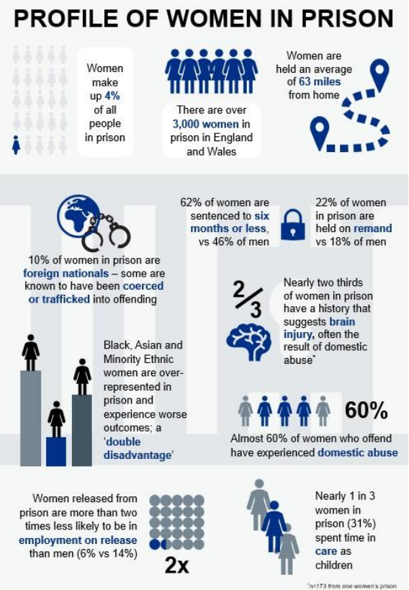
Health profile of women in prison
A review of health and social care in women’s prisons (england.nhs.uk)
Return to Contents

Slide 125
Young people in young offender institutions and prisons
Monthly statistics are produced on the population in custody of children and young people within secure children’s homes (SCH), secure training centres (STCs) and young offender institutions (YOIs). In September 2023, there were 441 children and young people aged under 18 in the Children and Young People's Secure estate (613 when including those aged 18 years and older).This has been reducing over time, from a peak of 3654 children and young people (including over 18) in July 2002. The majority are boys (606) and the most common age is 17 years (235)^{1.}
Analysis of routinely collected hospital data by the Nuffield Trust² highlighted serious challenges with the health and care of children and young people in custody, particularly around self-harm and violence.
42% of hospital admissions involving young adult males in custody had a primary diagnosis of injury or poisoning, significantly higher than the 16% among the adult prisoner population.
60% (n=55) of hospital admissions for young adult males in prison where a diagnosis of attention deficit hyperactivity disorder (ADHD) was flagged had a primary diagnosis of injury or poisoning.
Boys detained in young offender institutions had a higher proportion of outpatient appointments cancelled on their behalf (18%) than both young adult males (14%) and other adult males (13%) in prison.
A literature review conducted by the Centre for Mental Health highlighted that girls in the secure estate are often highly vulnerable, having been exposed to multiple traumatic events such as sexual abuse, victimisation and gender based violence³.They are also more likely to have co-existing mental and physical health needs, which may have been overlooked, as well as higher levels of neurodiversity.
Return to Contents
Notes:
1. GOV.UK (2023) ‘Youth custody report: September 2023 England and Wales’ (youth custody data). Latest data here Youth custody data - GOV.UK (www.gov.uk) youth-custody-population-report-sept-2023.ods (live.com) (accessed 25/11/23)
2. Davies M, Hutchings R and Keeble E (2023) Growing up inside: Understanding the key health care issues for young people in young offender institutions and prisons. Research report, Nuffield Trust
3. Khan L, Harris A and Sinclair C (2021) Out of Sight: Girls in the children’s secure estate. Centre for Mental Health.

Slide 126
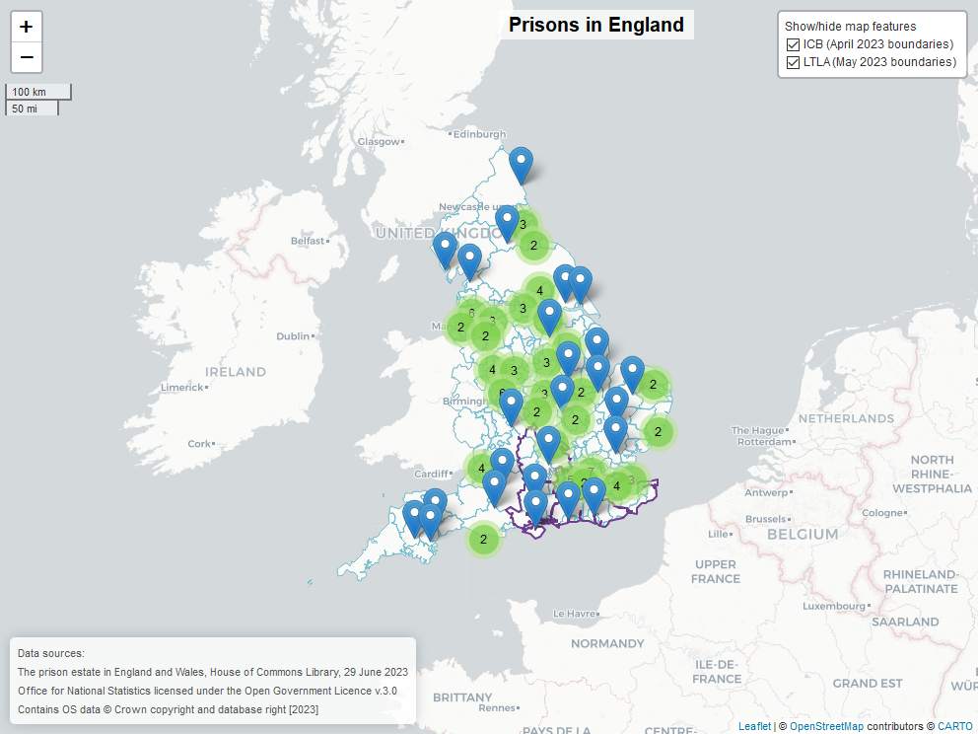
England Prisons
The total adult prison population in England and Wales is 87,576 as of September 2023. 84,006 adult prisoners are male while 3,570 prisoners are female.
HM Prison and Probation Service (HMPPS) is responsible for running an estate of 120 prison and Young Offenders institutions and one Secure Training Centre.
More information and an interactive map with prison populations can be found here.
Source: Offender management statistics (Prison population: September 2023), Ministry of Justice and HM Prison and Probation Service.
Available from Offender Management Statistics quarterly: April to June 2023 - GOV.UK (www.gov.uk)
Return to Contents
Notes:
House of Commons Library (2023) The Prison Estate in England and Wales. Research Briefing.
The map include Adult Prisons, Young Offenders Institutions (YOI), and Secure Training Centre’s (STC). It does not include Immigration Removal Centres or Removal Centres.
These additional institutions (YOI’s and STCs) are not included the total adult prison population.
Prison Population Source: Offender management statistics quarterly: April – June 2023 - Offender Management Statistics quarterly: April to June 2023 - GOV.UK (www.gov.uk) Population_30Sep2023.ods (live.com)
In addition to adult prisons, the map on the right also shows Young Offenders Institutions (YOI), Secure Children’s Home (SCH) and Secure Training Centre’s (STC). However, these additional institutions are not included the total adult prison population.
Immigration Removal Centres have been excluded from the map and are not included in the adult prisoner population.

Slide 127
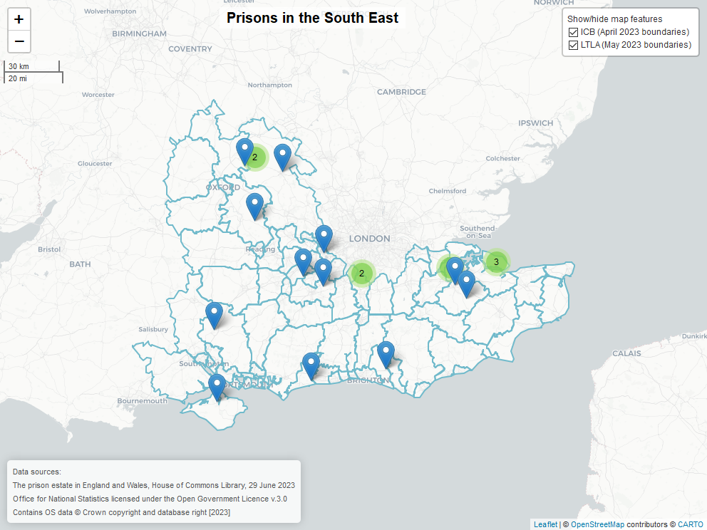
Prisons in the South East
The total adult prison population in the South East is 11,515 as of September 2023. 10,413 adult prisoners are male while 1102 prisoners are female.
A total of 20 prison institutions are shown on the map. Woodhill prison and Oakhill Secure Training Centre, both in Milton Keynes, are not included as they fall outside the South East health geographies.
Source: Offender management statistics. Prison Population September 2023. Ministry of Justice and HM Prison and Probation Service.
Available from Offender Management Statistics quarterly: April to June 2023 - GOV.UK (www.gov.uk)
Return to Contents
Notes:
The map include Adult Prisons and Young Offenders Institutions (YOI). It does not include Immigration Removal Centres or Removal Centres.
These additional institutions (YOI’s and STCs) are not included the total adult prison population.

Slide 128
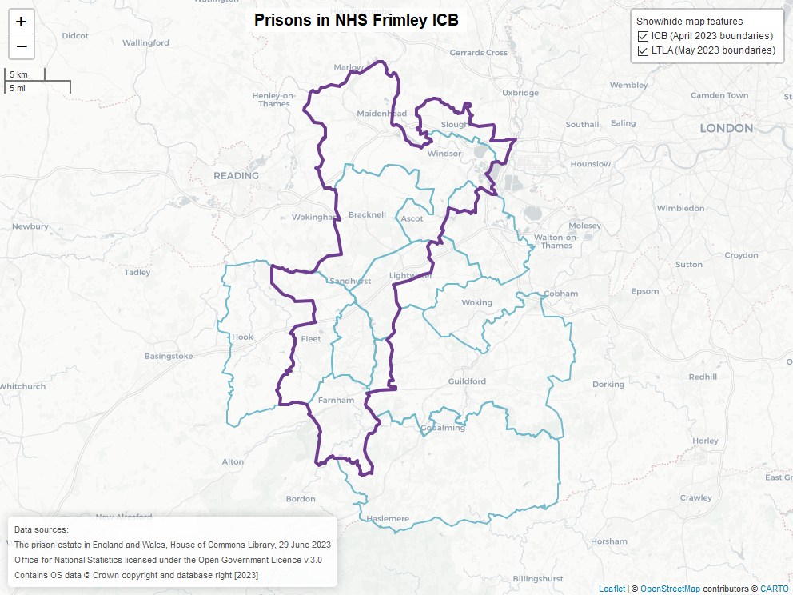
Prisons in NHS Frimley Integrated Care Board area
Frimley ICB contains no prisons or prison based institutions.
Source: Offender management statistics (Prison population: September 2023), Ministry of Justice and HM Prison and Probation Service.
Available from Offender Management Statistics quarterly: April to June 2023 - GOV.UK Population_30Sep2023.ods (live.com)
Return to Contents

Slide 129
People in contact with the criminal justice system: Resources
The Health and Justice Framework for integration 2022 – 2025
National Partnership Agreements:
National Partnership Agreement for Health and Social Care for England
Health and Justice Children Programme national partnership agreement 2023 – 2025
National partnership agreement for immigration removal centre (IRC) healthcare in England 2022 - 2025
Rebalancing Act A resource for Directors of Public Health, Police and Crime Commissioners and other health and justice commissioners, service providers and users.
RECONNECT: a holistic care after custody service which seeks to ensure that individuals with identified health needs who are leaving prison or an IRC receive access to ongoing care and support.
Homelessness Reduction Act: Duty to refer policy framework
Shelter Legal England - Homelessness referrals for prisoners and people on probation - Shelter England
Return to Contents

Slide 130
People with drug and alcohol dependence
Return to Contents

Slide 131
People with drug and alcohol dependence: Contents
People with drug and alcohol dependence: Key messages
Health outcomes: Drug dependence
Prevalence estimates of illicit opiate and/or crack cocaine use
Drug dependence data
Health outcomes: alcohol dependence
Prevalence estimates of alcohol dependence
Alcohol dependence data
Drug and alcohol dependence: Guidance and Resources
Return to Contents

Slide 132
People with drug and alcohol dependence: Key messages
There is a significant overlap of populations experiencing severe multiple disadvantage including alcohol and drug dependence, homelessness, offending behaviours and mental ill health.
Stigma remains a significant issue both for people affected by drug and alcohol dependence and their families and communities. This impacts on engagement with services and recovery.
Education, prevention and early intervention is necessary to reduce harm and prevent both hospital admissions and drug and alcohol related deaths. Therefore, a key focus is for systems to identify need and refer to effective treatment.
Return to Contents

Slide 133
Health outcomes: Drug dependence
Over the past 10 years, drug use in the South East has gone from 8.8% in 2011/12 to 9.1% of 16–59 year olds using any drug in the last year in 2019/20. Drug use in the South East region is at a similar level to England (9.1% and 9.2% respectively) in 2021/22 (ONS, 2022).
In 2019/20, there were 7,027 hospital admissions for drug-related mental and behavioural disorders in England, 5% fewer than the previous year. More men (73%) were admitted than women. Admissions were around 5 times more likely in the most deprived areas, compared to the least deprived areas (NHS Digital).
Drug use is associated with a range of health-related problems. These include mental health problems (anxiety, depression, psychosis, personality disorder and suicide), cardiovascular disease, blood borne viruses, liver damage from undiagnosed or untreated hepatitis C virus to sexual risk taking and associated sexually transmitted infections, as well as poor vein health and arthritis or mobility problems among those who inject drugs (OHID).
There is a significant overlap between those dependent on drugs and other levels of disadvantage, with the most deprived local authorities having the highest prevalence of problematic drug users. Drug dependence is associated with relationship breakdown and difficulty in maintaining social links. There is also a strong relationship between drug dependence and crime and between April 2022 and March 2022, there were 45,096 adults in alcohol and drug treatment in prisons and secure settings. Of these, 74% started treatment during the year and nearly of third of people starting treatment were identified as having a mental health need (OHID, 2023). The pattern of drug use has changed over time with new psychoactive substances, image and performance enhancing drugs and misuse of medication producing areas of concern. The rise in psychoactive substances within criminal justice settings can contribute to health related and behavioural problems.
.
Return to Contents

Slide 134
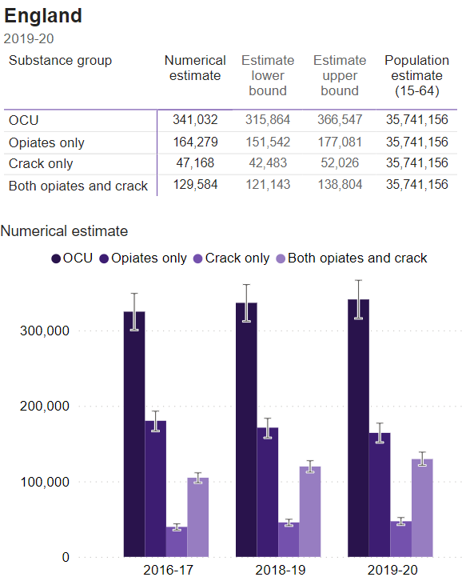
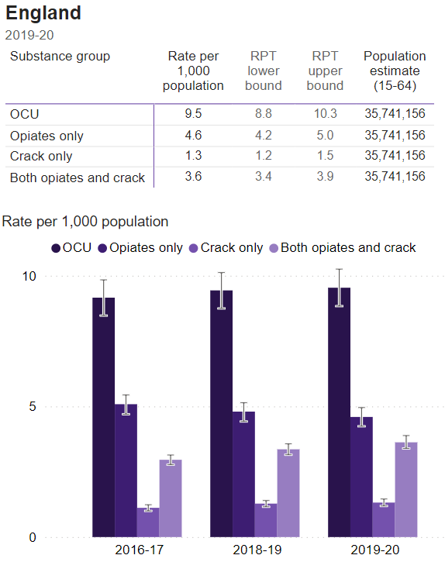
Prevalence estimates of illicit opiate and/or crack cocaine use (OCU) - England
Prevalence estimates of illicit opiate and/or crack cocaine use are shown as both numerical estimates and rates per 1,000 population for England. The above bar charts demonstrates the trend from 2016/17 to 2019/20.
Source: Opiate and crack cocaine use: prevalence estimates - GOV.UK (www.gov.uk)
Return to Contents

Slide 135
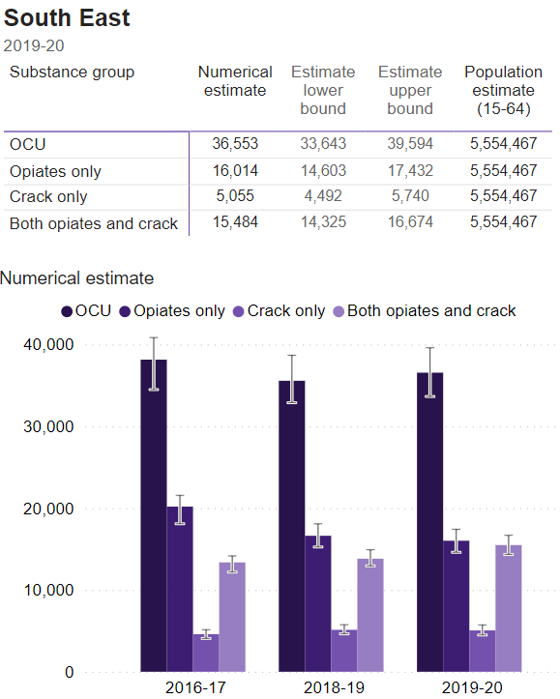
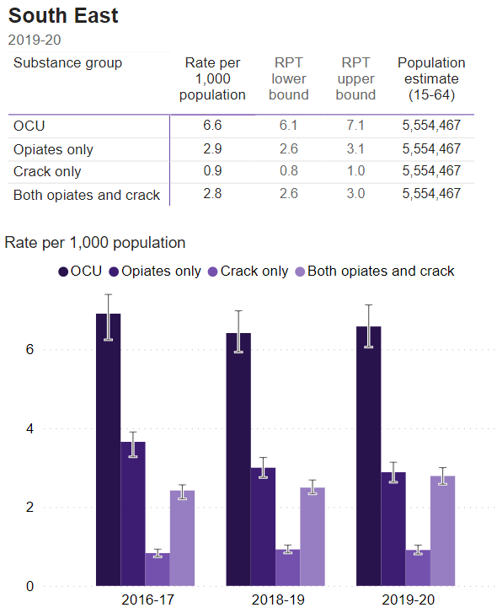
Prevalence estimates of illicit opiate and/or crack cocaine use (OCU) - South East
Prevalence estimates of illicit opiate and/or crack cocaine use are shown as both numerical estimates and rates per 1,000 population for the South East. The above bar charts demonstrates the trend from 2016/17 to 2019/20.
Source: Opiate and crack cocaine use: prevalence estimates - GOV.UK (www.gov.uk)
Return to Contents

Slide 136
Drug dependence data
This section contains the following indicators for each ICB:
Proportion of opiates and/or crack cocaine users (ICU) not in treatment
Deaths in drug treatment (mortality ratio)
Return to Contents

Slide 137
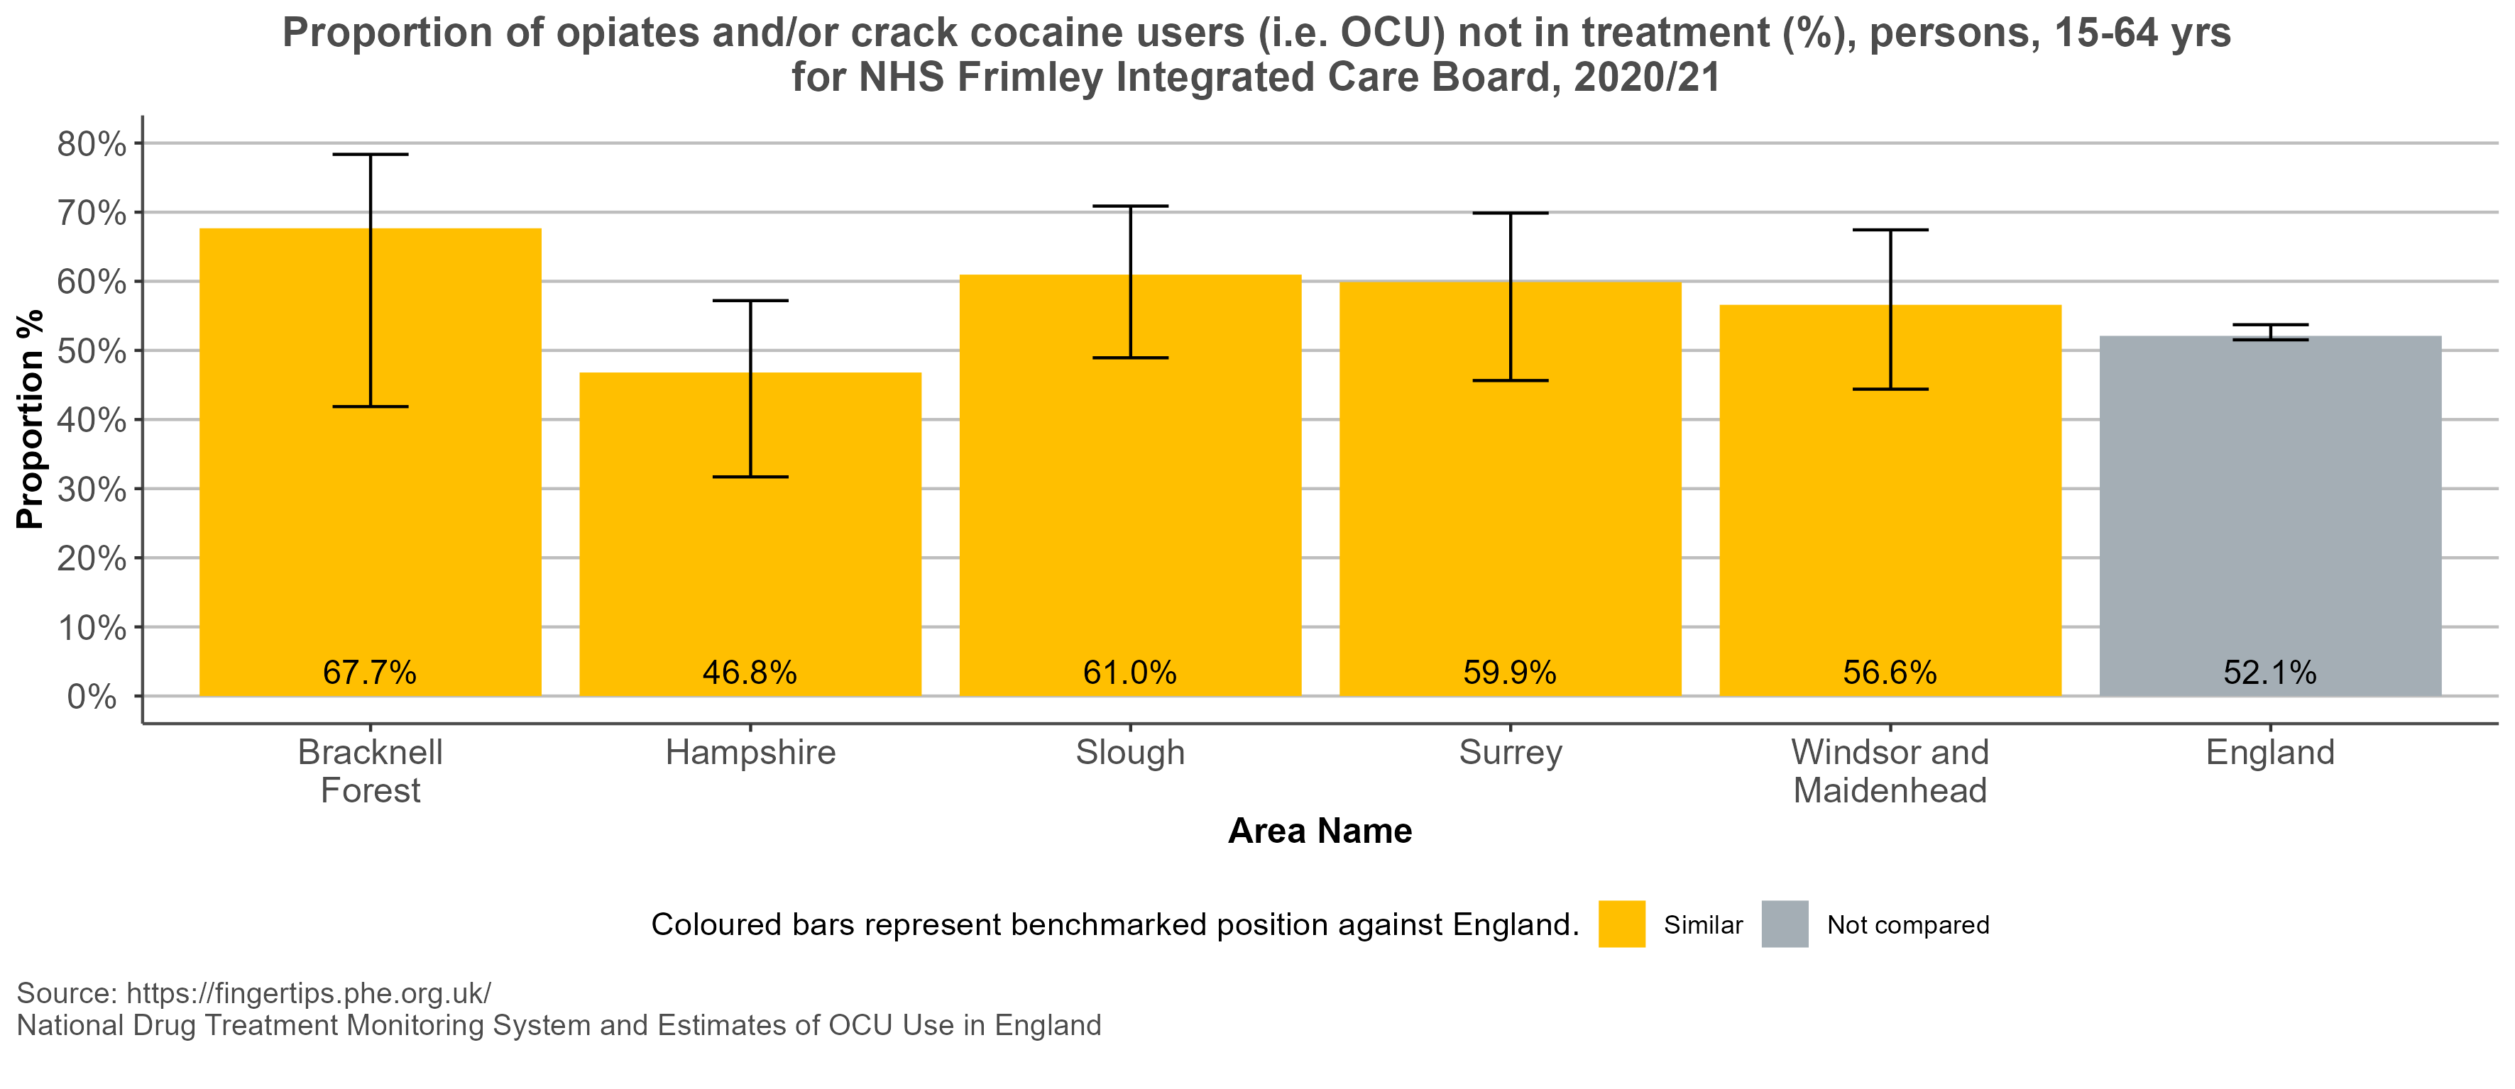
Proportion of opiates and/or crack cocaine users (OCU) not in treatment (%)
Return to Contents
Notes:
Proportion of opiates and/or crack cocaine users (i.e. OCU) not in treatment (%) Definition: The estimated proportion of the local OCU users in the given year who were not in contact with drug treatment services for an OCU problem in that year. Caveats: The OCU estimates are the only estimates available and are produced by Liverpool John Moores University (LJMU). The current estimates are the 13th iteration. Performance on this indicator provides intelligence on the proportion of the OCU population not in treatment, and provides local areas with an estimate of what outreach programmes, for example, might achieve.
The data for Hampshire and Surrey is for the whole upper tier authority not just the part within Frimley ICB. Date last updated: 04/01/2022

Slide 138
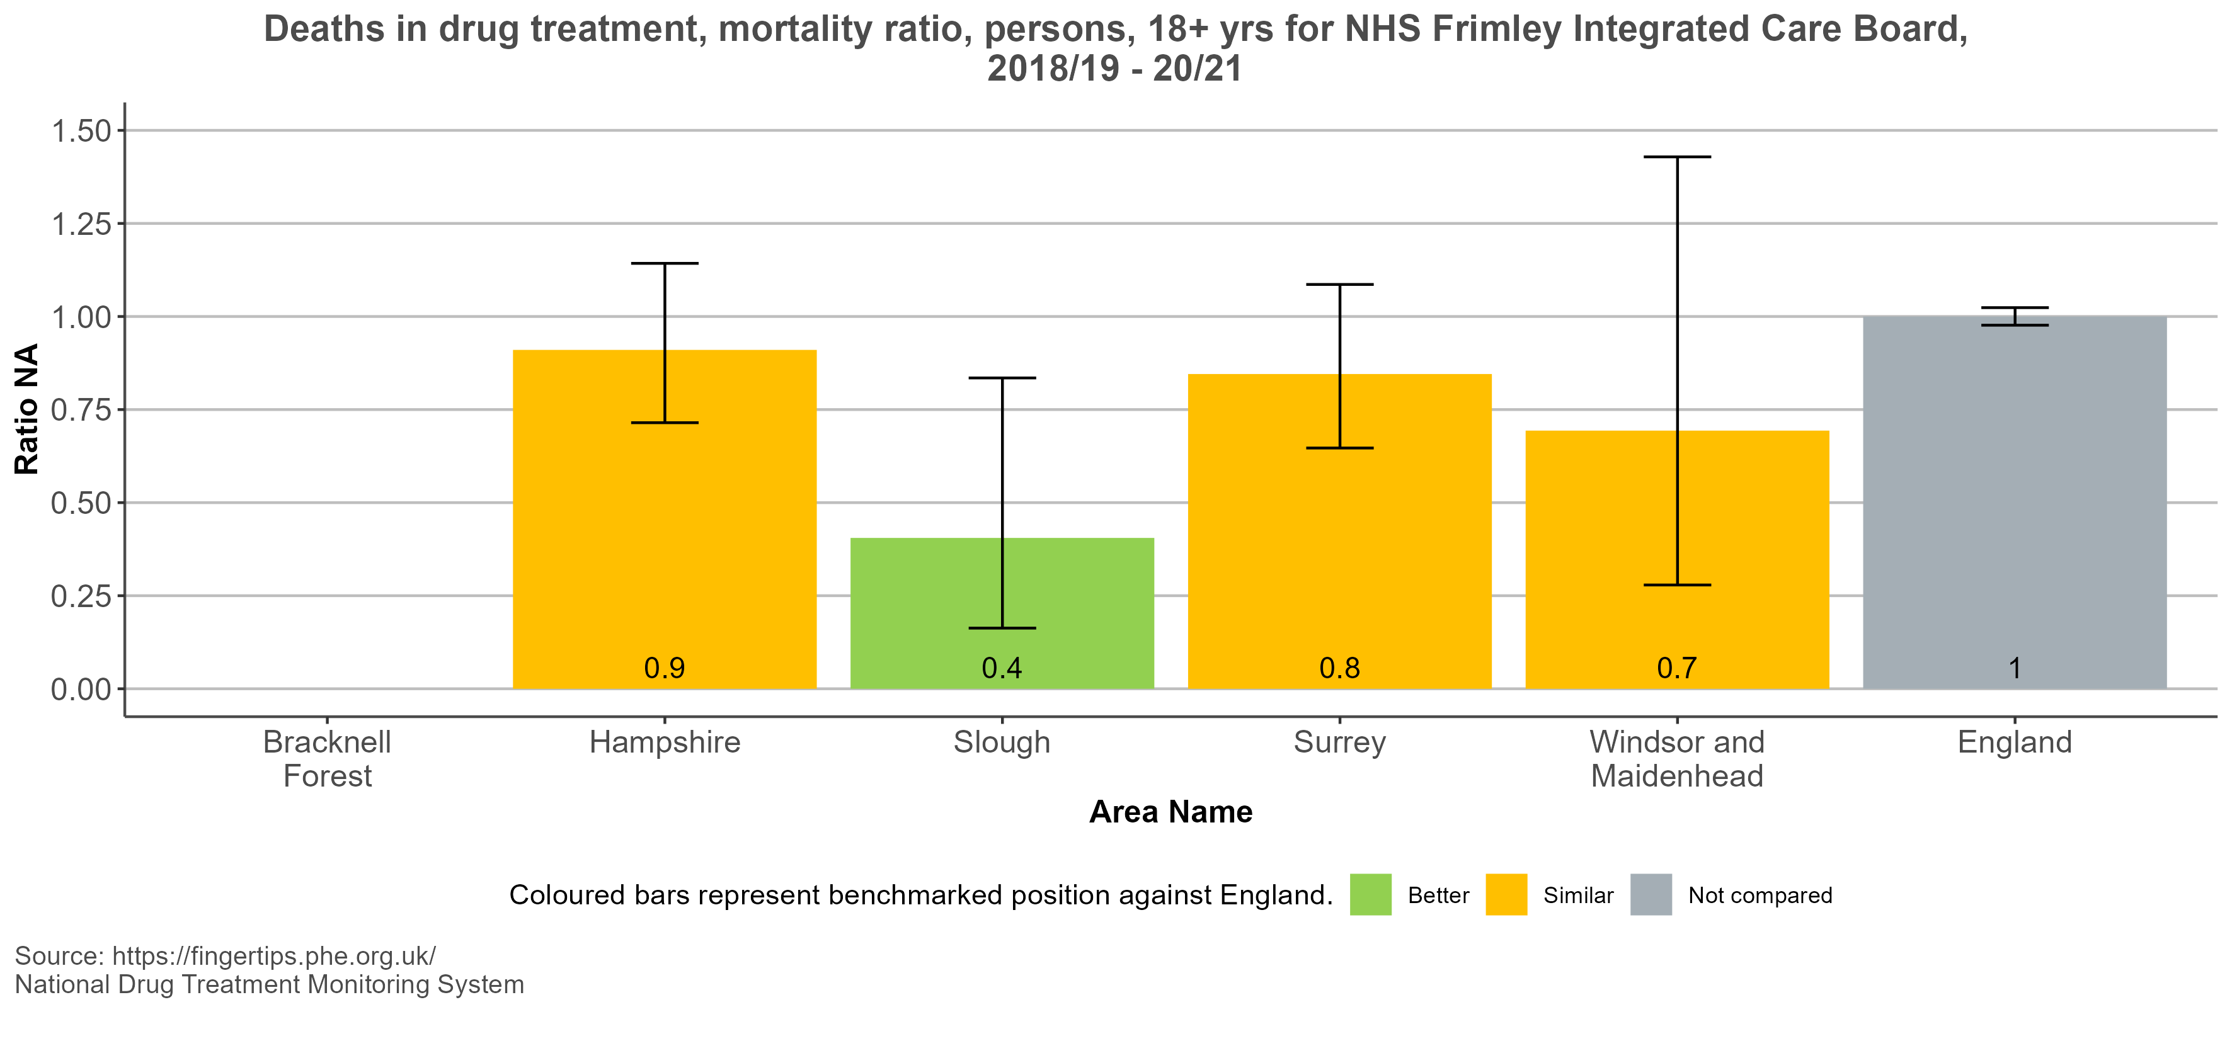
Deaths in drug treatment, mortality ratio
Return to Contents
Notes:
Deaths in drug treatment, mortality ratio This indicator identifies local authorities where deaths in drug treatment are higher or lower than expected.
This data should be interpreted with caution. It can indicate the safety, effectiveness and protection afforded by drug treatment services. It is of note however that this figure will reflect the health of the people in treatment and will be impacted by the proportion of people who are engaging in treatment. A service which is successful engaging people with multi-morbidities and risk factors might expect to see a higher rate of deaths, compared to those areas with services who have a lower rate of engagement. Definition: Indirectly age-standardised mortality ratio of deaths among adults in drug treatment (3-year average)
The indicator compares the observed number of deaths among adults in drug treatment over a three-year period to the expected number if the local authority experienced the same age-specific mortality rates as in the whole drug treatment population in England.
The data for Hampshire and Surrey is for the whole upper tier authority not just the part within Frimley ICB.
The data for Bracknell Forest has been suppressed due to small numbers.
Date last updated: 26/06/2023

Slide 139
Health outcomes: alcohol dependence (1/2)
Excessive alcohol consumption is a major cause of preventable premature death with 3 million deaths every year worldwide resulting from harmful use of alcohol (5.2% of all deaths). Overall, 5.1% of the global burden of disease and injury is attributable to alcohol (World Health Organisation).
The National Institute for Health and Care Excellence (NICE) defines harmful (higher risk) drinking as a pattern of alcohol consumption that causes health problems directly related to alcohol. Alcohol consumption is a risk factor for developing mental and behavioural conditions, along with non-communicable diseases including liver cirrhosis, cardiovascular disease and cancer (Alcohol guidelines review). Alcohol consumption in pregnancy can lead to low birth weight, preterm birth and being small for gestational age. Drinking alcohol also contributes to both unintentional and intentional injuries, including road traffic accidents, violence and suicide. The 2023 National Confidential Inquiry into Suicide and Safety in Mental Health identified high proportions of those with alcohol (48%) and drug (37%) misuse among those who died from suicide in the UK between 2010 – 2020.
The Health Survey for England (2021) found that 54% of men and 61% of women drank at levels that put them at a lower risk of alcohol-related harm. A higher proportion of men (28%) than women (15%) drank at increasing or higher risk levels (over 14 units in the last week for both men and women). The proportion of men and women who reported drinking over 14 units of alcohol per week, increased with household income and varied by age group, increasing up to the age of 55-64 (36% of men and 21% of women).
Return to Contents

Slide 140
Health outcomes: alcohol dependence (2/2)
High risk drinking is associated with a range of social and economic issues and there is significant overlap of populations that experience multiple and severe disadvantage including alcohol and drug dependency, homelessness, and offending behaviours. Alcohol and drug dependency are both common among people with mental ill health with over two-thirds of people starting treatment for drug or alcohol dependence, saying they had a mental health need (70% in the alcohol only group). Over one-fifth of these were not receiving treatment to meet their mental health needs (Adult Substance misuse treatment statistics 2021-2022).
In 2019/20, there were 280,000 estimated admissions to hospital in England, where the main reason was attributed to alcohol. This represented 1.6% of all hospital admissions, which is unchanged since 2016/17, however the total number was 8% higher than that seen in 2016/17. The majority of patients (65%) were male and the number of admissions rises with age up, peaking at 55-64 with 23% of patients falling in this age range. In total, 28% of the admission were for cancer, with 14% for mental and behavioural disorders due to the use of alcohol. When the broad measure of alcohol related admissions was used (including a secondary diagnosis linked to alcohol), this represented 5.7% of admissions, 45% of which were for cardiovascular disease (Local Alcohol Profiles for England).
In 2021 in the South East, the under 75 mortality rate from alcoholic liver disease was 9.1 per 100,000 population, compared to 11.5 per 100,000 across England. In 2020, there were 974 potential years of life lost due to alcohol related conditions in males, with 431 potential years of life lost for females in the South East (Statistics on Public Health, 2021).
Return to Contents

Slide 141
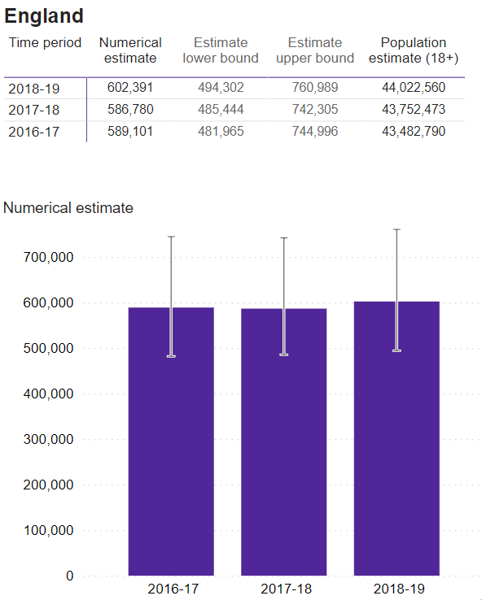
Prevalence estimates of alcohol dependence – England
Prevalence estimates of alcohol dependence are available at an England, regional and local authority level. The above charts show the trend between 2016/17 and 2018/19 for England, during which time there has been no significant change in the overall prevalence of alcohol dependency. Figures are shown as both numerical estimates and rates per 1,000 population.
Source: Alcohol dependence prevalence in England - GOV.UK (www.gov.uk)
Return to Contents

Slide 142
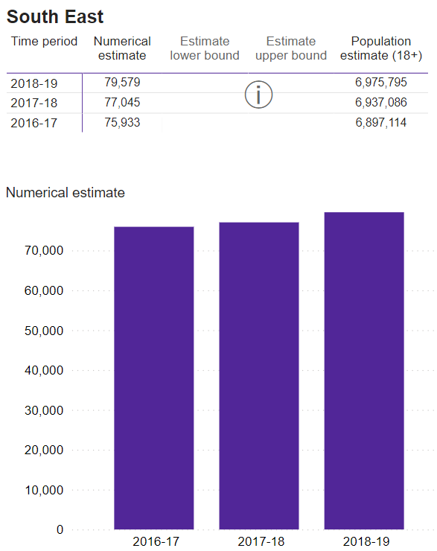
Prevalence estimates of alcohol dependence - South East
Prevalence estimates for alcohol dependence in the South East from 2016/17 to 2018/19 show a slight increasing trend. However, confidence intervals are not available to demonstrate if this is a significant increase.
Source: Alcohol dependence prevalence in England - GOV.UK (www.gov.uk)
Return to Contents

Slide 143
Alcohol dependence data
This section contains the following indicators for each ICB:
Admission episodes for alcohol-specific conditions
Number in treatment at specialist alcohol misuse services
Proportion of dependent drinkers not in treatment (%)
Deaths in alcohol treatment (mortality ratio)
Alcohol-related mortality
Potential years of life lost (PYLL) due to alcohol-related conditions
Return to Contents

Slide 144
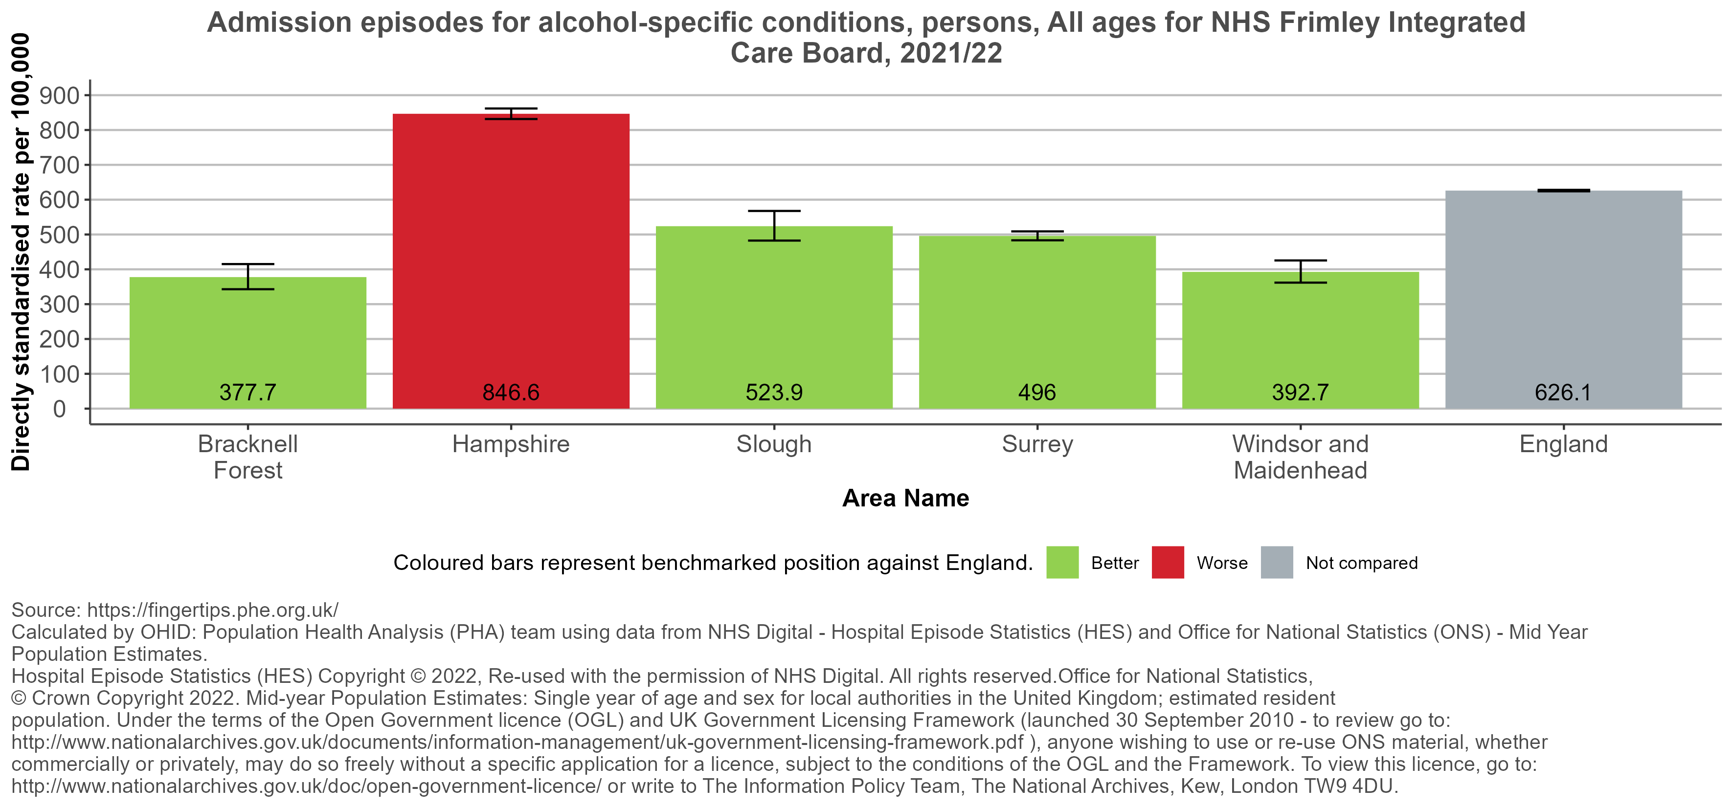
Admission episodes for alcohol-specific conditions
Return to Contents
Notes:
Admission episodes for alcohol-specific conditions Definition: Admissions to hospital where the primary diagnosis or any of the secondary diagnoses are an alcohol-specific (wholly attributable) condition. Directly age standardised rate per 100,000 population (standardised to the European standard population). Caveats: Hospital admission data can be coded differently in different parts of the country. In some cases, details of the patient’s residence are insufficient to allocate the patient to a particular area and in other cases, the patient has no fixed abode. These cases are included in the England total but not in the local authority figures. Conditions where low levels of alcohol consumption are protective (have a negative alcohol-attributable fraction) are not included in the calculation of the indicator. Does not include attendance at Accident and Emergency departments.
The data for Hampshire and Surrey is for the whole upper tier authority not just the part within Frimley ICB. Date last updated: 21/02/2023 Calculated by OHID: Population Health Analysis (PHA) team using data from NHS Digital – hospital Episode Statistics (HES) and Office for National Statistics (ONS) – Mid year Population Estimates.
Hospital Episode Statistics (HES) Copyright © 2022. Reused with the permission of NHS Digital. All rights reserved. Office for National Statistics.
© Crown Copyright 2022. Mid year Population Estimate: single year of age and sex for local authorities in the United Kingdom: estimated resident population. Under the terms of the Open Government licence (OGL) and UK Government Licensing Framework.

Slide 145
Number in treatment at specialist alcohol misuse services: NHS Frimley ICB
Number in treatment at specialist alcohol misuse services, persons, 18+ yrs, for NHS Frimley Integrated Care Board, 2020/21
Bracknell Forest | Hampshire | Slough | Surrey | Windsor and Maidenhead | England
152 | 797 | 99 | 1352 | 193 | 76,740
Source: https://fingertips.phe.org.uk/
National Drug Monitoring System
Return to Contents
Notes:
Number in treatment at specialist alcohol misuse services Definition: Total number of individuals who received treatment at a specialist alcohol misuse service
Caveat: the data for Hampshire and Surrey is for the whole upper tier authority not just the part within Frimley ICB Date last updated: 04/01/2022

Slide 146
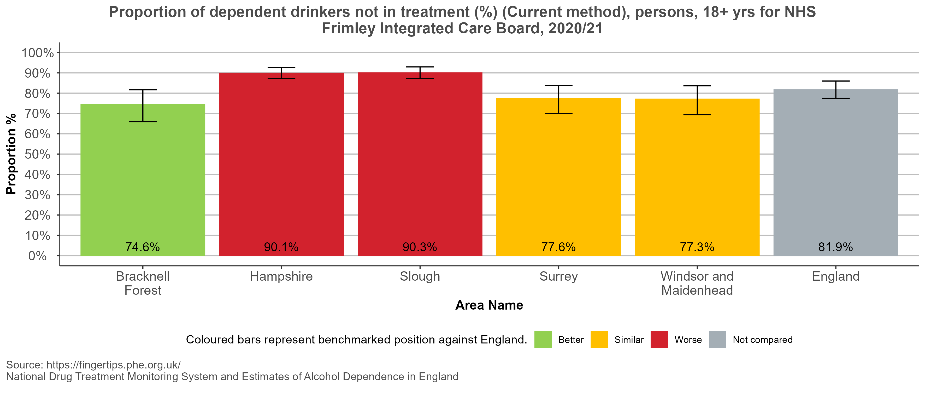
Proportion of dependent drinkers not in treatment (%)
(Current method)
Return to Contents
Notes:
Proportion of dependent drinkers not in treatment (%) (Current method) Definition: The estimated proportion of alcohol dependent adults in the given year who were not in contact with alcohol treatment services in that year Caveats: The dependent drinkers estimates are the only estimates available and are produced by the University of Sheffield. Performance on this indicator provides intelligence on the proportion of the dependent drinkers population not yet in treatment and provides local areas with an estimate of what outreach programmes, for example, might achieve.
The data for Hampshire and Surrey is for the whole upper tier authority. Date last updated: 04/01/2022

Slide 147
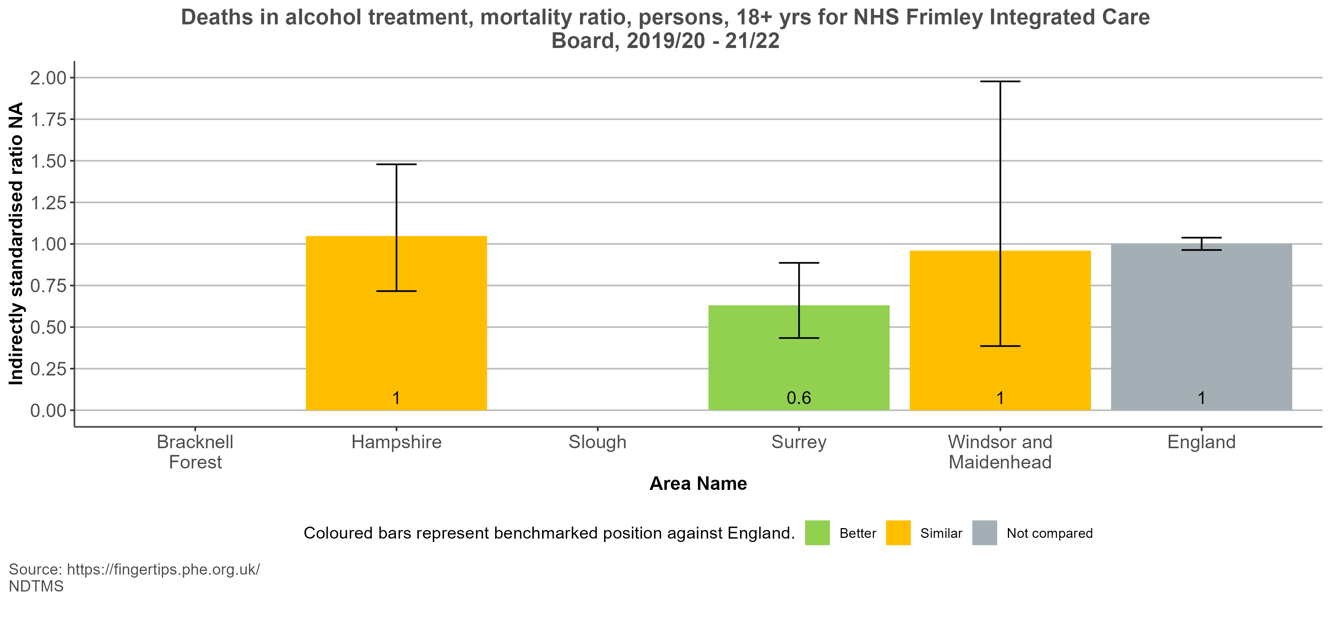
Deaths in alcohol treatment, mortality ratio
Return to Contents
Notes:
Deaths in alcohol treatment, mortality ratio Definition: Indirectly age-standardised mortality ratio of deaths among adults in alcohol treatment (3-year average)
The data for Hampshire and Surrey is for the whole upper tier authority.
The data for Bracknell Forest and Slough has been suppressed due to small numbers.
This data should be interpreted with caution. It can be an indicator of the safety, effectiveness and protection afforded by alcohol treatment services. It is of note however that this figure will reflect the health of the people in treatment and will be impacted by the proportion of people who are engaging in treatment. A service which is successful engaging people with multi-morbidities and risk factors might expect to see a higher rate of deaths, compared to those areas with services who have a lower rate of engagement. Date last updated: 26/06/2023

Slide 148
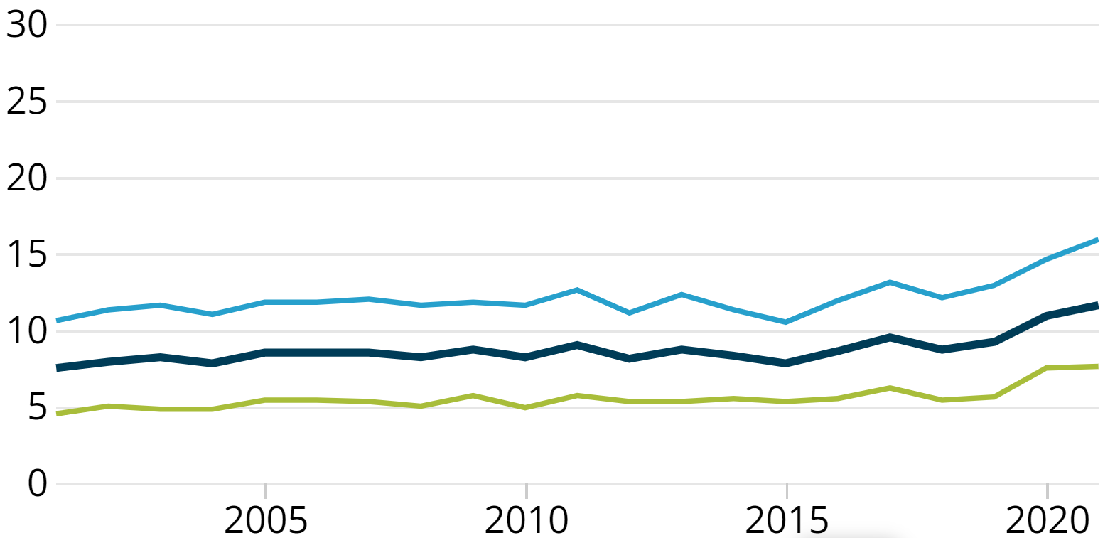
Alcohol-specific deaths in the South East: 2021 registrations
Age-standardised alcohol-specific death rates for deaths registered between 2001 and 2021
The graph shows the trend in age standardised alcohol specific death rates registered between 2001 and 2021. In the South East, the rate of alcohol-specific deaths in 2021 (11.6 deaths per 100,000 people) is a statistically significant increase of 26.1%, compared to deaths registered in 2019 (9.2 deaths per 100,000 people)
Source: OHS – alcohol specific deaths in the UK: registered in 2021
Return to Contents

Slide 149
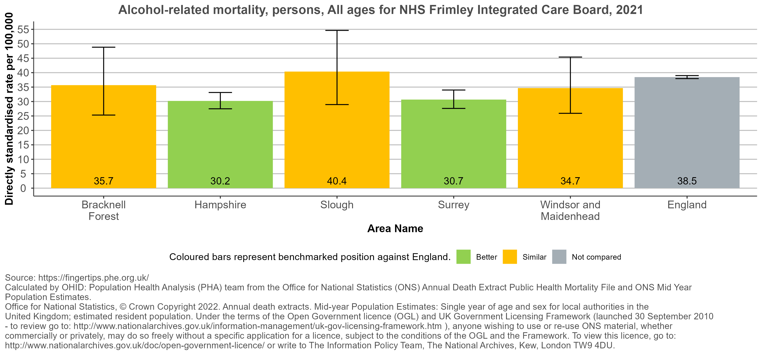
Alcohol-related mortality
Return to Contents
Notes:
Alcohol-related mortality Definition: Deaths from alcohol-related conditions, all ages, directly age-standardised rate per 100,000 population (standardised to the European standard population). Caveats: There is the potential for the underlying cause of death to be incorrectly attributed on the death certificate and the cause of death misclassified. Alcohol-attributable fractions were not available for children. Conditions where low levels of alcohol consumption are protective (have a negative alcohol-attributable fraction) are not included in the calculation of the indicator.
The confidence intervals do not take into account the uncertainty involved in the calculation of the AAFs – that is, the proportion of deaths that are caused by alcohol and the alcohol consumption prevalence that are included in the AAF formula are only an estimate and so include uncertainty. The confidence intervals published here are based only on the observed number of deaths and do not account for this uncertainty in the calculation of attributable fraction - as such the intervals may be too narrow.
The data for Hampshire and Surrey is for the whole upper tier authority. Date last updated: 20/02/2023 Office for National Statistics, © Crown Copyright 2022. Annual death extracts. Mid-year Population Estimates: Single Year of age and sex for local authorities in the United Kingdom; estimated resident population. Under the terms of the Open Government licence (OGL) and UK Government Licensing Framework (launched 30 September 2010 – to review go to http:www.nationalarchives.gov.uk/information-management/uk-gov-licensing-framework.htm), anyone wishing to use or re-use ONS material, whether commercially or privately may do so freely without a specific application for a licence, subject to the conditions of the OGL and the Framework. To view this licence go to: http://www.nationalarchives.gov.uk/doc/open-government-licence/ or write to The Information Policy Team, The National Archives, Kew, London TW9 4DU.

Slide 150
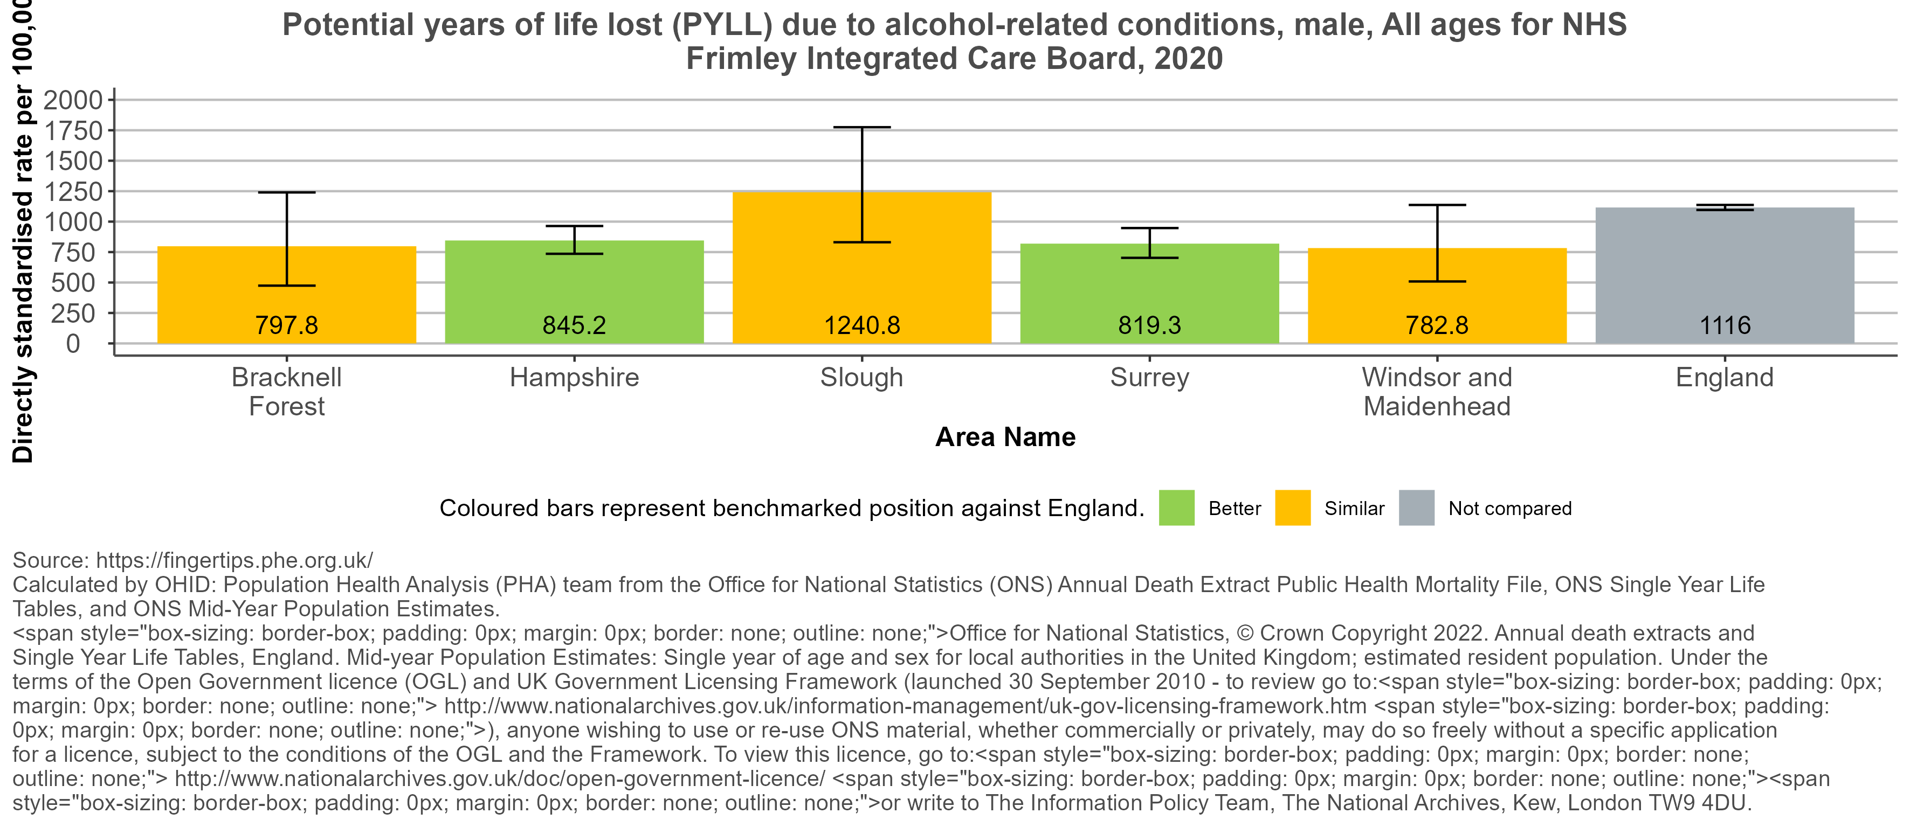
Potential years of life lost (PYLL) due to alcohol-related conditions
Return to Contents
Notes:
Potential years of life lost (PYLL) due to alcohol-related conditions Definition: Potential years of life lost (PYLL) due to alcohol-related conditions, all ages, directly age-standardised per 100,000 population (standardised to the ESP).
Potential years of life lost is a summary measure of premature mortality, providing an explicit way of weighting deaths occurring at younger ages, which may be preventable.
Caveats: There is the potential for the underlying cause of death to be incorrectly attributed on the death certificate and the cause of death misclassified. Alcohol-attributable fractions were not available for children. Conditions where low levels of alcohol consumption are protective (have a negative alcohol-attributable fraction) are not included in the calculation of the indicator. The national life expectancies for England have been used for all sub-national geographies to illustrate the disparities in the burden caused by alcohol between local areas and the national average. The confidence intervals do not take into account the uncertainty involved in the calculation of the AAFs – that is, the proportion of deaths that are caused by alcohol and the alcohol consumption prevalence that are included in the AAF formula are only an estimate and so include uncertainty. The confidence intervals published here are based only on the observed number of deaths and do not account for this uncertainty in the calculation of attributable fraction - as such the intervals may be too narrow.
The data for Hampshire and Surrey is for the whole upper tier authority. Date last updated: 06/07/2022 Office for National Statistics, © Crown Copyright 2022. Annual death extracts. Mid-year Population Estimates: Single Year of age and sex for local authorities in the United Kingdom; estimated resident population. Under the terms of the Open Government licence (OGL) and UK Government Licensing Framework (launched 30 September 2010 – to review go to http:www.nationalarchives.gov.uk/information-management/uk-gov-licensing-framework.htm), anyone wishing to use or re-use ONS material, whether commercially or privately may do so freely without a specific application for a licence, subject to the conditions of the OGL and the Framework. To view this licence go to: http://www.nationalarchives.gov.uk/doc/open-government-licence/ or write to The Information Policy Team, The National Archives, Kew, London TW9 4DU.

Slide 151
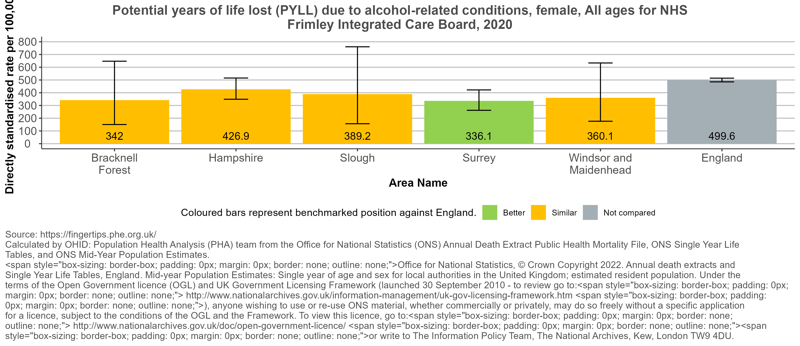
Potential years of life lost (PYLL) due to alcohol-related conditions
Return to Contents
Notes:
Potential years of life lost (PYLL) due to alcohol-related conditions Definition: Potential years of life lost (PYLL) due to alcohol-related conditions, all ages, directly age-standardised per 100,000 population (standardised to the ESP).
Potential years of life lost is a summary measure of premature mortality, providing an explicit way of weighting deaths occurring at younger ages, which may be preventable.
Caveats: There is the potential for the underlying cause of death to be incorrectly attributed on the death certificate and the cause of death misclassified. Alcohol-attributable fractions were not available for children. Conditions where low levels of alcohol consumption are protective (have a negative alcohol-attributable fraction) are not included in the calculation of the indicator. The national life expectancies for England have been used for all sub-national geographies to illustrate the disparities in the burden caused by alcohol between local areas and the national average. The confidence intervals do not take into account the uncertainty involved in the calculation of the AAFs – that is, the proportion of deaths that are caused by alcohol and the alcohol consumption prevalence that are included in the AAF formula are only an estimate and so include uncertainty. The confidence intervals published here are based only on the observed number of deaths and do not account for this uncertainty in the calculation of attributable fraction - as such the intervals may be too narrow. The data for Hampshire and Surrey is for the whole upper tier authority.
Date last updated: 06/07/2022 Office for National Statistics, © Crown Copyright 2022. Annual death extracts. Mid-year Population Estimates: Single Year of age and sex for local authorities in the United Kingdom; estimated resident population. Under the terms of the Open Government licence (OGL) and UK Government Licensing Framework (launched 30 September 2010 – to review go to http:www.nationalarchives.gov.uk/information-management/uk-gov-licensing-framework.htm), anyone wishing to use or re-use ONS material, whether commercially or privately may do so freely without a specific application for a licence, subject to the conditions of the OGL and the Framework. To view this licence go to: http://www.nationalarchives.gov.uk/doc/open-government-licence/ or write to The Information Policy Team, The National Archives, Kew, London TW9 4DU.

Slide 152
Drug and alcohol dependence: Guidance and Resources
Drugs strategy guidance for local delivery partners
Alcohol and drugs evidence reviews and inquiries
Alcohol and drug misuse prevention and treatment guidance
Opiate and crack cocaine use: prevalence estimates
Local alcohol profiles for England
National Drug Treatment Monitoring System (NDTMS)
Local Authority data visualisation tool on Hospital admissions related to Drug misuse – England 2019/20
Return to Contents

Slide 153
Metadata
ICB estimates for NHS Buckinghamshire, Oxfordshire and Berkshire West Integrated Care Board (E54000044) were built using the following geographies: West Berkshire (E06000037), Reading (E06000038), Wokingham (E06000041), Buckinghamshire UA (E06000060), Oxfordshire (E10000025).
ICB estimates for NHS Frimley Integrated Care Board (E54000034) were built using the following geographies: Bracknell Forest (E06000036), Slough (E06000039), Windsor and Maidenhead (E06000040), Hampshire (E10000014), Surrey (E10000030).
ICB estimates for NHS Hampshire and Isle of Wight Integrated Care Board (E54000042) were built using the following geographies: Portsmouth (E06000044), Southampton (E06000045), Isle of Wight (E06000046), Hampshire (E10000014).
ICB estimates for NHS Kent and Medway Integrated Care Board (E54000032) were built using the following geographies: Medway (E06000035), Kent (E10000016).
ICB estimates for NHS Surrey Heartlands Integrated Care Board (E54000052) were built using the following geographies: Surrey (E10000030), West Sussex (E10000032).
ICB estimates for NHS Sussex Integrated Care Board (E54000053) were built using the following geographies: Brighton and Hove (E06000043), East Sussex (E10000011), West Sussex (E10000032).

